Slide 1
ASP.NET Web API

Slide 2
What is ASP.NET Web API?
Overview
Features
How to use
Routes and controllers
OData queries
Simple client
HTTP Message Lifecycle

Slide 3
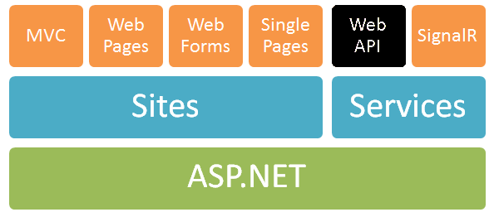
What is ASP.NET Web API?
Framework that makes it easy to build HTTP services for browsers and mobile devices
Platform for building RESTful applications on the .NET Framework using ASP.NET stack

Slide 4
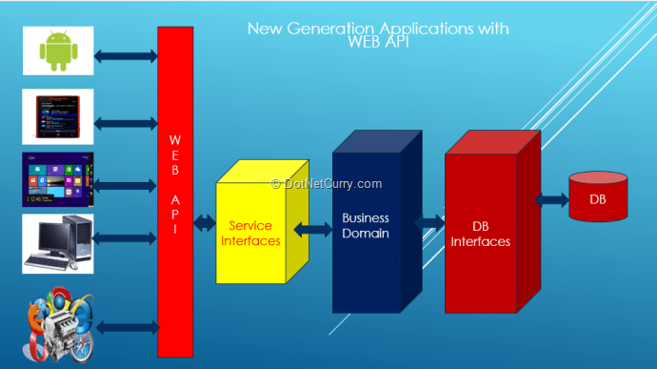
What is ASP.NET Web API?

Slide 5
What is ASP.NET Web API?
Modern HTTP programming model
Access to strongly typed HTTP object model
HttpClient API – same programming model
Content negotiation
Client and server work together to determine the right format for data
Provide default support for JSON, XML and Form URL-encoded formats
We can add own formats and change content negotiation strategy

Slide 6
What is ASP.NET Web API?
Query composition
Support automatic paging and sorting
Support querying via the OData URL conventions when we return IQueryable<T>
Model binding and validation
Combine HTTP data in POCO models
Data validation via attributes
Supports the same model binding and validation infrastructure as ASP.NET MVC

Slide 7
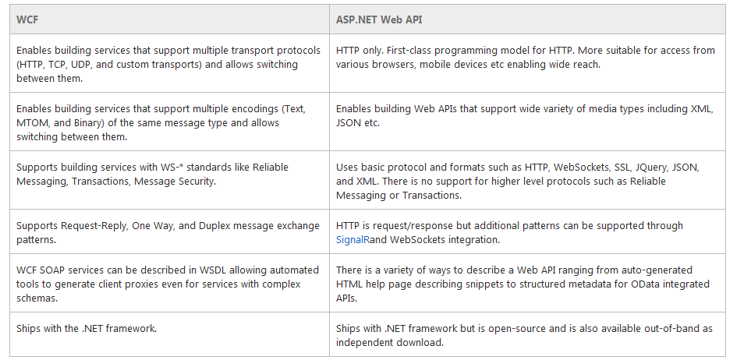
What is ASP.NET Web API?

Slide 8
How to use
A controller is an object that handles HTTP requests
All API controllers derive from ApiController
By default ASP.NET Web API will map HTTP requests to specific methods called actions
Action | HTTP method | Relative URI | Method
Get a list of all posts | GET | /api/posts | Get()
Get a post by ID | GET | /api/posts/id | Get(int id)
Create a new post | POST | /api/posts | Post(PostModel value)
Update a post | PUT | /api/posts/id | Put(int id, PostModel value)
Delete a post | DELETE | /api/posts/id | Delete(int id)
Get a post by category | GET | /api/posts?category=category | Get(string category)

Slide 9
How to use
1
2
3
Web Request
Match a Route
API Controller Responds
http://localhost:1337/api/posts
HTTP GET Request
Controller Name
public class PostsController : ApiController
{
public string Get()
{
return "Some data"; }
}

Slide 10
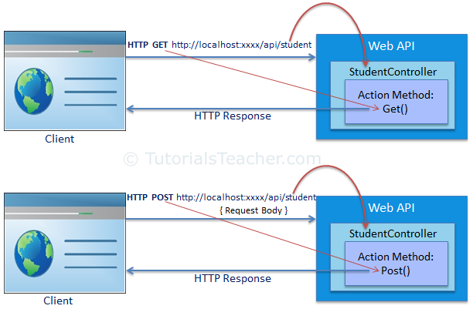
How to use
Route is defined, by default, as api/{controller}/{id} where action is defined by an HTTP method

Slide 11
How to use
By default the Web API will bind incoming data to POCO (CLR) types
Will look in body, header and query string
ASP.NET MVC has similar model binder
MediaTypeFormatters are used to bind both input and output
Mapped to content types
Validation attributes can also be used
To go down further into the HTTP (set headers, etc.) we can use HttpRequestMessage and HttpResponseMessage

Slide 12
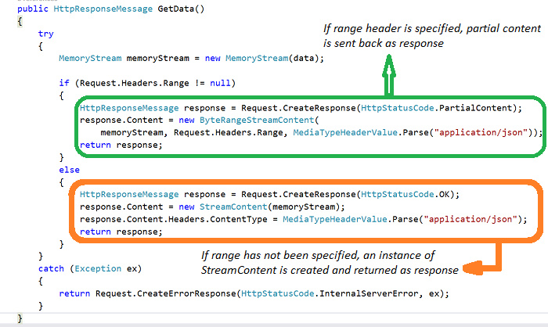
How to use
If the action returns an HttpResponseMessage, Web API converts the return value directly into an HTTP response message, using the properties of the HttpResponseMessage object to populate the response.

Slide 13
How to use
OData (http://odata.org) is a open specification written by Microsoft
OData defines parameters that can be used to modify an OData query. The client sends these parameters in the query string of the request URI. For example, to sort the results, a client uses the $orderby parameter:
http://localhost/Products?$orderby=Name

Slide 14
How to use
var client = new HttpClient {
BaseAddress = new Uri("http://localhost:12345/") };
client.DefaultRequestHeaders.Accept.Add(new
MediaTypeWithQualityHeaderValue("application/json"));
HttpResponseMessage response =
client.GetAsync("api/posts").Result;
if (response.IsSuccessStatusCode)
{
var products = response.Content
.ReadAsAsync<IEnumerable<Post>>().Result;
foreach (var p in products)
{
Console.WriteLine("{0,4} {1,-20} {2}",
p.Id, p.Title, p.CreatedOn);
}
}
else
Console.WriteLine("{0} ({1})",
(int)response.StatusCode, response.ReasonPhrase);
<ol id="posts"></ol>
<script>
$.ajax({
url: '/api/posts',
success: function (posts) {
var list = $('#posts');
for (var i = 0; i < posts.length; i++) {
var post = posts[i];
list.append('<li>' + post.title + '</li>');
}
}
});
</script>
jQuery

Slide 15
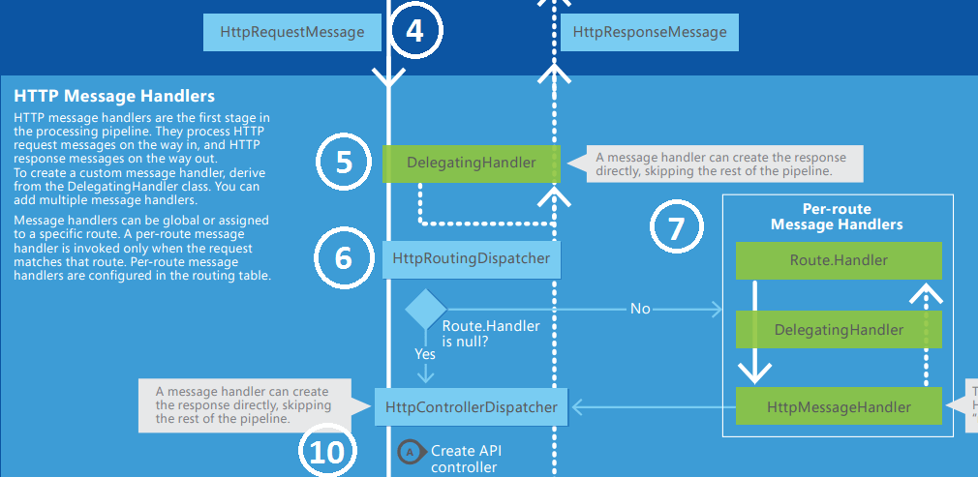
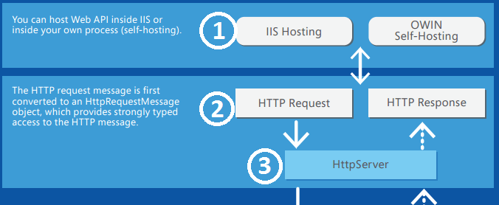
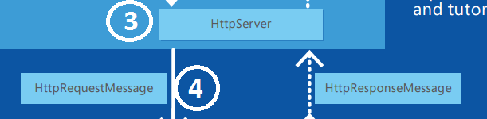
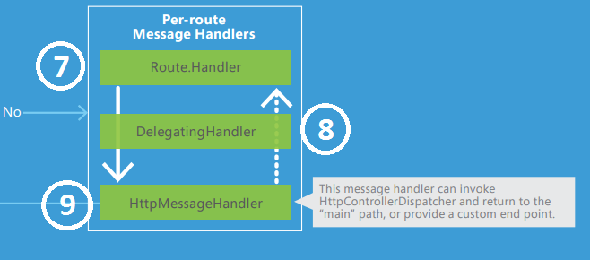
HTTP Message Lifecycle

Slide 16
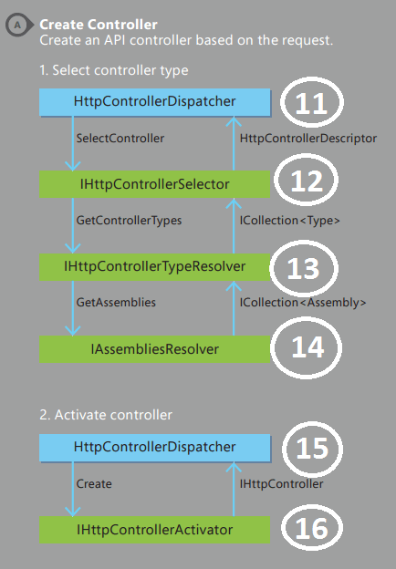
HTTP Message Lifecycle

Slide 17
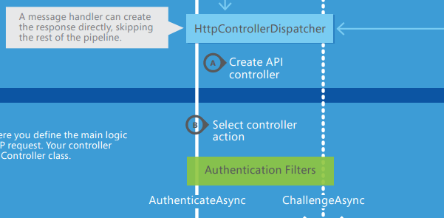
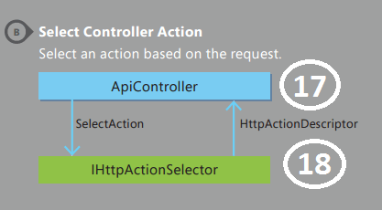
HTTP Message Lifecycle

Slide 18
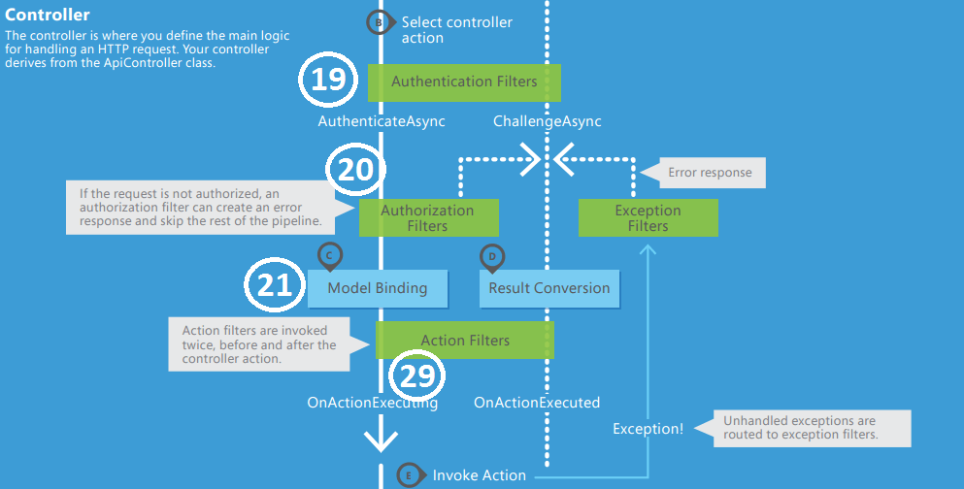
HTTP Message Lifecycle

Slide 19
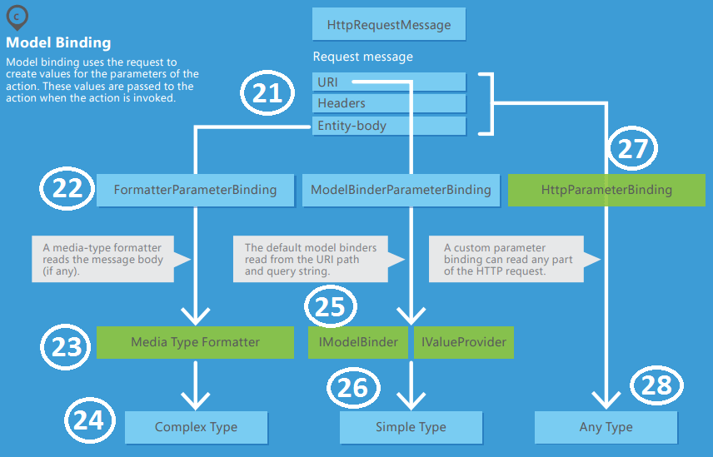
HTTP Message Lifecycle

Slide 20
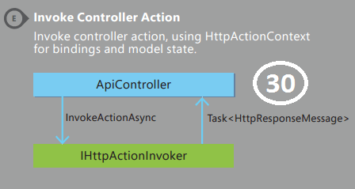
HTTP Message Lifecycle

Slide 21
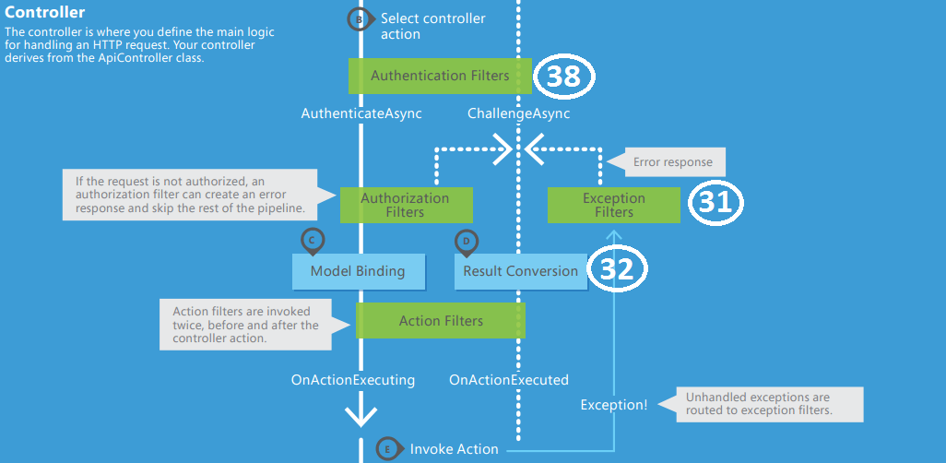
HTTP Message Lifecycle

Slide 22
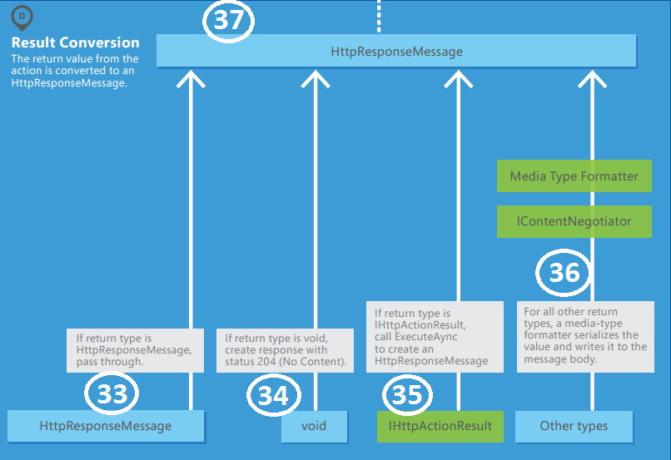
HTTP Message Lifecycle

Slide 23
HTTP Message Lifecycle

Slide 24
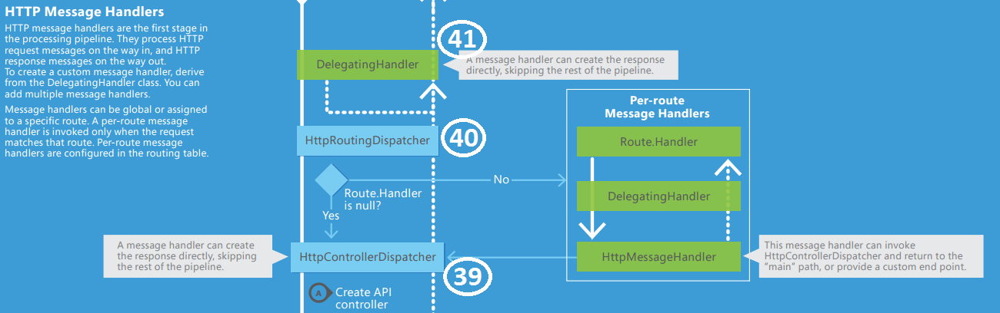
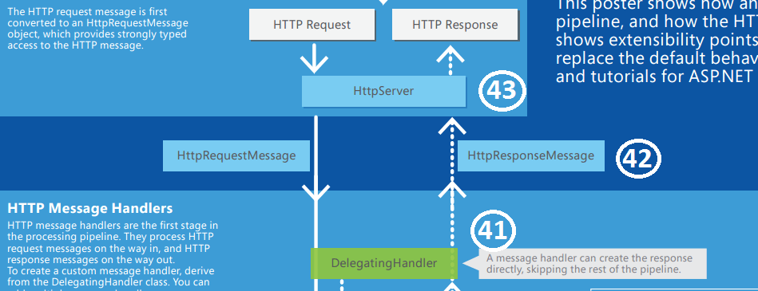
HTTP Message Lifecycle

