Slide 1
ECE477 Midterm Design Review: Team 15
<Add team picture or relevant project picture here>

Slide 2
Outline
Project Overview
Major Components
Block Diagram
Packaging Design
Electrical Schematic
PCB Layout
Prototyping Progress
Software Development Status
Project Timeline
Questions

Slide 3
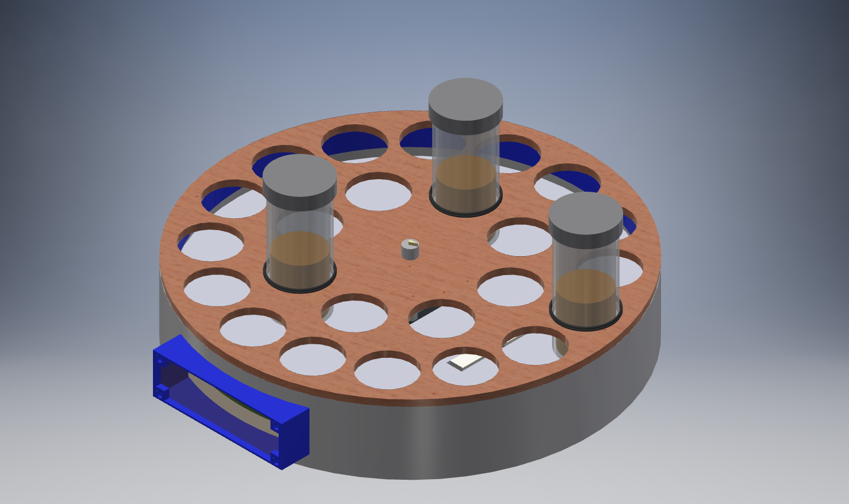
Project Overview
SUPER SUsan
Smart lazy Susan turntable to inventory and store spices.
Monitors spices present on turntable and delivers spice upon user request.
Measures remaining quantity of each spice and displays to user.
Connects to phone app to allow for remote monitoring.

Slide 4
PSSCs
Super Susan Project Specific Success Criteria
An ability to take input instructions from a dial interface.
An ability to rotate the Super Susan using a stepper motor, and present desired object at delivery location.
An ability to centrally monitor the identities of spices on the Super Susan using RFID tags.
An ability to measure the remaining amount of contents of each container through weight measurement, with a minimum accuracy of 10% total amount.
An ability to view the Super Susan’s inventory (identities and amounts) on a mobile device.

Slide 5
Major Components
Choose the major (electrical) components being utilized by your design. For each component, provide a brief description of what it is, relevant specifications, and what it will do. Examples of major components include the microcontroller, motors, wireless interfaces, power converters and regulators. Examples of relevant specifications include operating speed (uC), number of I/O (uC), stall current (motors), operating voltage, and expected current consumption

Slide 6
MaJor Components
Stepper Motor
Required Functionalities
Rotate Super Susan turntable to present spice
Accurate rotation in either direction
Rotate with 6 kg – torque requirement of 8.5 oz-in
Criteria | Seeed Technology Stepper | Adafruit Hybrid Stepper | SparkFun Hybrid Stepper
Type | Permanent Magnet | Hybrid | Hybrid
Unipolar/bipolar | Bipolar | Bipolar | Bipolar
Torque-Holding | 5.5 oz-in | 28 oz-in | 125 oz-in
Steps per revolution | 2048 | 200 | 200
Voltage Rating | 5V | 12 V | 3.2 V
Current Rating | N/A | 350 mA | 2 A
NEMA frame size | N/A | 17 | 23
Price | $4.59 | $14.00 | $23.95
 |  | CHOSEN

Slide 7
Block Diagram
Include one or more images of your system block diagram here. Block diagrams should include all relevant major parts and systems, bus widths, and interface types.

Slide 8
Packaging Design
Include one or more images of your packaging design here. Include relevant dimensions and how you are planning to manufacture your product packaging.

Slide 9
Electrical Schematic
Include one or more views of your electrical schematic here. If necessary, break up this section into multiple slides detailing various subsystems which are easily viewable (Hint: a zoomed out view of a large electrical schematic in which nothing can be read will not be helpful for the design review). Your schematics should be complete, organized, and readable.

Slide 10
PCB Layout
Include one or more views of your PCB Layout here. If necessary, break up this section into multiple slides detailing various subsystems which are easily viewable (Hint: a zoomed out view of a large electrical schematic in which nothing can be read will not be helpful for the design review). Your layout should be complete, organized, and readable.

Slide 11
Prototyping Progress
Describe your team’s prototyping progress here. For each of your project’s major components, what has been tested? What is known to work? What still needs to be tested, and what still needs to be proven to work?
NFC has not been tested yet
Load cells have not been tested yet
LCD screen has been tested but is still buggy
WiFi module has been tested and proven to work
Motor has been tested and proven to work

Slide 12
Software Development Status
In this section, detail team progress with software development. List out the major modules for your team’s software. For each module, detail its status (Not yet started / In development / In testing / Completed)
Input card (LCD/input interface) – In development
WiFi module – In development
NFC interfacing – Not yet started
Weight interfacing – Not yet started
Motor Control – Not yet started
Overall system – Not yet started

Slide 13
Project Timeline
Provide a timeline (or GANTT chart, etc.), starting from the current week until the end of the semester, detailing work to be undertaken in completing your team’s project.

Slide 14
3D Printing
Questions?

