Slide 1
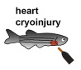
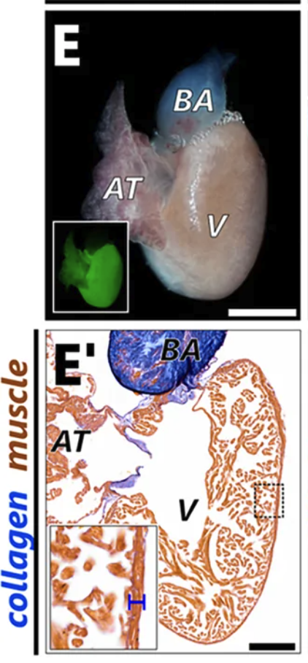
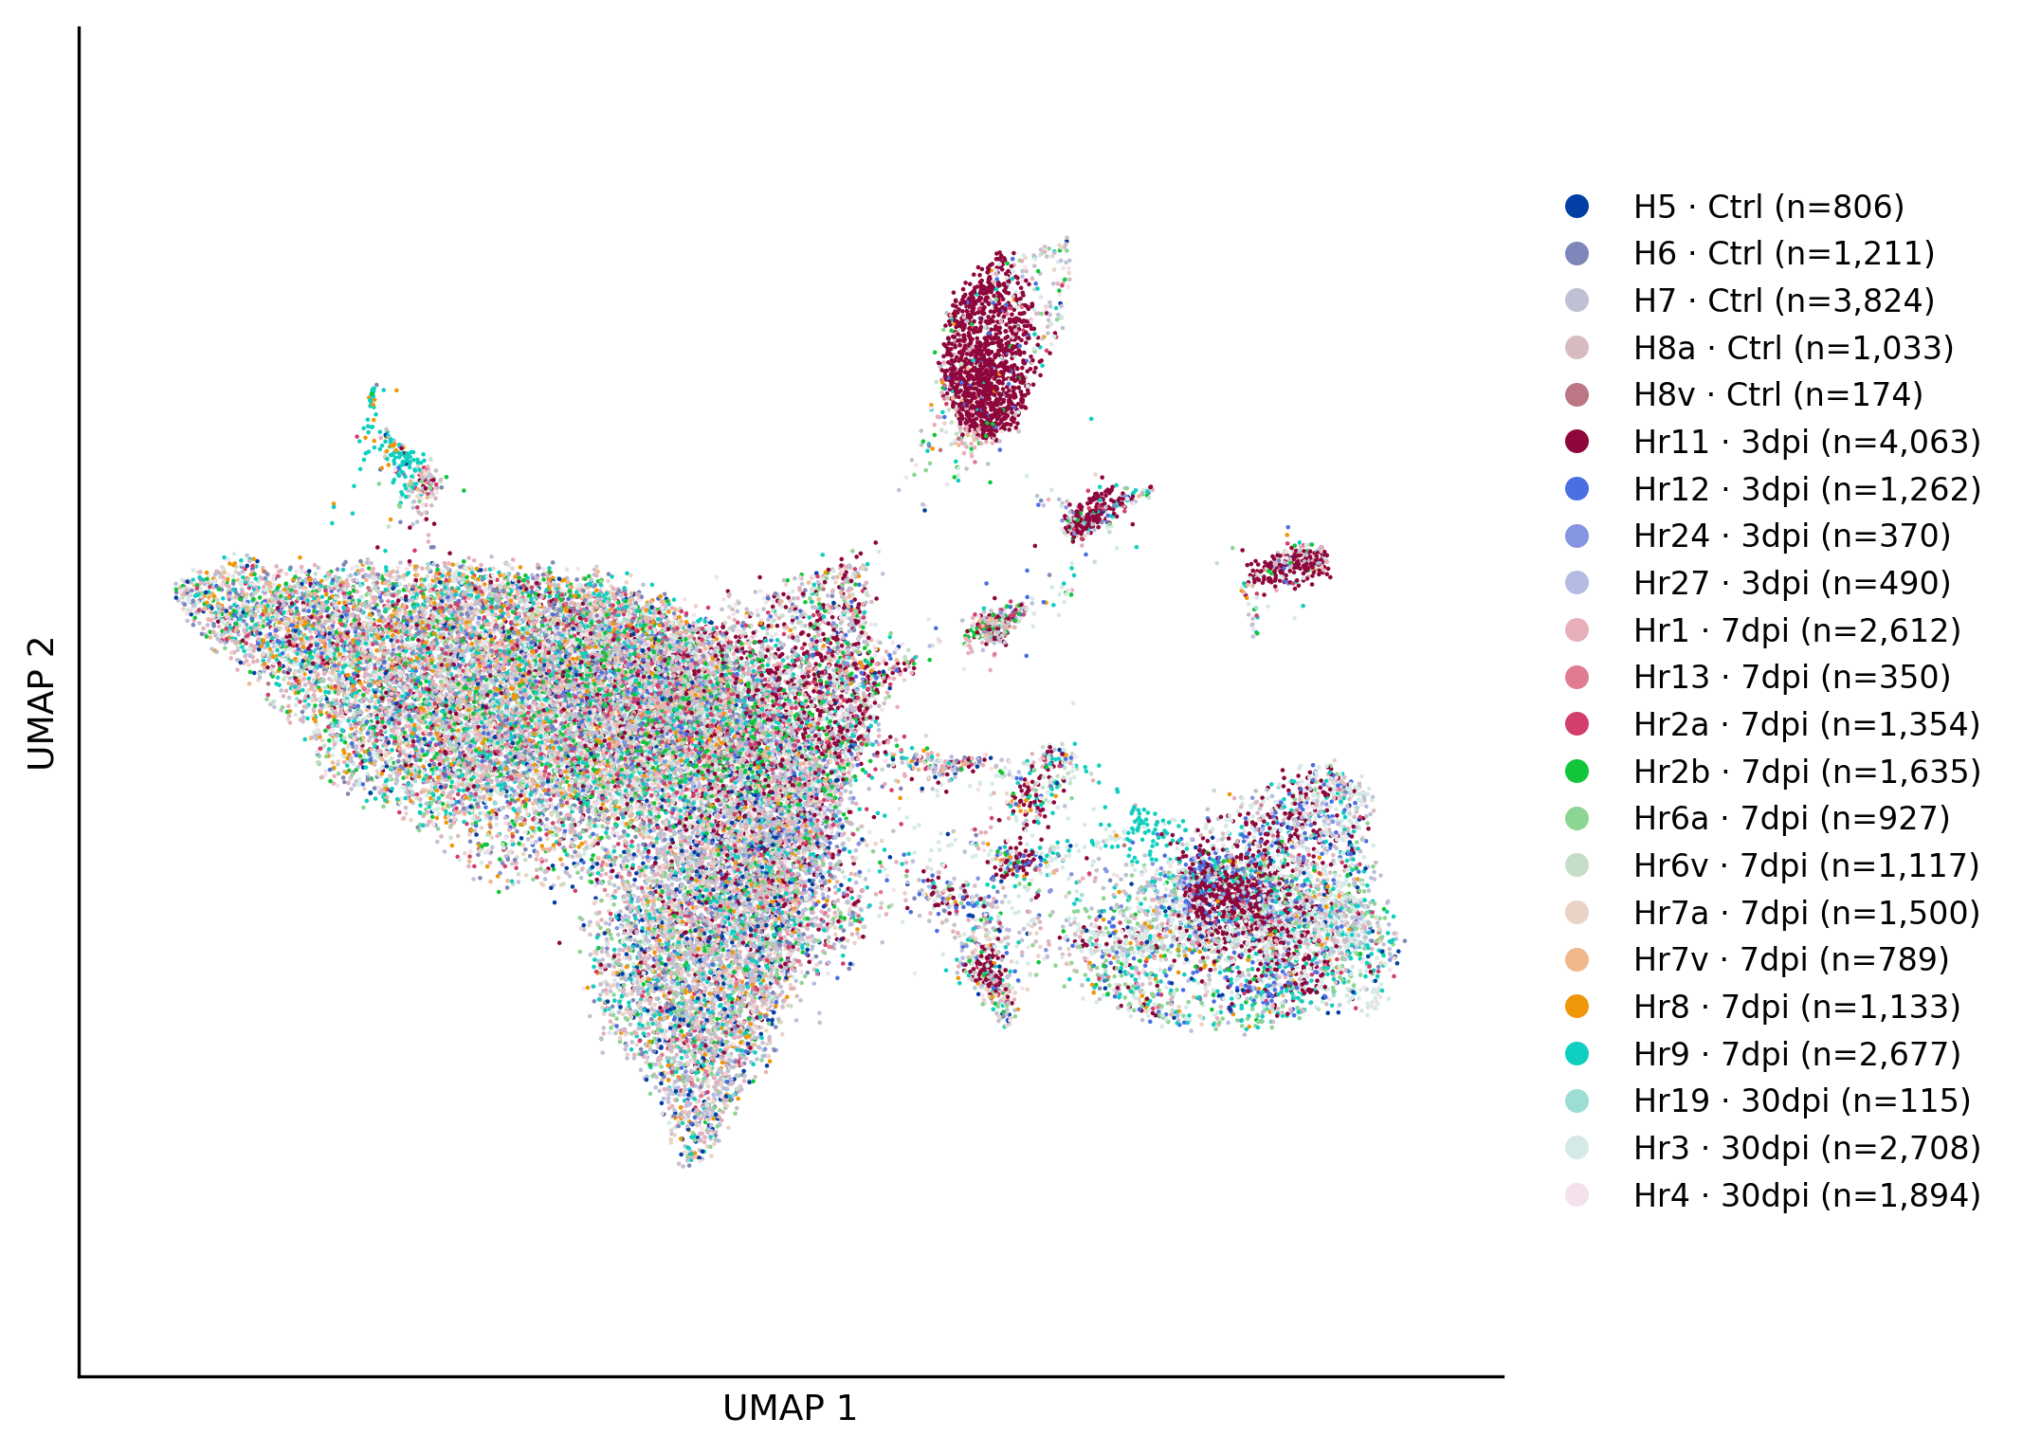
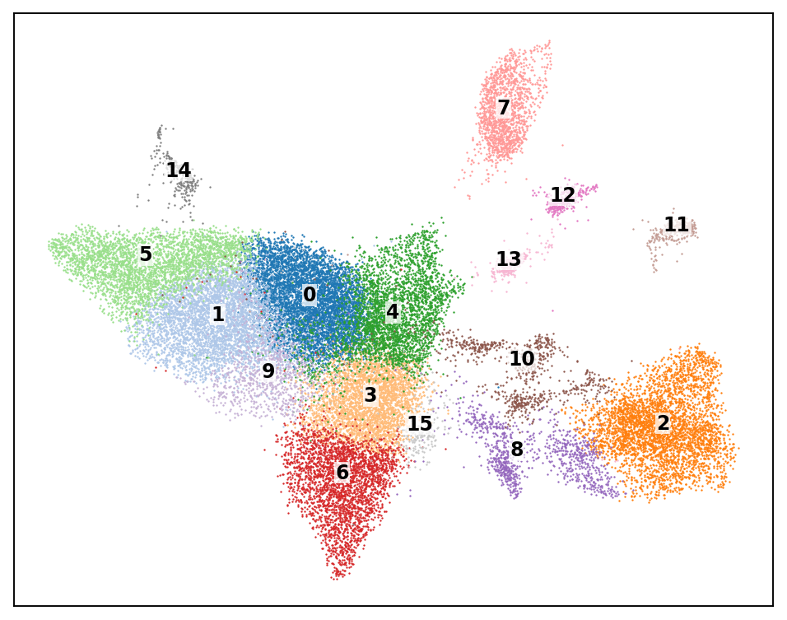
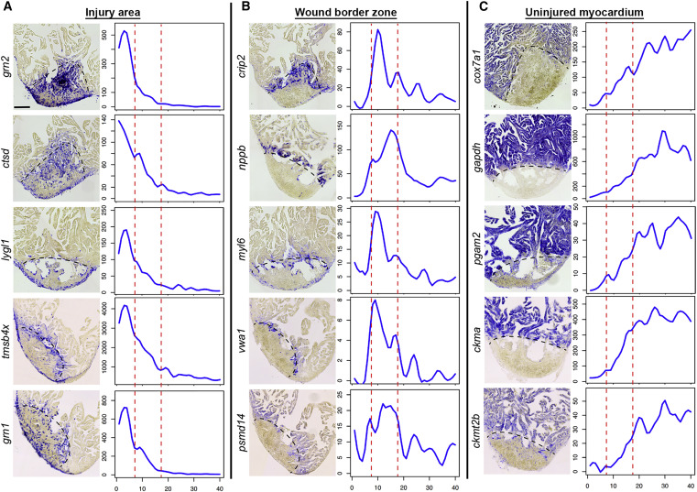
Can an agent annotate cell states when there’s no ground truth?
The problem:
After cryoinjury, zebrafish cardiomyocytes take on several states
injury-responsive
border-zone-like
dedifferentiated
proliferating
Do these states co-occur in cells?
What do publish markers really mark?
e.g. one supposed “dedifferentiation” marker turns out to mostly track library size, not biology
The data:
Hu et al., 2022 public zebrafish heart single-cell data (Junker lab, MDC)
32,044 cells × 18,794 genes from 22 libraries
counts and metadata
a held-out expert annotation for an agreement check
known traps to test the agent against
Task of the agent:
find marker genes for each state itself: from literature or spatial data
score every cell on each axis
test the scores against technical confounds (library size, doublets, ambient RNA)
test whether the axes coincide or come apart
Question for the humans:
With no ground truth, how do we decide which annotation to trust?
Which checks did the agent run on its own versus which would a domain expert add?
Wu et al., 2016

