Slide 1
EE/CSCI 451 Introduction to
Parallel and Distributed Computation
Discussion #4
9/20/2019
University of Southern California

Slide 2
Midterm 1
Online Proctored Exam:​
Time: Week 6 discussion session – 2 hours: 3:30-5:30PM (Los Angeles time) ​
Format: Open-book, open-notes [Attendance is required, no make-up given]​
Proctoring: 2 proctors watching different subgroups of students in separate Zoom meetings, links will be sent to students in advance ​
Require camera-enabled device​
Receiving and returning your exam:​
Exam will be released on Piazza under resource page at/around 3:26 PM​
You will submit the completed exam on Blackboard (a submission portal will be created in advance)​
Completing your exam:​
Download the assignment pages (exam pages) as pdf files on to your tablet and annotate it with your answers. Only hand-annotated pdf files are acceptable.​
Require a writable tablet device​
Coverage: Week 1-Week 5 contents (Week 6 contents - analytical modeling & communication primitives - not covered)​
Special note 1: Important - discussion attendance is required on Week 5 (Sept 18)!​
10-min midterm trial run to make sure all students are prepared for and comfortable with the exam process​
Special note 2:​
We have created a Piazza poll [link] to collect info regarding your available resources/capabilities to complete the exam with writable tablet. Everyone is required to participate in the poll​

Slide 3
Today’s topic
OpenMP
What is OpenMP
OpenMP programming model
OpenMP directives

Slide 4
What is OpenMP
OpenMP (Open Multi-Processing)
Application programming interface (API) that supports multi-platform shared memory multi-processing programming
A portable, scalable model
Consist of compiler directives, library routines, and environment variables

Slide 5
OpenMP Programming Model (1)
Shared Memory, Thread Based Parallelism
Based upon multiple threads in the shared memory programming paradigm
A shared memory process consists of multiple threads
Explicit Parallelism
Explicit (not automatic) programming model, offering the programmer full control over parallelization
Parallelization can be taking a serial program and inserting compiler directives

Slide 6
OpenMP Programming Model (2)
Directive based parallel programming
Provide support for concurrency, synchronization
OpenMP programs execute serially until they encounter the parallel directive
The directive is responsible for creating a group of threads
The directive defines the structured block that each thread executes
The thread which encounters the directive becomes the master of this group of threads

Slide 7
OpenMP Programming Model (3)
Fork - Join Model:
Fork: The master thread creates a team of parallel threads
Join: When the team threads complete the statements in the parallel region, they synchronize and terminate, leaving only the master thread
Fork
Fork
Join
Join

Slide 8
OpenMP Programming Model (4)
Fork - Join Model Example:
printf(“Program begins”)
N=1000;
parallel directive
For ( i=0; i<N; i++)
A[i] = B[i] + C[i];
M=2000;
parallel directive
For ( i=0; i<M; i++)
A[i] = B[i] + C[i];
printf(“Program finishes”)
serial
parallel
…
serial
parallel
…
serial

Slide 9
OpenMP Programming Model (5)
Fork/Join can be nested:
Nesting complication handled “automatically” at compile-time
Independent of the number of threads actually running
Fork
Join
Fork
Join

Slide 10
OpenMP Programming Model (6)
Master Thread
Thread with ID=0
Only thread that exists in sequential regions
Depending on implementation, may
have special purpose inside parallel
regions
Some special directives affect only
the master thread
0
Fork
0 1 2 3 4 5 6 7
Join
0

Slide 11
General Structure
Serial code . . .
#parallel directive
{
Parallel section executed by all threads .
Other OpenMP directives .
Run-time Library calls .
All threads join master thread .
}
Resume Serial code . . .

Slide 12
OpenMP API Overview
Compiler Directives:
OpenMP compiler directives are used for various purposes:
Spawning a parallel region
Dividing blocks of code among threads
Distributing loop iterations between threads
Serializing sections of code
Synchronization of work among threads

Slide 13
OpenMP API Overview
Run-time Library Routines:
These routines are used for a variety of purposes:
Setting and querying the number of threads
Setting and querying the dynamic threads feature
Querying if in a parallel region, and at what level
Setting, initializing and terminating locks and nested locks
Setting and querying nested parallelism
For C/C++, you need to include the <omp.h> header file.

Slide 14
OpenMP API Overview
Environment Variables:
OpenMP provides several environment variables for controlling the execution of parallel code at run-time:
Setting the number of threads
Specifying how loop iterations are divided
Binding threads to processors
Setting thread stack size
Setting thread wait policy
Setting OpenMP environment variables is done the same way you set any other environment variables.
csh/tcsh | setenv OMP_NUM_THREADS 8
sh/bash | export OMP_NUM_THREADS=8

Slide 15
Compiling OpenMP Programs
Compiler / Platform | Compiler | Flag
Intel Linux Opteron/Xeon | icc | -openmp
 | icpc
 | ifort
PGI Linux Opteron/Xeon | pgcc | -mp
 | pgCC
 | pgf77
 | pgf90
GNU Linux Opteron/Xeon IBM Blue Gene | gcc | -fopenmp
 | g++
 | g77
 | gfortran

Slide 16
OpenMP Directives (1)
C / C++ Directives Format:
#pragma omp
Required for all OpenMP C/C++ directives.
directive-name
A valid OpenMP directive. Must appear after the pragma and before any clauses.
[clause, ...]
Optional. Clauses can be in any order, and repeated as necessary unless otherwise restricted.
Newline
Required. Precedes the structured block which is enclosed by this directive
Example: #pragma omp parallel default(shared) private(beta,pi)

Slide 17
OpenMP Directives (2)
PARALLEL Region Construct
A parallel region is a block of code that will be executed by multiple threads. This is the fundamental OpenMP parallel construct.
Format
C/C++ | #pragma omp parallel [clause ...] newline structured_block
Notes:
When a thread reaches a PARALLEL directive, it creates a team of threads and becomes the master of the team. The master is a member of that team and has thread number 0 within that team.
Starting from the beginning of this parallel region, the code is duplicated and all threads will execute that code.
There is an implied barrier at the end of a parallel section. Only the master thread continues execution past this point.

Slide 18
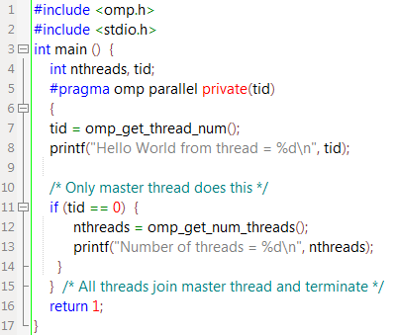
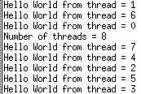
Example
Output:

Slide 19
OpenMP Directives (3)
PARALLEL Region Construct
How Many Threads?
Setting of the NUM_THREADS clause
Use of the omp: set_num_threads() library function
Setting of the OMP_NUM_THREADS environment variable
Implementation default - usually the number of CPUs on a node
Threads are numbered from 0 (master thread) to N-1

Slide 20
OpenMP Directives (4)
PARALLEL Region Construct Example:
When a thread reaches a PARALLEL directive, it creates a team of threads and becomes the master of the team with thread number 0
The code in parallel region is executed by
all threads
There is implied barrier at the end of a parallel section. Only the master thread continues execution past this point
Thread
set_num_threads(3);
#pragma omp parallel
{
task();
}
#pragma omp parallel
Master thread ID =0
Team thread ID =1
Team
Thread
ID =2
task()
task()
task()
Implied Barrier
Thread

Slide 21
OpenMP Directives (5)
Work-Sharing Constructs
Divide the execution of the enclosed code region among the members of the team that encounter it.
There is no implied barrier upon entry to a work-sharing construct, however there is an implied barrier at the end of a work sharing construct.
Types of Work-Sharing Constructs:
DO / for - shares iterations of a loop across the team. Represents a type of "data parallelism".
SECTIONS - breaks work into separate, discrete sections. Each section is executed by a thread. Can be used to implement a type of "functional parallelism".
SINGLE - serializes a section of code

Slide 22
OpenMP Directives (6)
DO/for directive
Specify that the iterations of the loop immediately following it must be executed in parallel by the team.
Assume a parallel region has already been initiated, otherwise it executes in serial on a single processor
Format:
SCHEDULE: Describes how iterations of the loop are divided among the threads in the team. The default schedule is implementation dependent.
Loop iterations are divided into pieces of size chunk and assigned to threads
C/C++ | #pragma omp for [clause ...] schedule (schedule_type , [chunk]) newline …… for_loop

Slide 23
OpenMP Directives (7)
Schedule:
Describes how iterations of the loop are divided among the threads in the team.
STATIC: loop iterations divided in pieces of size chunk and statically assigned to threads
DYNAMIC: loop iterations divided in pieces of size chunk and dynamically scheduled
RUNTIME: scheduling decision is deferred until runtime
For more info: http://jakascorner.com/blog/2016/06/omp-for-scheduling.html#

Slide 24
STATIC vs DYNAMIC Scheduling
STATIC
When workload can be evenly divided among threads
Example: Blocked MM, Parallel K-means
DYNAMIC
Uneven workload
Example: Parallel Graph algorithms

Slide 25
OpenMP Directive (8)
Other Clauses for Do/for directive
NO WAIT: threads do not synchronize at the end of the loop
ORDERED: the iterations (of a particular statement within loop above which ordered directive used) of the loop executed in the order they would be in a serial program

Slide 26
OpenMP Directive (9)
Restrictions in Do/for directive
The loop should have a loop control. For example, while loops cannot be parallelized using this directive
It is illegal to branch outside the loop
Chunk size must be specified as a loop invariant integer expression and must evaluate to the same value for all the threads

Slide 27
OpenMP Directives (10)
DO/for Example: vector-add
set_num_threads(3);
#pragma omp parallel [clause…]
{
#pragma omp for [chunk = 10…]
for (i=0; i < 30; i++)
c[i] = a[i] + b[i];
}
#pragma omp parallel
Master thread ID =0
Team thread ID =1
Team
Thread
ID =2
for (i=0; i < 10; i++)
c[i] = a[i] + b[i];
for (i=21; i < 30; i++)
c[i] = a[i] + b[i];
for (i=11; i < 20; i++)
c[i] = a[i] + b[i];
Implied Barrier
Notes:
The DO loop can not be a DO WHILE loop, or a loop without loop control. Also, the loop iteration variable must be an integer and the loop control parameters must be the same for all threads.
Program correctness must not depend upon which thread executes a particular iteration.
It is illegal to branch (goto) out of a loop associated with a DO/for directive.
The chunk size must be specified as a loop invarient integer expression, as there is no synchronization during its evaluation by different threads.
ORDERED, COLLAPSE and SCHEDULE clauses may appear once each.

Slide 28
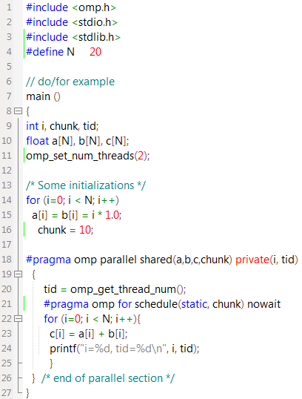

Example
Output:

Slide 29
OpenMP Directives (11)
SECTIONS directive
The SECTIONS directive is a non-iterative work-sharing construct. It specifies that the enclosed section(s) of code are to be divided among the threads in the team.
Each SECTION is executed once by a thread in the team. Different sections may be executed by different threads. It is possible for a thread to execute more than one section if it is quick enough and the implementation permits such.
Format:
C/C++ | #pragma sections [clause ...] newline { #pragma omp section newline structured_block #pragma omp section newline structured_block }

Slide 30
OpenMP Directives (12)
SECTIONS Example:
set_num_threads(2);
#pragma omp parallel [clause…]
{
#pragma omp sections [clause…]
{
#pragma omp section
for (i=0; i < 10; i++)
c[i] = a[i] + b[i];
#pragma omp section
for (i=0; i < 10; i++)
d[i] = a[i] - b[i];
}
}
#pragma omp parallel
Master thread
ID =0
Team thread
ID =1
for (i=0; i < 10; i++)
c[i] = a[i] + b[i];
for (i=0; i < 10; i++)
d[i] = a[i] - b[i];
Implied Barrier

Slide 31
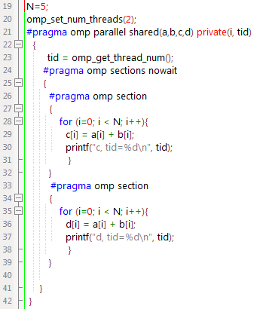

Example
Output:

Slide 32
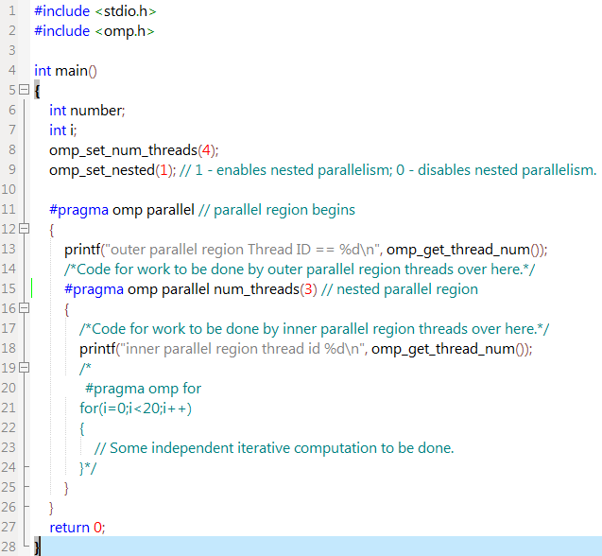
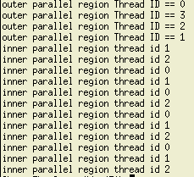
Nested Parallelism

Slide 33
OpenMP Directives (13)
SINGLE directive
The enclosed code is to be executed by only one thread in the team.
Threads in the team that do not execute the SINGLE directive, wait at the end of the enclosed code block, unless a
nowait clause is specified.
Format:
C/C++ | #pragma omp single [clause ...] newline structured_block

Slide 34
OpenMP Directives (14)
SINGLE Example:
set_num_threads(2);
#pragma omp parallel [clause…]
{
#pragma omp single[clause…]
{
for (i=0; i < 10; i++)
c[i] = a[i] + b[i];
}
}
#pragma omp parallel
Master thread
ID =0
Team thread
ID =1
for (i=0; i < 10; i++)
c[i] = a[i] + b[i];
idle
Implied Barrier

Slide 35
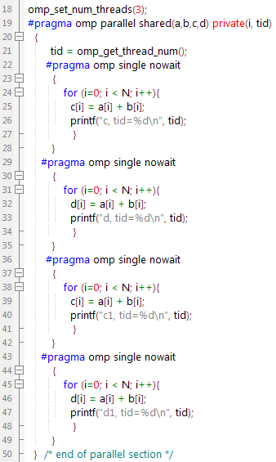

Example
Output:
c1[i] = a[i]+b[i];
d1[i] = a[i]+b[i];

Slide 36
OpenMP Directives (15)
Combined parallel work-sharing constructs
Behave identically to an individual PARALLEL directive being immediately followed by a separate work-sharing directive
Most of the rules, clauses and restrictions that apply to both directives are in effect
Example:
#pragma omp parallel default(share) private(i)
{
#pragma omp for schedule(static)
for (i=0; i<10; i++)
printf(‘hello world’);
}
#pragma omp parallel for private(i) schedule(static)
for (i=0; i<10; i++)
printf(‘hello world’);

Slide 37
OpenMP Directives (16)
Synchronization Constructs
MASTER Directive
The MASTER directive specifies a region that is to be executed only by the master thread of the team. All other threads on the team skip this section of code
Example:
set_num_threads(2);
#pragma omp parallel [clause…]
{
#pragma omp master
{
task();
}
}
Master thread
ID =0
Team thread
ID =1
task()
idle

Slide 38
OpenMP Directives (17)
Synchronization Constructs
CRITICAL Directive
The CRITICAL directive specifies a region of code that must be executed by only one thread at a time.
Example:
Master thread
ID =0
Team thread
ID =1
set_num_threads(2);
#pragma omp parallel [clause…]
{
#pragma omp critical
{
task();
}
}
task()
idle
idle
task()

Slide 39
OpenMP Directives (18)
Synchronization Constructs
ATOMIC Directive
The ATOMIC directive specifies that a specific memory location must be updated atomically, rather than letting multiple threads attempt to write to it.
Provide a mini-CRITICAL section.
Format:
Example:
C/C++ | #pragma omp atomic newline statement_expression
#pragma omp parallel [clause…]
{
#pragma omp atomic
x = x + 1;
}

Slide 40
OpenMP Directives (19)
Synchronization Constructs
BARRIER Directive
The BARRIER directive synchronizes all threads in the team.
When a BARRIER directive is reached, a thread will wait at that point until all other threads have reached that barrier. All threads then resume executing in parallel the code that follows the barrier.
Example:
Master thread
ID =0
Team thread
ID =1
set_num_threads(2);
#pragma omp parallel [clause…]
{
task_A();
#pragma omp barrier
task_B();
}
task_A()
task_A()
task_B()
task_B()

Slide 41
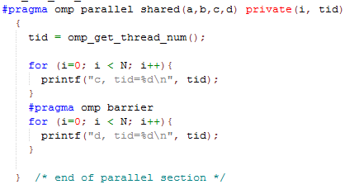
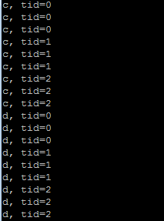
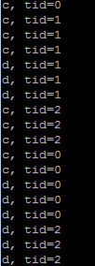
Example
Output:
Without barrier:

Slide 42
OpenMP Directives (20)
Synchronization Constructs
ORDERED Directive
The iterations of the enclosed loop will be executed in the same order as if they were executed on a serial processor.
Threads will need to wait before executing their chunk of iterations if previous iterations haven't completed yet.
Used within a DO / for loop with an ORDERED clause
Example:
set_num_threads(2);
#pragma omp parallel [clause…]
{
#pragma omp for [chunk = 10…]
for (i=0; i < 20; i++){
#pragma omp ordered
c[i] = a[i] + b[i];
}
}
Master thread
ID =0
Team thread
ID =1
for (i=0; i < 10; i++)
c[i] = a[i] + b[i];
for (i=11; i < 20; i++)
c[i] = a[i] + b[i];

Slide 43
Parallelism with ORDERED?
T0
T1
T2
T3
set_num_threads(4);
#pragma omp parallel [clause…]
{
#pragma omp for
for (i=0; i < 4; i++){
Taskb (some big task b)
#pragma omp ordered
c[i] = a[i] + b[i];
}
}
Taskb
Taskb
Taskb
Taskb
Time
c[0] <-
c[1] <-
c[2] <-
c[3] <-

Slide 44
OpenMP Directives (21)
Data Scope Attribute Clauses
The OpenMP Data Scope Attribute Clauses are used to explicitly define how variables should be scoped. They include:
PRIVATE
FIRSTPRIVATE
LASTPRIVATE
SHARED
DEFAULT
REDUCTION
Data Scope Attribute Clauses are used in conjunction with several directives (PARALLEL, DO/for, and SECTIONS) to control the scoping of enclosed variables.

Slide 45
OpenMP Directives (22)
Data Scope Attribute Clauses
PRIVATE Clause
The PRIVATE clause declares variables in its list to be private to each thread.
SHARED Clause
The SHARED clause declares variables in its list to be shared among all threads in the team.
DEFAULT Clause
The DEFAULT clause allows the user to specify a default scope for all variables of any parallel region.

Slide 46
OpenMP Directives (23)
Data Scope Attribute Clauses
FIRSTPRIVATE Clause
Combine the behavior of the PRIVATE clause with automatic initialization of the variables in its list.
LASTPRIVATE Clause
Combine the behavior of the PRIVATE clause with a copy from the last loop iteration or section to the original variable object.
REDUCTION Clause
The REDUCTION clause performs a reduction on the variables that appear in its list.
A private copy for each list variable is created for each thread. At the end of the reduction, the reduction variable is applied to all private copies of the shared variable, and the final result is written to the global shared variable.
Notes:
operator can be one of +, *, -, &, |, ^, &&, and ||.

Slide 47
FirstPrivate vs LastPrivate
I <- 0
I <- 0
Private
I -> uninitialized
S2
I <- 1
…
LastPrivate
I -> uninitialized
S2
I <- 1
…
I -> 0
I -> 1
I <- 0
FirstPrivate
I -> 0
S2
I <- 1
…
I -> 0

Slide 48
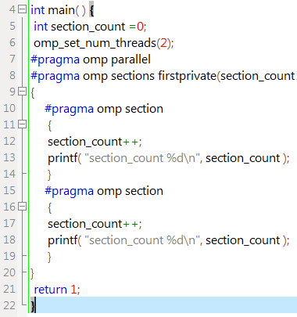
Firstprivate Example
Output:
Notes:
http://www.lindonslog.com/programming/openmp/openmp-tutorial-firstprivate-and-lastprivate/

Slide 49
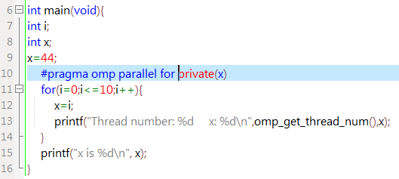
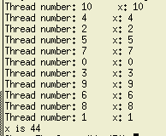
Lastprivate Example (1)
Output:
Notes:
http://www.lindonslog.com/programming/openmp/openmp-tutorial-firstprivate-and-lastprivate/

Slide 50
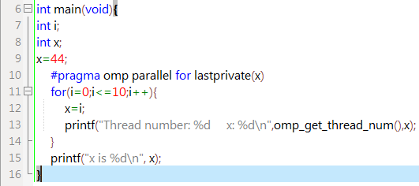
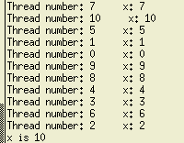
Lastprivate Example (2)
Output:
Notes:
http://www.lindonslog.com/programming/openmp/openmp-tutorial-firstprivate-and-lastprivate/

Slide 51
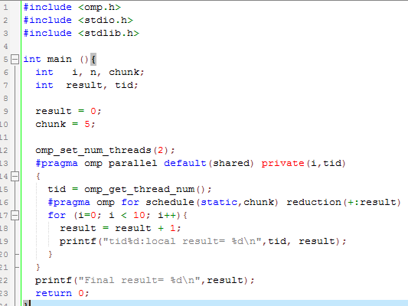
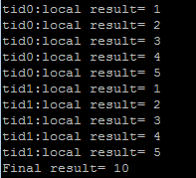
Reduction Example
Output:
Notes:
http://www.lindonslog.com/programming/openmp/openmp-tutorial-firstprivate-and-lastprivate/

Slide 52
Questions?
Thank you
For more routes, visit
http://www.mcs.anl.gov/research/projects/mpi/tutorial/gropp/talk.html
https://computing.llnl.gov/tutorials/openMP/#CFormat

