Slide 1
EE/CSCI 451 Introduction to
Parallel and Distributed Computation
Discussion #5
9/18/2020
University of Southern California

Slide 2
Today’s topic
PHW3 (OpenMP): Discussion
MPI
Principles of MPI
MPI operations

Slide 3
USC HPC
Consists of 2 shared head nodes and many compute nodes
A typical compute node:
2 to 12 cores dual-processor CPU
Dual GPU (K40 / P100 / V100)
10-gigabit Myrinet backbone or the 56.6-gigabit FDR Infiniband backbone

Slide 4
USC HPC
Login:
hpc-login3.usc.edu
Username: USC user name
Password: USC password
2-step verification

Slide 5
USC HPC
Login to HPC login/head node.
Organize workspace.
Transfer data and files.
Install/run software on HPC.
Test your job interactively on a compute node.
Submit your job to the batch processor, to run it remotely on a compute node.
Monitor your job and check your results when it has completed.

Slide 6





Computing $π$(1)
Algorithm
Generate random numbers in a unit length square
Count the number of points that fall within the largest circle inscribed in the square
$$(1,0)$$
$$(1,1)$$
$$(0,0)$$
$$(0,1)$$

Slide 7



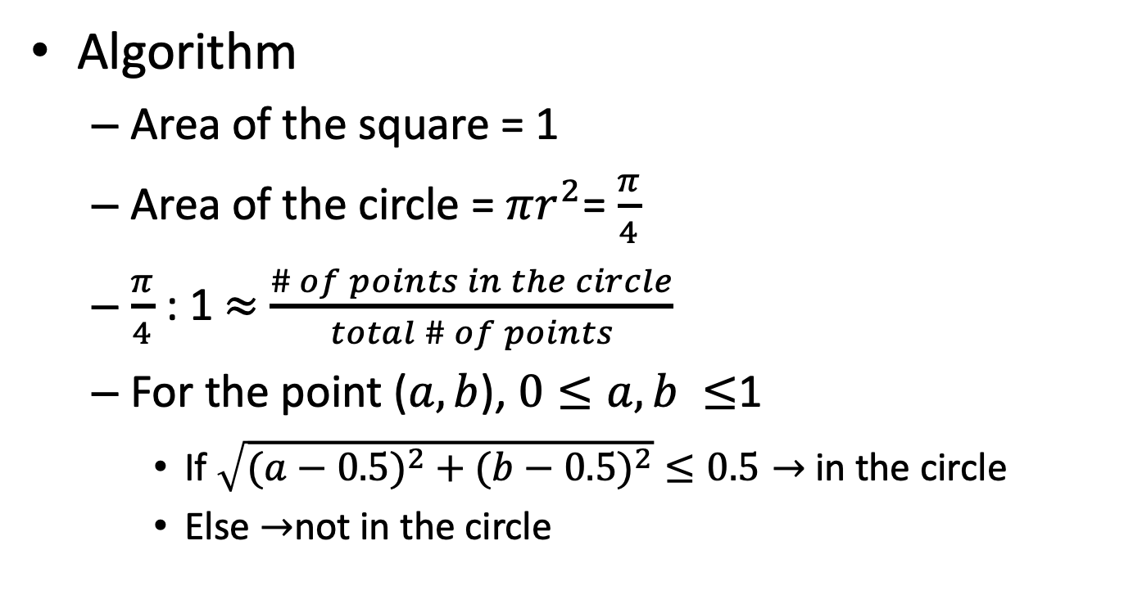
Computing $π$(2)
$$(1,0)$$
$$(1,1)$$
Algorithm
Area of the square = 1
Area of the circle = $πr^{2}$= $\frac{π}{4}$
$\frac{π}{4}$ : 1 $≈$ $\frac{\# of points in the circle}{total \# of points}$
For the point ($a,b$), $0≤a,b ≤$1
If $\sqrt{(a−0.5)^{2}+(b−0.5)^{2}}≤0.5→$in the circle
Else $→$not in the circle
center
$$(0,0)$$
$$(0,1)$$
Notes:
center

Slide 8

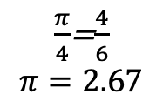
Computing $π$(3)
Example: generate 6 points
# of points in the circle = 1
Total # of points = 1
# of points in the circle = 1
Total # of points = 2
# of points in the circle = 2
Total # of points = 3
$\frac{π}{4}$=$\frac{4}{6}$
$$π=2.67$$
# of points in the circle = 3
Total # of points = 4
# of points in the circle = 3
Total # of points = 5
# of points in the circle = 4
Total # of points = 6
Notes:
center

Slide 9

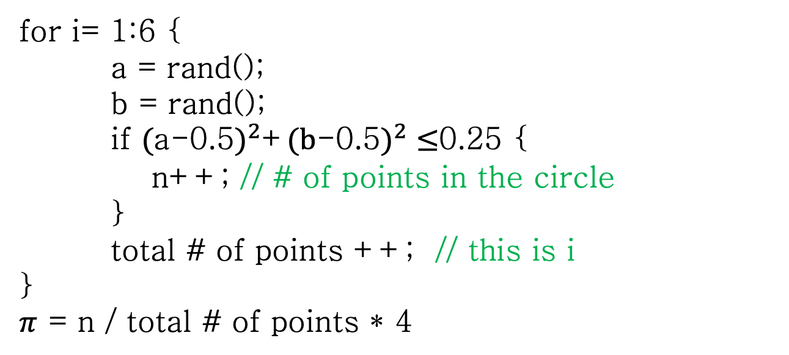
Computing $π$(4)
Pseudo code
for i= 1:6 {
a = rand();
b = rand();
if $($a-0.5$)^{2}$+$(b$-0.5$)^{2}≤$0.25 {
n++; // # of points in the circle
}
total # of points ++; // this is i
}
$π$ = n / total # of points * 4
Notes:
center

Slide 10
Random Number Generator
Common used in C:
rand()
srand()
They are pseudo-random!
They are not re-entrant!
They are not threadsafe!
Notes:
center

Slide 11
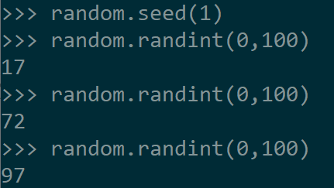
Random Number Generator
Pseudo-randomness: produces predictable outcomes given information which is typically difficult to acquire(seed); absent such information, pseudorandom sequences of numbers exhibit statistical randomness.
Always the same sequence! -> need to keep track on the executions
Possible solution: use current time as seed
Notes:
center

Slide 12
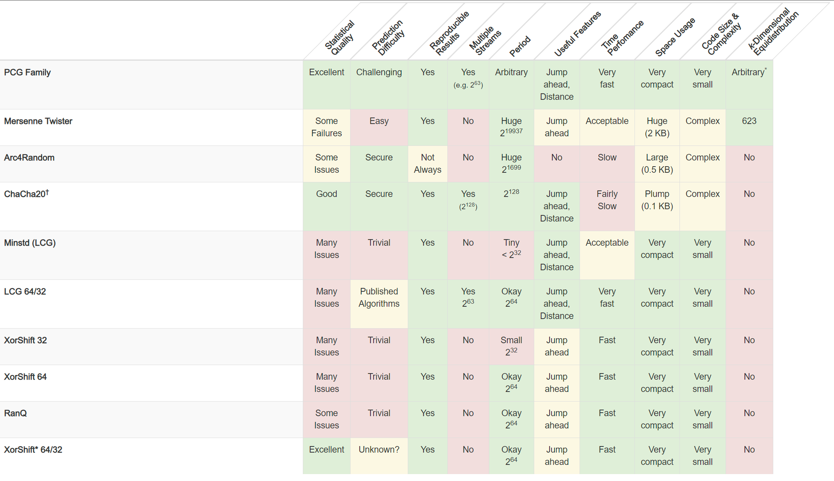
www.pcg-random.org

Slide 13
Random Number Generator
True-randomness:
generates random numbers from a physical process
need special hardware support
based on microscopic phenomena
random.org
provide free true random number from atmospheric noise
Notes:
center

Slide 14
QuickSort (1)
Divide and Conquer technique
Algorithm
Pick an element call pivot
Partitioning: Reorder the array so all elements smaller to pivot are on the left and all elements greater than pivot are on the right
Recursively apply the algorithm to the sub-array to the left and right of the pivot.

Slide 15
QuickSort (2)
Partitioning
3
8
2
5
9
1
4
7
0
6
3
2
5
1
4
0
6
7
9
8

Slide 16
QuickSort (3)
3
2
5
1
4
0
6
7
9
8
QuickSort
QuickSort

Slide 17

Partitioning
Partitioning(A, lo, hi)
Pivot = A[hi]
i = lo
For j = lo to hi -1
if A[j] $≤$ pivot
swap A[i] with A[j]
i++
swap A[i] with A[hi]

Slide 18
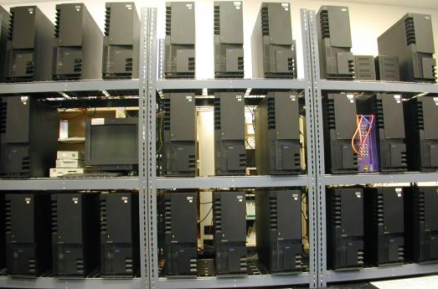
Principle of Message-Passing
Two key attributes
A partitioned address space
each data element must belong to one of the partitions of the space → locality of access
all interactions (read-only or read/write) require cooperation of two processes
Supports only explicit parallelization
The programmer is fully aware of all the costs of non-local interactions
Notes:
The second implication is that all interactions (read-only or read/write) require cooperation of two processes – the process that has the data
and the process that wants to access the data. This requirement for cooperation adds a great deal of complexity for a number of reasons. The process that has the data must participate in the interaction even it has no logical connection to the events at the requesting process. In certain circumstances, this requirement leads to unnatural programs.

Slide 19
Principle of Message-Passing (2)
Memory
Memory
Memory
Memory

Slide 20
The Building Blocks
Send and Receive Operations
Interactions are accomplished by sending and receiving messages, the basic operations in the message-passing programming paradigm are send and receive
Prototype
send (void *sendbuf, int nelems, int dest)
receive(void *recvbuf, int nelems, int source)

Slide 21
Send & Receive example
P0
a = 100;
send(&a, 1, P1);
a=0;
P1
receive(&a, 1, P0); printf("%d\n", a);
Which goes first?
Most message passing platforms have additional hardware support for sending and receiving messages. Example, DMA (direct memory access)

Slide 22
Protocols For Send/Receive
Blocking Operations
Non-Blocking Operations
Sending process returns after data has been copied into communication buffer
Buffered
Sending/receiving process creates a request for communication for send or receive and gets back a handle and then terminates.
Sending process blocks until matching receive operation has been encountered
Non-Buffered
Send and Receive semantics assured by corresponding operation
Programmer must explicitly ensure semantics by polling to verify completion

Slide 23
Blocking Message Passing Operations
The sending operation blocks until it can guarantee that the semantics will not be violated
Two mechanisms
Blocking Non-Buffered Send/Receive
Blocking Buffered Send/Receive

Slide 24
Blocking Non-Buffered Send/Receive
Involve a handshake between the sending and receiving processes
There are no buffers used at either sending or receiving ends
Sending Process
Receiving Process
Request
OK to send

Slide 25
Blocking Non-Buffered Send/Receive
Idling Overheads in Blocking Non-Buffered Operations
Sending Process
Receiving Process
Sending Process
Receiving Process
Request
Request
OK to send
OK to send
Idling at sender
Idling at receiver

Slide 26
Blocking Non-Buffered Send/Receive
Deadlocks in Blocking Non-Buffered Operations
P0
send(&a, 1, P1); receive(&b, 1, P1);
P1
send(&a, 1, P0); receive(&b, 1, P0);
The send at P0 waits for the matching receive at P1
The send at P1 waits for the matching receive at P0
Result in an infinite wait.

Slide 27
Blocking Buffered Send/Receive
Rely on buffers at the sending and receiving ends
Alleviate idling overheads at the cost of adding buffer management overheads.
Sending Process
Receiving Process

Slide 28
Blocking Buffered Send/Receive
Impact of finite buffers in message passing
P0
for (i = 0; i < 1000; i++) {
produce_data(&a);
send(&a, 1, P1);
}
P1
for (i = 0; i < 1000; i++) {
receive(&a, 1, P0);
consume_data(&a);
}
P1 is slow and buffer is not sufficient →
P0 would have to be blocked until some of the
corresponding receive operations had been posted

Slide 29
Blocking Buffered Send/Receive
Deadlocks in Buffered Send and Receive Operations
P0
receive(&a, 1, P1);
P1
receive(&a, 1, P0);
While buffering alleviates many of the deadlock situations, it is still possible to write code that results in deadlocks. This is due to the fact that receive calls are always blocking (to ensure semantic consistency)

Slide 30
Non-Blocking Message Passing Operations
Returns from the send or receive operation before it is semantically safe to do so
Non-blocking operations are generally accompanied by a check-status operation, which indicates whether the semantics of a previously initiated transfer may be violated or not

Slide 31
Non-Blocking Message Passing Operations
Sending Process
Receiving Process
Request
Unsafe to update the data being sent
OK to send

Slide 32
Questions?
Thank you

