Slide 1
EE/CSCI 451: Parallel and Distributed Computation
Discussion #1
8/21/2020
Yuan Meng
University of Southern California

Slide 2
Discussion times & TA info.
Yuan Meng
Email: ymeng643@usc.edu
Office hours: Friday 11:00am-1:00 pm, Online at: https://usc.zoom.us/j/8629150353
Meeting ID: 862 915 0353
Discussion: 3:30 – 4:50 pm, Friday
Discussion Location: Online at: https://usc.zoom.us/j/93866326251
Meeting ID: 938 6632 6251

Slide 3
Today’s topic
Tools
Basic Unix commands
Programming HW discussion
PHW1
P1 Matrix Multiplication
P2 K-means

Slide 4
Assignments info and Grading Policy
All assignments will be released on Piazza
Assignments will be collected through Blackboard
Expected submission format: PDF
Can be neatly handwritten or typewritten - Latex (Overleaf) recommended
Scanner app on smartphone:
CamScanner (ios)
Genius Scan (Android)
Grading: HWs & Programming HWs
10% late penalty per day
No credit received after 3rd day

Slide 5
Access to remote server
Tools
OpenSSH
Built-in for mac and Windows 10 after 1709
Free UNIX Computing Account for all USC students
aludra.usc.edu
Nunki.usc.edu
How to access:
ssh aludra.usc.edu -l <username>
<username> is your USC NetID

Slide 6
Basic Unix commands
ls: list your files
vim filename: an editor that lets you create and edit a file (pre-installed for most UNIX system)
To exit: :q enter
To save: :w enter
mv filename1 filename2: rename a file
cp filename1 filename2: copy a file
rm filename: remove a file

Slide 7
Basic Unix commands
mkdir: make a new directory
cd dirname: change directory
pwd: tell you where you currently are
For more commands, please visit:
http://www.math.utah.edu/lab/unix/unix-commands.html

Slide 8
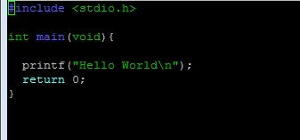
Run a “Hello world” program
Type vim hello.c to open the editor
Write the program to print “hello world”
Save and exit: :wq enter
Compile your code: gcc –o go hello.c
Run your code: ./go
If you want to edit on your local machine and copy it to the remote server through ssh for testing: use
scp local-path_of_file yourusername@host_name

Slide 9
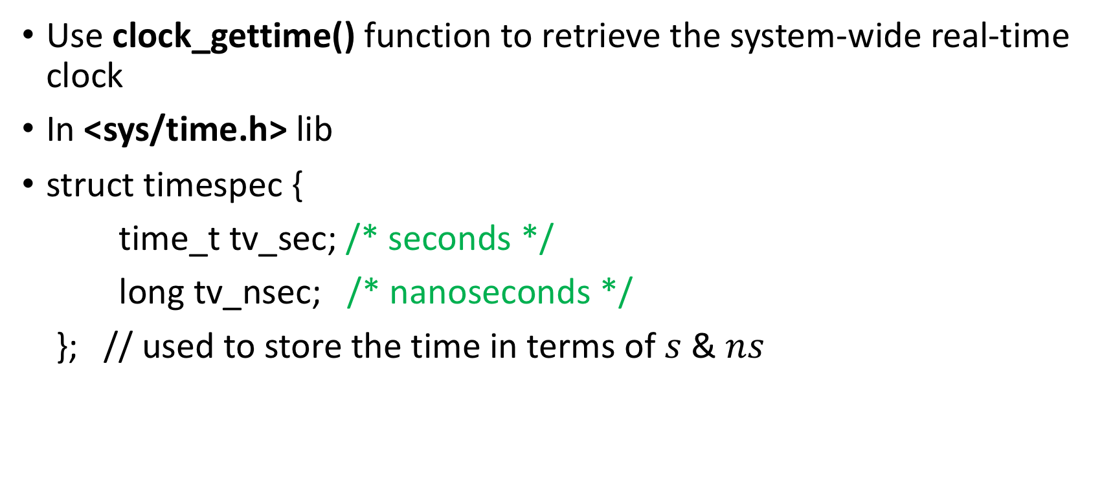
Measure program time (1)
Use clock_gettime() function to retrieve the system-wide real-time clock
In <sys/time.h> lib
struct timespec {
time_t tv_sec; /* seconds */
long tv_nsec; /* nanoseconds */
}; // used to store the time in terms of $s$ & $ns$

Slide 10
Measure program time (2)
Example:
#include <time.h>
struct timespec start, stop; Double t;
if(clock_gettime(CLOCK_REALTIME, &start) == -1) { perror( "clock gettime" );}
// Your codes go here
if(clock_gettime(CLOCK_REALTIME, &stop) == -1) { perror( "clock gettime" );}
t = (stop.tv_sec - start.tv_sec)+
(double)(stop.tv_nsec - start.tv_nsec)/1e9;

Slide 11
Programming homework (1)
Matrix Multiply
Implement C = A × B (A, B, C are n × n matrixes)
for i = 1 to n
for j = 1 to n
for k = 1 to n
C(i,j) = C(i,j) + A(i,k) × B(k,j)
C(i,j)
A(i,:)
=
×
B(:,j)

Slide 12


Programming homework (2)
Blocked Matrix Multiply
The matrix can be partitioned into four 2×2 blocks

Slide 13
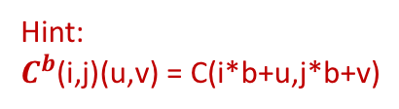

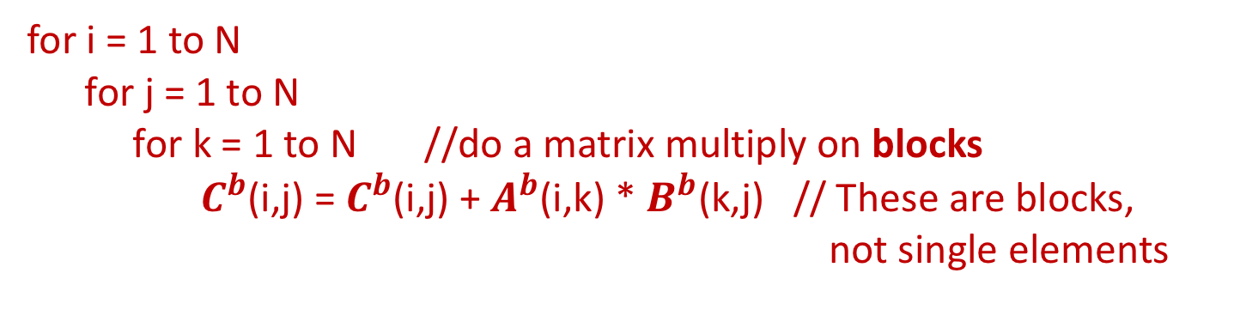

Programming homework (3)
Blocked Matrix Multiply
C = A × B : n $×$ n matrices
$A^{b}$, $B^{b}$,$C^{b}$ : b $×$ b sub-matrices
Number of sub-matrices in A/B/C: $N×N$ , $N=n/b$
for i = 1 to N
for j = 1 to N
for k = 1 to N //do a matrix multiply on blocks
$C^{b}$(i,j) = $C^{b}$(i,j) + $A^{b}$(i,k) * $B^{b}$(k,j) // These are blocks, not single elements
Fill C block matrix here.
Fill A, B block matrices here.
$C^{b}$(i,j)
$A^{b}$(i,:)
=
×
$B^{b}$(:,j)
Hint:
$C^{b}$(i,j)(u,v) = C(i*b+u,j*b+v)

Slide 14
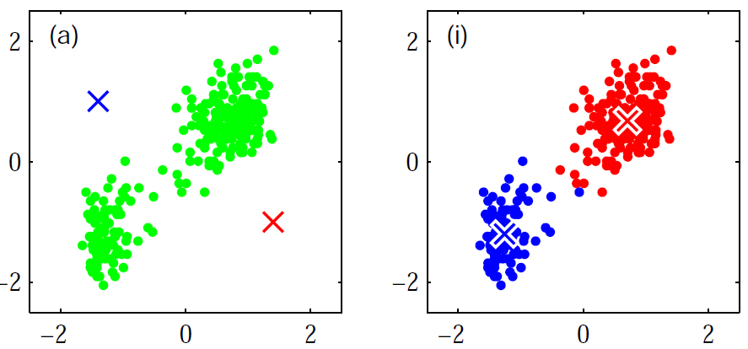

Programming homework (4)
K-means
Partition $n$ observations into $k$ clusters
Each cluster has a mean value, $μ_{i} (0<i≤k)$
Each observation belongs to the cluster with the nearest mean
Example

Slide 15

Programming homework (5)
K-means
Steps
Initialize each $μ_{i}$ to some value.
For each data element, compute its ‘distance’ to each $μ_{i}$. Assign it to the `closest' cluster.
Re-compute each $μ_{i}$
Check convergence; if not, go to Step 2

Slide 16
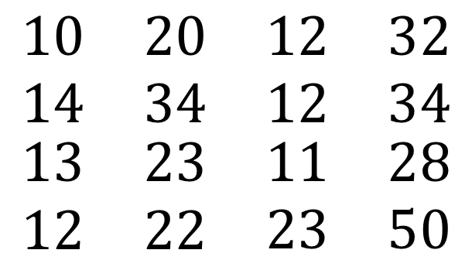

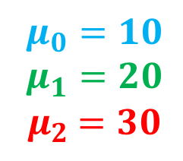
Programming homework (7)
Example
Step 1 (Initialize $μ_{i}$):
$$\begin{matrix}\begin{matrix}10 & 20 \\ 14 & 34\end{matrix} & \begin{matrix}12 & 32 \\ 12 & 34\end{matrix} \\ \begin{matrix}13 & 23 \\ 12 & 22\end{matrix} & \begin{matrix}11 & 28 \\ 23 & 50\end{matrix}\end{matrix}$$
$$μ_{0}=10$$
$$μ_{1}=20$$
${ μ}_{2} =30$

Slide 17
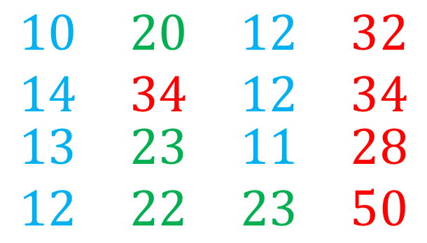
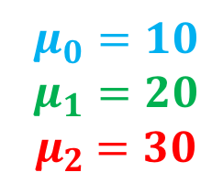
Programming homework (7)
Step 2 (assign to closest cluster)
$$\begin{matrix}\begin{matrix}10 & 20 \\ 14 & 34\end{matrix} & \begin{matrix}12 & 32 \\ 12 & 34\end{matrix} \\ \begin{matrix}13 & 23 \\ 12 & 22\end{matrix} & \begin{matrix}11 & 28 \\ 23 & 50\end{matrix}\end{matrix}$$
$$μ_{0}=10$$
$$μ_{1}=20$$
${ μ}_{2} =30$

Slide 18
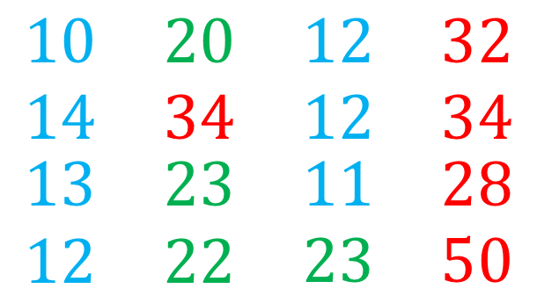

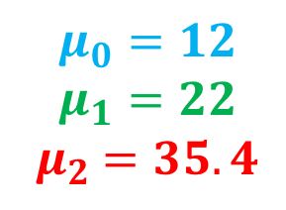
Programming homework (7)
Step 3 (Recompute $μ_{i}$):
$$\begin{matrix}\begin{matrix}10 & 20 \\ 14 & 34\end{matrix} & \begin{matrix}12 & 32 \\ 12 & 34\end{matrix} \\ \begin{matrix}13 & 23 \\ 12 & 22\end{matrix} & \begin{matrix}11 & 28 \\ 23 & 50\end{matrix}\end{matrix}$$
$$μ_{0}=12$$
$$μ_{1}=22$$
${ μ}_{2} =35.4$

Slide 19

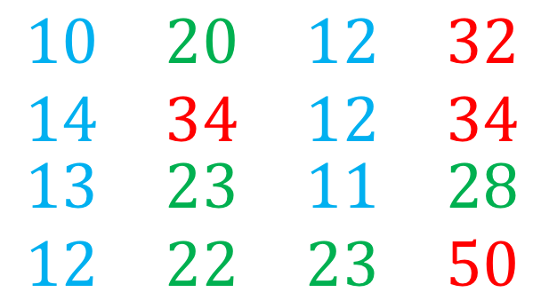
Programming homework (8)
Step 2 (Assign to Closest cluster)
28 changes cluster
$$\begin{matrix}\begin{matrix}10 & 20 \\ 14 & 34\end{matrix} & \begin{matrix}12 & 32 \\ 12 & 34\end{matrix} \\ \begin{matrix}13 & 23 \\ 12 & 22\end{matrix} & \begin{matrix}11 & 28 \\ 23 & 50\end{matrix}\end{matrix}$$
$$μ_{0}=12$$
$$μ_{1}=22$$
${ μ}_{2} =35.4$

Slide 20
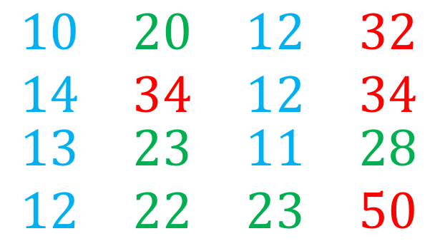

Programming homework (8)
Step 3 (Recompute $μ_{i}$):
$$\begin{matrix}\begin{matrix}10 & 20 \\ 14 & 34\end{matrix} & \begin{matrix}12 & 32 \\ 12 & 34\end{matrix} \\ \begin{matrix}13 & 23 \\ 12 & 22\end{matrix} & \begin{matrix}11 & 28 \\ 23 & 50\end{matrix}\end{matrix}$$
$$μ_{0}=12$$
$$μ_{1}=23.2$$
${ μ}_{2} =37.5$

Slide 21
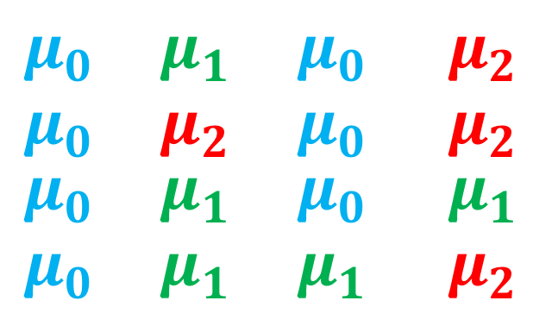
Programming homework (9)
Output
$$\begin{matrix}\begin{matrix}μ_{0} & μ_{1} \\ μ_{0} & μ_{2}\end{matrix} & \begin{matrix}μ_{0} & { μ}_{2} \\ μ_{0} & { μ}_{2}\end{matrix} \\ \begin{matrix}μ_{0} & μ_{1} \\ μ_{0} & μ_{1}\end{matrix} & \begin{matrix}μ_{0} & { μ}_{1} \\ μ_{1} & { μ}_{2}\end{matrix}\end{matrix}$$

Slide 22
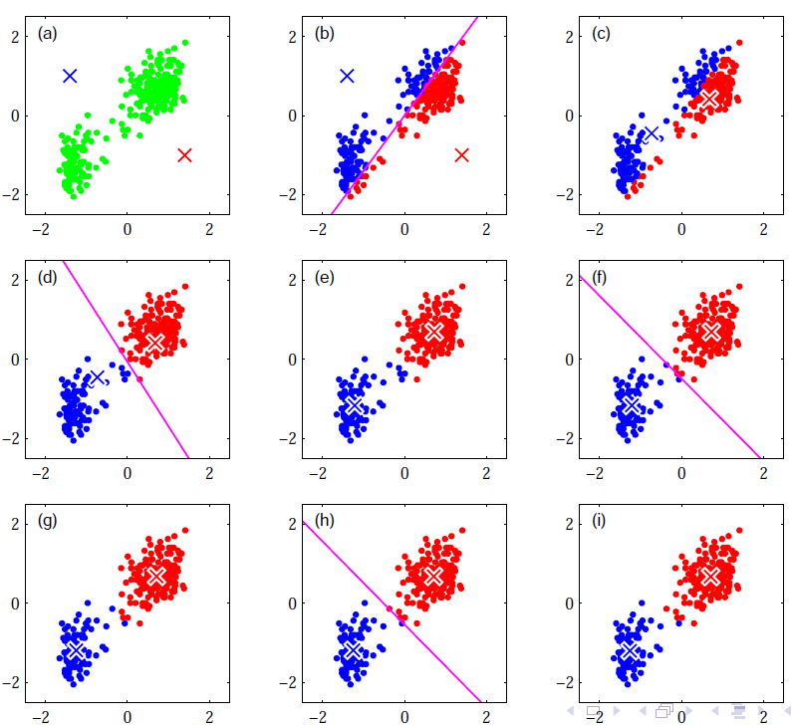
Programming homework (6)
Example

Slide 23
Questions?
Thank you

