Slide 1
EE/CSCI 451 Introduction to
Parallel and Distributed Computation
Discussion #2 & #3
8/28/2020 & 9/4/2020
University of Southern California

Slide 2
Topics Covered
Discussion #2
Selected Problem (Modified) in Homework 1
Pthread Programming Model
Pthread API
Discussion #3
Pthread Synchronization
Programming HW 2 discussion
Parallel K-means

Slide 3
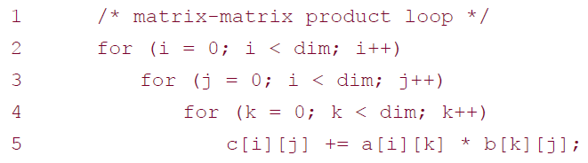
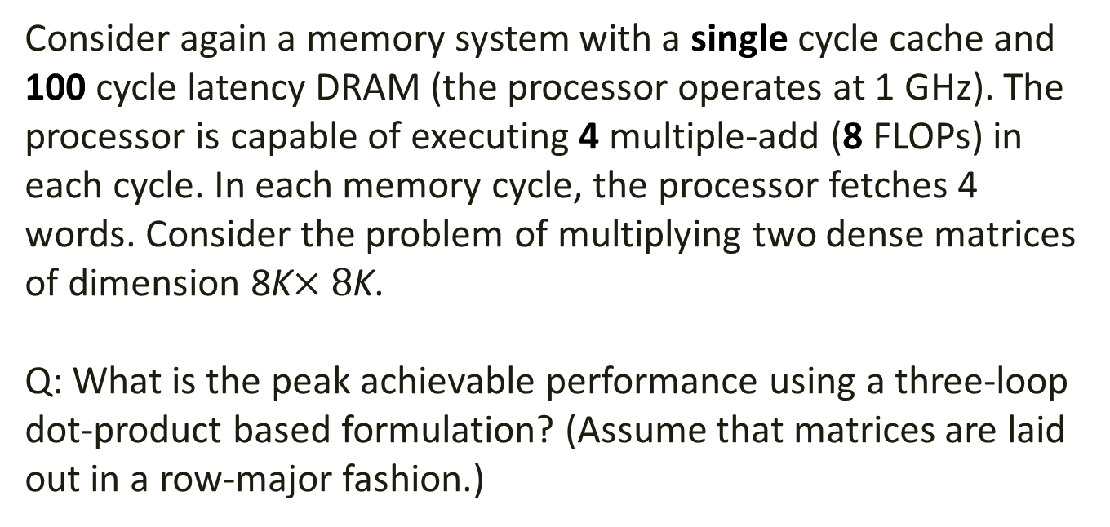
HW Problems 4 (1)
Consider again a memory system with a single cycle cache and 100 cycle latency DRAM (the processor operates at 1 GHz). The processor is capable of executing 4 multiple-add (8 FLOPs) in each cycle. In each memory cycle, the processor fetches 4 words. Consider the problem of multiplying two dense matrices of dimension 8K$×8$K.
Q: What is the peak achievable performance using a three-loop dot-product based formulation? (Assume that matrices are laid out in a row-major fashion.)

Slide 4
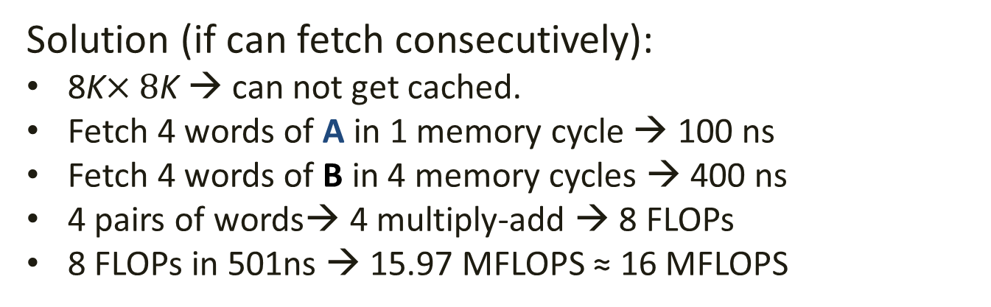
HW Problems 4 (2)
Solution (if can fetch consecutively):
8K$×8$K → can not get cached.
Fetch 4 words of A in 1 memory cycle → 100 ns
Fetch 4 words of B in 4 memory cycles → 400 ns
4 pairs of words→ 4 multiply-add → 8 FLOPs
8 FLOPs in 501ns → 15.97 MFLOPS ≈ 16 MFLOPS
1
2
3
4
1
2
3
4
A
B

Slide 5
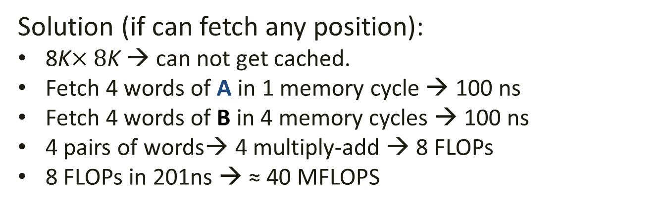
HW Problems 4 (3)
Solution (if can fetch any position):
8K$×8$K → can not get cached.
Fetch 4 words of A in 1 memory cycle → 100 ns
Fetch 4 words of B in 4 memory cycles → 100 ns
4 pairs of words→ 4 multiply-add → 8 FLOPs
8 FLOPs in 201ns → ≈ 40 MFLOPS
1
2
3
4
1
2
3
4
A
B

Slide 6
Threads programming model (1)
A single process can have multiple, concurrent execution paths
The main program is scheduled to run by the operating system
main program acquires all necessary system/user resources to run
main program creates tasks (threads) execution that can be run concurrently
Operating System
Main 1
Main 2
T1
T2
T1
T2

Slide 7
Threads programming model (2)
Each thread has local data but also shares the entire resources of the main program.
Threads communicate with each other through global memory
Synchronization is required to ensure that more than one thread is not updating the same global address at any time.
Threads can come and go, but the main program remains present to provide the necessary shared resources until the application has completed.
T1
T2
T3
Memory

Slide 8
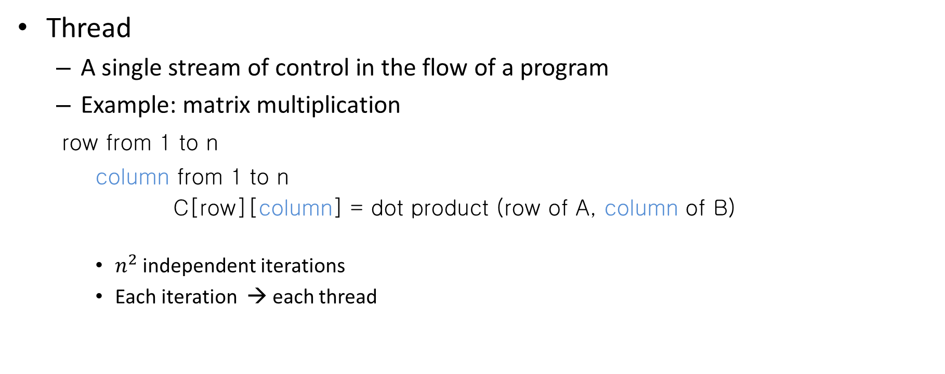
What is a thread?
Thread
A single stream of control in the flow of a program
Example: matrix multiplication
row from 1 to n
column from 1 to n
C[row][column] = dot product (row of A, column of B)
$n^{2}$ independent iterations
Each iteration → each thread

Slide 9
Why Threads
Latency Hiding
Hide the access latency for memory access, I/O, and communication
Scheduling and Load Balancing

Slide 10
POSIX Threads API
Pthreads
A set of C language programming types and procedure calls
Implemented with a pthread.h header
Can be created with much less operating system overhead

Slide 11
Creation
pthread_create
Create a single thread
Thread function
Unique identifier
Argument
On success → return 0
Example:
pthread_create(ID, dot_product, argument(A, B, C, row, column));

Slide 12
Termination
Several ways in which threads are terminated
The thread returns normally from its starting routine. It's work is done.
The thread makes a call to the pthread_exit.
The thread is canceled by another thread via the pthread_cancel.
If main() finishes first.

Slide 13
Pthread Joining
Wait for the specific thread to run to completion
One way to accomplish synchronization between threads.
create
Thread 1
exit
Join 1
Main
create
Thread 2
exit
Join 2

Slide 14
Pthread_create
pthread_create arguments:
thread: An opaque, unique identifier for the new thread returned by the subroutine
attr: An opaque attribute object that may be used to set thread attributes. You can specify a thread attributes object, or NULL for the default values
start_routine: the C routine that the thread will execute once it is created
arg: A single argument that may be passed to start_routine. It must be passed by reference as a pointer cast of type void. NULL may be used if no argument is to be passed.

Slide 15
Thread Attributes
By default, a thread is created with certain attributes
Some of these attributes can be changed by the programmer via the thread attribute object of type pthread_attr_t
pthread_attr_init and pthread_attr_destroy are used to initialize/destroy the thread attribute object
Other routines are then used to query/set specific attributes in the thread attribute object

Slide 16
Example
#include <pthread.h>
#include <stdio.h>
#include <stdlib.h>
#define NUM_THREADS 5
void *PrintHello(void *threadid){
long tid;
tid = (long)threadid;
printf("Hello World! It's thread #%ld!\n", tid);
pthread_exit(NULL);
}

Slide 17
Example Cont.
int main(int argc, char *argv[]) {
pthread_t threads[NUM_THREADS];
int rc;
long t;
for(t=0;t<NUM_THREADS;t++) {
printf("In main: creating thread %ld\n", t);
rc = pthread_create(&threads[t], NULL, PrintHello, (void *)t );
if (rc) {
printf("ERROR; return code from pthread_create() is %d\n", rc);
exit(-1);
}
}
return 0;
}

Slide 18
Example Cont.
Output:
In main: creating thread 0
In main: creating thread 1
In main: creating thread 2
In main: creating thread 3
In main: creating thread 4
Hello World! It's thread #0!
Hello World! It's thread #1!
Hello World! It's thread #2!
Hello World! It's thread #3!
Hello World! It's thread #4!
Output order might be different

Slide 19
Passing Arguments to Threads
The pthread_create() routine permits the programmer to pass one argument to the thread start routine
For cases where multiple arguments must be passed:
create a structure which contains all of the arguments
then pass a pointer to that structure in the pthread_create()routine.
All arguments must be passed by reference and cast to (void *)

Slide 20
Arguments Passing Example
#include <pthread.h>
#include <stdio.h>
#include <stdlib.h>
#define NUM_THREADS 4
char *messages[NUM_THREADS];
struct thread_data{
int thread_id;
char *message;
};
struct thread_data thread_data_array[NUM_THREADS];

Slide 21
Arguments Passing Example Cont.
void *PrintHello(void *threadarg){
struct thread_data * my_data;
my_data = (struct thread_data *) threadarg;
int thread_id = my_data->thread_id;
char *hello_msg = my_data->message;
printf("Thread %d says %s \n", thread_id , hello_msg);
pthread_exit(NULL);
}

Slide 22
Arguments Passing Example Cont.
int main(int argc, char *argv[]) {
pthread_t threads[NUM_THREADS];
int rc, i;
char * message[NUM_THREADS];
messages[0] = "Hello!";
messages[1] = " How are you!";
messages[2] = " I am good";
messages[3] = " Thank you";
// main continues //

Slide 23
Arguments Passing Example Cont.
for(i=0; i<NUM_THREADS; i++) { thread_data_array[i].thread_id = i;
thread_data_array[i].message = messages[i]; rc = pthread_create(&threads[i], NULL, PrintHello,
(void *) &thread_data_array[i] );
if (rc) { printf("ERROR; return code from pthread_create() is %d\n", rc);
exit(-1);}
}
pthread_exit(NULL);
}

Slide 24
Argument Passing Example Output
Output:
Thread 0 says Hello!
Thread 1 says How are you?
Thread 2 says I am good.
Thread 3 says Thank you

Slide 25
Joining
"Joining" is one way to accomplish synchronization between threads.
The pthread_join() subroutine blocks the calling thread until the specified threadid thread terminates.
Only threads that are created as joinable can be joined.
To explicitly create a thread as joinable, the attr argument in the pthread_create() routine is used

Slide 26
Joining
The typical 4 step process is:
Declare a pthread attribute variable of the pthread_attr_t data type
Initialize the attribute variable with pthread_attr_init()
Set the attribute detached status with pthread_attr_setdetachstate()
When done, free library resources used by the attribute with pthread_attr_destroy()

Slide 27
Example: Pthread Joining
Example Code - Pthread Joining
This example demonstrates how to "wait" for thread completions by using the Pthread join routine.
Since some implementations of Pthreads may not create threads in a joinable state, the threads in this example are explicitly created in a joinable state

Slide 28
Example: Pthread Joining
#include <pthread.h>
#include <stdio.h>
#include <stdlib.h>
#define NUM_THREADS 4
void *BusyWork(void *t) {
int i;
long tid = (long) t;
int result=0;
printf("Thread %ld starting...\n", tid);
for (i=0; i<1000000; i++) {
result = result + i* i} printf("Thread %ld done. Result = %d\n",tid, result);
pthread_exit((void*) t);
}

Slide 29
Example: Pthread Joining
int main (int argc, char *argv[]){
pthread_t thread[NUM_THREADS];
pthread_attr_t attr;
int rc; long t;
/* Initialize and set thread attribute */
pthread_attr_init(&attr);
pthread_attr_setdetachstate(&attr, PTHREAD_CREATE_JOINABLE);
for(t=0; t<NUM_THREADS; t++) {
printf("Main: creating thread %ld\n", t);
rc = pthread_create(&thread[t], &attr, BusyWork, (void *)t);
if (rc) { printf(" creating error "); exit(-1);}
}

Slide 30
Example: Pthread Joining
/* Free attribute */
pthread_attr_destroy(&attr);
for(t=0; t<NUM_THREADS; t++) {
rc = pthread_join(thread[t], NULL);
if (rc) { printf(" joining error %d ", rc); exit(-1);} printf("Main: completed join with thread %ld “) }
Return 0;
}

Slide 31
Compilation
The pthread.h header file must be included in the source file using the threads library.
link to the pthread library using -lpthread
E.g.: gcc –o ptexample ptexample.c -lpthread

Slide 32
Announcements
Midterm 1 - Sep 25th , in discussion session (2hrs!)
HW2 due 9/10
PHW2 due 9/14 [Pls. download the newest version uploaded to Piazza]
3 late days are free for this PHW. No additional late days will be given
The slides for discussion 2_3 are also updated with new info about updated PHW2. [Pls. download the latest version when you refer to these slides when doing PHW2]

Slide 33
Thread synchronization (1)
Most of threaded programs have threads that interact with one another
Interaction in the form of sharing access to variables
Multiple concurrent reads (ok)
Multiple concurrent writes (not ok, outcome non-deterministic)
One write, multiple reads (not ok, outcome non-deterministic)
Needs to make sure that the outcome is deterministic.
Synchronization: allowing concurrent accesses to variables, removing non-deterministic outcome by enforcing the order of thread execution.

Slide 34
Thread Synchronization (2)
Multiple threads manipulate the same data
Example: Find the maximum value
Shared variable
max = 0
i =30
j =50
What happens with
execution order ?
1→ 3 → 4 → 2
Thread 1
1. if ( i > max)
2. max = i;
Thread 2
3. if ( j > max)
4. max = j;

Slide 35
Thread synchronization (3)
Mutex variables
abbreviation for “mutual exclusion”
protecting shared data with multiple concurrent writes
acting like a lock
Condition Variable
Waiting and signaling on condition variables
Always with a mutex

Slide 36

Mutex (1)
mutex
Two states: locked and unlocked
Initialized as unlocked
Can only be locked by one thread
Try to acquire the lock first
Unlock the lock when leaving the critical section

Slide 37
Mutex (2)
1 thread locks the mutex
Remaining threads wait for mutex to become free
T2 T3 denied access
Critical Section
Locked
T1

Slide 38
Example
A buffer of size SIZE
Put: puts elements into array if the array is not full
Get: removes elements from the array if the array is not empty

Slide 39
Example: Using Locks
met_condition = false
While (!met_condition) {
Acquire_lock()
If (size != SIZE)
addItem() //update size
met_condition = true
Release_lock()
}
met_condition = false
While (!met_condition) {
Acquire_lock()
If (size != 0)
removeItem() //update size
met_condition = true
Release_lock()
}
Put
Get
size: Shared Variable

Slide 40
Using Conditional Variables
Acquire_lock(lock)
While (size == SIZE)
Wait_CV(CV, lock)
addItem()
Signal_CV(CV)
Release_lock(lock)
Acquire_lock(lock)
While (size == 0)
Wait_CV(CV, lock)
removeItem()
Signal_CV(CV)
Release_lock(lock)
Put
Get

Slide 41
Mutex variables
Usage:
Mutex variables must be declared with type pthread_mutex_t, and must be initialized before they can be used. There are two ways to initialize a mutex variable:
pthread_mutex_t mymutex = PTHREAD_MUTEX_INITIALIZER;
pthread_mutex_init() routine. This method permits setting mutex object attributes, attr.
The mutex is initially unlocked.

Slide 42
Mutex variables
Routines:
pthread_mutex_init (mutex, attr)
pthread_mutex_destroy (mutex)
pthread_mutex_lock(mutex)
pthread_mutex_trylock(mutex)
pthread_mutex_unlock(mutex)
pthread_mutexattr_init (attr)
pthread_mutexattr_destroy (attr)

Slide 43
Mutex variables
Routines:
pthread_mutex_lock(mutex)
Used by a thread to acquire a lock on the specified mutex. If the mutex is already locked by another thread, this call will block the calling thread until the mutex is unlocked.
pthread_mutex_trylock(mutex)
Attempt to lock a mutex. However, if the mutex is already locked, the routine will return immediately with a "busy" code
pthread_mutex_unlock (mutex)
Unlock a mutex if called by the owning thread. Calling this routine is required after a thread has completed its use of protected data if other threads are to acquire the mutex for their work with the protected data.

Slide 44
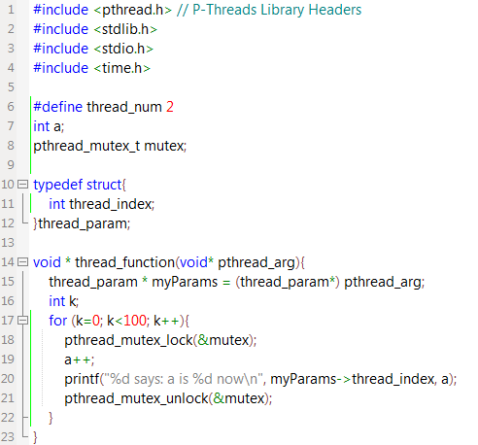
Mutex variables
Example:

Slide 45
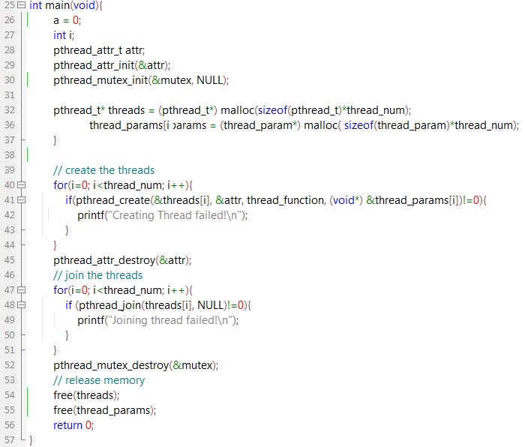
thread_param *thread_params

Slide 46
Condition Variable (1)
Thread 1 locks mutex.
If condition is true, does work and releases mutex
If condition is false, releases lock and waits for condition to become true
Thread 2 locks mutex
If condition is false, does some work and if condition becomes true, signals Thread 1.
Does some more work and releases the mutex

Slide 47
Condition Variable (2)
Thread 1 after being woken up waits for mutex
When it acquires mutex, does some work and releases mutex
T3 T4 denied access
Critical Section
Locked
T2
Wait Queue
CV
T1

Slide 48
Condition Variable (3)
T1
Acquire_lock(lock)
While Condition false
Wait_CV(CV, lock)
Do work
Release_lock(lock)
T2
Acquire_lock(lock)
If Condition false
do some work possibly making condition true
Signal/Broadcast_CV(CV, lock)
Do some more work
Release_lock(lock)
Condition: Shared Variable

Slide 49
Condition variables
While mutex implement synchronization by controlling thread access to data, condition variables allow threads to synchronize based upon the actual value of data
Without condition variables, the programmer would need to have threads continually polling (possibly in a critical section), to check if the condition is met. A condition variable is a way to achieve the same goal without polling.
A condition variable is always used in conjunction with a mutex lock.

Slide 50
Condition variables
Usage:
Condition variables must be declared with type pthread_cond_t, and must be initialized before they can be used. There are two ways to initialize a condition variable:
pthread_cond_t myconvar = PTHREAD_COND_INITIALIZER;
pthread_cond_init() routine. This method permits setting condition variable object attributes, attr.

Slide 51
Condition variables
Routines:
pthread_cond_wait (condition,mutex)
blocks the calling thread until the specified condition is signaled. This routine should be called while mutex is locked, and it will automatically release the mutex while it waits. After signal is received and thread is awakened, mutex will be automatically locked for use by the thread.
pthread_cond_signal (condition)
is used to signal (or wake up) another thread which is waiting on the condition variable.
pthread_cond_broadcast (condition)
to signal (or wake up) all the threads which is waiting on the condition variable.

Slide 52
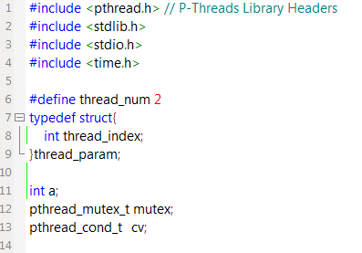
Condition variables
Example:

Slide 53
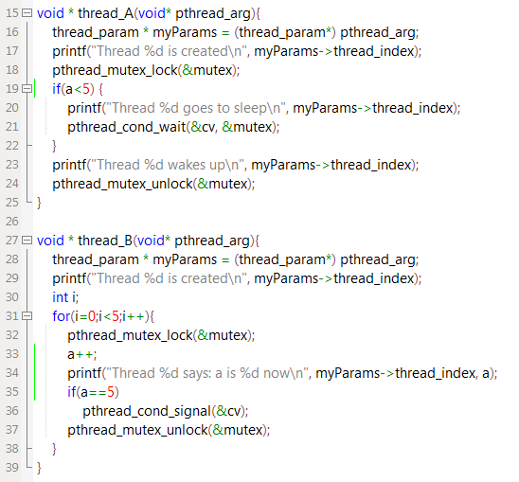
Condition variables

Slide 54
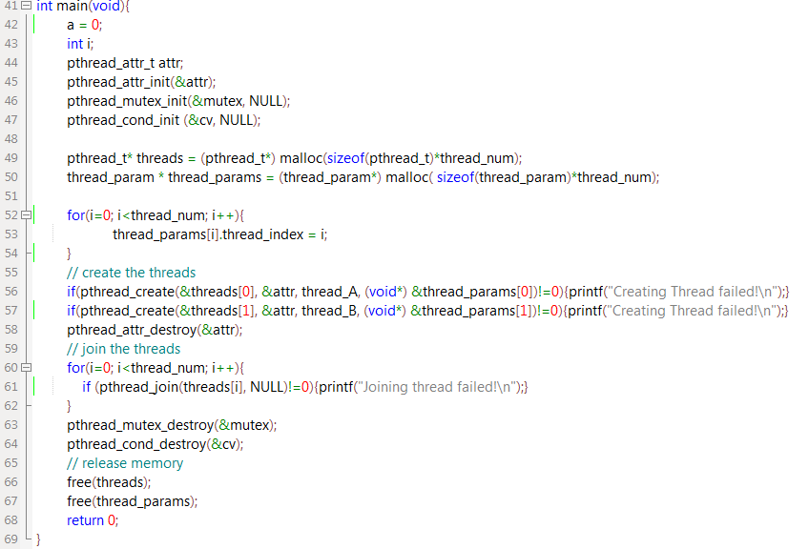

Slide 55

Condition variables
Execution order 1
Time
Thread A
Thread B
“Thread 0 is created”
Thread 1 is created
“Thread 0 goes to sleep”
Sleeping
zzz…
a is now 1
…
a is now 5
Wake up
“Thread 0 wakes up”

Slide 56
Condition variables
Execution order 2
Time
Thread A
Thread B
“Thread 0 is created”
Thread 1 is created
a is now 1
“Thread 0 goes to sleep”
Sleeping
zzz…
a is now2
…
a is now 5
Wake up
“Thread 0 wakes up”

Slide 57





MM(1)
Local output variables:
Matrix C is partitioned into $p×p$ blocks, each sized at $\frac{n}{p}×\frac{n}{p}$
$p×p$ threads, each thread$(i,j)$ “owning” the computation for a C$\left(i,j\right)$ block, is responsible for calculating the matrix product of corresponding tiles from A and B and write the results to C$\left(i,j\right)$
B$(:,j)$
$$A(i,:)$$
C$(i,j)$
A
x
B
=
C
Thread$(i,j)$

Slide 58




MM(3)
Shared output variables:
Matrix C is partitioned into $p×p$ blocks, each sized at $\frac{n}{p}×\frac{n}{p}$
$p×p$ threads, each thread$(i,j)$ “owning” the computation of an A$\left(i,j\right)$ block, is responsible for calculating its matrix product of corresponding tile from B and write the (intermediate) results to C$\left(i,j\right)$
B$(j,:)$
$$A(i,j)$$
C$(i,:)$
A
x
B
=
C
Thread$(i,j)$

Slide 59
MM(4)
In your main function:
static pthread_mutex_t mutexes [p];
For (i=0;i<p;i++) pthread_mutex_init(&mutexes[i],NULL);
Set attributes … Create threads … Join threads …
Thread (i,j) routine:
Acquire mutexes[i];
Perform C[i,:]+=A[i,j]*B[j,:]
Release mutexes[i];
This is a matrix multiplication process (3-nested loop)! i and j are used to index blocks/tiles, not individual elements as shown in lecture slides

Slide 60





K-means (1)
Parallelized K-means
$$\begin{matrix}10 & 10 & 12 \\ 20 & 21 & 16 \\ 33 & 28 & 22\end{matrix}$$
$$\begin{matrix}10 & 10 & 12 \\ 20 & 21 & 16 \\ 33 & 28 & 22\end{matrix}$$
$$\begin{matrix}10 & 10 & 12 \\ 20 & 21 & 16 \\ 33 & 28 & 22\end{matrix}$$
$$\begin{matrix}10 & 10 & 12 \\ 20 & 21 & 16 \\ 33 & 28 & 22\end{matrix}$$
$$μ_{1}=10$$
$$μ_{2}=20$$
${ μ}_{3} =30$
Thread 1
Thread 2
Thread 3
$μ_{w}=(sum\left[w\right]+sum\left[w\right]+$ $sum[w])/(no[w]+no[w]+no[w]), w=1,2,3$

Slide 61

K-means (9)
Pseudo code
Main(){
initialize each arg;
for i=1:30{
for w=1:p {
create_thread(thread[k], kmeans, arg[k]);
}
for w=1:p {
join_thread(thread[k]);
}
update each $μ$;
}
Output;
}
Notes:
center

Slide 62
K-means (2)
Parallelized K-means
$$\begin{matrix}10 & 10 & 12 \\ 20 & 21 & 16 \\ 33 & 28 & 22\end{matrix}$$
$$μ_{1}=10$$
$$μ_{2}=20$$
${ μ}_{3} =30$
Thread 1
Thread 2
Thread 3
sum[1]=0
no[1]=0
sum[2]=0
no[2]=0
sum[3]=0
no[3]=0
sum[1]=0
no[1]= 0
sum[2]=0
no[2]=0
sum[3]=0
no[3]=0
sum[1]=0
no[1]=0
sum[2]=0
no[3]=0
sum[3]=0
no[3]=0

Slide 63
K-means (3)
Parallelized K-means
$$\begin{matrix}10 & 10 & 12 \\ 20 & 21 & 16 \\ 33 & 28 & 22\end{matrix}$$
$$\begin{matrix}10 & 10 & 12 \\ 20 & 21 & 16 \\ 33 & 28 & 22\end{matrix}$$
$$μ_{1}=10$$
$$μ_{2}=20$$
${ μ}_{3} =30$
Thread 1
Thread 2
Thread 3
sum[1]=10
no[1]=1
sum[2]=0
no[2]=0
sum[3]=0
no[3]=0
sum[1]=10
no[1]=1
sum[2]=0
no[2]=0
sum[3]=0
no[3]=0
sum[1]=12
no[1]=1
sum[2]=0
no[2]=0
sum[3]=0
no[3]=0
sum[1]=0
no[1]=0
sum[2]=0
no[2]=0
sum[3]=0
no[3]=0
sum[1]=0
no[1]= 0
sum[2]=0
no[2]=0
sum[3]=0
no[3]=0
sum[1]=0
no[1]=0
sum[2]=0
no[3]=0
sum[3]=0
no[3]=0

Slide 64
K-means (4)
Parallelized K-means
$$\begin{matrix}10 & 10 & 12 \\ 20 & 21 & 16 \\ 33 & 28 & 22\end{matrix}$$
$$\begin{matrix}10 & 10 & 12 \\ 20 & 21 & 16 \\ 33 & 28 & 22\end{matrix}$$
$$μ_{1}=10$$
$$μ_{2}=20$$
${ μ}_{3} =30$
Thread 1
Thread 2
Thread 3
sum[1]=10
no[1]=1
sum[2]=0
no[2]=0
sum[3]=0
no[3]=0
sum[1]=10
no[1]=1
sum[2]=0
no[2]=0
sum[3]=0
no[3]=0
sum[1]=12
no[1]=1
sum[2]=0
no[2]=0
sum[3]=0
no[3]=0
sum[1]=10
no[1]=1
sum[2]=20
no[2]=1
sum[3]=0
no[3]=0
sum[1]=0
no[1]=0
sum[2]=0
no[2]=0
sum[3]=0
no[3]=0
sum[1]=10
no[1]=1
sum[2]=21
no[2]=1
sum[3]=0
no[3]=0
sum[1]=0
no[1]= 0
sum[2]=0
no[2]=0
sum[3]=0
no[3]=0
sum[1]=12
no[1]=1
sum[2]=16
no[2]=1
sum[3]=0
no[3]=0
sum[1]=0
no[1]=0
sum[2]=0
no[3]=0
sum[3]=0
no[3]=0

Slide 65

K-means (5)
Parallelized K-means
$$\begin{matrix}10 & 10 & 12 \\ 20 & 21 & 16 \\ 33 & 28 & 22\end{matrix}$$
$$\begin{matrix}10 & 10 & 12 \\ 20 & 21 & 16 \\ 33 & 28 & 22\end{matrix}$$
$$\begin{matrix}10 & 10 & 12 \\ 20 & 21 & 16 \\ 33 & 28 & 22\end{matrix}$$
$$\begin{matrix}10 & 10 & 12 \\ 20 & 21 & 16 \\ 33 & 28 & 22\end{matrix}$$
$$μ_{1}=10$$
$$μ_{2}=20$$
${ μ}_{3} =30$
Thread 1
Thread 2
Thread 3
sum[1]=10
no[1]=1
sum[2]=0
no[2]=0
sum[3]=0
no[3]=0
sum[1]=10
no[1]=1
sum[2]=0
no[2]=0
sum[3]=0
no[3]=0
sum[1]=12
no[1]=1
sum[2]=0
no[2]=0
sum[3]=0
no[3]=0
sum[1]=10
no[1]=1
sum[2]=20
no[2]=1
sum[3]=0
no[3]=0
sum[1]=10
no[1]=1
sum[2]=20
no[2]=1
sum[3]=33
no[3]=1
sum[1]=0
no[1]=0
sum[2]=0
no[2]=0
sum[3]=0
no[3]=0
sum[1]=10
no[1]=1
sum[2]=21
no[2]=1
sum[3]=0
no[3]=0
sum[1]=10
no[1]=1
sum[2]=21
no[2]=1
sum[3]=28
no[3]=1
sum[1]=0
no[1]= 0
sum[2]=0
no[2]=0
sum[3]=0
no[3]=0
sum[1]=12
no[1]=1
sum[2]=16
no[2]=1
sum[3]=0
no[3]=0
sum[1]=12
no[1]=1
sum[2]=38
no[2]=2
sum[3]=0
no[3]=0
sum[1]=0
no[1]=0
sum[2]=0
no[3]=0
sum[3]=0
no[3]=0

Slide 66
K-means (6)
Parallelized K-means
$$\begin{matrix}10 & 10 & 12 \\ 20 & 21 & 16 \\ 33 & 28 & 22\end{matrix}$$
$$\begin{matrix}10 & 10 & 12 \\ 20 & 21 & 16 \\ 33 & 28 & 22\end{matrix}$$
$$\begin{matrix}10 & 10 & 12 \\ 20 & 21 & 16 \\ 33 & 28 & 22\end{matrix}$$
$$\begin{matrix}10 & 10 & 12 \\ 20 & 21 & 16 \\ 33 & 28 & 22\end{matrix}$$
$$μ_{1}=10$$
$$μ_{2}=20$$
${ μ}_{3} =30$
Thread 1
Thread 2
Thread 3
sum[1]=10
no[1]=1
sum[2]=0
no[2]=0
sum[3]=0
no[3]=0
sum[1]=10
no[1]=1
sum[2]=0
no[2]=0
sum[3]=0
no[3]=0
sum[1]=12
no[1]=1
sum[2]=0
no[2]=0
sum[3]=0
no[3]=0
sum[1]=10
no[1]=1
sum[2]=20
no[2]=1
sum[3]=0
no[3]=0
sum[1]=10
no[1]=1
sum[2]=20
no[2]=1
sum[3]=33
no[3]=1
sum[1]=0
no[1]=0
sum[2]=0
no[2]=0
sum[3]=0
no[3]=0
sum[1]=10
no[1]=1
sum[2]=21
no[2]=1
sum[3]=0
no[3]=0
sum[1]=10
no[1]=1
sum[2]=21
no[2]=1
sum[3]=28
no[3]=1
sum[1]=0
no[1]= 0
sum[2]=0
no[2]=0
sum[3]=0
no[3]=0
sum[1]=12
no[1]=1
sum[2]=16
no[2]=1
sum[3]=0
no[3]=0
sum[1]=12
no[1]=1
sum[2]=38
no[2]=2
sum[3]=0
no[3]=0
sum[1]=0
no[1]=0
sum[2]=0
no[3]=0
sum[3]=0
no[3]=0
$μ_{w}=(sum\left[w\right]+sum\left[w\right]+$ $sum[w])/(no[w]+no[w]+no[w]), w=1,2,3$

Slide 67
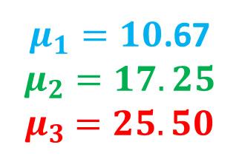
K-means (7)
Parallelized K-means
$$\begin{matrix}10 & 10 & 12 \\ 20 & 21 & 16 \\ 33 & 28 & 22\end{matrix}$$
$μ_{1}=10$.67
$$μ_{2}=17.25$$
$${ μ}_{3} =25.50$$
$$\begin{matrix}10 & 10 & 12 \\ 20 & 21 & 16 \\ 33 & 28 & 22\end{matrix}$$
$$\begin{matrix}10 & 10 & 12 \\ 20 & 21 & 16 \\ 33 & 28 & 22\end{matrix}$$
$$\begin{matrix}10 & 10 & 12 \\ 20 & 21 & 16 \\ 33 & 28 & 22\end{matrix}$$
$$μ_{1}=10$$
$$μ_{2}=20$$
${ μ}_{3} =30$
Thread 1
Thread 2
Thread 3
sum[1]=10
no[1]=1
sum[2]=0
no[2]=0
sum[3]=0
no[3]=0
sum[1]=10
no[1]=1
sum[2]=0
no[2]=0
sum[3]=0
no[3]=0
sum[1]=12
no[1]=1
sum[2]=0
no[2]=0
sum[3]=0
no[3]=0
sum[1]=10
no[1]=1
sum[2]=20
no[2]=1
sum[3]=0
no[3]=0
sum[1]=10
no[1]=1
sum[2]=20
no[2]=1
sum[3]=33
no[3]=1
sum[1]=0
no[1]=0
sum[2]=0
no[2]=0
sum[3]=0
no[3]=0
sum[1]=10
no[1]=1
sum[2]=21
no[2]=1
sum[3]=0
no[3]=0
sum[1]=10
no[1]=1
sum[2]=21
no[2]=1
sum[3]=28
no[3]=1
sum[1]=0
no[1]= 0
sum[2]=0
no[2]=0
sum[3]=0
no[3]=0
sum[1]=12
no[1]=1
sum[2]=16
no[2]=1
sum[3]=0
no[3]=0
sum[1]=12
no[1]=1
sum[2]=38
no[2]=2
sum[3]=0
no[3]=0
sum[1]=0
no[1]=0
sum[2]=0
no[3]=0
sum[3]=0
no[3]=0
$μ_{w}=(sum\left[w\right]+sum\left[w\right]+$ $sum[w])/(no[w]+no[w]+no[w]), w=1,2,3$

Slide 68
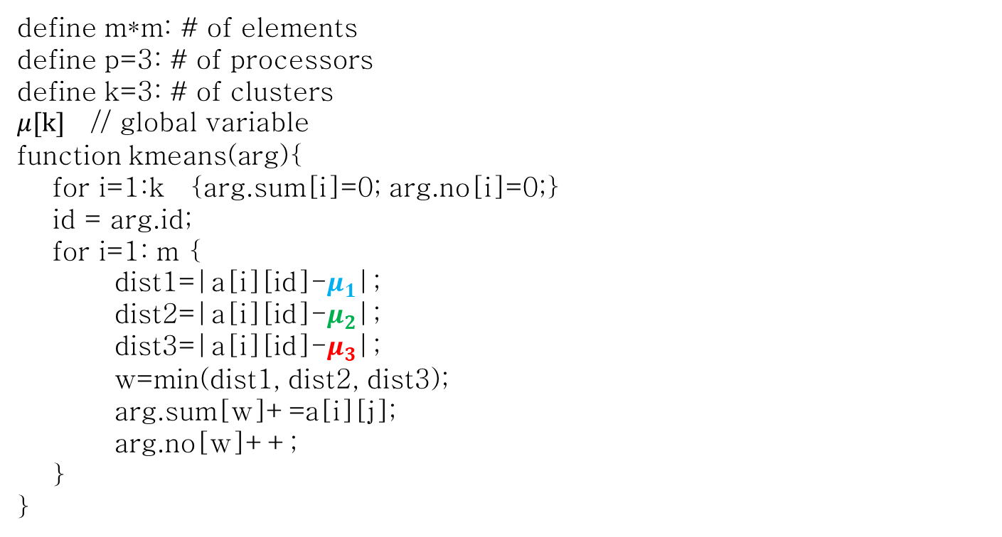
K-means (8)
Pseudo code
define m*m: # of elements
define p=3: # of processors
define k=3: # of clusters
$μ[k]$ // global variable
function kmeans(arg){
for i=1:k {arg.sum[i]=0; arg.no[i]=0;}
id = arg.id;
for i=1: m {
dist1=|a[i][id]-$μ_{1}$|;
dist2=|a[i][id]-$μ_{2}$|;
dist3=|a[i][id]-$μ_{3}$|;
w=min(dist1, dist2, dist3);
arg.sum[w]+=a[i][j];
arg.no[w]++;
}
}
Notes:
center

Slide 69
End of Discussion #3
Questions?

