Slide 1
My Project Going Open Source !
Include Docu-fiction videos
in digital History Textbooks

Slide 2
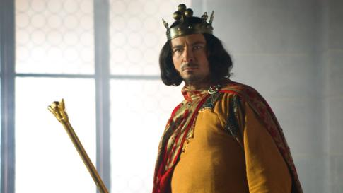
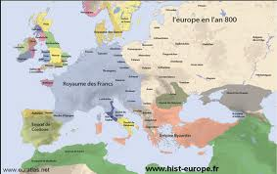

What is docu-fiction ?
+
=

Slide 3
Docu-Fiction make
History more attractive

Slide 4
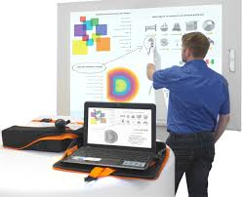
Digital is an opportunity
Cheaper means and easier tools to show images
Interactive White Board and projector

Slide 5
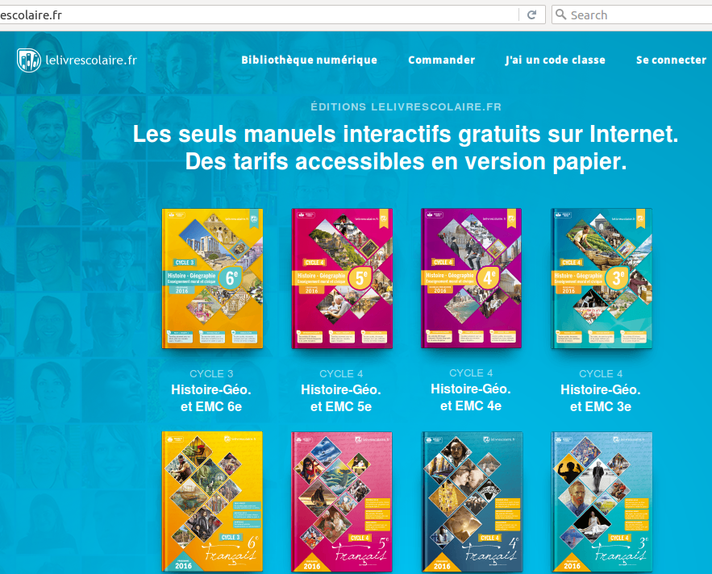

Digital Textbook : LeLivrescolaire.fr

Slide 6
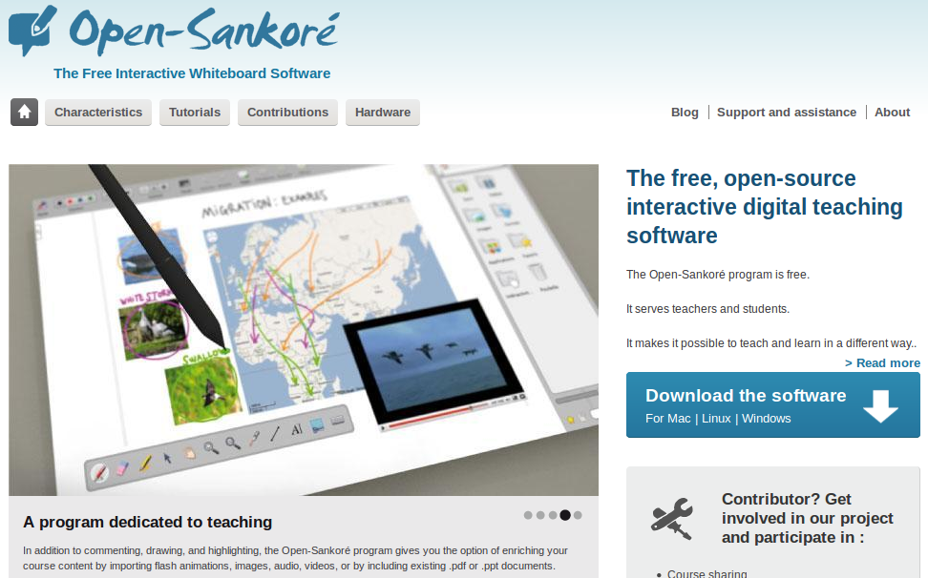
An Open Source Project

Slide 7
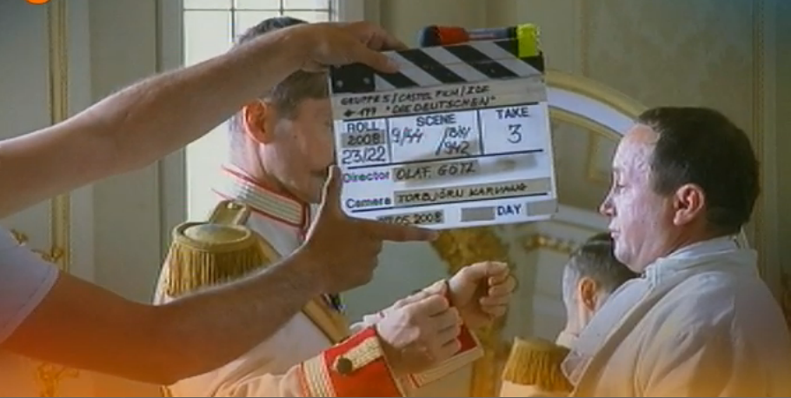
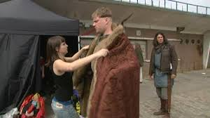

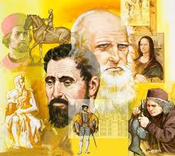
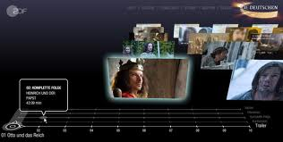
Let’s make History alive !

Slide 8
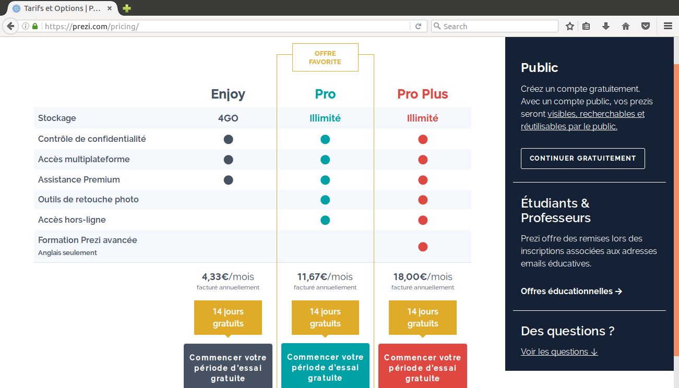
By the way… Prezi

Slide 9
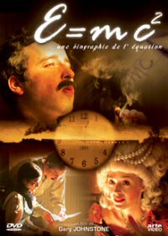
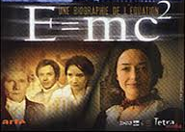
By the way...
Einstein and the world’s most famous Equation
Starring: A. Einstein, M.Faraday, Emilie du Châtelet, A-L Lavoisier, Lise Mietner...
https://www.youtube.com/watch?v=iJAP4-Gk6Nk

