Slide 1
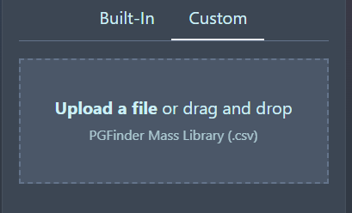
Database builder
MS analysis
MS/MS analysis
Building block components
(list of sugars and amino-acids)
Building block components
(list of sugars and amino-acids)
Building block components
(list of sugars and amino-acids)
Fragmentation Predictor
Standard sugars and amino acids 
Sugars
GlcNAc [g], MurNAc [m] and O-acetylated/de-N-acetylated derivatives [g(-Ac)], [m(-Ac)], [g(+Ac)], [m(+Ac)],
Amino acids
A,C,D,E,F,G,H,I,K,L,M,N,P,Q,R,S,T,V,W,Y
Diaminoacids
mDAP [J], Ornithine [O], diaminobutyric acid [B], threo-3-hydroxglutamate [X]
list of muropeptides (.csv )
Muropeptide list
E. coli (monomers; mDAP, D-Glu)
B. subtilis (monomers; mDAP_{NH2}, D-Glu)
C. difficile (monomers; GlcN, mDAP, D-Glu)
S. aureus (monomers; L-Lys, D-Gln, Gly₅ lateral chain)
E. faecalis (monomers; L-Lys, D-Gln, Ala₂ lateral chain)
E. faecium (monomers; L-Lys, D-Gln, Asp/Asn lateral chain)
Build database

Slide 2
Database builder
MS analysis
MS/MS analysis
Building block components
(list of sugars and amino-acids)
Building block components
(list of sugars and amino-acids)
Fragmentation Predictor
E. coli (mDAP, D-Glu)
B. subtilis (mDAP_{NH2}, D-Glu)
C. difficile (GlcN, mDAP, D-Glu)
S. aureus (L-Lys, D-Gln, Gly5 lateral chain)
E. faecium (L-Lys, D-Gln, D-Asp/Asn lateral chain)
E. faecalis (L-Lys, D-Gln, L-Ala₂ lateral chain)
list of muropeptides (.csv )
list of sugars and amino-acids (.csv )
Muropeptide list
E. coli (monomers; mDAP, D-Glu)
B. subtilis (monomers; mDAP_{NH2}, D-Glu)
C. difficile (monomers; GlcN, mDAP, D-Glu)
S. aureus (monomers; L-Lys, D-Gln, Gly₅ lateral chain)
E. faecalis (monomers; L-Lys, D-Gln, Ala₂ lateral chain)
E. faecium (monomers; L-Lys, D-Gln, Asp/Asn lateral chain)
Build database

Slide 3
Database builder
MS analysis
MS/MS analysis
Building block components
(list of sugars and amino-acids)
Building block components
(list of sugars and amino-acids)
Fragmentation Predictor
E. coli (mDAP, D-Glu)
B. subtilis (mDAP_{NH2}, D-Glu)
C. difficile (GlcN, mDAP, D-Glu)
S. aureus (L-Lys, D-Gln, Gly5 lateral chain)
E. faecium (L-Lys, D-Gln, D-Asp/Asn lateral chain)
E. faecalis (L-Lys, D-Gln, L-Ala₂ lateral chain)
list of muropeptides (.csv )
list of sugars and amino-acids (.csv )
Muropeptide list
list of muropeptides (.csv )
Build database

Slide 4
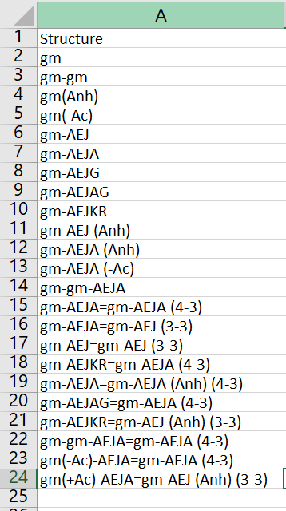
.csv files to download for users to amend
Buiding block components example
(mDAP, D-Glu)
Buiding block components example
E. coli muropeptide list

