Slide 1
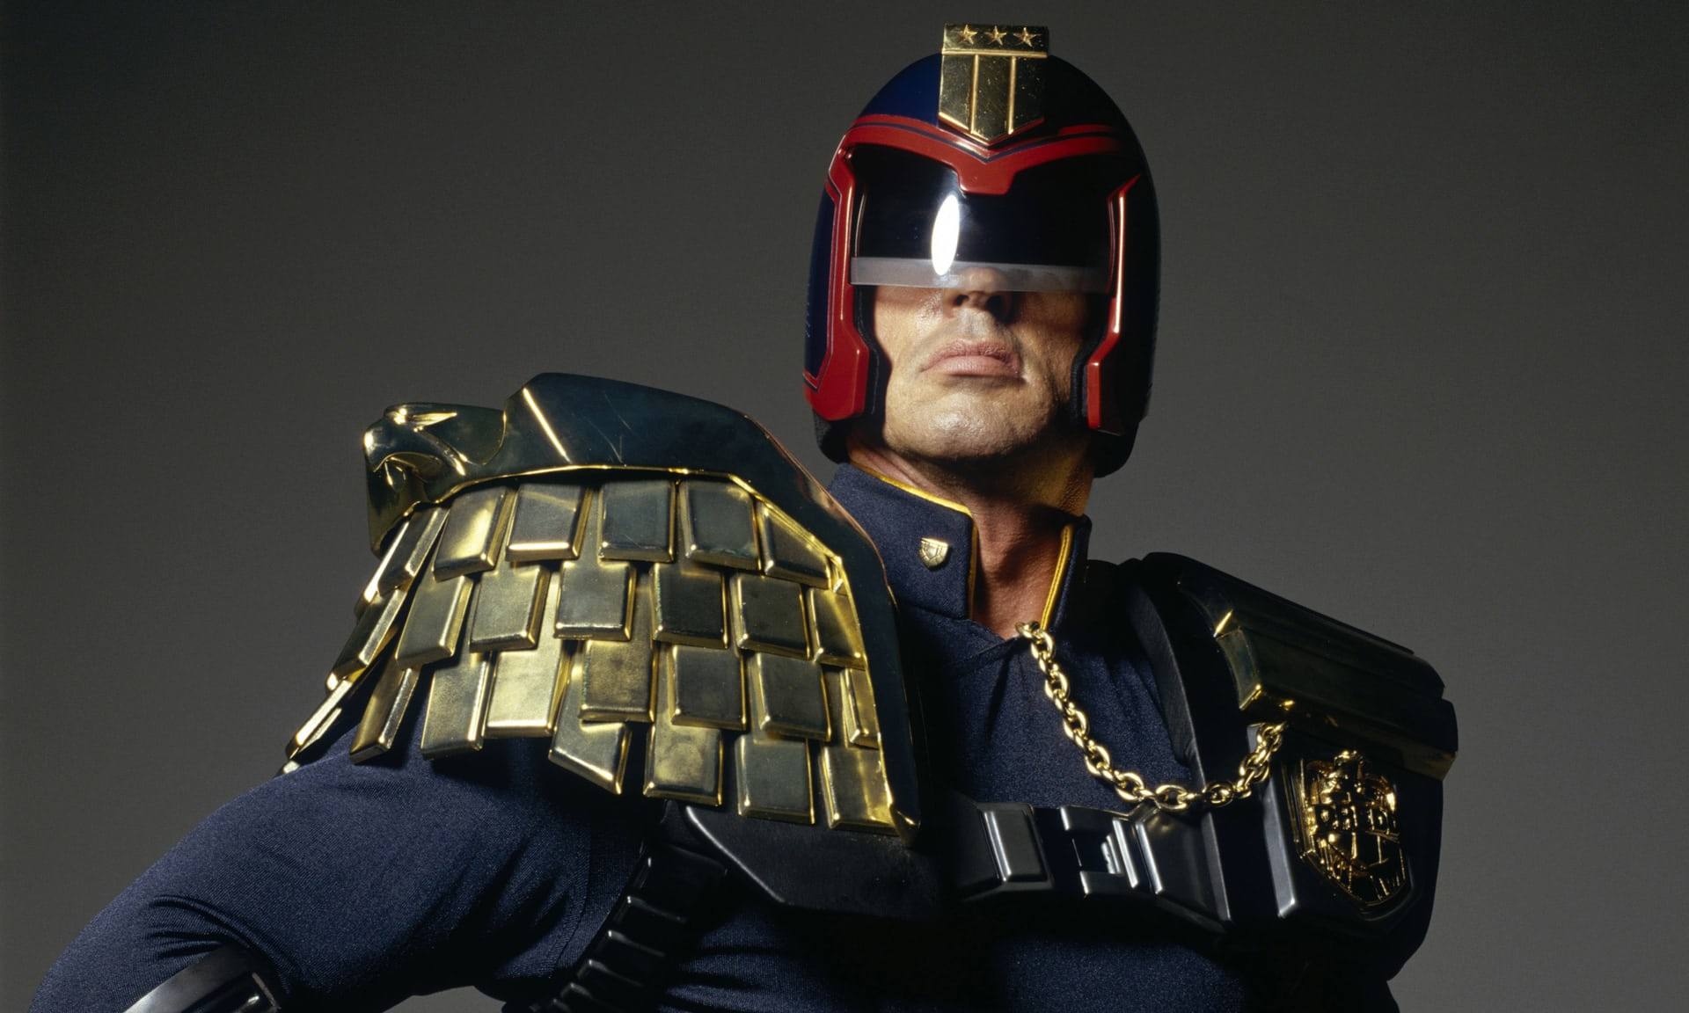
Future Factory –Team Dredd

Slide 2
WHY?
P1
P2
P3
Pn
The cost of failure further down the process chain is high !!!
CORRECT EARLY

Slide 3
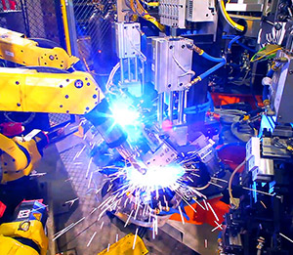
REAL LIFE PROBLEM
Millions of Sensors
Complexity increases
Accurately reproduce
Artificial intelligence

Slide 4
WHAT SHOULD OUR SOLUTION BE?
TECHNICAL SINGULARITY
MACHINE
LEARNING
SENSORS
ACTUATORS

Slide 5
UNIQUE SOLUTION
Sensors are N-Dimensional Arrays
GOOD OR BAD?
TRAININGDATA
AI
RESULT
DATA
Decision Tree Algorithm

Slide 6
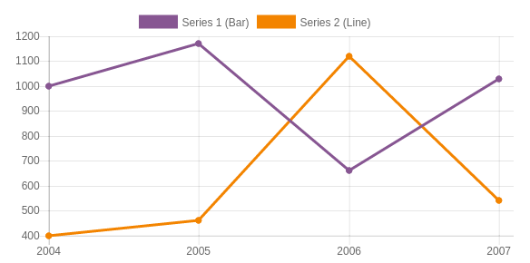
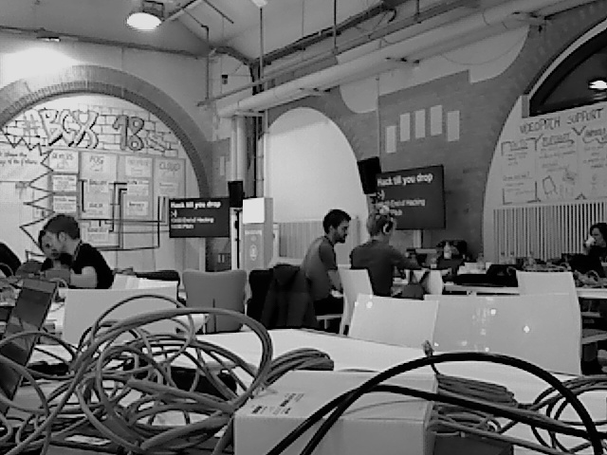

HOW?
Ultra Sonic Sensor
EDGE KIT
IoT GATEWAY
KAFKA
SERVER
DOCKER
BALLUFF
Webclient
NODE RED
Decision Tree
CAMERA

Slide 7









TECHNOLOGIES

Slide 8
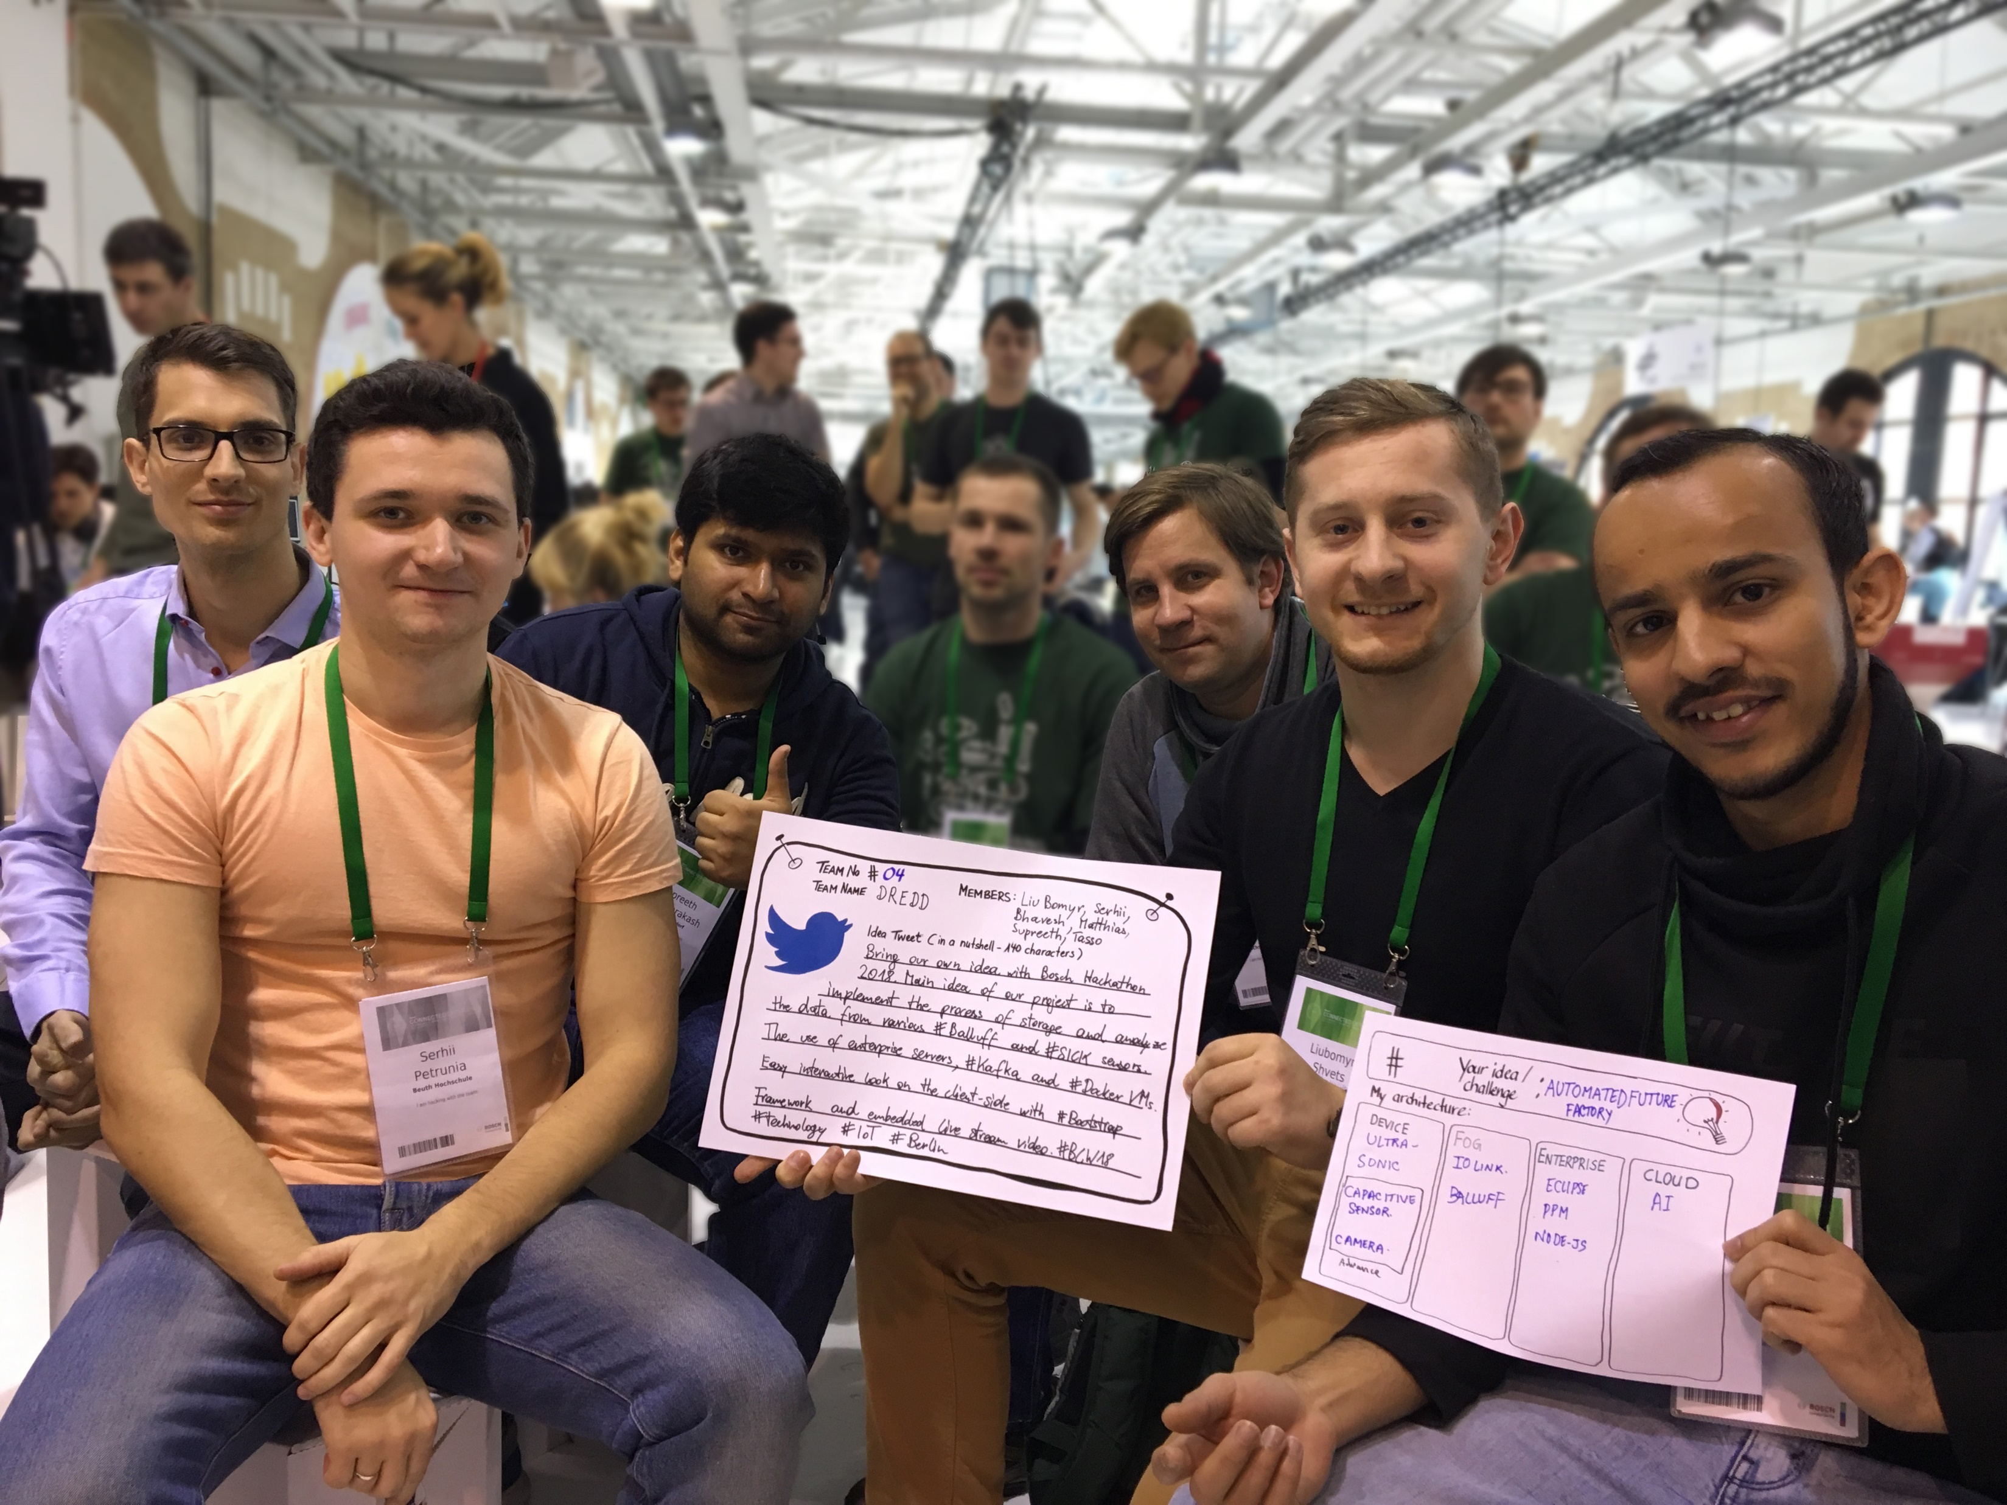
THANK YOU!
OUR TEAM:
Supreeth Raghuprakash
Liubomyr Shvets
Serhii Petrunia
Matthias Eckhart
Tasso Mulzer
Bhavesh Kumar

