Slide 1


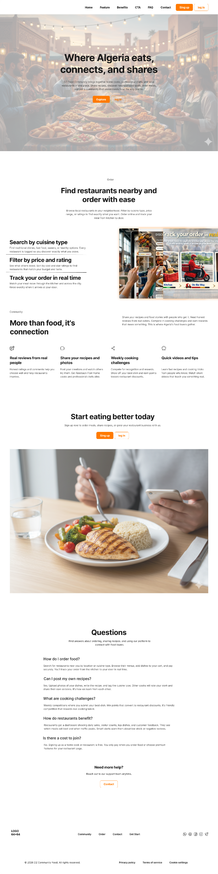
FeedMe
Platform
ESI - SIDI BEL ABBES
2025-2026

Slide 2


Our team members and supervisor:
Back-end Developer
Mosbah messaoud
m.mosbah@esi-sba.dz
Back-end Developer
Diaf wafaa
w.diaf@esi-sba.dz
Back-end Developer
Benaissa bochra nardjis
bn.benaissa@esi-sba.dz
Front-end Developer
Soualmi abdennour
a.soualmi@esi-sba.dz
Front-end Developer
Azeroual taha el amine
Te.azeroual@esi-sba.dz
UX/UI designer
Behlouli mohamed hassen
mh.behlouli@esi-sba.dz
Supervised by:
Dr. Djihed anani

Slide 3

Table of contents:
1-Introduction:
• Context and Problem Statement
• Our Solution
• Project Objectives
3-Technical Design and Implementation:
• Use Case Diagram
• Class Diagram
• Technologies and Tools
2-Conceptualization:
• Target Actors
• Core Features
4-Conclusion:
• Limitations
• Future Improvements
• What We’ve Learned
• Conclusion
• Thank You

Slide 4

Introduction:
Context and Problem Statement:
Algeria has a rich food culture yet none of it exists in one digital place.
No Community Space
Food conversations buried in unrelated social media
No Ordering Platform
Orders over phone no digital flow, no confirmation
No Digital Storefront
Restaurants have no dedicated space to showcase their menu, prices, or working hours

Slide 5

Our Solution:
FeedMe Discover, Order, Share, All in one single platform.
Food Ordering
Users browse the store, add items to cart, and place orders
Social Feed
Posts & reels from users and restaurants. Discover a place through its content, then order directly.
Community Q&A
Ask food questions, share recipes, get answers from the community.
Restaurant Tools
Managing restaurant’s information, products, and incoming orders.

Slide 6
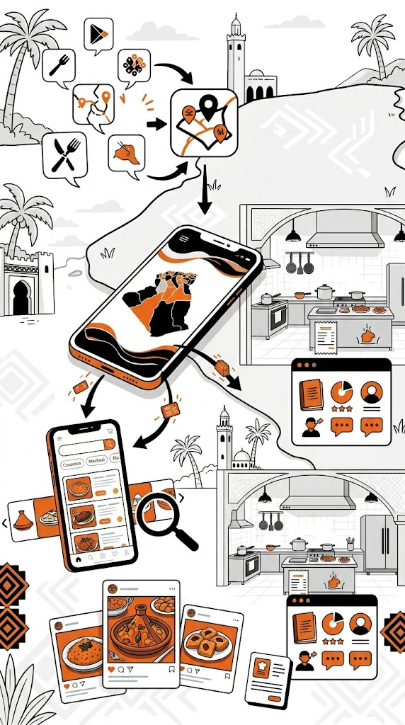
Project Objectives:
Unify the Algerian Food Experience
Bring social interaction, restaurant discovery, and food ordering into one cohesive platform eliminating fragmentation.
Empower Restaurant Businesses
Give restaurants a professional digital presence to manage menus, receive orders, and engage customers.
Enhance Food Discovery for Users
Make it easy to find restaurants and order food , filter by cuisine, and explore menus in an intuitive experience.
Foster a Culinary Social Community
Allow users and restaurants to share food content, recipes, and discoveries, celebrating Algerian food culture.

Slide 7
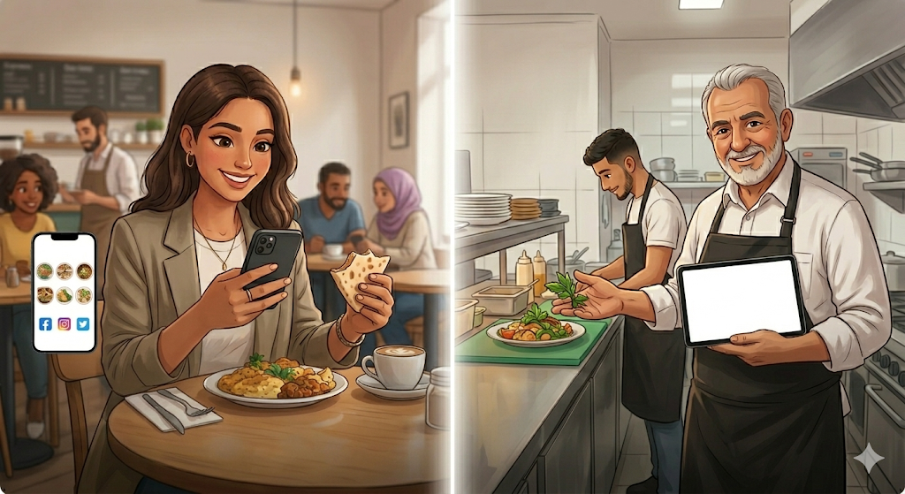
Target Actors:
Regular User
Everyday people who use FeedMe to discover
food and engage with the community. They're not
just consumers , they're active participants.
They order food, share their experiences through
posts and reels, ask and answer food questions
and shape the social dynamic of the platform
through their interactions.
Restaurant Owner
Businesses that come to FeedMe to build a real
digital presence.
They manage their restaurant profile, publish
their menu with full product details, process
incoming orders, and engage with the community.

Slide 8
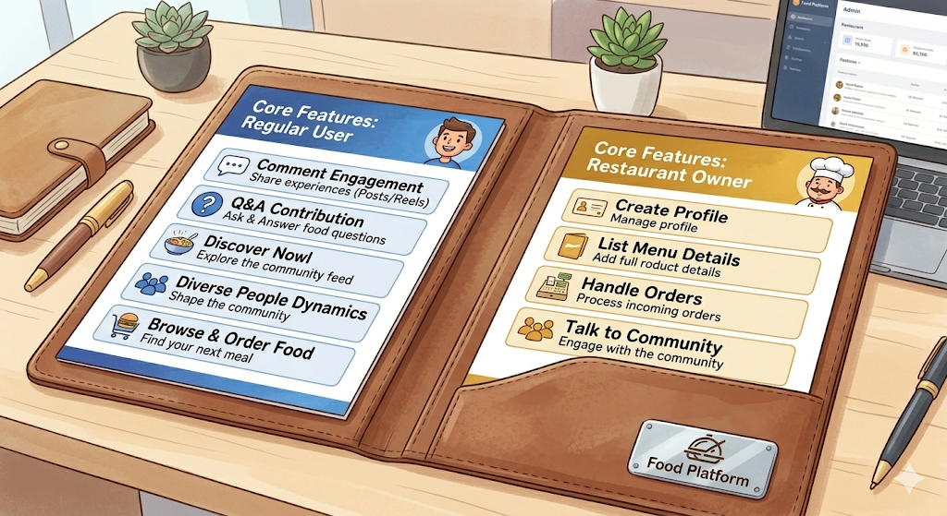
Core Features:
t
t
Both
Both
t
Both
Auth & Onboarding
Profile Management
Community Feed
Sign-up, email verification, secure login & password recovery
Edit personal info, photos & restaurant details. Updating sensitive data like email or password requires additional verification.
Posts & reels open to both users and restaurants. Like, comment, and discover restaurants directly through their content.
t
t
t
Restaurant
Both
User
Community Q&A
The Store
Product & Order Management
Ask or answer food questions regardless of role. Save questions to revisit later.
Browse products, search by name, filter by price & preparation time, add to cart, place an order and get a confirmation.
Add, edit, or delete products. View incoming orders by status and accept them from a dedicated dashboard.

Slide 9
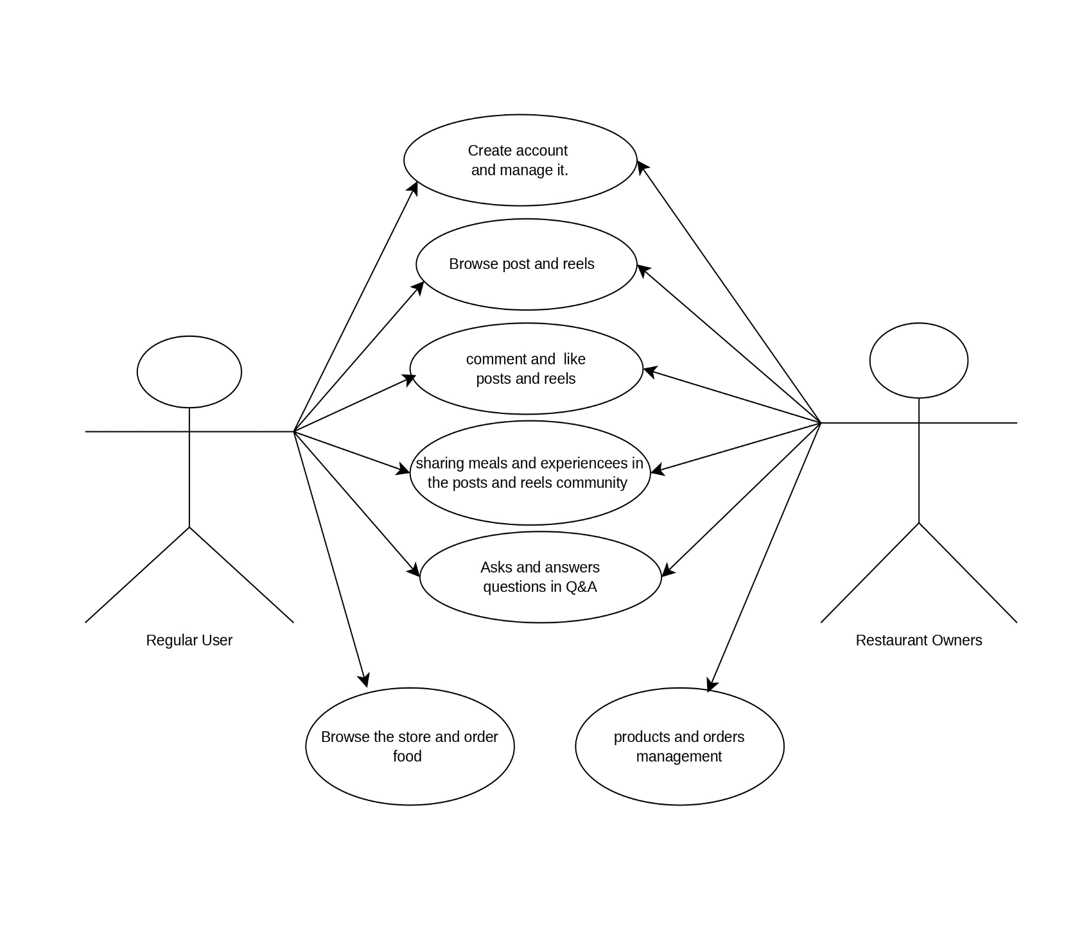
Use case diagram:

Slide 10
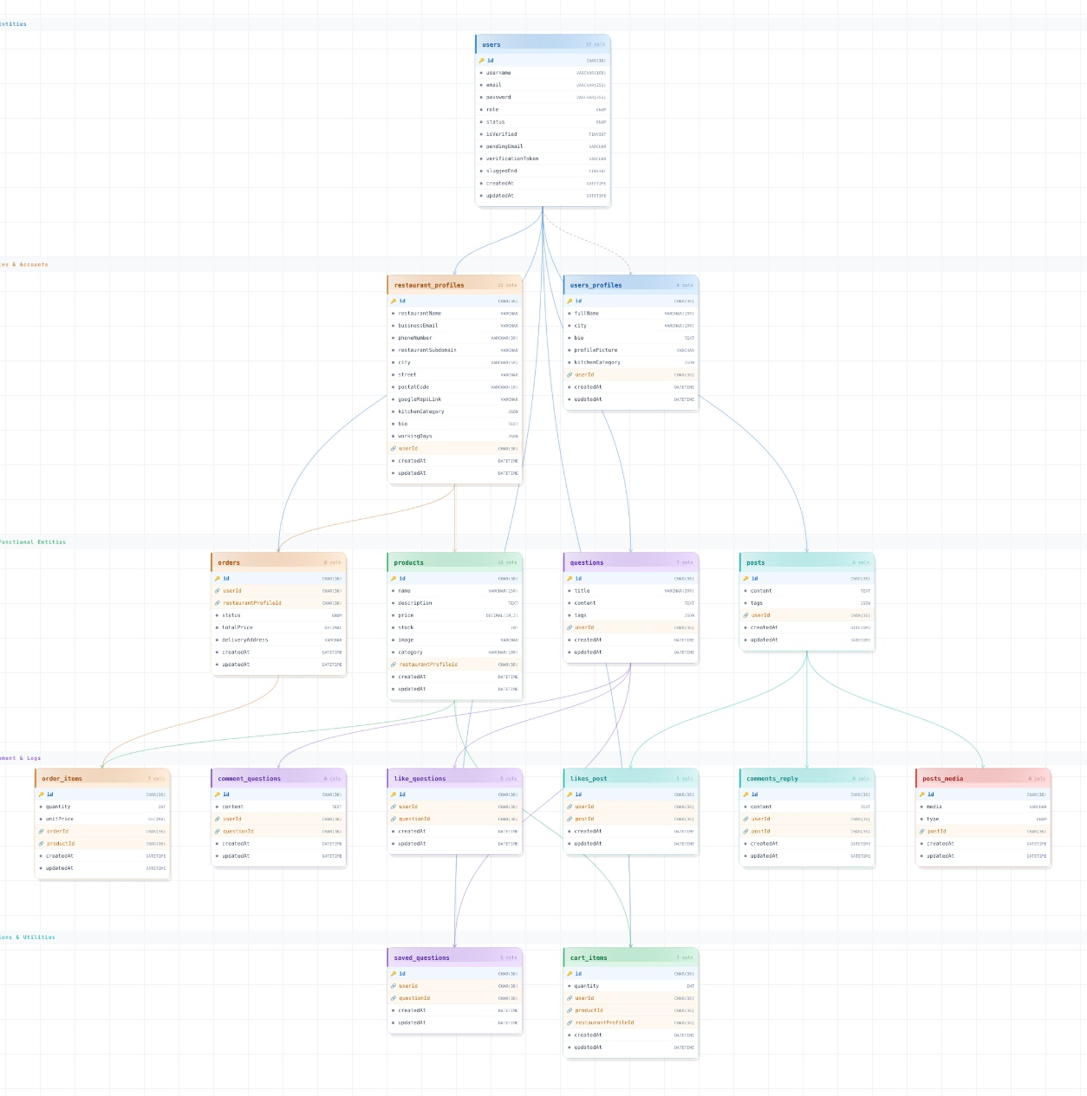
class diagram:

Slide 11









Technologies and Tools
Front-End
Communication
Back-End
Design

Slide 12
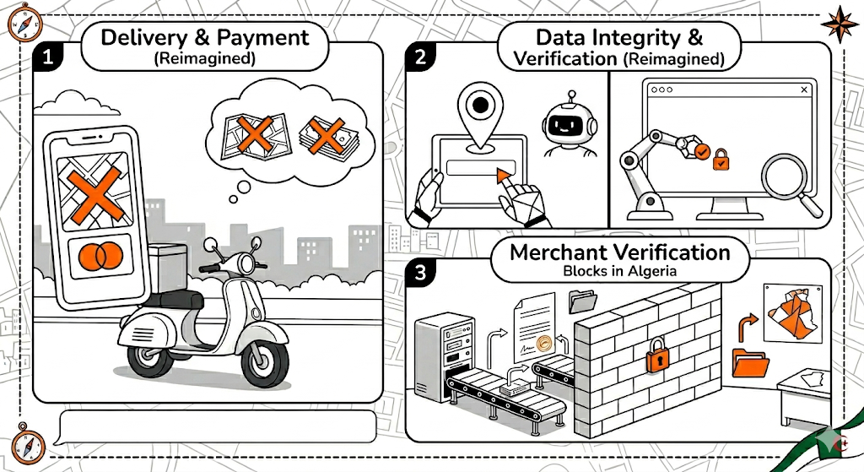
Platform limitations:
Delivery & Payment
No real time delivery tracking and no integrated payment gateway, The current order flow is a prototype .
Data Integrity
GPS coordinates rely on user input without automated validation, Community content lacks an automated moderation system.
Merchant Verification
Digital commerce in Algeria faces hurdles in verifying merchant legitimacy, The absence of a centralized national database makes automated commercial registry integration currently impossible.

Slide 13
Future Improvements :
Map Integration
GPS coordinates unlocking interactive maps and distance-based filtering.
Multi-Language Support
Arabic & French support for a genuinely inclusive Algerian platform.
Recommendation System
Analyze order history & behavior to surface personalized restaurants and dishes.
Real-time Notifications
Instant order alerts for restaurants; automatic status updates for customers.
Ratings & Reviews
Verified reviews locked to completed orders .
Admin Dashboard
Frontend for the existing admin endpoints.

Slide 14

What We've Learned:
Designing for Real Data
A poor schema decision spreads across the entire system.
Embracing Change
Our plan changed multiple times. Adapting quickly became one of our strongest collective habits.
Building as a Team
Coordinating six people taught us that communication is just as demanding as coding. Staying aligned on a shared vision is harder than it sounds.
Thinking Before Building
Asking why before how became our most valuable habit .

Slide 15
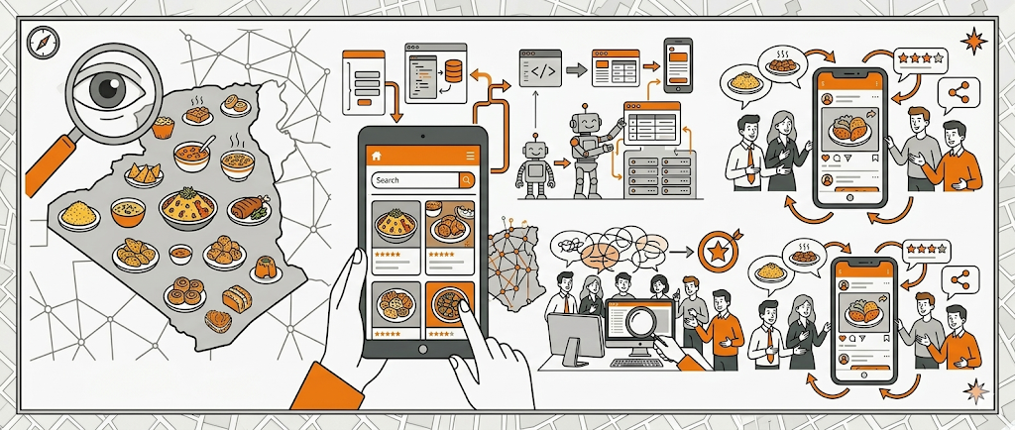
Conclusion
FeedMe began as an observation that Algeria had a rich food culture
with no digital home. Over one academic year, it became a working,
tested, and fully documented product. A platform where users
discover restaurants, place orders, share food content, and engage
with a community built around Algerian cuisine.

Slide 16

Thank You!

