Slide 1

Data Analytics & Visualization
Predicting Students’ Grades from Their Activities
Mohammad
Messbah Uddin

Slide 2
Research Questions To Be Answered
Does use of smartphone affect students’ academic performance? If so, how much?
Does students who feel lonely really do worse in exams compared to other students?
Does loneliness have any relationship with confidence?

Slide 3
Does use of smartphone affect students’ academic performance? If so, how much?
(Felisoni & Godoi, 2018) conducted a study that suggests, “It is more likely that a student who uses less his or her cellphone will have a higher grade than the one who uses more, given an equal performance in the college's entrance exam and same belief to self regulate their own studying.”
(Morphitou, 2014), (Kibona & and Mgaya, 2015), (Yi, et al., 2016) also mentioned the same.
Let’s test ourselves……

Slide 4
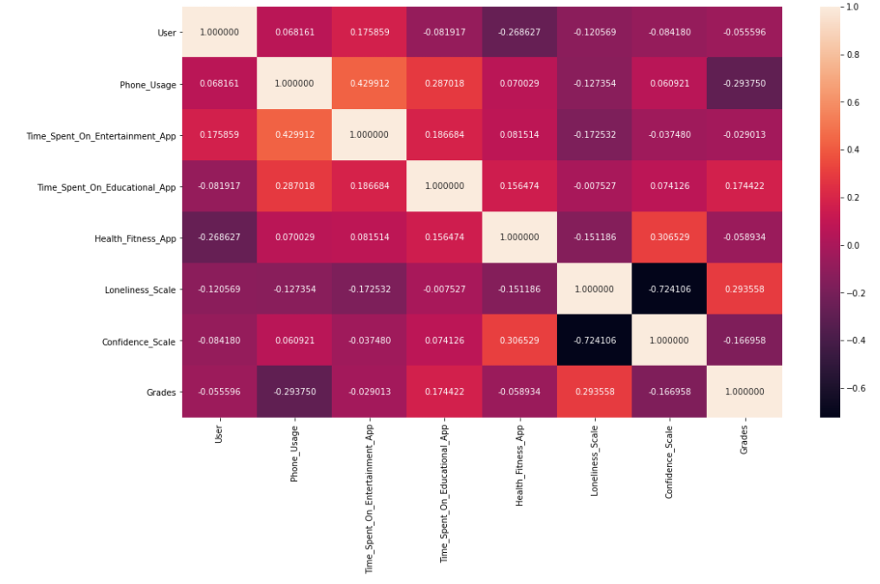
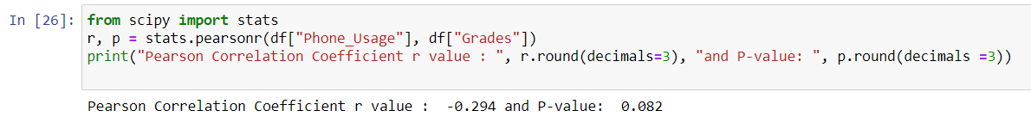
Does use of smartphone affect students’ academic performance? If so, how much?

Slide 5
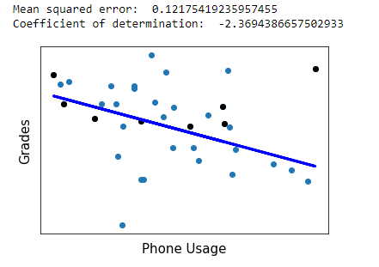
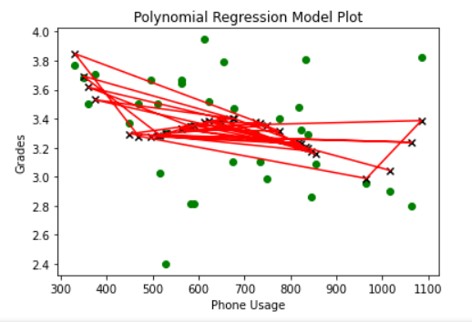
Does use of smartphone affect students’ academic performance? If so, how much?
Linear Regression
Polynomial Regression

Slide 6
Does students who feel lonely really do worse in exams compared to other students?
(Bek, 2017) said, “Students who feel lonely and isolated tend to spend their time idly and therefore do not thrive in academic environments.”
Vs
(Pervez, 2018) infers, “There is a definite but low and positive overall correlation exists between Loneliness and Academic Achievement.”

Slide 7
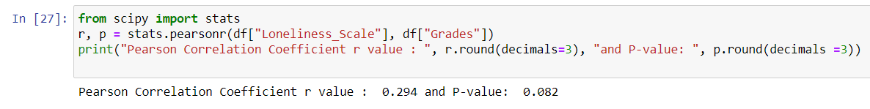
Does students who feel lonely really do worse in exams compared to other students?

Slide 8
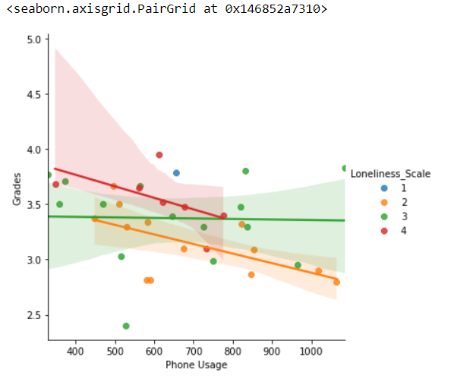
Does students who feel lonely really do worse in exams compared to other students?
Never feels lonely
Rarely feels lonely
Sometimes feels lonely
Very often feels lonely
Multiple Variable Regression

Slide 9
Does loneliness have any relationship with confidence?
Loneliness can be attributed to low self-esteem and lack of confidence. (Jane Keogh)

Slide 10
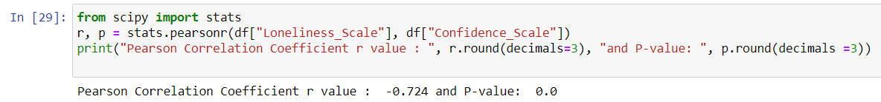
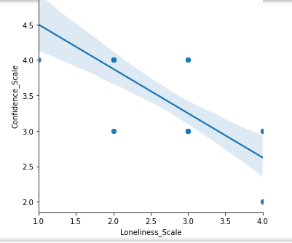
Does loneliness have any relationship with confidence?
So yes, Loneliness is inversely proportional to confidence to some extent.

Slide 11
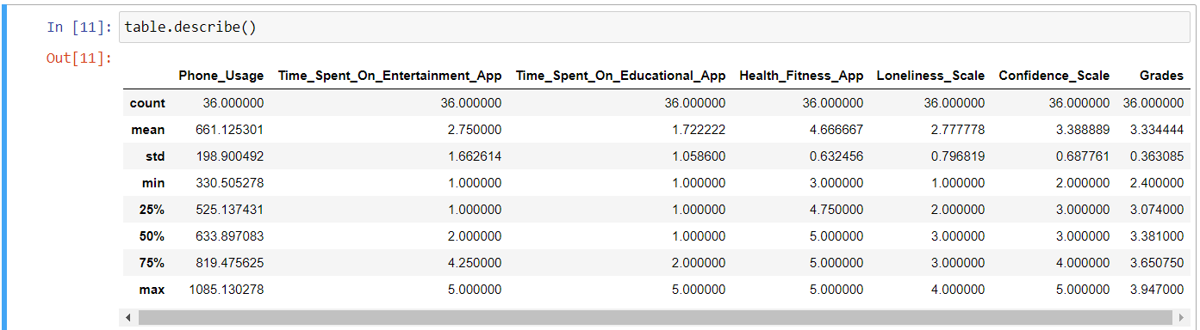
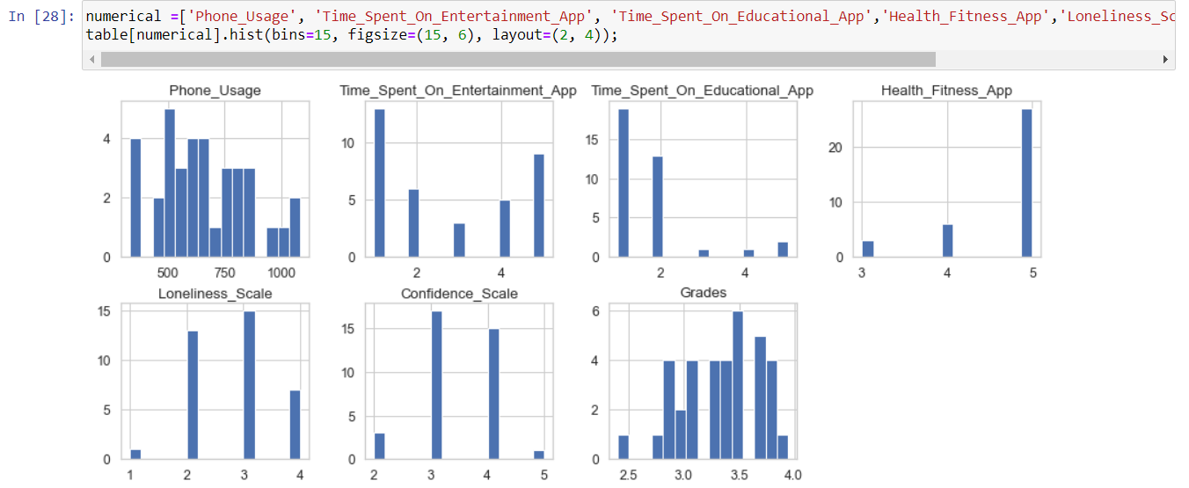
Other Findings:
Here 5 means Students spent way too much time whereas 1 means almost no time was spent

Slide 12
Limitations: -lack or necessary data. -Missing grades
Future Work: -more parameters like food habit, study time, gossiping time, etc. can be taken into account so that the prediction becomes more accurate.
-an application can be developed accordingly that will alert students when they exceed a limit on any activity that may severely affect his grade or health.

Slide 13

Thank you

Slide 14
References:
Felisoni, D. D. & Godoi, A. S., 2018. Cell phone usage and academic performance: An experiment. Computers & Education, 117(0360-1315), pp. 175-187.
Morphitou, R. N., 2014. The use of smartphones among students in relation to their education and social life. 2014 International Conference on Interactive Mobile Communication Technologies and Learning (IMCL2014), pp. 315-319.
Pervez, S. I., 2018. The relationship between Loneliness and Academic Achievement: A study on Undergraduate level students.. International Journal of Creative Research Thoughts (IJCRT), 6(1), pp. 1302-1305.
Bek, H., 2017. Understanding the Effect of Loneliness on Academic Participation and Success among International University Students. Journal of Education and Practice, 8(14), pp. 46-50.

