Slide 1
Customer Conversion Prediction
Presented by
Pallavi paramita Nayak
Wahid
Viyas Jee
Junmani

Slide 2
Problem Statement
We are working for a new-age insurance company and employ multiple outreach plans to sell term insurance to your customers. Telephonic marketing campaigns still remain one of the most effective way to reach out to people however they incur a lot of cost.
Hence, it is important to identify the customers that are most likely to convert beforehand so that they can be specifically targeted via call. We are given the historical marketing data of the insurance company and are required to build a ML model that will predict if a client will subscribe to the insurance.

Slide 3
Introduction
The goal was to predict whether a client will subscribe to the insurance based on historical marketing data of the insurance company.
It is a supervised learning problem - We are predicting target variable. From target varible we can clearly understand it is a classification problem From target variable we can tell it is a binary classification problem. target = (y/n)
Features considered were age (numeric), job: type of job, marital: marital status, educational_qual: education status, call_type: contact communication type, day: last contact day of the month (numeric), mon: last contact month of the year, dur: last contact duration, in seconds (numeric), num_calls: number of contacts performed during this campaign and for this client, prev_outcome: outcome of the previous marketing campaign (categorical: "unknown", "other", "failure", "success"
Output Variable (Desired Target): y - has the client subscribed to the insurance?

Slide 4
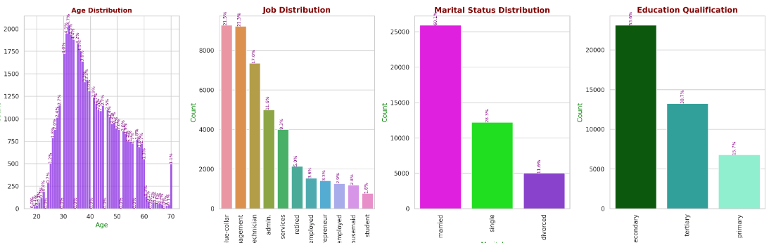
Data Preprocessing :
Data Cleaning: handling missing or duplicate data, correcting data types, and removing outliers or irrelevant information, finding Unique Values of Categorical Column etc. , removal of incorrect or wrong data that is spelling mistake, upper case and lower case mismatch of each values.
Exploring the Dataset and replace the unknown values: conversion of categorical Target column into numerical column, removal of unkown based on percentage etc.
Outlier Deduction and Correction:
Z-Score Z-Score(x)=(x-mean(x)) / SD(x) Threshold Limit Z-Score > 3 and Z-Score < -3 ---> Outlier
IQR IQR = Q3(75%)-Q1(25%) Upper Threshold = Q3 + (1.5 * IQR) Lower Threshold = Q1 - (1.5 * IQR)
Plotting Box Plot
Correction: deletion / clip / strip
EDA - Exploratory Data Analysis: Distribution of Feature and Target variable

Slide 5
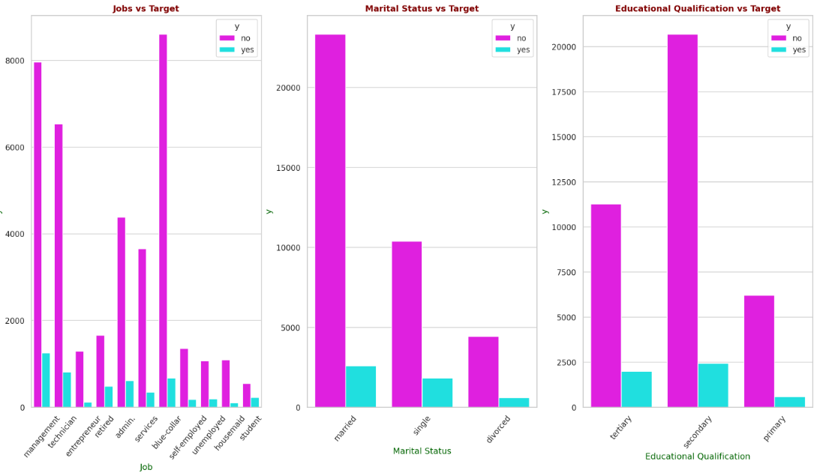
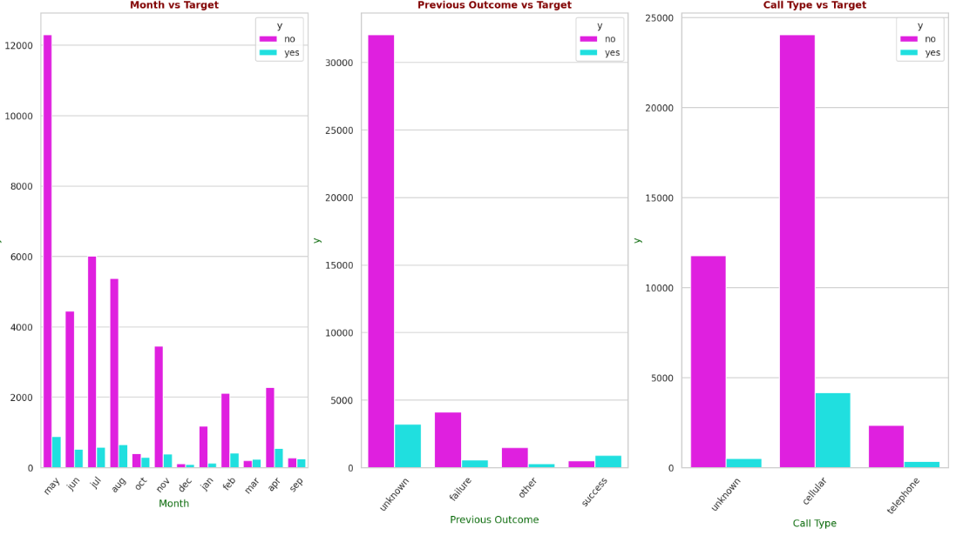
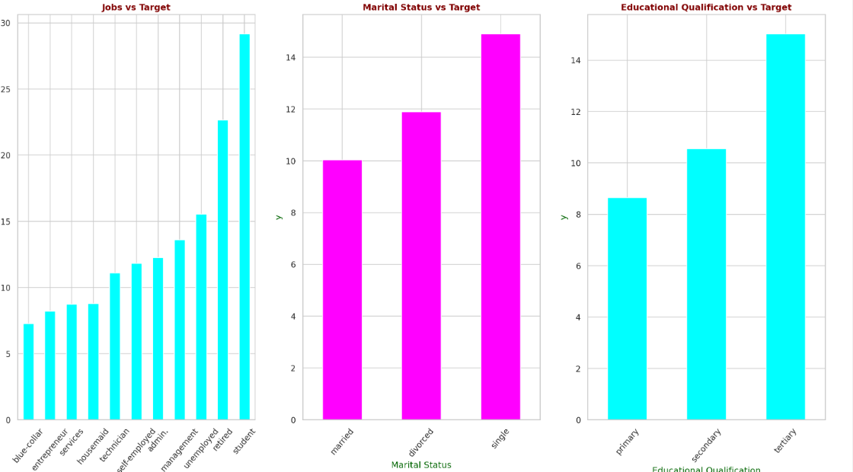
Features vs Target
Categorical Variable vs Target (Categorical) -- Job, Marital, Educational Qualification, Call Type, Month
Features vs Target Distribution - Percentage of people Subscribed

Slide 6
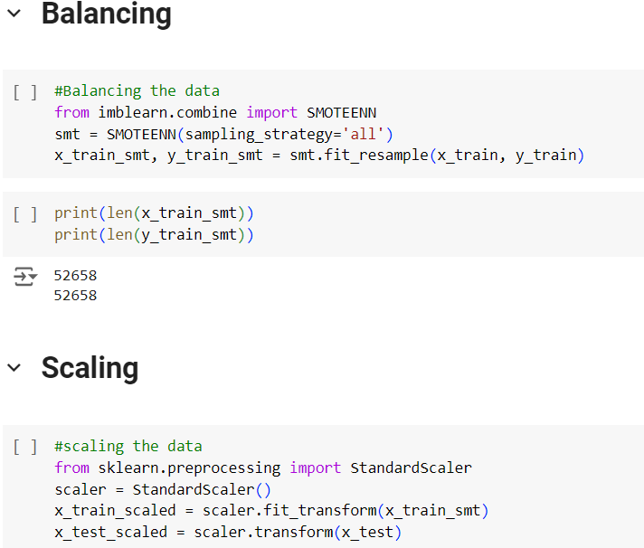
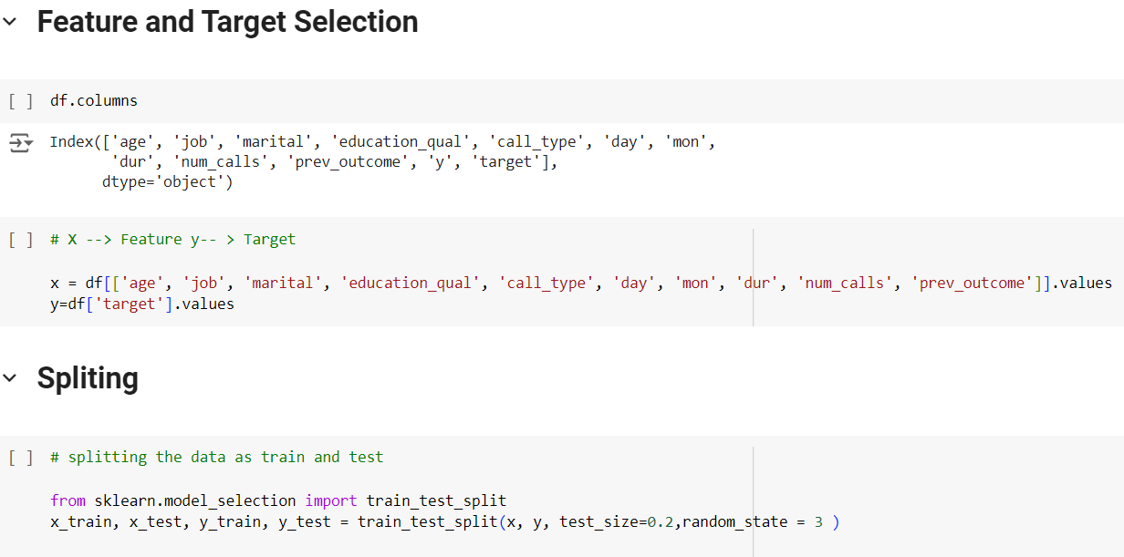
Balancing | Scaling | Feature and Target selection

Slide 7
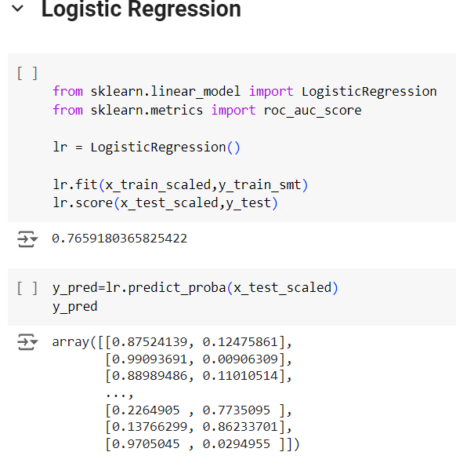
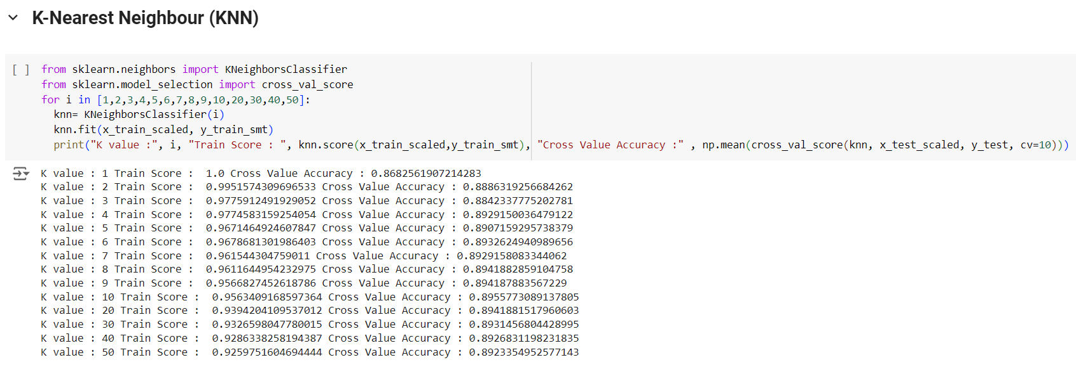
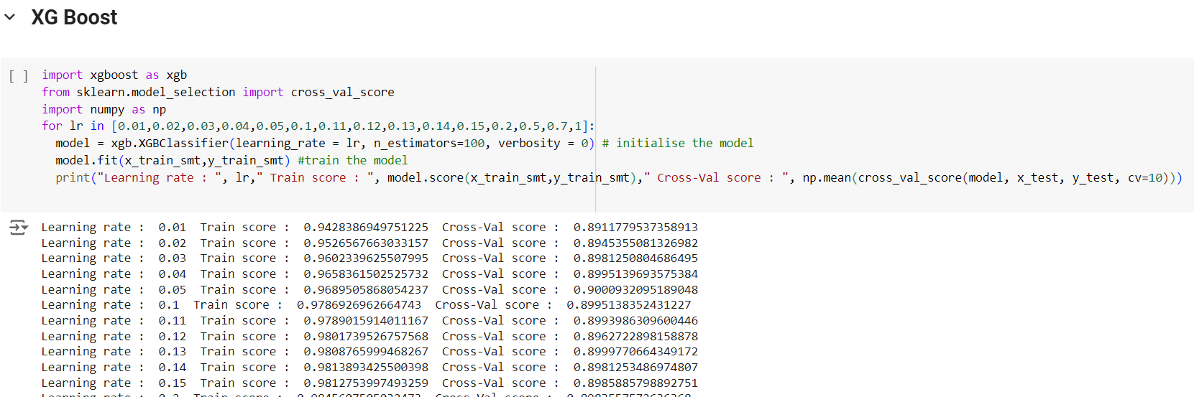
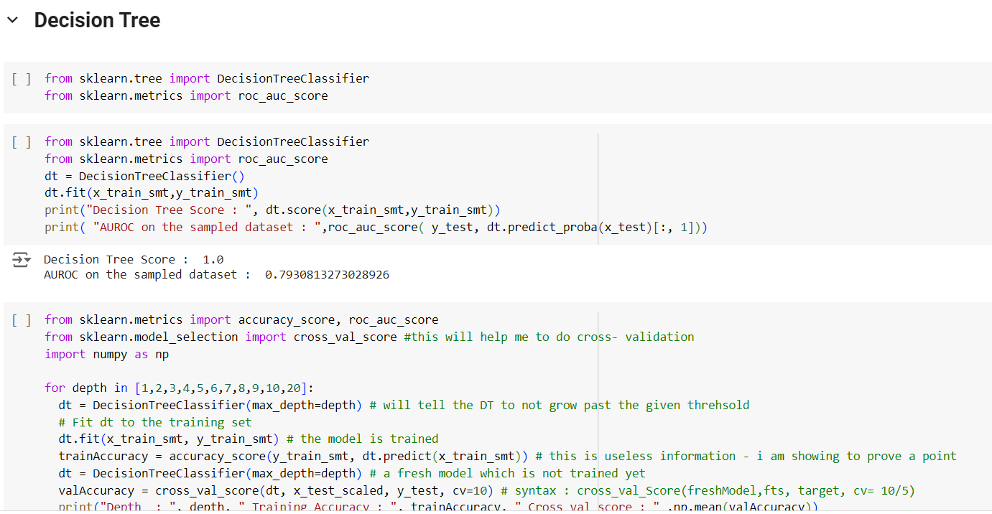
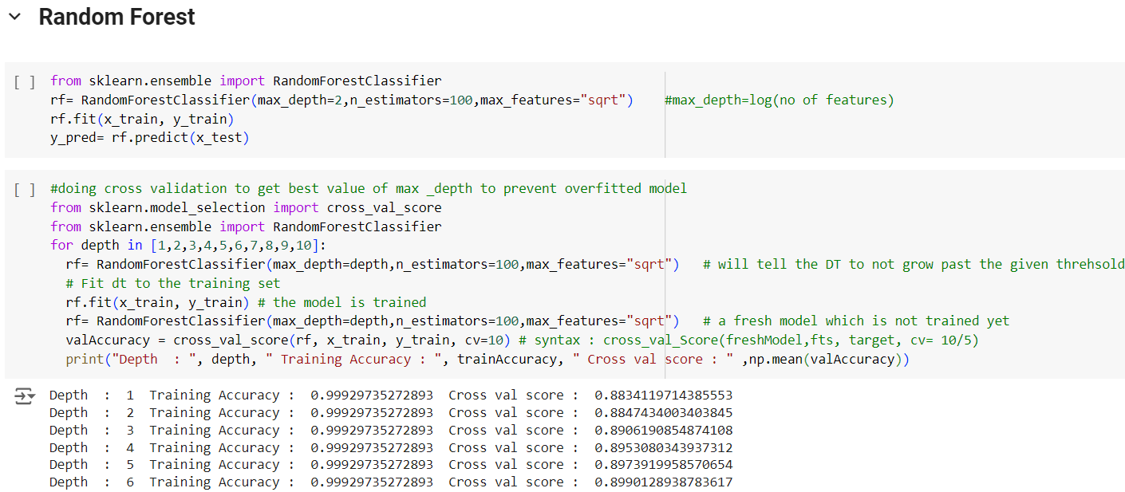
Modelling

Slide 8
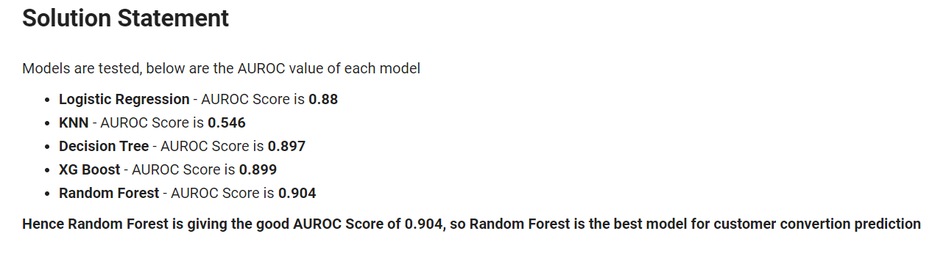
Modelling and AUROC score
It is not sufficient to just fit a model; the model must be analyzed to find the important factors that contribute to the conversion rate. AUROC must be used as a metric to evaluate the performance of the models.

Slide 9
Solution Statement
Models are tested, below are the AUROC value of each model
Logistic Regression - AUROC Score is 0.88
KNN - AUROC Score is 0.895
Decision Tree - AUROC Score is 0.897
XG Boost - AUROC Score is 0.899
Random Forest - AUROC Score is 0.904
Hence Random Forest is giving the good AUROC Score of 0.904, so Random Forest is the best model for customer convertion prediction

Slide 10
Conclusion:
Based on the Feature Importance given by best machine Learning that will predict if a client subscribed to the insurance.
The client should focused on the top few features of order given below to have them subscribed to the insurance.
Duration - Longer the call better influncing the clients
Age - Age of the person plays an important role in insurance. Middle age people are targeted more and people who suscribed to insurance also middle age people.
Day - People who subscribed to insurance are mostly mid of the month.
Month - In the month of may people subscribed to insurance are more.
Job - In this blue collar people are targeted more but people who subscribed more are from management job.

Slide 11
Further Scope
The current project has successfully built and evaluated a machine learning model to predict whether a customer will subscribe to an insurance policy. However, there is still room for improvement and further scope in this project, which includes:
Feature Engineering: The current dataset includes limited features, and feature engineering could be performed to extract more relevant features from the given data or other external sources, which could enhance the model's performance.
Hyperparameter Tuning: Hyperparameter tuning of the model could be performed to optimize its performance further. By varying the hyperparameters of the model and evaluating its performance, we could achieve better results.
Exploratory Data Analysis (EDA): Exploratory data analysis could be performed on the data to gain insights into the customers' behavior, which could help in understanding the customers' preferences, demographics, and other characteristics that influence their decision-making.
Model Comparison: In addition to the models evaluated in this project, other classification models could also be implemented and compared to identify the best performing model for this problem.
Regular Maintenance: As the company's customer base grows and changes, the model's performance might degrade. Regular monitoring and maintenance of the model are necessary to ensure it continues to perform effectively.

