Slide 1
WF results varying number of target sites & fitness cost at each site

Slide 2
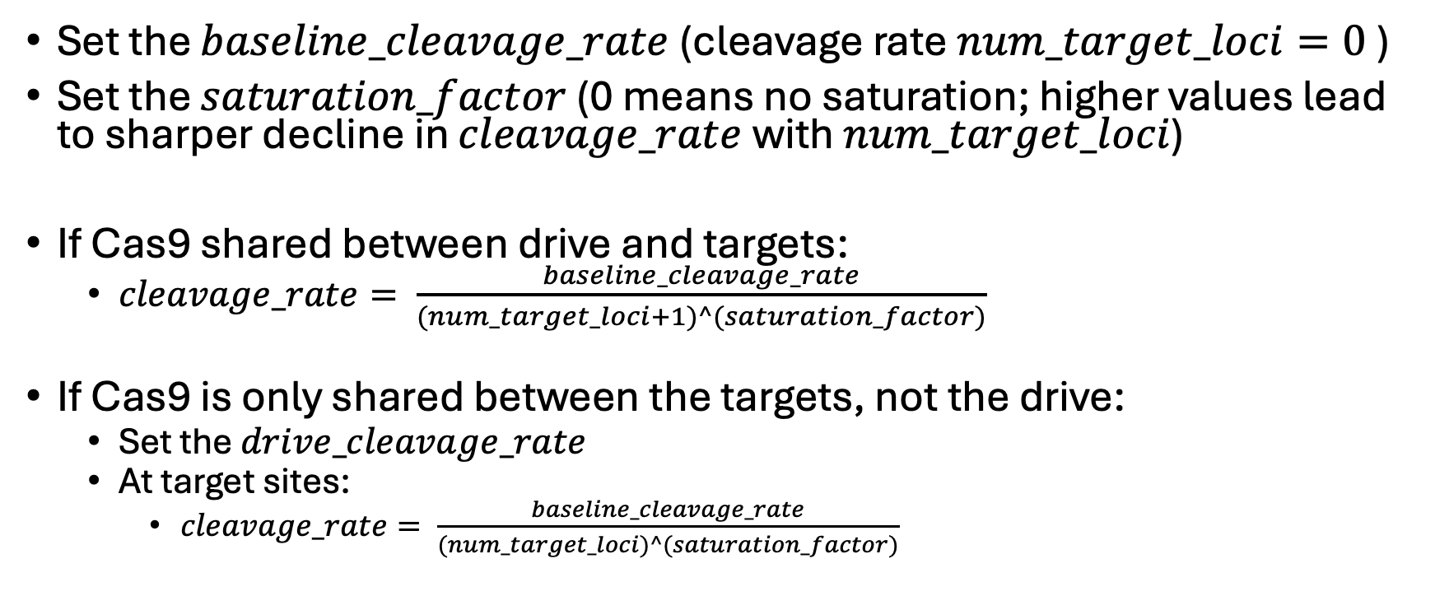
Proposed Cas9 saturation equation
Set the $baseline_cleavage_rate$(cleavage rate $num_target_loci=0$)
Set the $saturation_factor$(0 means no saturation; higher values lead to sharper decline in $cleavage_rate$with $num_target_loci$)
If Cas9 shared between drive and targets:
$cleavage_rate= \frac{baseline_cleavage_rate}{(num_target_loci+1)^(saturation_factor)}$
If Cas9 is only shared between the targets, not the drive:
Set the $drive_cleavage_rate$
At target sites:
$cleavage_rate= \frac{baseline_cleavage_rate}{(num_target_loci)^(saturation_factor)}$

Slide 3
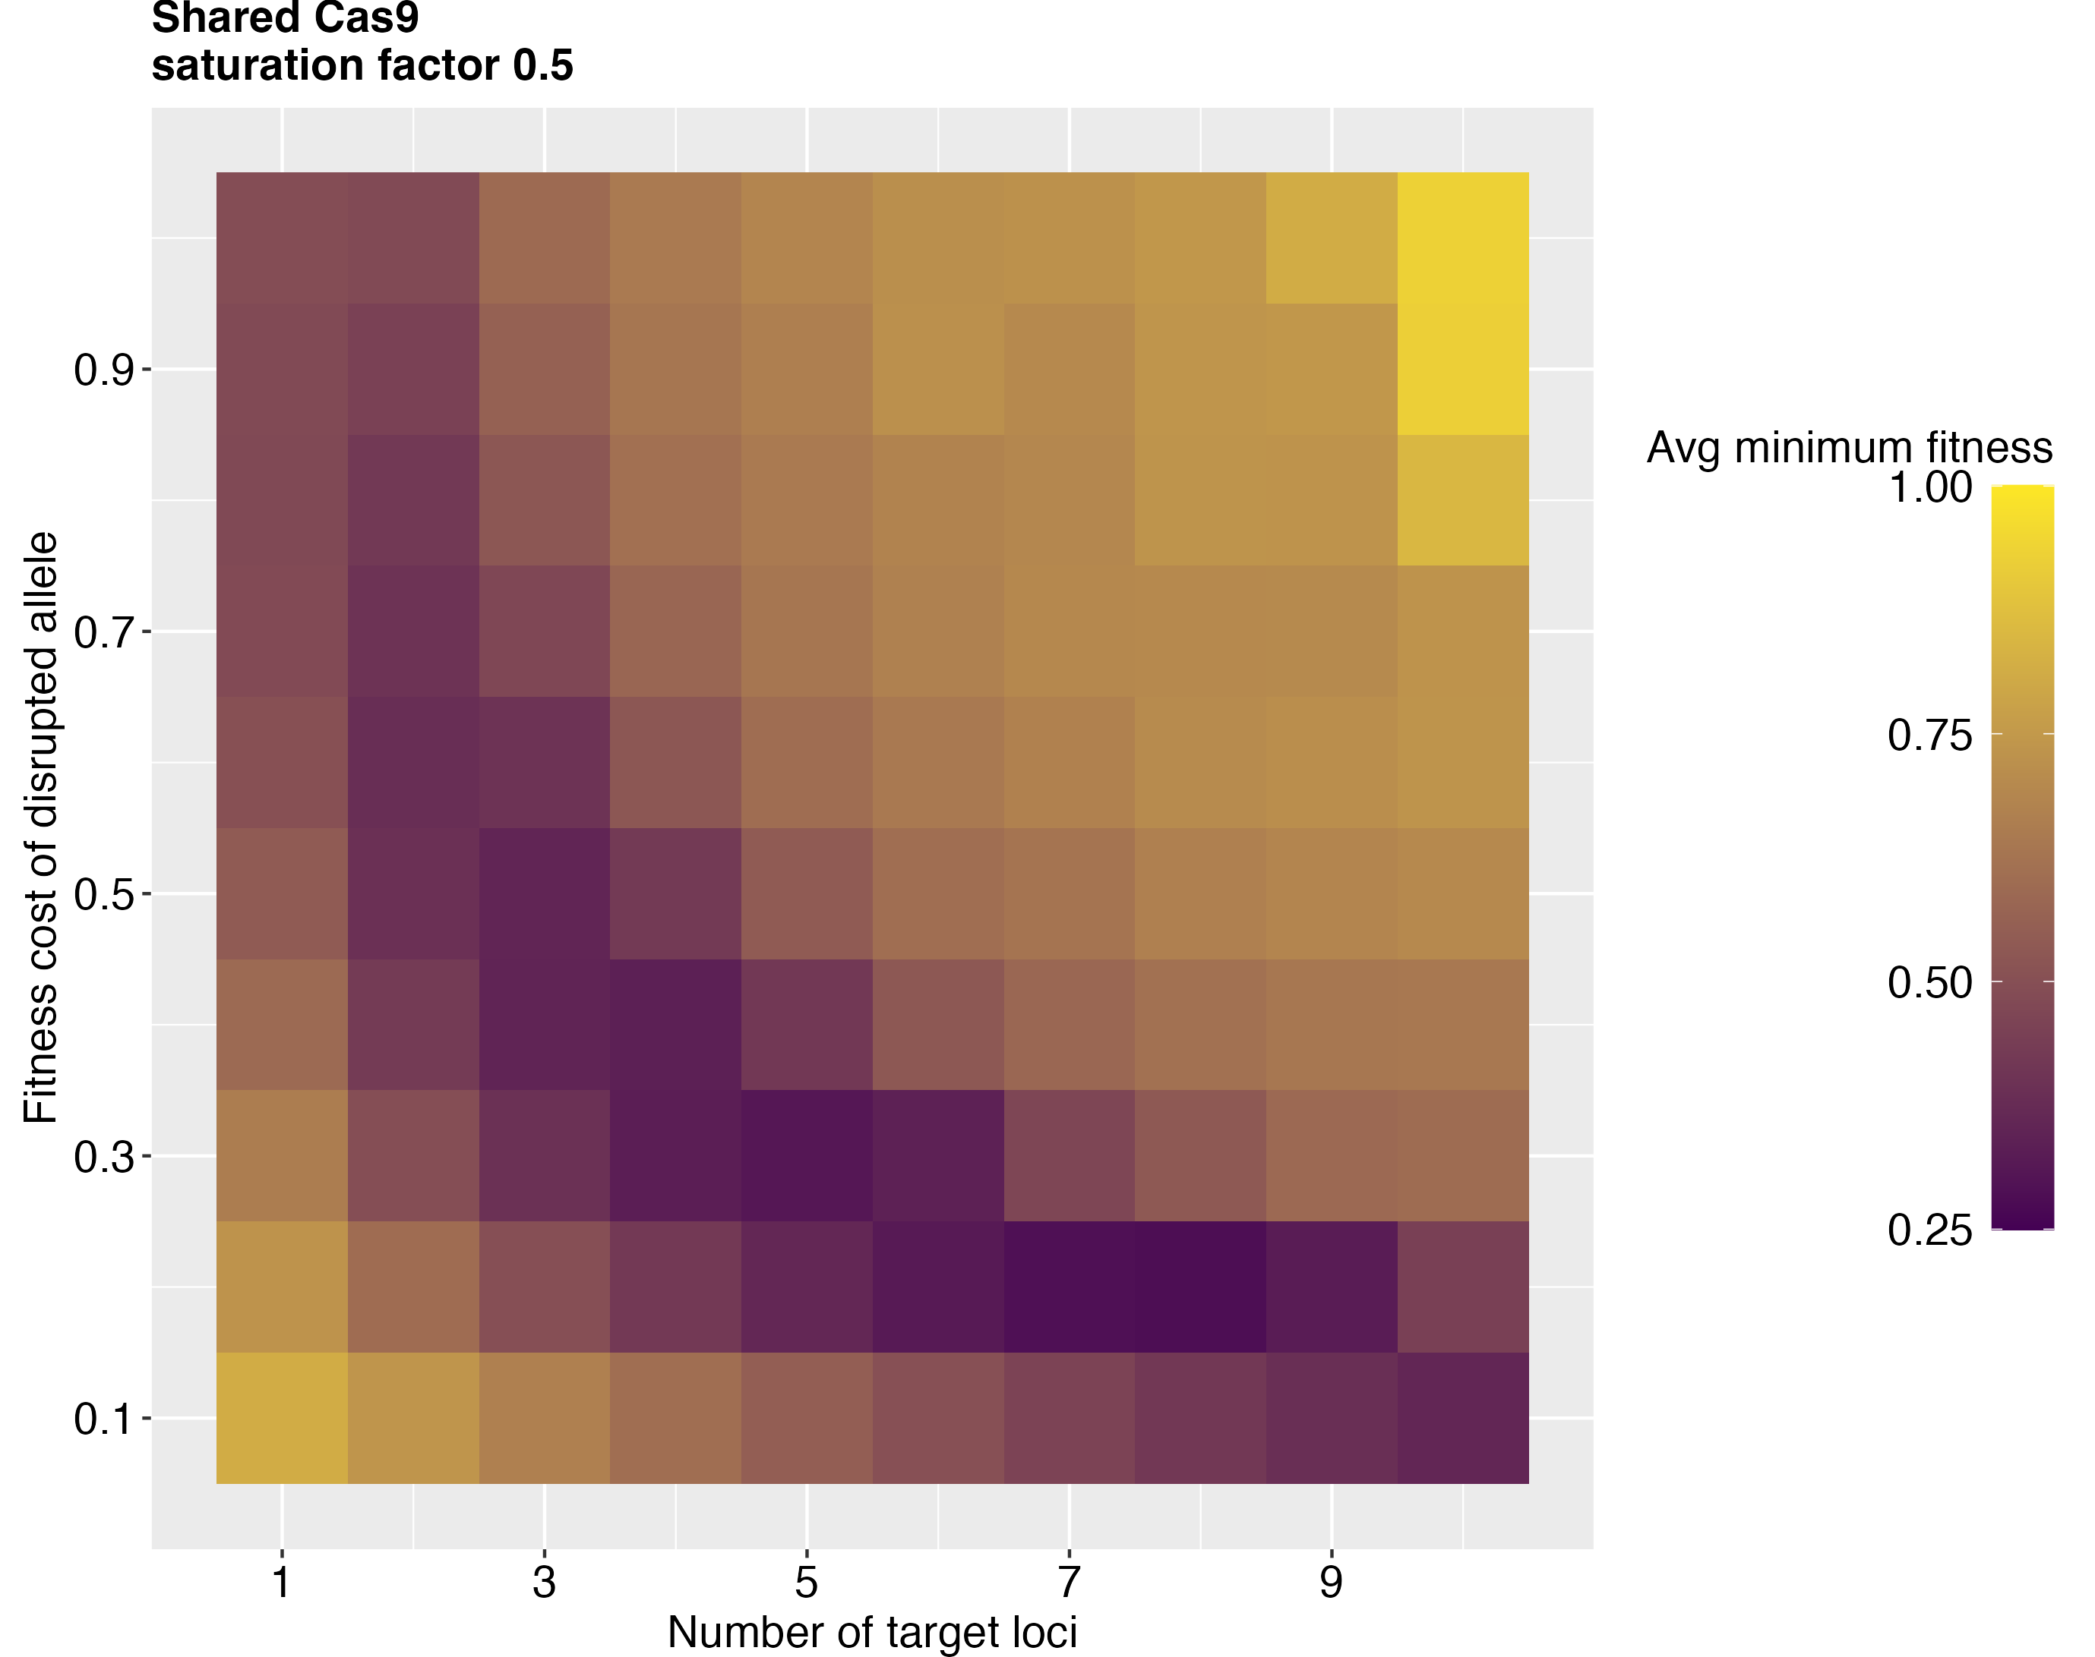
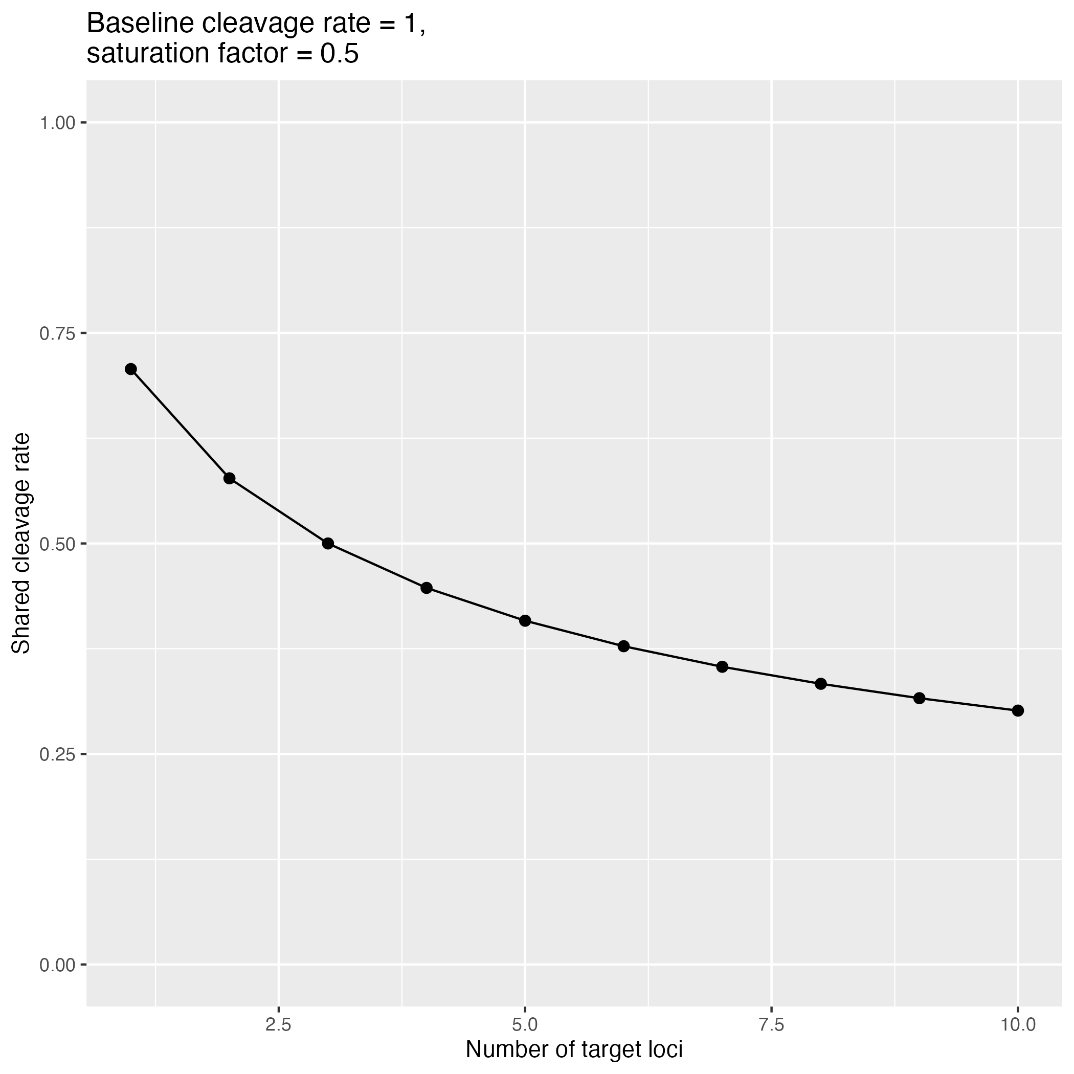
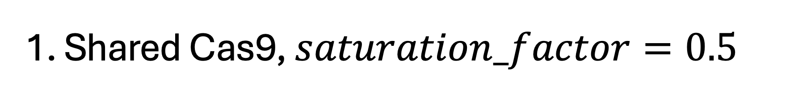
1. Shared Cas9, $saturation_factor=0.5$
Notes:
Tradeoff: more target loci → greater potential fitness cost but lower cleavage rate and conversion rate at the drive locus
Drive also gets this cleavage rate

Slide 4
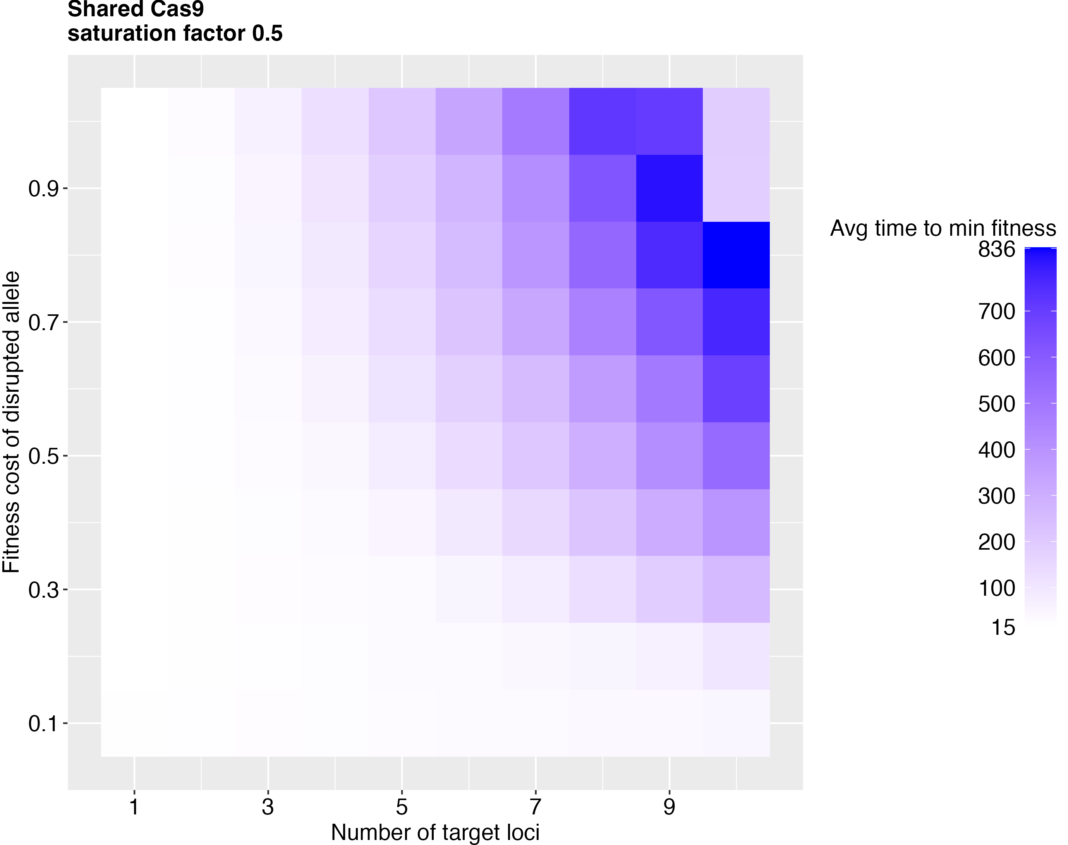
1. Shared Cas9, $saturation_factor=0.5$
Notes:
Tradeoff: more target loci → greater potential fitness cost but lower cleavage rate and conversion rate at the drive locus
Drive also gets this cleavage rate

Slide 5
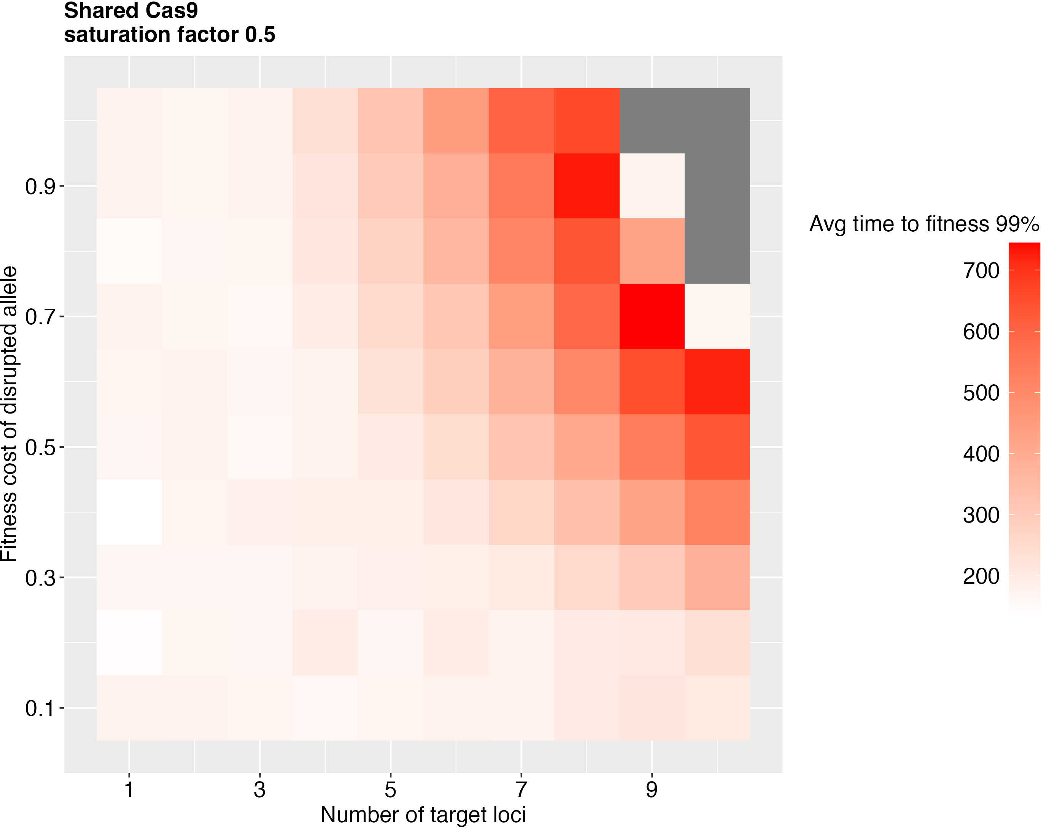
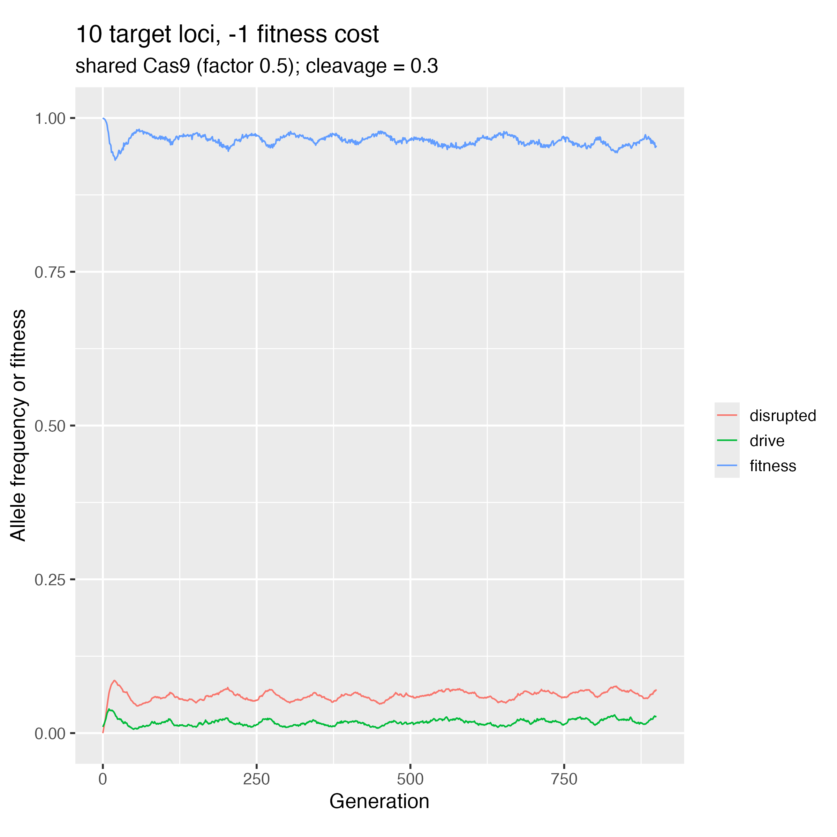
1. Shared Cas9, $saturation_factor=0.5$
Notes:
Time to “recovery”
When cleavage rate is too low, frequencies plateau

Slide 6
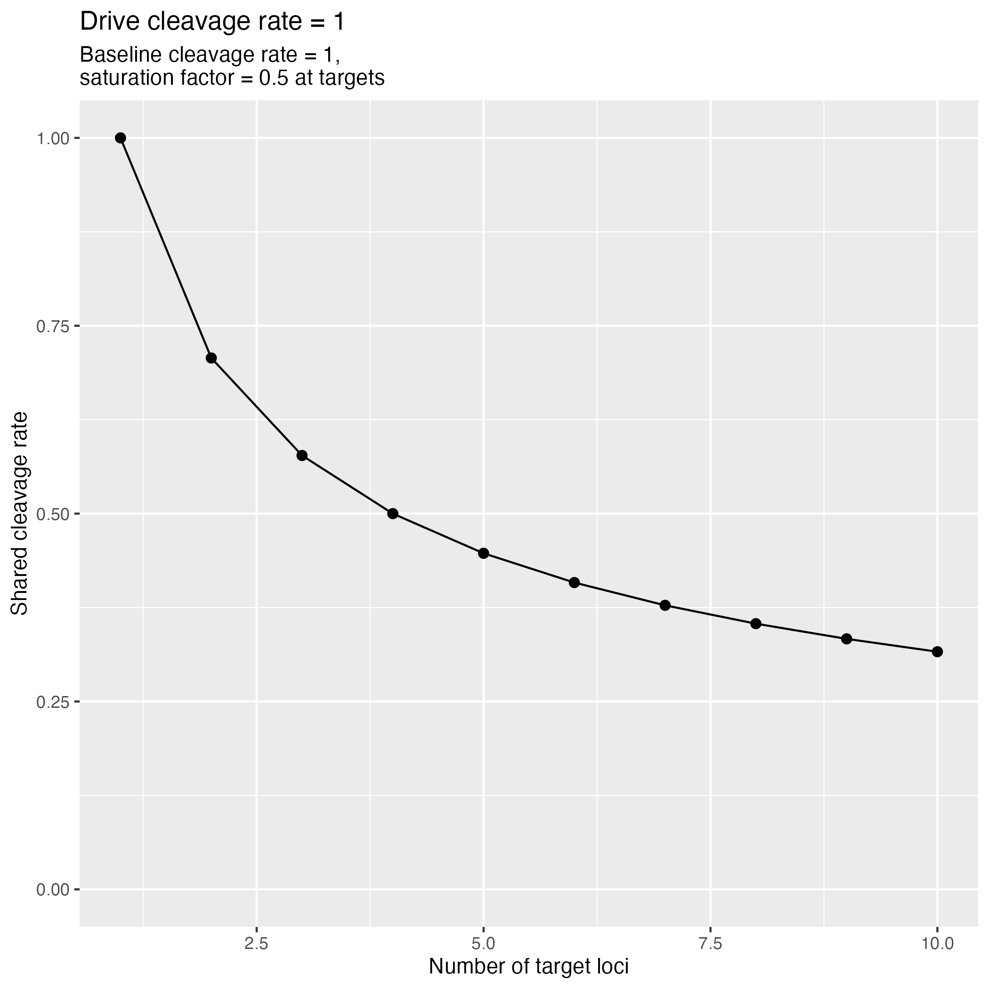
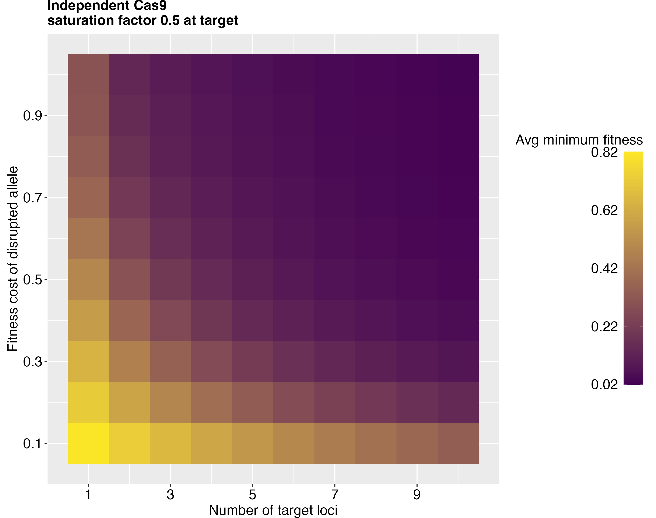
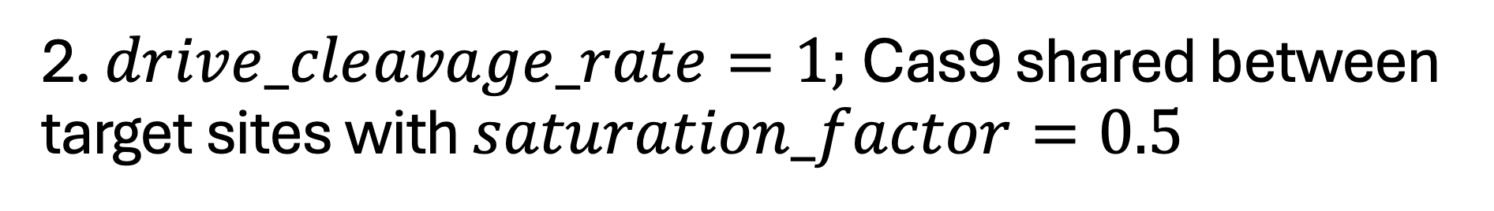
2. $drive_cleavage_rate=1;$Cas9 shared between target sites with $saturation_factor=0.5$
Notes:
No longer a real tradeoff
Can lower fitness the most with a lot of target sites and high fitness cost

Slide 7
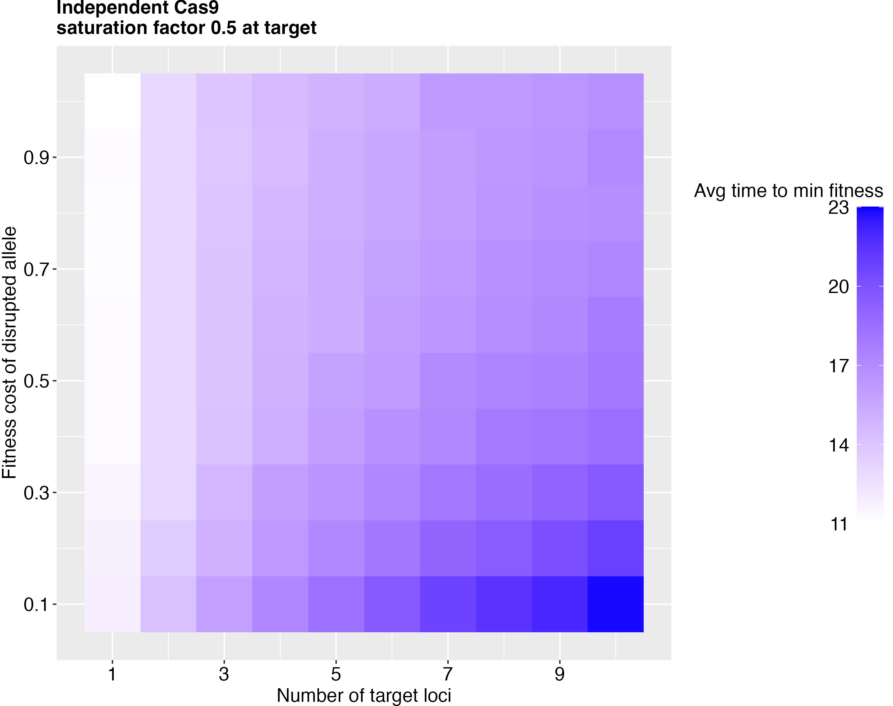
2. $drive_cleavage_rate=1;$Cas9 shared between target sites with $saturation_factor=0.5$
Notes:
No longer a real tradeoff
Can lower fitness the most with a lot of target sites and high fitness cost

Slide 8
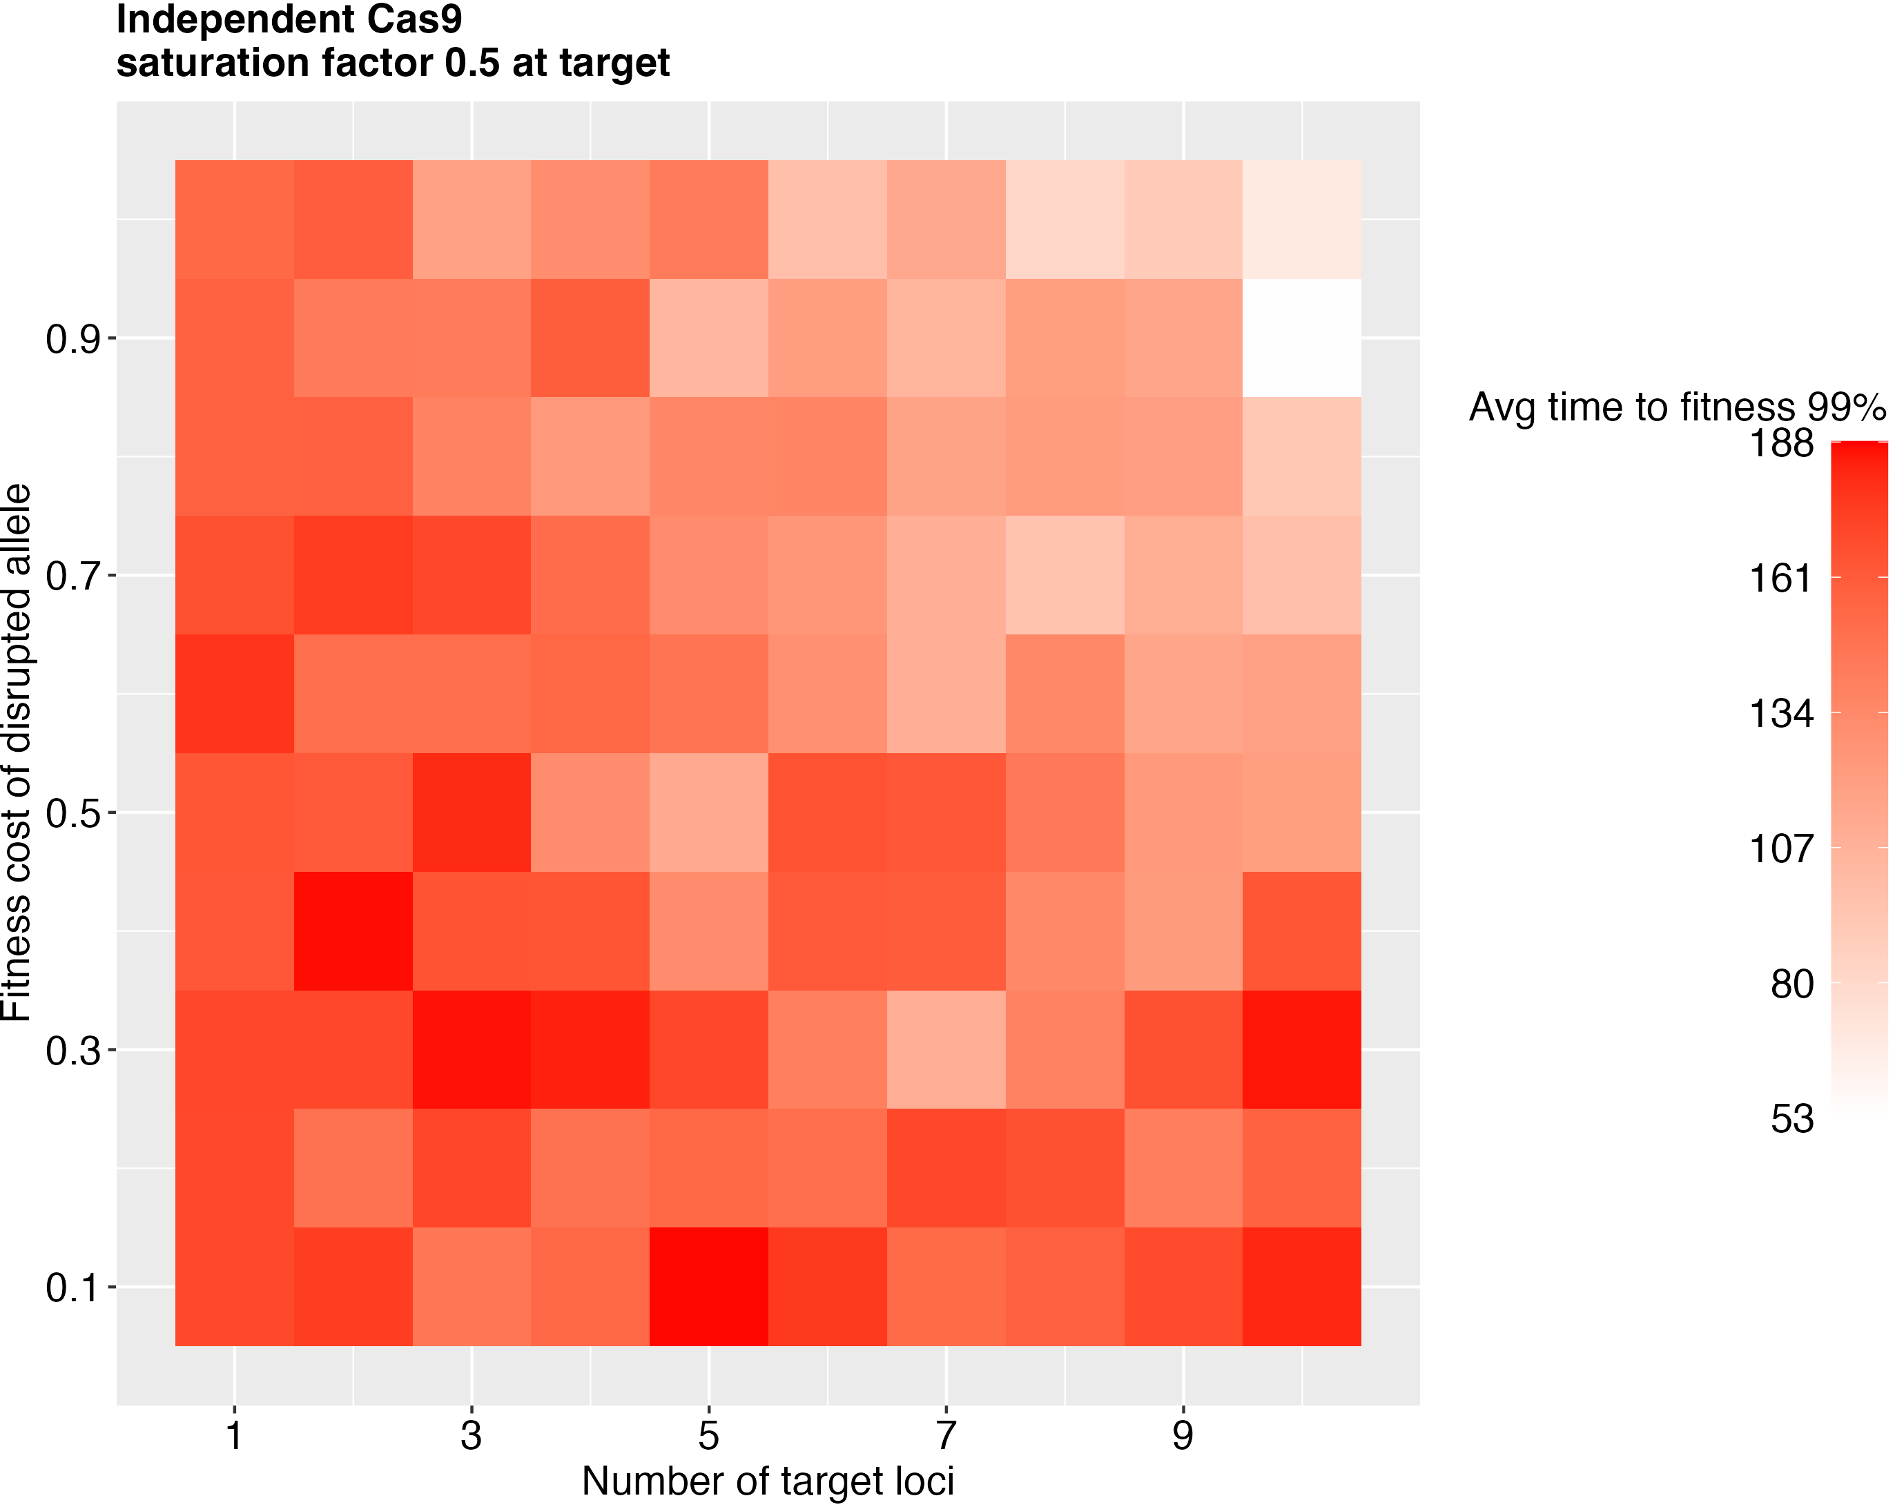
2. $drive_cleavage_rate=1;$Cas9 shared between target sites with $saturation_factor=0.5$
Notes:
At a set # of target loci, fitness recovers the more slowly when the fitness cost is higher

Slide 9
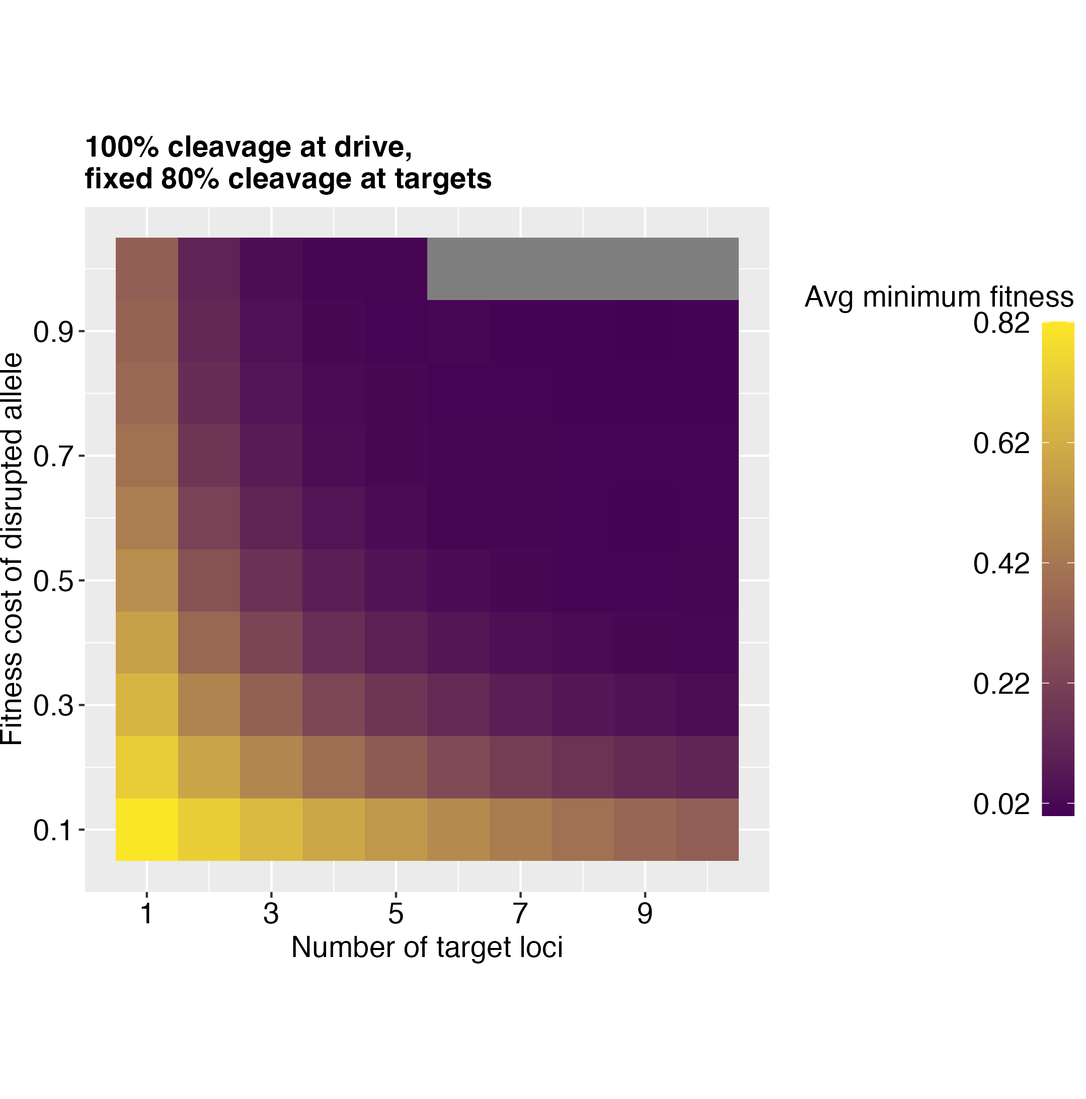
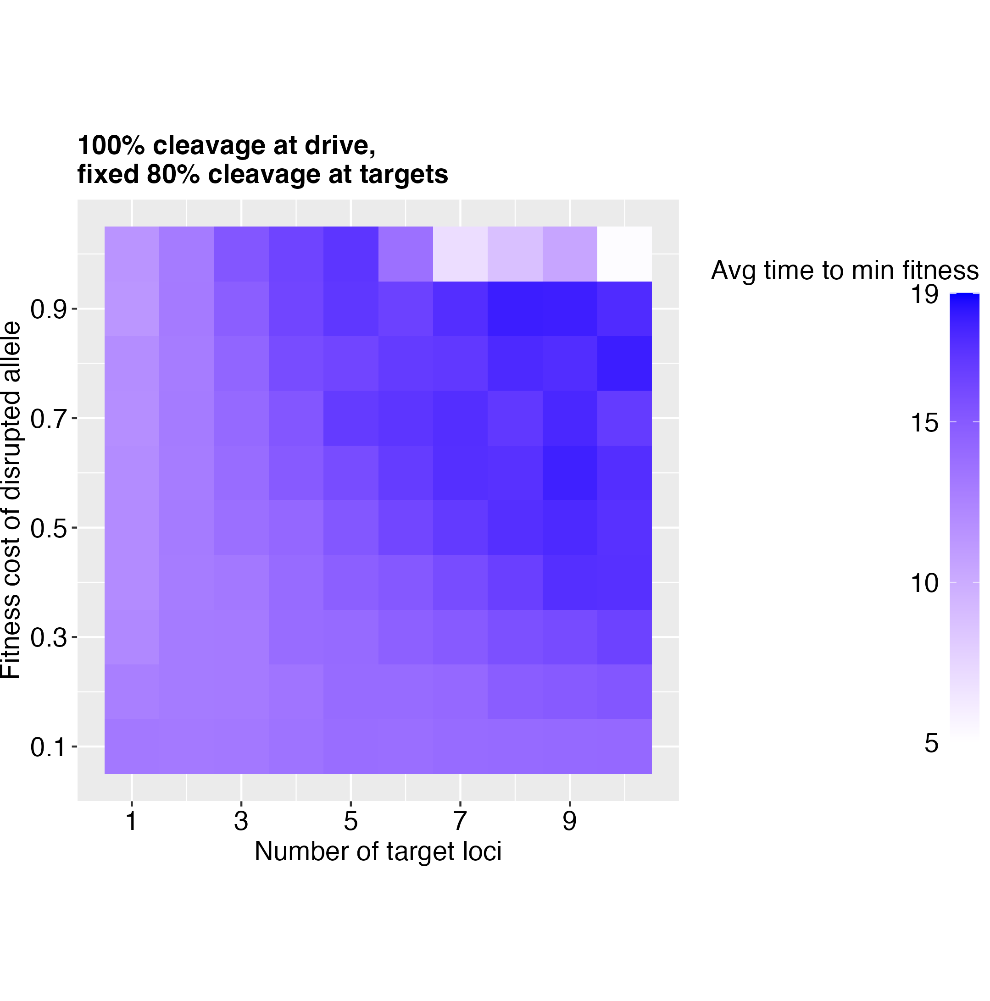
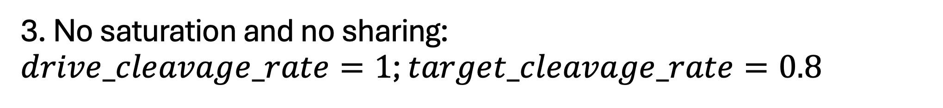
3. No saturation and no sharing: $drive_cleavage_rate=1$; $target_cleavage_rate=0.8$
Issues with total fitness being < 0 (need to set s < 1)

Slide 10
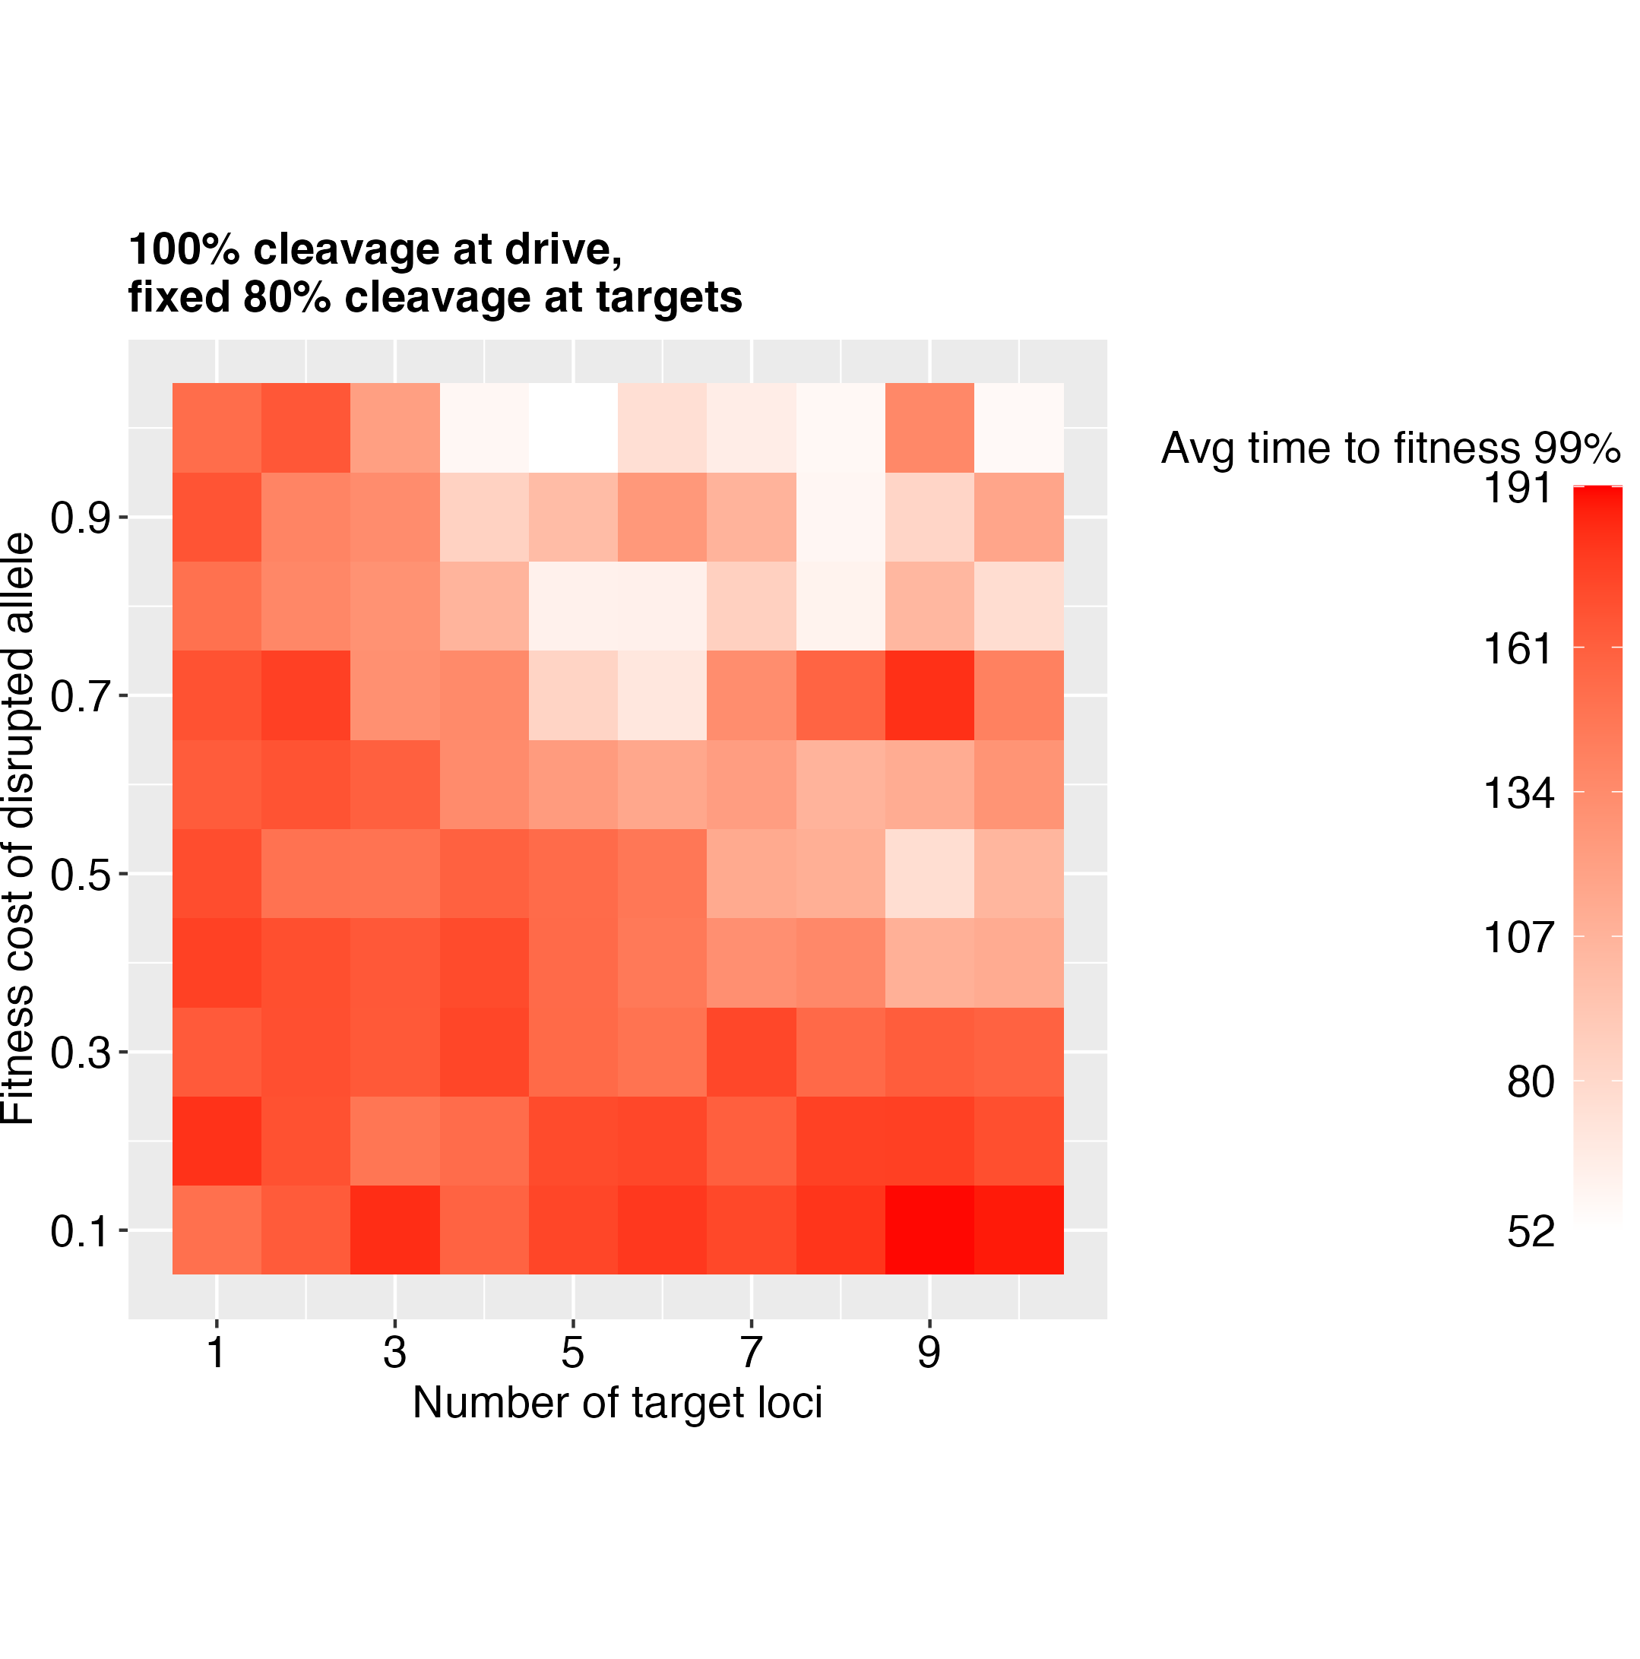
3. No saturation and no sharing: $drive_cleavage_rate=1$; $target_cleavage_rate=0.8$

