Slide 1

Project on
Drowsiness Detection

Slide 2

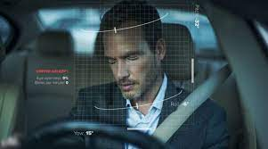

`
The Importance of Preventing Drowsy Driving Accidents
Thousands of accidents are caused by drowsy driving every year, imposing a significant threat to public safety. Recognizing the signs of drowsiness and taking preventive measures can save lives and prevent devastating consequences on the road.

Slide 3

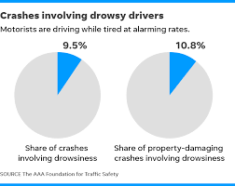
Statistics on Drowsy Driving Accidents
Prevalence
Impact
Drowsy driving causes an estimated 72,000 crashes and 800 deaths annually.
These accidents result in $12.5 billion in losses to the U.S. economy each year.
Underreported
Many drowsy driving incidents go unreported, making the impact even more significant.

Slide 4
Signs of drowsiness in drivers
Heavy eyelids and frequent blinking
Yawning and difficulty in keeping eyes open
Difficulty in remembering the past few miles driven
Drifting from the lane or hitting rumble strips

Slide 5

Advantages of Alerting Drivers When Signs of Drowsiness are Detected
Early detection of drowsiness can prevent accidents by prompting drivers to take a break.
Alerting drivers also promotes awareness of personal health and safety while on the road.
Ultimately, it enhances road safety and reduces the risk of potential collisions.

Slide 6
Benefits of implementing an alert system for drowsy drivers
Preventing Accidents
Saving Lives
Reducing Injuries
Implementing an alert system can potentially save lives by reducing the risk of collisions caused by drowsiness.
By alerting drowsy drivers, the system can contribute to minimizing the number of injuries resulting from accidents.
An alert system can help prevent drowsy driving accidents by notifying the driver to take a break or pull over.

Slide 7
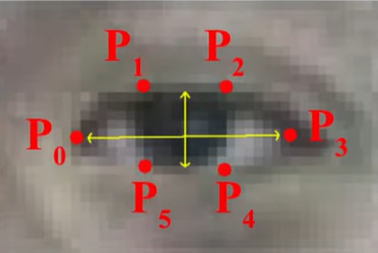
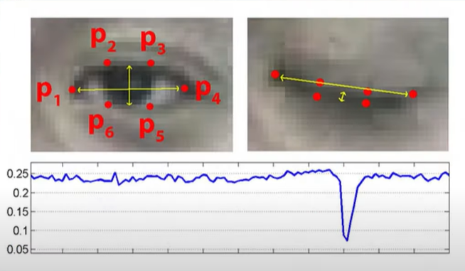
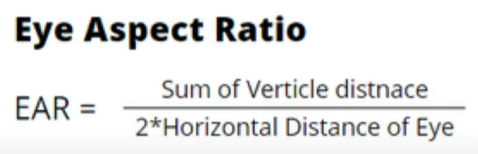

Slide 8
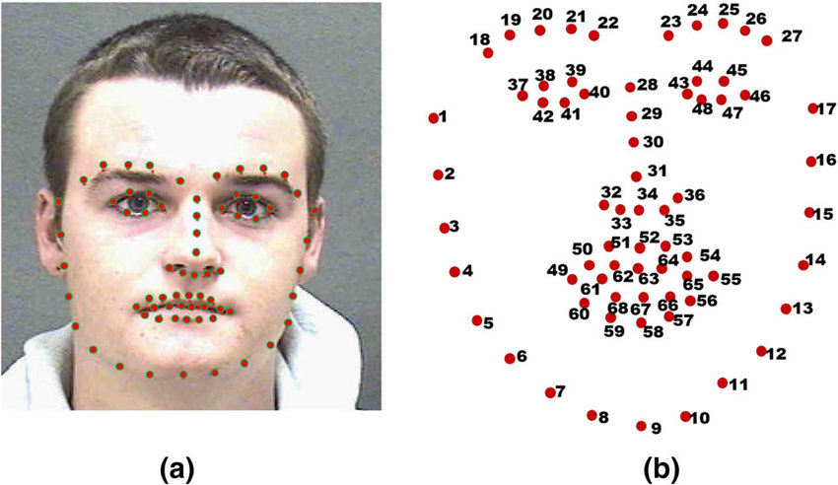
pre-trained facial landmark predictor model
It is trained on a large dataset of facial images with annotated landmarks.
Provided by dlib library
Supervised learning algorithm is used .

