Slide 1


E-Commerce Customer Segmentation & Prediction
Boston Institute of Analytics · Capstone 2026

Slide 2
Agenda
01
Project Overview & Objectives
07
Cancellation & Returns Analysis
02
Dataset & Data Cleaning
08
Power BI Dashboard
03
Feature Engineering, EDA & RFM
09
Business Recommendations
04
Customer Segmentation — K-Means, Hierarchical, DBSCAN
10
Conclusion & Deliverables
05
Segment Profiles — VIP, Loyal, At Risk, New
11
Q&A
06
Predictive Classification — High-Value Customer
BIA
BOSTON INSTITUTE OF ANALYTICS
CONFIDENTIAL: The information in this document belongs to Boston Institute of Analytics LLC. Any unauthorized sharing of this material is prohibited and subject to legal action under breach of IP and confidentiality clauses.

Slide 3
01
Background, Goals & Benefits
Framing the business problem this capstone solves and the value it creates for e-commerce marketing decisions.
Project
Overview &
Objectives
BIA
BOSTON INSTITUTE OF ANALYTICS

Slide 4
Business Problem, Goal & Key Benefits
Business Problem
The retailer lacks insight into customer purchasing behavior — causing inefficient marketing spend and weak retention.
❗
Project Goal
Build a customer segmentation model plus a predictive classifier that enable data-driven, targeted marketing.
🎯
Key Benefits
📈
💰
😊
Enhanced Segmentation
Cost Efficiency
Improved Satisfaction
Targeted marketing strategies per customer group
Focus resources on high-value customers
Personalized offers per segment
BIA
BOSTON INSTITUTE OF ANALYTICS
CONFIDENTIAL: The information in this document belongs to Boston Institute of Analytics LLC. Any unauthorized sharing of this material is prohibited and subject to legal action under breach of IP and confidentiality clauses.

Slide 5
02
Dataset, Cleaning, Features & RFM
Preparing 541K UK e-commerce transactions and engineering the Recency-Frequency-Monetary features that power segmentation.
Data &
Exploratory
Analysis
BIA
BOSTON INSTITUTE OF ANALYTICS

Slide 6
Dataset Snapshot & Data Cleaning
Dataset Snapshot
Data Cleaning Steps
Raw Transactions
Unique Customers
Converted InvoiceDate
to datetime format
541,909
4,338
Dropped null CustomerID rows
cannot link to a customer
Removed duplicates
reduced overall dataset size
Unique Products
Countries
3,665
37
Filtered UnitPrice ≤ 0
removed test / adjustment entries
Split into two datasets:
Period: Dec 2010 – Dec 2011 | UK-based online retailer
Valid Purchases: 392,692 rows · Returns/Cancellations: 8,872 rows
8 Fields:
InvoiceNo · StockCode · Description · Quantity · InvoiceDate · UnitPrice · CustomerID · Country
BIA
BOSTON INSTITUTE OF ANALYTICS
CONFIDENTIAL: The information in this document belongs to Boston Institute of Analytics LLC. Any unauthorized sharing of this material is prohibited and subject to legal action under breach of IP and confidentiality clauses.

Slide 7
Feature Engineering & RFM Framework
Engineered Features
The RFM Framework
✓
Revenue
Quantity × UnitPrice — core monetary metric
R
F
M
✓
Month
InvoiceDate.to_period('M') for trend analysis
Recency
Frequency
Monetary
Days since last purchase
Lower = better
Number of unique invoices
Higher = better
Total revenue generated
Higher = better
✓
RFM
Recency, Frequency, Monetary — core segmentation features
✓
Log1p + StandardScaler
de-skews & normalizes RFM before clustering
BIA
BOSTON INSTITUTE OF ANALYTICS
CONFIDENTIAL: The information in this document belongs to Boston Institute of Analytics LLC. Any unauthorized sharing of this material is prohibited and subject to legal action under breach of IP and confidentiality clauses.

Slide 8
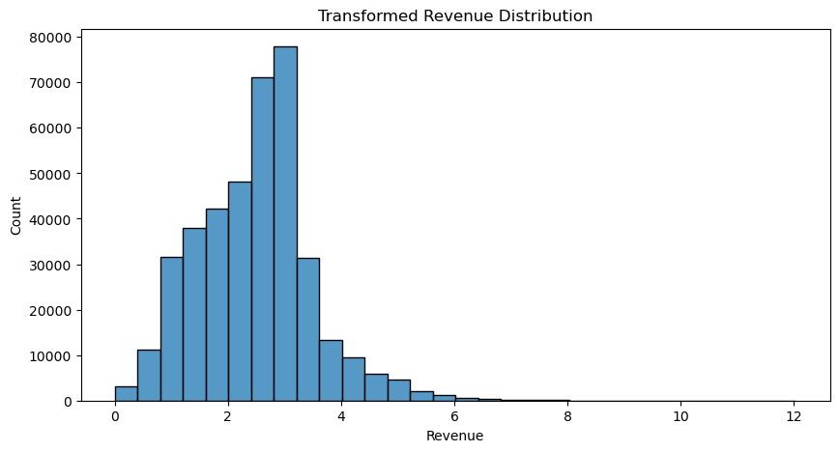
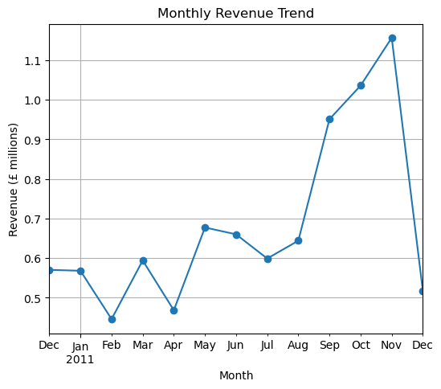
EDA Insights — Revenue Patterns
Key Findings
Revenue is highly right-skewed
Most transactions are low-value; a few are very high
📊
UK dominates revenue at 82%
£7.28M of £8.89M total revenue
Revenue Distribution
Insert histogram from EDA.ipynb
Seasonal peaks in Sep–Nov
Nov 2011 was the highest month at £1.16M
Top 10 customers drive outsized revenue
A small cohort are VIP spenders
📊
Monthly Revenue Trend (£M)
Insert line chart from EDA.ipynb
BIA
BOSTON INSTITUTE OF ANALYTICS
CONFIDENTIAL: The information in this document belongs to Boston Institute of Analytics LLC. Any unauthorized sharing of this material is prohibited and subject to legal action under breach of IP and confidentiality clauses.

Slide 9
RFM Distribution Summary
RFM scores each customer on Recency, Frequency & Monetary dimensions to reveal high-value segments.
Skewness Handling
RFM Distribution Table
Metric | Mean | Min | Max
Recency (days) | 92.5 | 1 | 374
Frequency | 4.3 | 1 | 209
Monetary (£) | £2,049 | £3.75 | £280,206
Frequency (skew: 12.07) and Monetary (skew: 19.34) were highly right-skewed.
log1p transformation → skewness near zero → StandardScaler applied.
High-Value Customers (VIP + Loyal)
1,879 customers · 43.3% of total customer base
BIA
BOSTON INSTITUTE OF ANALYTICS
CONFIDENTIAL: The information in this document belongs to Boston Institute of Analytics LLC. Any unauthorized sharing of this material is prohibited and subject to legal action under breach of IP and confidentiality clauses.

Slide 10
03
K-Means · Hierarchical · DBSCAN
Comparing three clustering algorithms on scaled RFM features to find the most useful, business-interpretable customer segments.
Customer
Segmentation
BIA
BOSTON INSTITUTE OF ANALYTICS

Slide 11
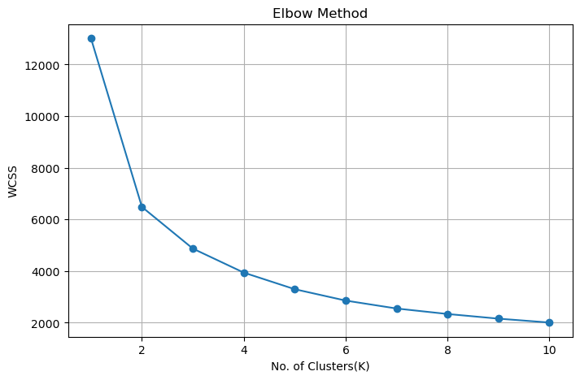
K-Means Clustering — Optimal K Selection
Silhouette Scores (K = 2 to 6)
K=2
0.4328
📊
K=3
0.3751
Elbow Curve (WCSS vs K)
K=4
0.3504
Insert elbow plot from CustomerSegmentation_Prediction.ipynb
K=5
0.3289
K=6
0.3102
K=2 scores highest, but K=4 was chosen for business interpretability: 4 actionable segments (VIP, Loyal, At Risk, New).
WCSS gain flattens after K=4 → Optimal K = 4
BIA
BOSTON INSTITUTE OF ANALYTICS
CONFIDENTIAL: The information in this document belongs to Boston Institute of Analytics LLC. Any unauthorized sharing of this material is prohibited and subject to legal action under breach of IP and confidentiality clauses.

Slide 12
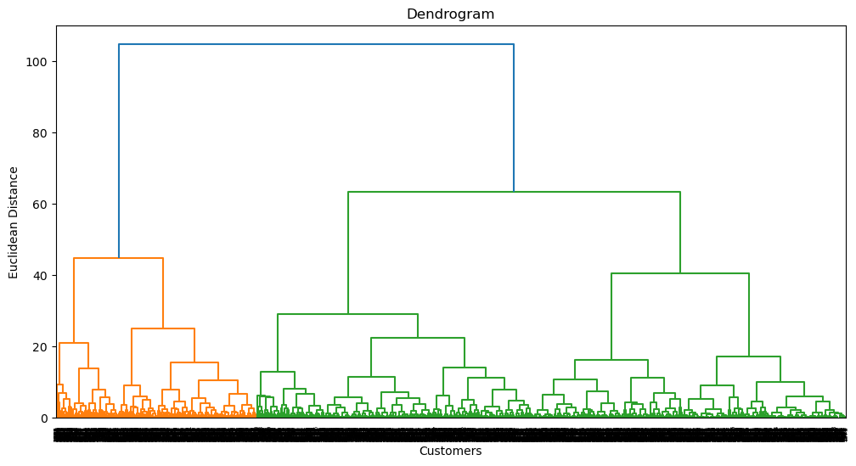
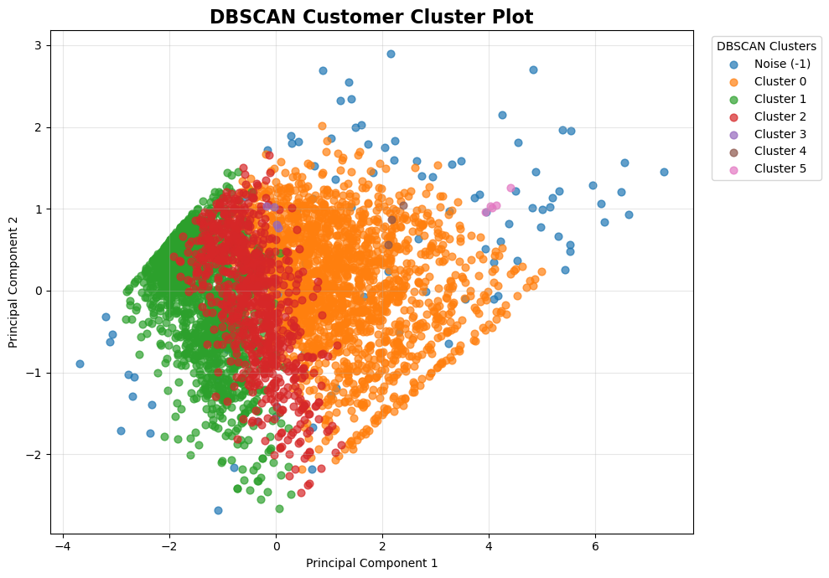
Hierarchical Clustering & DBSCAN
Hierarchical (Agglomerative, Ward linkage)
DBSCAN (Density-Based)
📊
📊
Dendrogram
DBSCAN Cluster Plot
Insert dendrogram from CustomerSegmentation_Prediction.ipynb
Insert DBSCAN scatter from CustomerSegmentation_Prediction.ipynb
n_clusters = 4 · linkage = ward
Confirms 4 natural groupings — a good alternative to K-Means.
eps = 0.4 · min_samples = 5
Found 6 clusters + noise — useful for outlier detection, less for segmentation.
BIA
BOSTON INSTITUTE OF ANALYTICS
CONFIDENTIAL: The information in this document belongs to Boston Institute of Analytics LLC. Any unauthorized sharing of this material is prohibited and subject to legal action under breach of IP and confidentiality clauses.

Slide 13
Clustering Algorithm Comparison
Three algorithms evaluated — K-Means selected as the final segmentation model.
Model | Clusters | Requires K | Detects Outliers | Scalability | Status
K-Means | 4 | Yes | No | High | Selected ✓
Hierarchical | 4 | Yes | No | Medium | Good Alternative
DBSCAN | 6 + Noise | No | Yes | Medium | Not Preferred
Final selection: K-Means with K=4 — best balance of performance, scalability & interpretability.
BIA
BOSTON INSTITUTE OF ANALYTICS
CONFIDENTIAL: The information in this document belongs to Boston Institute of Analytics LLC. Any unauthorized sharing of this material is prohibited and subject to legal action under breach of IP and confidentiality clauses.

Slide 14
Customer Segment Profiles
K-Means mapped 4 clusters to 4 business segments based on RFM profiles.
VIP
713 · 16.4%
Loyal
1,166 · 26.9%
At Risk
1,622 · 37.4%
New
837 · 19.3%
R:12d F:13.8 £8,088 avg
R:72d F:4.1 £1,802 avg
R:182d F:1.3 £341 avg
R:18d F:2.2 £557 avg
Most recent, most frequent, top spenders.
Loyalty rewards & dedicated account managers.
Regular buyers with solid spend.
Upsell campaigns; tier-up incentives.
Formerly active, now lapsing — largest segment.
Win-back emails; limited-time discounts.
Recent first-time or early-stage buyers.
Onboarding journeys; first-purchase offers.
High-Value Customers (VIP + Loyal): 1,879 — 43.3% of total customer base
BIA
BOSTON INSTITUTE OF ANALYTICS
CONFIDENTIAL: The information in this document belongs to Boston Institute of Analytics LLC. Any unauthorized sharing of this material is prohibited and subject to legal action under breach of IP and confidentiality clauses.

Slide 15
04
High-Value Customer Prediction
Target: High_Value_Customer (VIP/Loyal vs At Risk/New). Features: RFM. Models: Logistic Regression, Random Forest, XGBoost.
Predictive
Classification
BIA
BOSTON INSTITUTE OF ANALYTICS

Slide 16
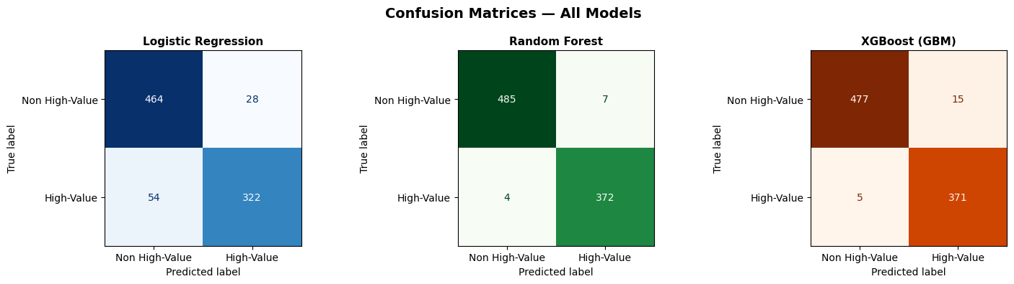
Classification Model Results
43.3% High-Value vs 56.7% Non High-Value — no SMOTE required. 80/20 stratified split.
Logistic Regression
🏆 BEST MODEL
XGBoost (GBM)
Accuracy
Random Forest
Accuracy
90.55%
Accuracy
97.70%
98.73%
ROC-AUC
ROC-AUC
ROC-AUC
97.86%
99.94%
99.90%
F1 Score
F1 Score
F1 Score
88.71%
98.54%
97.38%
📊
Confusion Matrix — Random Forest (Best Model)
Insert confusion matrix from Classification_HighValueCustomer.ipynb
BIA
BOSTON INSTITUTE OF ANALYTICS
CONFIDENTIAL: The information in this document belongs to Boston Institute of Analytics LLC. Any unauthorized sharing of this material is prohibited and subject to legal action under breach of IP and confidentiality clauses.

Slide 17
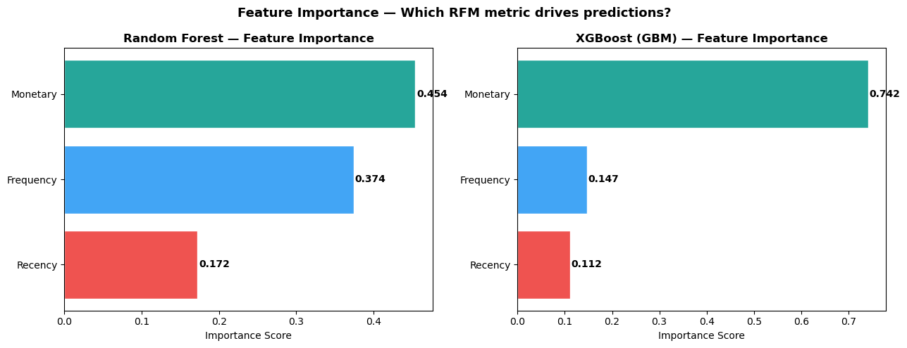
Feature Importance & Cross-Validation
5-Fold Cross-Validation
Random Forest
98.6% ± 0.4%
📊
XGBoost
97.5% ± 0.5%
Feature Importance (Random Forest)
Insert bar chart from Classification_HighValueCustomer.ipynb
Logistic Regression
90.3% ± 0.9%
Cross-validation confirms model stability across all folds — no overfitting detected.
Monetary 45.4% · Frequency 37.4% · Recency 17.2%
BIA
BOSTON INSTITUTE OF ANALYTICS
CONFIDENTIAL: The information in this document belongs to Boston Institute of Analytics LLC. Any unauthorized sharing of this material is prohibited and subject to legal action under breach of IP and confidentiality clauses.

Slide 18
Cancellation & Returns Analysis
Return Rows
Unique Return Orders
Returning Customers
Revenue Lost
8,872
3,654
1,589
£608,689
Top Customers by Return Volume
Key Insights
ID 16446
80,995 units
Investigate for fraud
UK accounts for 98%+ of return volume — proportionate to sales.
ID 12346
74,215 units
Likely wholesale cancellation
Jan 2011 peak: 79,767 units — likely post-holiday cancellations.
Dec 2011 spike: 83,565 units — year-end bulk order reversals.
ID 15838
9,361 units
Monitor
ID 15749
9,014 units
Monitor
BIA
BOSTON INSTITUTE OF ANALYTICS
CONFIDENTIAL: The information in this document belongs to Boston Institute of Analytics LLC. Any unauthorized sharing of this material is prohibited and subject to legal action under breach of IP and confidentiality clauses.

Slide 19
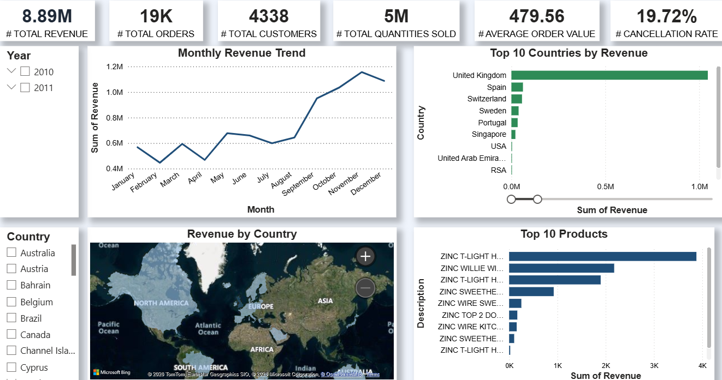
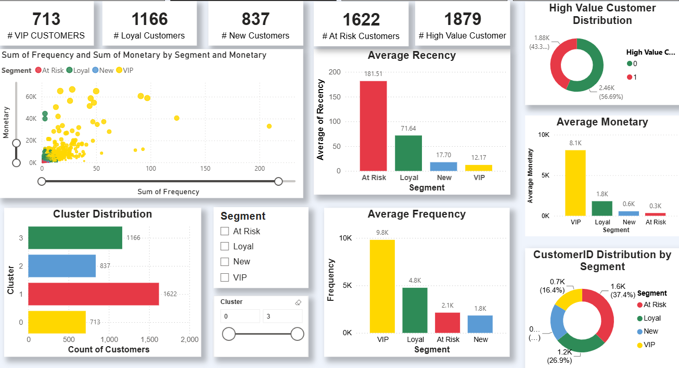
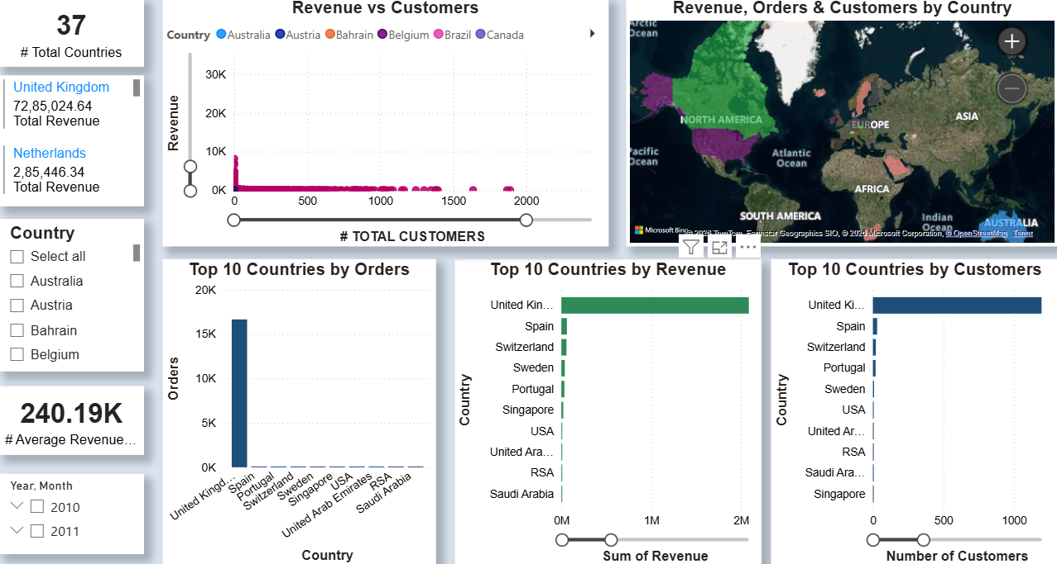
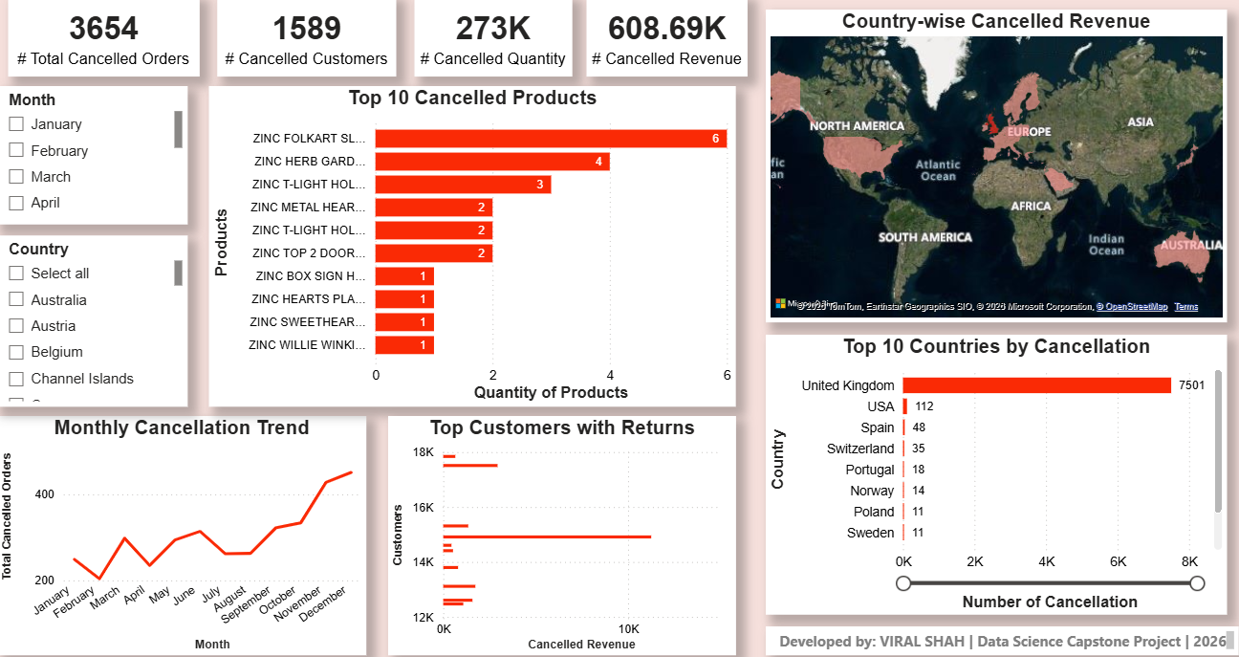
Power BI Dashboard
Built on rfm_with_predictions.csv + order_returns.csv across four report pages.
📊
📊
Executive Overview
Customer Segmentation
KPIs · revenue trend · segment mix
Frequency vs Monetary · segment breakdown
📊
📊
Geographic Analysis
Returns Dashboard
Revenue & customers by country
Return volume, rate & top return customers
CONFIDENTIAL: The information in this document belongs to Boston Institute of Analytics LLC. Any unauthorized sharing of this material is prohibited and subject to legal action under breach of IP and confidentiality clauses.
BIA
BOSTON INSTITUTE OF ANALYTICS

Slide 20
Business Recommendations
Actionable strategies per segment, derived from RFM profiles and model insights.
VIP
713 · 16.4%
Loyal
1,166 · 26.9%
At Risk
1,622 · 37.4%
New
837 · 19.3%
Exclusive loyalty tier + early access
Tier-upgrade campaigns to VIP
Win-back emails within 90 days
Onboarding email series
Retention alerts if Recency > 30 days
Cross-sell via purchase history
Time-limited 15–20% discounts
First-repeat-purchase discount
Inventory: Stock seasonal items Aug–Oct to meet the Sep–Nov demand peak (+72% vs summer).
Returns: Flag customers 16446 & 12346 for account review; tighten bulk-order return policy.
BIA
BOSTON INSTITUTE OF ANALYTICS
CONFIDENTIAL: The information in this document belongs to Boston Institute of Analytics LLC. Any unauthorized sharing of this material is prohibited and subject to legal action under breach of IP and confidentiality clauses.

Slide 21
Conclusion, Key Takeaways & Deliverables
Key Takeaways
Submission Deliverables
1
4 segments identified: VIP (713), Loyal (1,166), At Risk (1,622), New (837)
📓
DataAnalysis_Preprocessing.ipynb
Data cleaning & preparation
2
Random Forest is the best classifier: 98.73% accuracy, 99.94% AUC
📓
EDA.ipynb
Univariate & bivariate analysis
3
Monetary is the strongest predictive signal (45% importance)
📓
CustomerSegmentation_Prediction.ipynb
RFM + clustering models
📓
Classification_HighValueCustomer.ipynb
Predictive classifier
4
UK drives 82% of revenue — international expansion is a lever
📊
Presentation.pptx
This presentation (BIA template)
5
Returns are manageable at 1.6%; two outliers warrant review
📁
CustomerSegmentationPowerBI.pbix
Power BI dashboard
6
Seasonal peaks in Sep–Nov guide inventory planning
BIA
BOSTON INSTITUTE OF ANALYTICS
CONFIDENTIAL: The information in this document belongs to Boston Institute of Analytics LLC. Any unauthorized sharing of this material is prohibited and subject to legal action under breach of IP and confidentiality clauses.

Slide 22
Questions ?
Thank you for your attention.
BIA
BOSTON INSTITUTE OF ANALYTICS
CONFIDENTIAL: The information in this document belongs to Boston Institute of Analytics LLC. Any unauthorized sharing of this material is prohibited and subject to legal action under breach of IP and confidentiality clauses.

