Slide 1

Team
Fall 2022
Naveen Kumar Rajesh | Ajay Samra | Paul Lu | Alex Bae

Slide 2
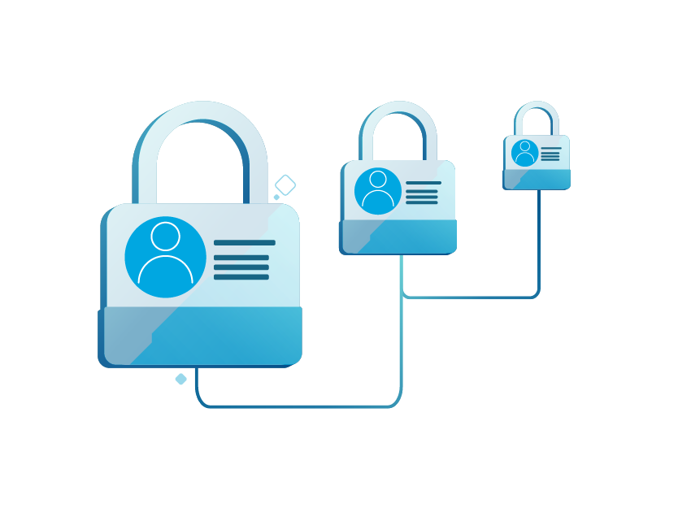
Problem Statement
Current forms of digital credentials to prove the identity and validity of documents rely on a single centralized database or services such as Google and Facebook. Our project aims to create a verifiable credential system that will allow campus faculty, surrounding business owners, and students to create and verify credentials without relying on a central system while giving users full control over their data.

Slide 3
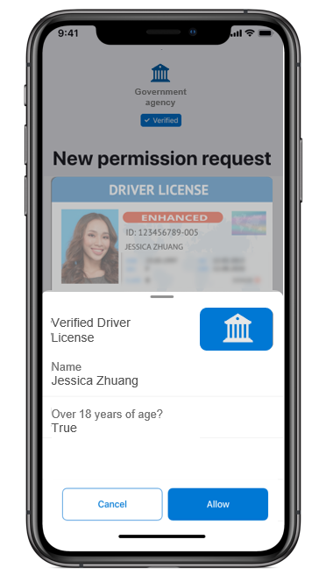
User Stories
As a User/Holder I want:
Reliable and securely stored credentials for identification purposes
To only present what is necessary
Have my ID and credentials on my phone
As an Issuer I want:
To issue credentials, remove credentials through a web app
To digitally sign credentials, make claims to a user’s credentials
As a Verifier I want:
An easy way to view list of claims presented by credential holder through a web app
Ability to verify signature of credentials for authenticity
To check claims/proofs are valid
*Example from Microsoft

Slide 4
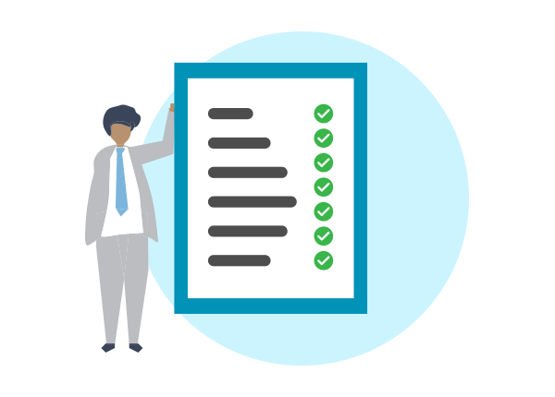
Requirements
Interface:
Web interface for management, issuance, and verification
MS Authenticator Application for storing credentials
Security:
Open ID Connect Standard
Safeguards: rate limiting, session expiration
Documentation;
GitHub Wiki for documentation & logging tasks
Performance:
Demonstration of scalability
Misc:
Error mitigation: Dev mode vs Production mode errors

Slide 5
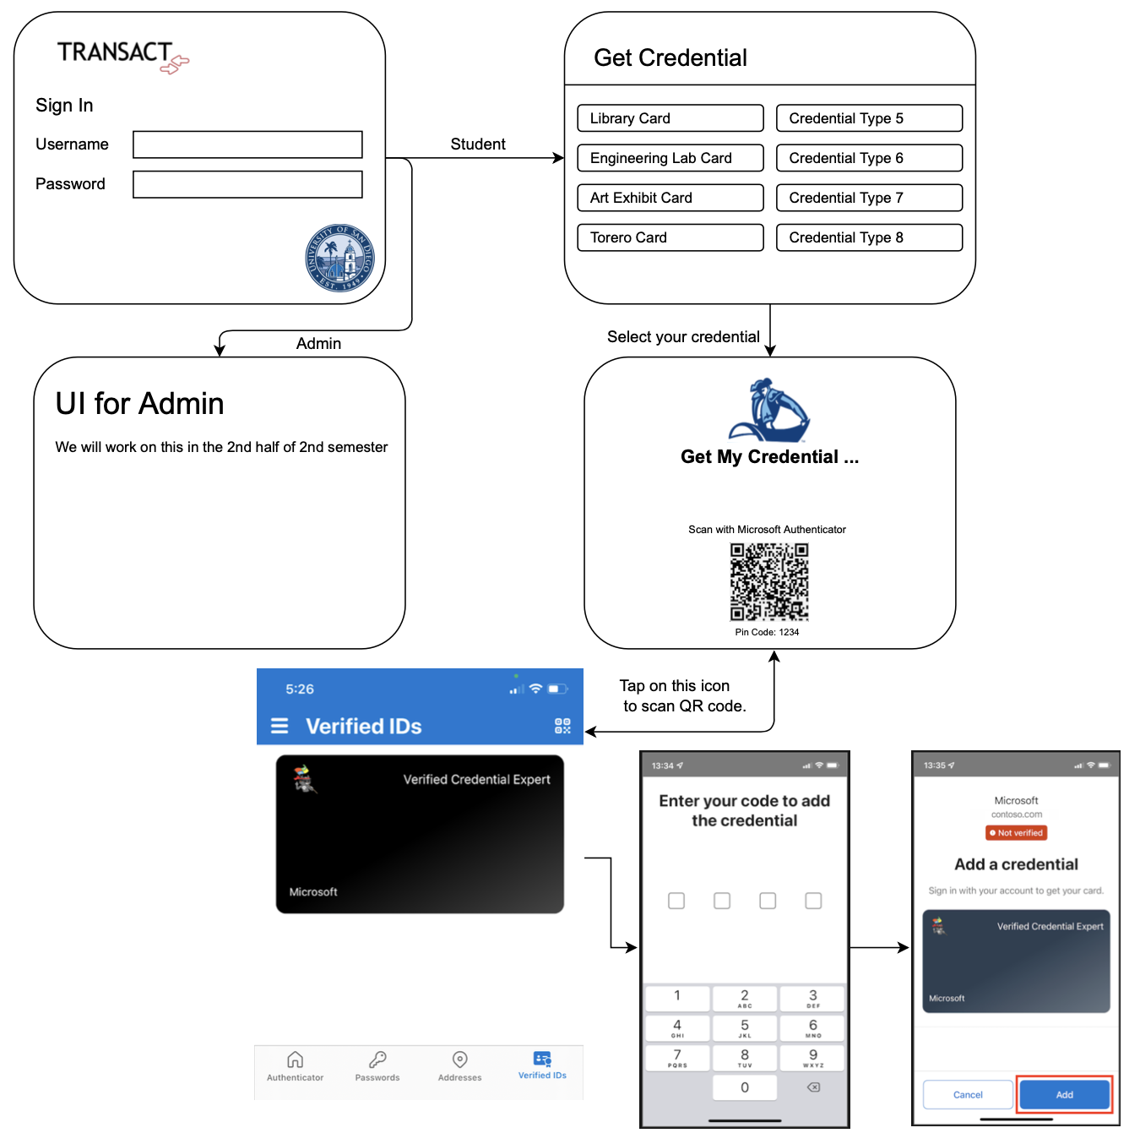
Lo-Fi UI
Credential/
Management
Web
Application
Notes:
After you press ‘Enter’, based on your username, you will be directed towards the student or admin tab
API call to Azure MySQL database
Retrieve ‘name’ attribute of the role entity which is related to the user entity
Student will select his/her/their credential type
Scan the provided QR code using digital wallet (Microsoft Authenticator) to verify ownership of credential.
We will use microsoft’s authenticator app as the digital wallet

Slide 6
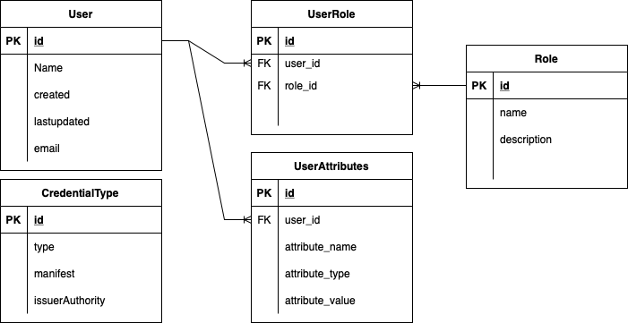
Database Schema
Notes:
After you press ‘Enter’, based on your username, you will be directed towards the student or admin tab
API call to Azure MySQL database
Retrieve ‘name’ attribute of the role entity which is related to the user entity
Student will select his/her/their credential type
Scan the provided QR code using digital wallet (Microsoft Authenticator) to verify ownership of credential.
We will use microsoft’s authenticator app as the digital wallet

Slide 7
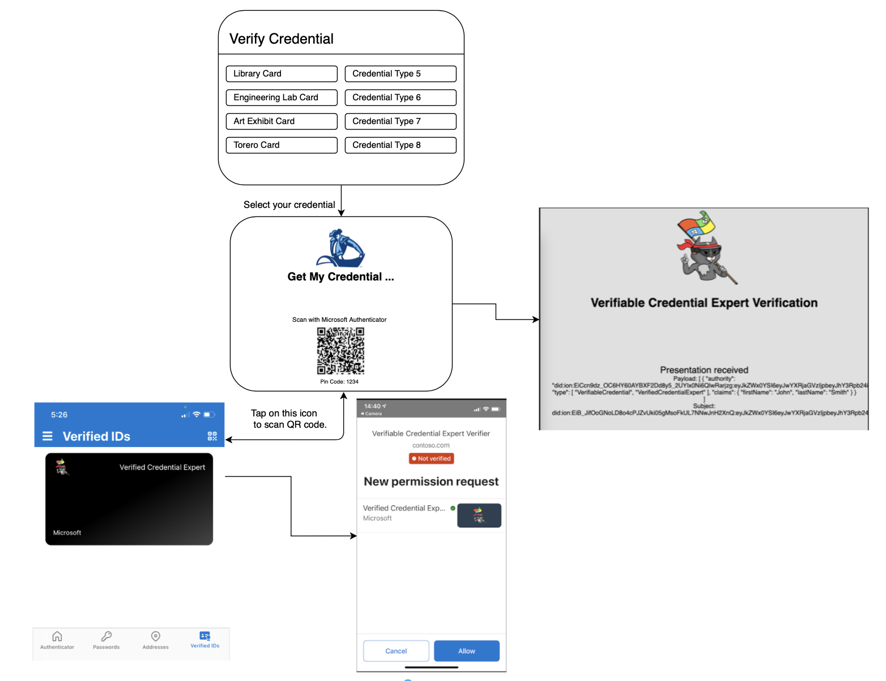
Lo-Fi UI
Verifier
Web Application

Slide 8
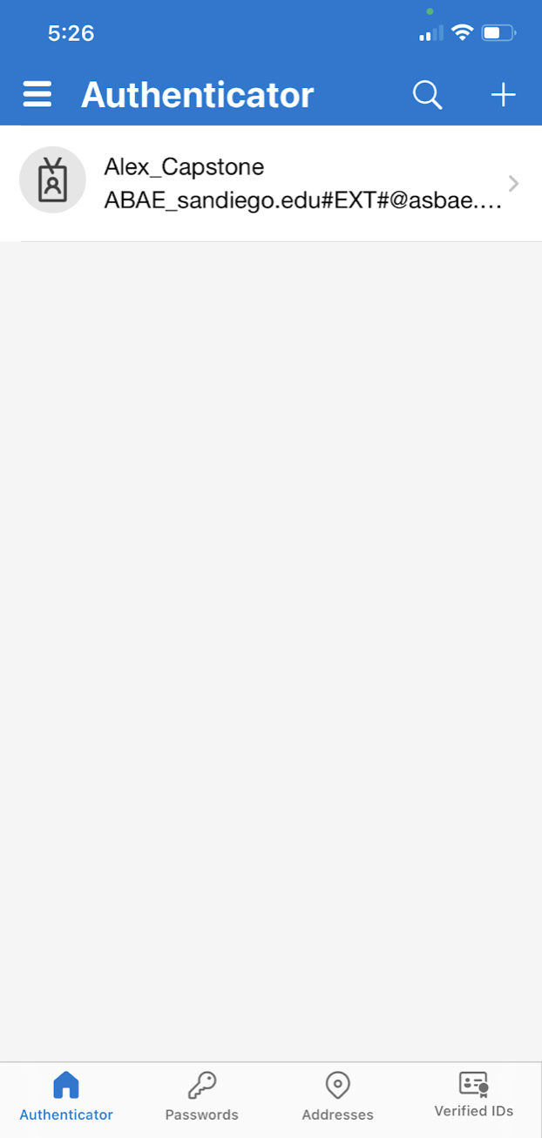
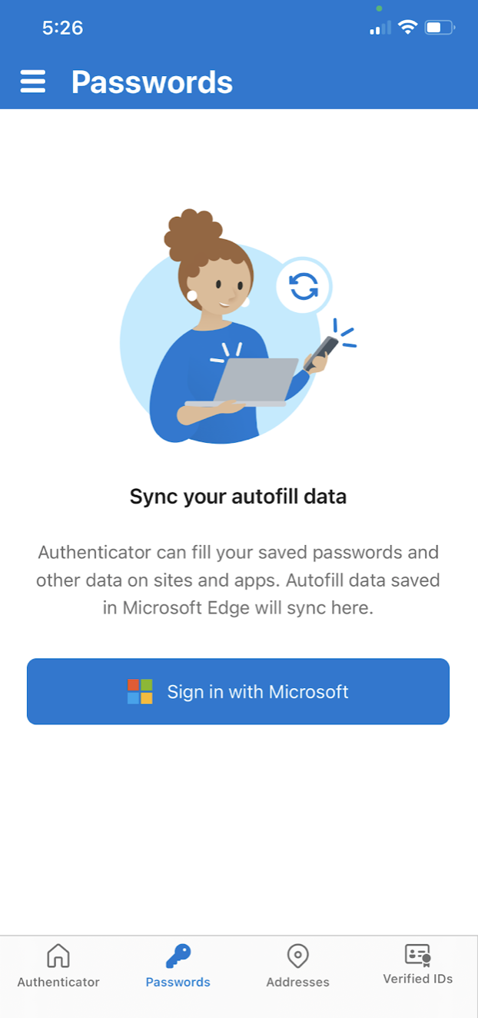
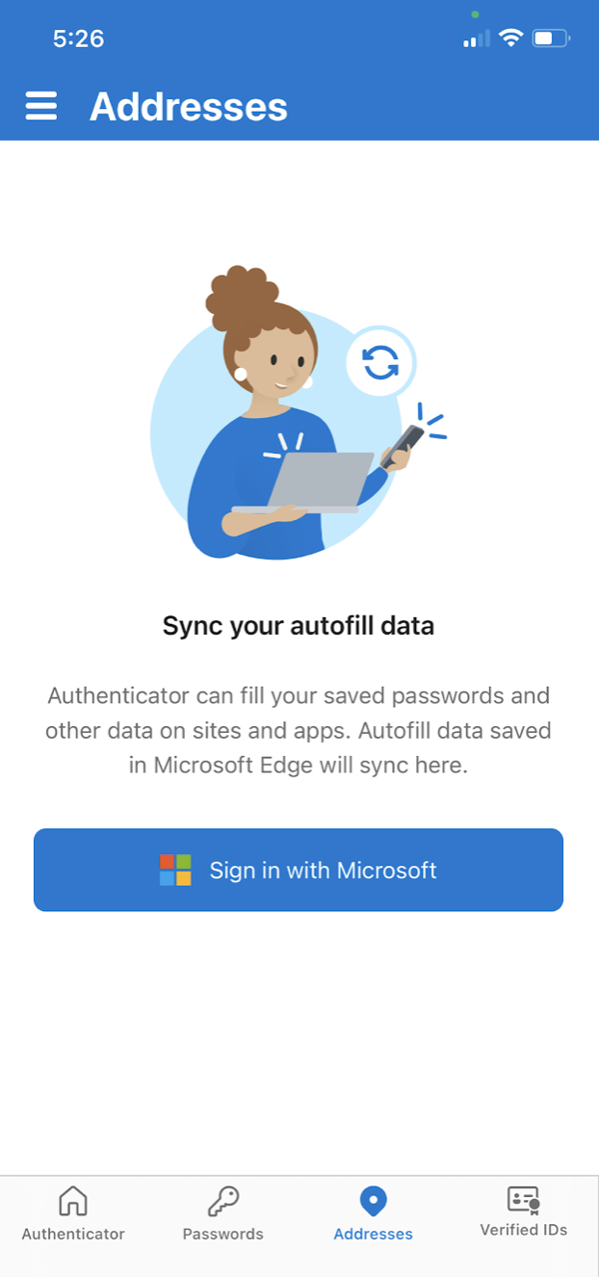
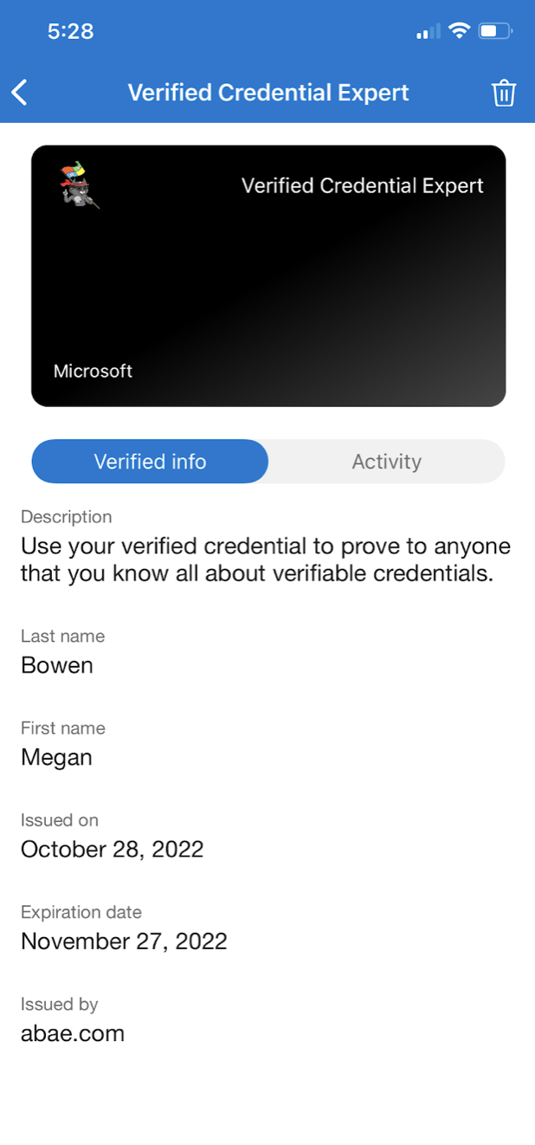
Microsoft Authenticator App

Slide 9
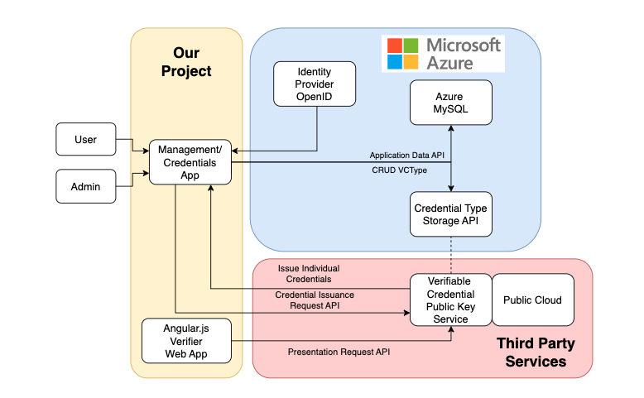
Software Architecture
Services within the blue shaded region are provided by Microsoft Azure
Angular.js will be used for the Frontend
Express.js will be used for the Backend

Slide 10



Progress So Far:
Completed the software architecture
Created a draft of the database schema
Knew how to elaborate on github to contribute code
Learned how to utilize API tools to do CRUD operations call the backend service such as GET, POST, DELETE, PUT
Set up Microsoft Azure account so we can interact with the Azure server

Slide 11
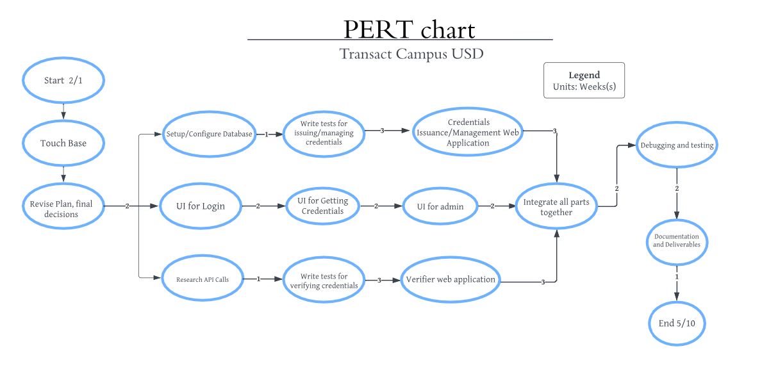
Next Semester Plan

