Slide 1
AI-Demo-Udacity
$Solve-a-prediction-problem-using-python$

Slide 2
HIGHLIGHTS
What’s the prediction?
Solve a prediction problem using python

Slide 3
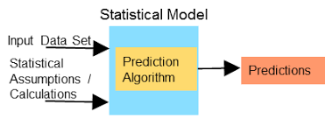
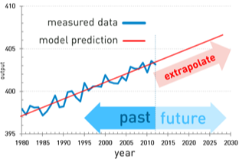
What’s the prediction-model

Slide 4
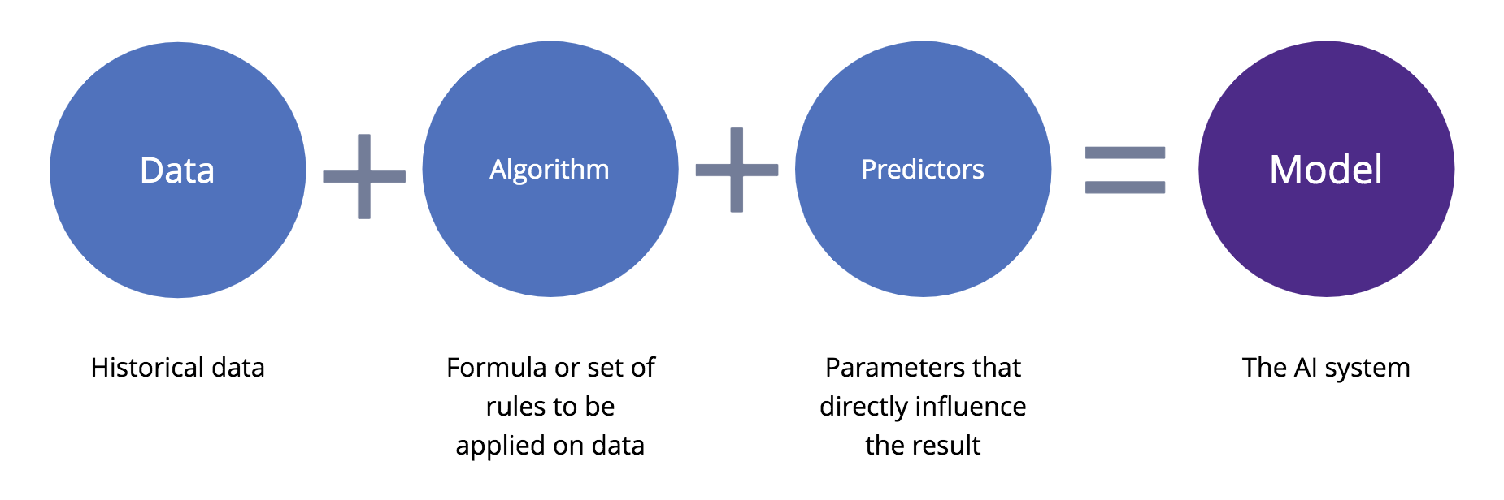
How can we try it with python?
1- get the historical data from here:
<a> https://finance.yahoo.com/</a>
2- try the code from here:
<a> https://github.com/Mestkawyy/Forecast_Prophet_python</a>
3-for any question from here:
<a> ahmed.aliii.sw@gmail.com</a>

Slide 5
Thank-You-For-Today

