Slide 1
OS161: SHELL PROJECT
Operating Systems
2021/2022
Salpietro Savatore mat. s305520
Mattia Dipaola mat. s287843
Antonio Colonna mat. s277965

Slide 2
Introduction to OS/161
OS/161 is a teaching operating system, written in C, similar to a simplified BSD unix operating system.
OS/161 is a monolithic kernel operating system.
OS/161 offers a high degree of customization, in fact it is possible to modify and implement new features such as locks, system calls, virtual memory and file systems.

Slide 3
Project objectives
Management of processes and files.
Implementation of the following system calls:
Open, read, write, lseek, close dup2, chdir, getcwd: which manage files and directories in the operating system.
Getpid which returns the identifier (PID) of the calling process.
Fork: which allows you to create a new process.
Execv: which allows you to run a new program in an existing process by replacing the code and resources of the current process with the code and resources of the new program.
Waitpid: which suspends execution of the calling process until one of its child processes terminates
Exit: which terminates a process.
System calls must return the correct value on success or an error code on failure as specified in the man pages.

Slide 4
How a system call works
The exceptions are the key to operating systems; they are mechanism that enables the OS to regain control of execution and therefore do its job. The exceptions are the interface between the processor and the operating system. When the OS boot, it installs an "exception handler"( in assembly code) in memory. When the processor raises an exception, it invokes the exception handler which sets up a "trap frame" and calls the mips_trap() function. The trap frame holds information about the system call code to be executed and the arguments passed to it. The mips_trap() function uses the information in the trap frame to identify the type of exception that caused the call as a memory access error or a system call, in the latter case the function will pass control to the system call dispatcher (syscall(tf)). The dispatcher uses the information in the trap frame to identify which system call was made, verify permissions, and passes the parameters of the system call, which it takes from the trap frame, to the operating system making the call. The return value of the system call is registered in the trapframe and therefore the trapframe, consisting of 35 registers, contains input and output of the system calls.

Slide 5
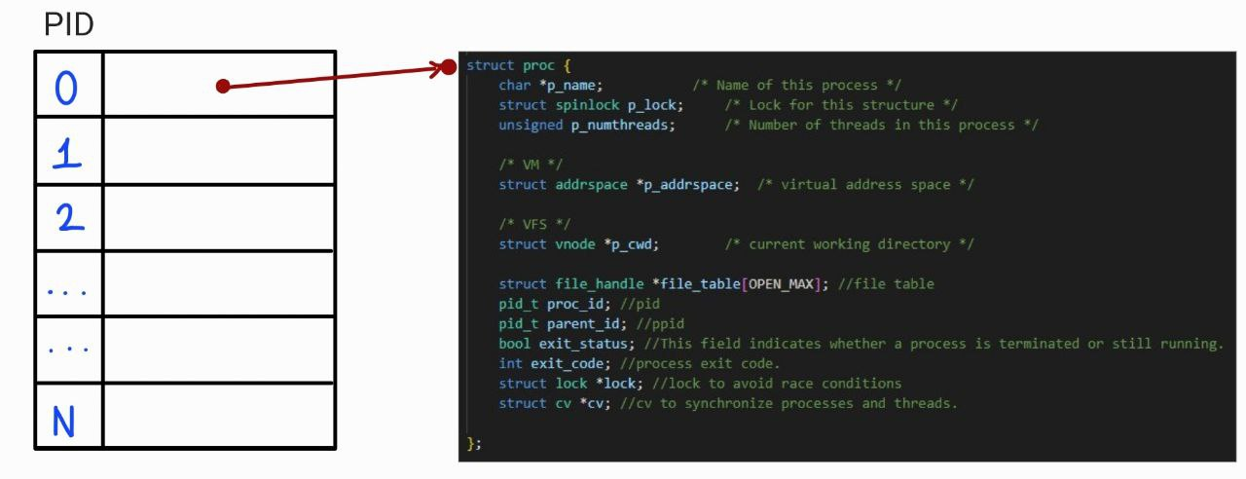
Process management in OS/161
A process is a running program. OS161 uses a process management model based on a process table which keeps track of all processes running on the system and is indexed by an integer called “PID”.
Each process is represented by a data structure that contains different types of information. In OS161, processes are single threaded, meaning that each process runs with only one thread at a time. However, OS161 supports multi-process programming, which means that multiple processes can run concurrently, but the number of which is limited by the implemented memory.
New processes are created using the system call fork, which creates an exact copy of the calling process.

Slide 6
getpid
int sys_getpid(pid_t *curproc_pid)
The getpid() system call in OS161 returns the process identifier (pid) of the calling process. This identifier is a unique integer that uniquely identifies the process within the operating system.
The function sys_getpid takes as parameter a curproc_pid pointer which will be used to store the PID value of the current process.
Fork
int sys_fork(pid_t *child_pid, struct trapframe *tf)
The system call fork creates a new process that is an exact copy of the calling process and runs in parallel with the calling process. The new child process has a different PID than the parent process and this will correspond to the first free slot in the process table. The new process can run its code independently of the parent process. The child process inherits the executable code, address space, trapframe, file table and cwd information from the parent process while not inheriting the parent PID. The fork system call returns two values: 0 in the child process and the process identifier of the new process in the parent process.
The sys_fork system call takes two arguments, a pointer to a pid_t type and a pointer to a trapframe structure. The first argument will be used to store the pid of the child process created by the fork. The second argument points to the trapframe structure used to pass information about the current process to the new child process.
Finally, the sys_fork calls the thread_fork to start the execution of the child. This function creates a new thread for the child process and starts it by executing the enter_forked_process function which modifies some trapframe values and calls the mips_usermode function to switch from kernel space to user space.

Slide 7
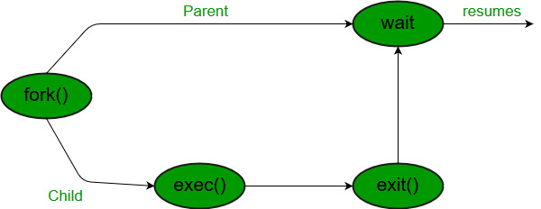
Wait and exit
Exit
void sys_exit(int exitcode)
Condition Variable
a CV is normally used to wait until a variable meets a particular condition.
Operations:
cv_wait Release the supplied lock, go to sleep, and, after waking up again, re-acquire the lock.
cv_signal Wake up one thread that's sleeping on this CV.
The exit system call terminates the execution of a process.
- Find the process in the process table
- Set the exit status of the process in true and set the exit code with the exitcode passed
- Wake up the parent process that's sleeping on the condition variable of this child.
- Remove the process from the process table
- Execution of thread_exit function: cause the current thread to exit

Slide 8
Waitpid
int sys_waitpid(pid_t pid, int *status, int options, pid_t* retval)
The waitpid system call suspends the current process until the child process with the given pid terminates.
-Check that the pid of the process is different from the passed pid
-Find in the process table the process with the passed pid
-Check that the found process has the parent id equal to the pid of the current process, so check the relation parent and child
-Parent process waits until the child terminates with the cv_wait function.
-Set status with child exit code
-Destroy the child process

Slide 9
Runprogram
int runprogram(char *progname, int argc, char **argv)
- This is the main function for executing user programs
- It is called by cmd_progthread function in the menu.c
- Performs various operations:
1. Open the file of the program
2. Create a new address space
3. Switch to it and activate it
4. Load the executable
5. Define the user stack in the address space
6. Copy arguments into user stack
7. Warp to user mode with enter_new_precess function

Slide 10
Execv
int sys_execv(char *program, char **args)
The execv system call replaces the executable code of the current process with the code specified by path.
- It is based on the same operations of runprogram
- A key aspect is arguments handling: sequence of operations to fill the user stack
User space
Kernel buffer
User stack
- Since the data in memory are organized in multiples of 4 bytes, if an argument does not have a multiple of 4 characters, padding 0s must be added

Slide 11
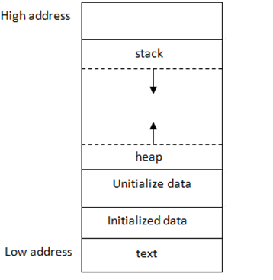
low
Calculate argc and the total amount of memory needed
Fill the kernel buffer with arguments and pointers.
Compute the corresponding pointers to match the arguments positions inside the stack
Copy the kernel buffer inside the user stack.
pointer1
argc
pointer2
pointer3
NULL
arg1
arg2
high
arg3
Kernel buffer

Slide 12
File Management
We have a file_handle structure where we store some variables to manage the file.
File_handle(flags, offset, lock, vnode, ref_count)
We use the file_table that is a vector that contain the pointers of a specific file_handle and this position is the file descriptor FD
The first 3 position of the file_table are reserved and inizialized to
Std_in with FD=0
Std_out with FD=1
Std_err with FD=2
This three file are inizialized in runprogram() when the first process are created.
In this way all next forked_process will have already initialized std_in out and err.

Slide 13
Vnode, vfs and vop
We also use the vnode structure that is used to represent a file in the file system.
The main function used are:
Vfs_open() opens a file in the virtual file system and returns a file descriptor.
Vfs_close() close a file that was opened by vfs_open
Vfs_getcwd() returns the current working directory
The vfs (virtual file system) is an abstraction of a file system that provides to uniform interface for accessing files.
With this feature we can read data from an open file using the VOP_READ() and write data in a file using VOP_WRITE() .

Slide 14
Open
sys_open(userptr_t filename, int flags, int *retfd)
The open system call permits to open a file by a name in different version:
It can be opened in O_RDONLY, O_WRONLY or O_RDWR.
The file it can be O_CREATE, O_TRUNC or opened in O_APPEND.
First of all we search the first empty slot in the file table and create the memory location.
After that we used the vfs_open() to generate the vnode object of the file and we initialize the proprer fields.
The ref_count variable is the number of pointers to an opened file. If this value is 0 the file can be closed.
In case of success return the fd.
Close
sys_close(int fd)
-The close system call is used to close a file using the file descriptor FD. The file can be closed only if the ref_count is equal to 0 otherwise the ref_count is decremented.
-The real close is performed by vfs_close by passing the correct vnode structure of a file.
-The close syscall return 0 in case of success. -1 otherwise.

Slide 15
Write
sys_write(int fd, userptr_t buff, size_t buff_len, int *retval)
The write system call permits to write in the file by passing a specific FD using the VOP_WRITE().
The file must be opened in O_WRONLY or O_RDWR mode.
The size written is given by buf_len starting by the offset of the file.
The write system call returns the amount of bytes written or -1 in case of failure.
Read
sys_read(int fd, userptr_t buff, size_t buff_len, int *retval)
The read system call permits to read the file by passing a specific FD using the VOP_READ().
The file must be opened in O_RDONLY or O_RDWR mode.
The size read is given by buf_len starting by the offset of the file.
The read system call returns the amount of bytes read or -1 in case of failure.

Slide 16
Lseek
sys_lseek(int fd, off_t pos, int whence, off_t *retval)
The lseek system call is used to move the current seek position in the file by passing a fd argument.
The pos indicate the value of offset and whence specifies the starting point for the seek operation. It can be:
SEEK_SET
SEEK_dup2(int oldfd, int newfd, int *retval)CUR
SEEK_END
If the lseek system call success return the new position of pointer otherwise returns 0
Dup2
sys_dup2(int oldfd, int newfd, int *retval)
The dup2 system call permits to duplicate a file descriptor by passing an oldFD and a newFD.
In the dup2 system call the value ref_counter is incremented because now, in the file_table we have 2 pointers to the same file.
Return the newFD in case of success and 0 otherwise.

Slide 17
Chdir
sys_chdir(userptr_t path, int *retval)
The chdir system call permits to change the current working directory with the path specified in the argument.
The main operation are:
Copy the path into k_buf.
vfs_open() to open directory vnode.
Vfs_setcurdir() set current directory as a vnode.
Vfs_close() to close directory vnode.
On success the chdir system call returns 0 , return err in case of failure.
Getcwd
sys_getcwd(userptr_t buf, size_t buf_len, int *retval)
Getcwd system call returns the current working directory path.
Is mainly performed by vfs_getcwd() that using the uio structure reads the path of the current proc and write in a buffer.
On success the system call return the lenght of the current pathname directory and err in case of failure.

Slide 18
End

