Slide 1

SWE Midterm Milestone
Presented by Joy Itodo

Slide 2

Problem Statement
Teams struggle with poor task organization, schedule conflicts, manual task assignment, lack of real-time collaboration, and limited data-driven insights
Traditional task management tools are way too complex, do not intelligently reorganize schedules, and lack AI-assisted planning.

Slide 3
Proposed Feature (MVP)
User Authentication & Profile Management
Project Creation & Editing
Task Creation, Editing, and Deletion
Team Member Assignment
Task Status & Priority Color Coding

Slide 4
Proposed Features (Stretch Goals)
Lock-Based Concurrency Control (Prevents simultaneous edit conflicts)
Real-Time Notifications
AI Functionality
Data Visualization (Pie Charts & Progress Tracking)

Slide 5
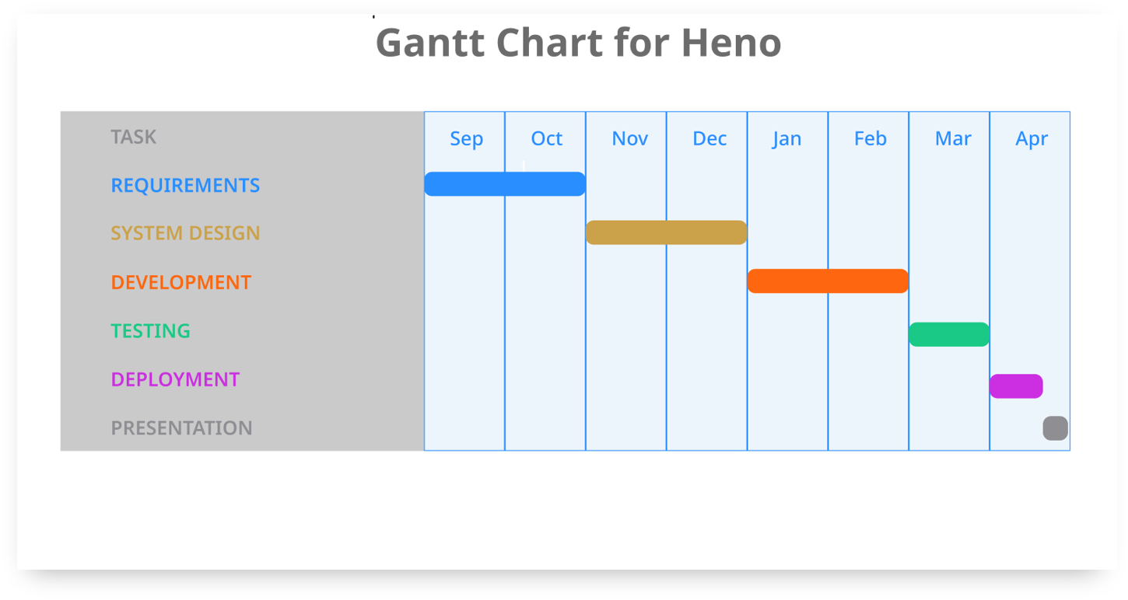

Slide 6
Completed | Planned
User Authentication | Email and in-app notification
User Authorization | AI Functionality
Database set up
Frontend
Calendar Functionality

Slide 7
Progress Percentage

Slide 8
Challenges
While integrating the Gemini LLM, I encountered API rate limits, which restricted the number of AI requests that could be made within a certain time frame. This affected testing and slowed development.
I initially struggled with deploying the full-stack application due to configuration issues between the frontend, backend, and database environment variables.

