Slide 1


From Signal Processing to Quantum Encoding: EEG-Based Attention Paradigm Classification
QUANTUM BRAINATHON-25
EEG Attention Multiclassification Challenge
Enrolment Number: 23RAJCBSPH000008

Slide 2
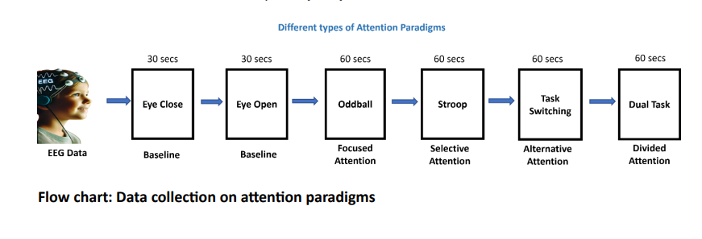
Some Introduction to the data set:
This dataset contains EEG (Electroencephalography) recordings collected from multiple subjects during different cognitive tasks and baseline conditions. The goal is to analyze EEG signals, extract relevant features, and classify cognitive states or tasks using advanced machine learning models, including Quantum Machine Learning (QML).
Each EEG CSV file contains multichannel data from electrodes placed on the subject’s scalp according to the 10-20 international syste. The columns represent different electrodes eg.(fp1, fp2, cz, pz) and each row represents the signal amplitude recorded at a given time point (in microvolts, µV). Marker Files provide labels or timestamps indicating significant events during the task.
EEG Sampling and Frequency Bands:
EEG signals are recorded at a sampling frequency of 250 Hz, capturing changes in brain activity over time. EEG data is typically analysed in different frequency bands to understand brain states:
Delta (0.5–4 Hz): Deep sleep
Theta (4–8 Hz): Drowsiness, meditation
Alpha (8–13 Hz): Relaxed state, closed eyes
Beta (13–30 Hz): Active thinking, focus
Gamma (>30 Hz): High-level cognitive processing
Each subject’s EEG data is recorded in multiple experimental paradigms, such as:
Baseline Eyes Closed and Eyes Open: Captures resting-state brain activity.
Dual-Task Paradigm: Simulates a multitasking environment to assess cognitive load.
Oddball Paradigm: Used to study attention and event-related potentials (ERP).
Stroop Task: A classic cognitive test that measures selective attention and response inhibition.
Task-Switching Paradigm: Evaluates cognitive flexibility by requiring frequent task switching.

Slide 3
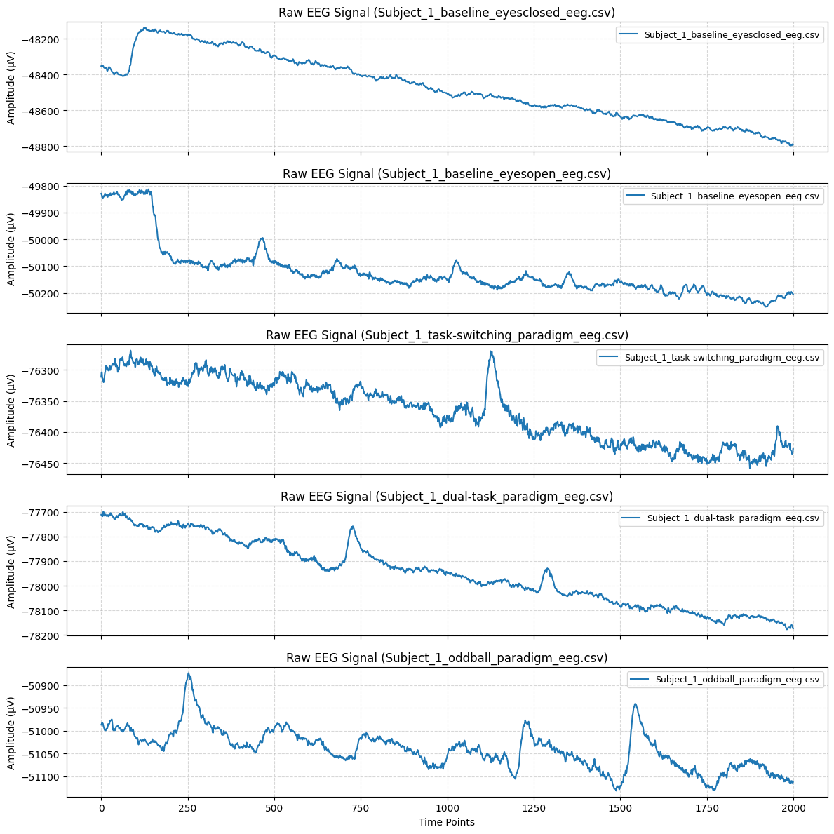
Metric analysis
The baseline conditions (eyes closed vs. eyes open) show clear differences in amplitude and wave structure, reflecting typical resting-state EEG characteristics.
The task-related paradigms (task-switching, dual-task, oddball) contain distinct peaks and variations, which suggest the presence of event-related potentials (ERPs).
The oddball paradigm displays clear transient responses, which can be useful in detecting cognitive responses to infrequent stimuli.

Slide 4
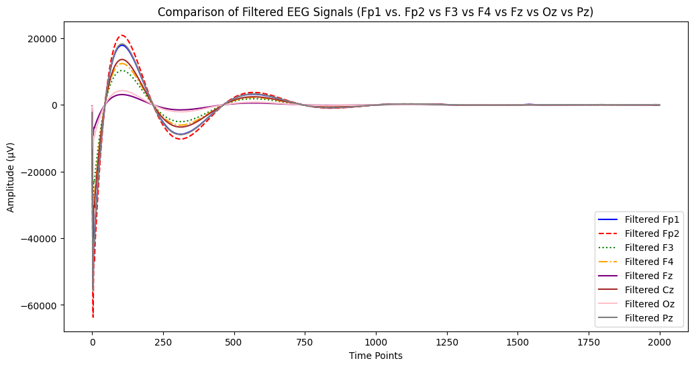

Slide 5
Observations Between EEG Channels after bandpass filter
EEG Channel | Region of Brain | Observation
Fp1, Fp2 | Prefrontal Cortex | Show highest initial response, meaning prefrontal involvement is significant.
F3, F4 | Frontal Cortex | Lower than Fp1/Fp2 but still shows strong oscillations.
Fz | Mid-Frontal | More stable than frontal electrodes, showing less oscillatory behavior.
Cz | Central Cortex | Displays moderate amplitude with less extreme peaks.
Oz, Pz | Occipital & Parietal | Show least fluctuation, meaning the visual cortex is less engaged in this response.

Slide 6
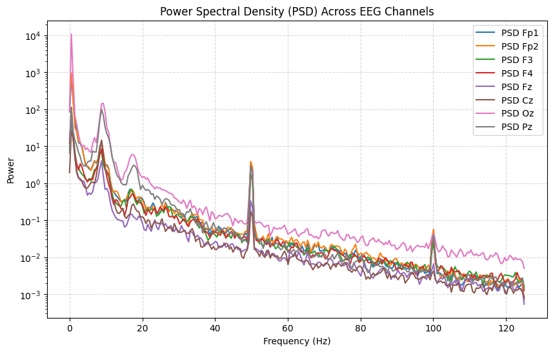

Slide 7
Differences Between EEG Channels for Power Spectral Density
EEG Channel | Region of Brain | Observation from PSD
Fp1, Fp2 | Prefrontal Cortex | Strong power in low frequencies, moderate alpha band activity
F3, F4 | Frontal Cortex | Similar to Fp1/Fp2, but slightly lower power at higher frequencies
Fz | Mid-Frontal | Shows less variation, suggesting more stable activity
Cz | Central Cortex | Similar to mid-frontal, with low power at high frequencies
Oz, Pz | Occipital & Parietal | Higher power in low frequencies (theta, delta), possibly due to visual cortex activity

Slide 8
Explanation to the Full QML Pipeline
Quantum Machine Learning (QML) pipeline follows a structured approach that combines EEG signal processing, feature engineering, quantum feature encoding, hybrid model training, and evaluation.
The first step involves data acquisition and preprocessing, where raw EEG signals are collected and filtered using bandpass filtering (0.5–50 Hz) to remove noise and artifacts. This ensures that only relevant brain activity is retained for analysis. Next, feature engineering is performed, where both time-domain features (e.g., mean, standard deviation, peak-to-peak amplitude) and frequency-domain features (e.g., power in Alpha, Beta, and Theta bands) are extracted to capture essential signal characteristics. To further optimize the dataset, Principal Component Analysis (PCA) is applied, reducing redundancy and making the dataset more computationally efficient.
Since EEG data is often imbalanced, Synthetic Minority Over-Sampling Technique (SMOTE) is used to balance class distributions, preventing bias toward the majority class. After balancing, the data undergoes quantum feature encoding, where EEG features are mapped into quantum states using Angle Encoding. This step ensures that quantum circuits can effectively process classical data, and alternative encoding techniques like IQP Encoding could further enhance performance.
Following feature encoding, the data is processed by a Hybrid Quantum Neural Network (QNN), which consists of a quantum circuit for feature extraction and a classical dense layer for classification. The Strongly Entangling Layers in the quantum circuit help capture complex relationships within the EEG data. The model is trained using the Adam optimizer, which adjusts weights iteratively to improve classification accuracy.
Once the model is trained, its performance is evaluated using accuracy, AUC-ROC score, precision-recall curves, and confusion matrices. The AUC-ROC score (0.61) indicates that the model is slightly better than random guessing, and the confusion matrix reveals how well the model distinguishes between EEG classes. Additionally, a feature correlation heatmap is generated to identify the top 20 most important EEG features, helping in refining the model by removing redundant features.
Overall, this QML pipeline successfully integrates classical EEG signal processing with quantum machine learning, demonstrating the potential of quantum-enhanced models for EEG classification. However, further improvements, such as optimizing quantum encodings, fine-tuning hyperparameters, and testing on real quantum hardware, can be explored to achieve better accuracy and generalization.

Slide 9
Feature Engineering
Extracted time-domain features:
Mean, Standard Deviation, Peak-to-Peak Amplitude
Extracted frequency-domain features:
Alpha (8–13 Hz), Beta (13–30 Hz), Theta (4–8 Hz) power levels
Applied Principal Component Analysis (PCA) to reduce dimensionality.
Why It’s Important
Time-domain features capture signal fluctuations over time.
Frequency-domain features capture cognitive activity (e.g., increased beta power → higher mental focus).
PCA reduces redundant features, improving model efficiency.
Code Used:
pca = PCA(n_components=18) # Match number of qubits X_pca = pca.fit_transform(X)
Outcome:
A compact and relevant feature set, preserving only the most important EEG characteristics for QML.

Slide 10
Data Balancing with SMOTE
Used SMOTE (Synthetic Minority Over-sampling Technique) to balance EEG classes.
Why It’s Important
EEG datasets are naturally imbalanced, with some paradigms occurring more often than others.
SMOTE generates synthetic samples to balance the dataset and prevent bias.
Code Used:
smote = SMOTE(random_state=42) X_smote, y_smote = smote.fit_resample(X, y)
Outcome:
A balanced dataset, ensuring fair model training and preventing bias.

Slide 11
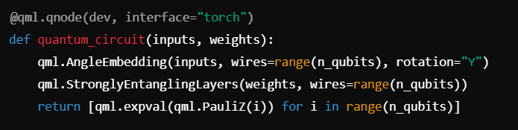
Quantum Feature Encoding
Angle encoding is a technique used in quantum computing to represent classical data in quantum states. It involves using the angles of rotation gates to encode information into qubits, allowing for the manipulation and processing of that information within quantum algorithms and computations.
Mapped EEG features into quantum states using Angle Encoding.
Considered alternative encoding methods (IQPEncoding, Basis Encoding).
Why It’s Important
Classical ML struggles with high-dimensional, nonlinear patterns in EEG data.
Quantum encoding maps classical data to a quantum state space, allowing entanglement-based feature extraction.
Code Used:
Outcome:
EEG features are embedded into a quantum circuit, enabling quantum-enhanced feature learning.

Slide 12
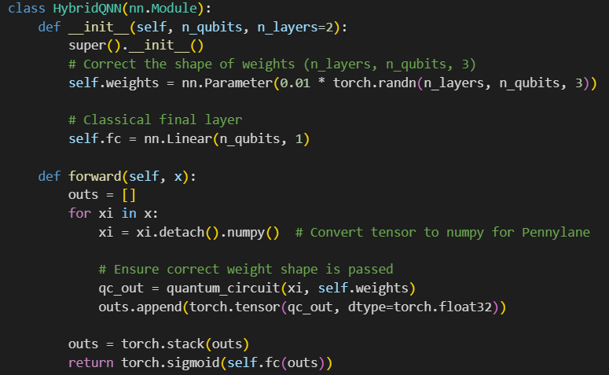
Hybrid Quantum Model Training
Implemented Quantum Neural Network (QNN):
Quantum Feature Extraction → Classical Neural Network for Classification
Used Strongly Entangling Layers to capture quantum correlations.
Why It’s Important
Hybrid models leverage quantum feature extraction while utilizing classical backpropagation for training.
Entanglement allows the model to learn richer feature relationships.
Training Loss
Epoch 1/20, Loss: 0.6906 Epoch 2/20, Loss: 0.6905 Epoch 3/20, Loss: 0.6905 Epoch 4/20, Loss: 0.6905 Epoch 5/20, Loss: 0.6904 Epoch 6/20, Loss: 0.6904 Epoch 7/20, Loss: 0.6904 Epoch 8/20, Loss: 0.6903 Epoch 9/20, Loss: 0.6903 Epoch 10/20, Loss: 0.6903 Epoch 11/20, Loss: 0.6902 Epoch 12/20, Loss: 0.6902 Epoch 13/20, Loss: 0.6902 Epoch 14/20, Loss: 0.6902 Epoch 15/20, Loss: 0.6901 Epoch 16/20, Loss: 0.6901 Epoch 17/20, Loss: 0.6901 Epoch 18/20, Loss: 0.6900 Epoch 19/20, Loss: 0.6900 Epoch 20/20, Loss: 0.6900
Code Used:
Outcome:Successfully trained a quantum-classical model for EEG classification.

Slide 13
Quantum Model Performance
Confusion Matrix
16 true negatives (correct class 0 predictions)
9 false negatives (misclassified class 1 as class 0)
13 false positives (misclassified class 0 as class 1)
20 true positives (correct class 1 predictions)
Takeaway:
Model correctly classifies more class 1 instances than class 0.
False positives are slightly higher, meaning the model sometimes mistakes class 0 for class 1.
Achieved 62% accuracy on the EEG classification task.
Precision (0.64 for class 0, 0.61 for class 1)
Indicates how many of the predicted positives are actually correct.
Recall (0.55 for class 0, 0.69 for class 1)
Shows how many actual positives were correctly identified.
F1-score (0.59 for class 0, 0.65 for class 1)
A balance between precision and recall.
Macro Avg & Weighted Avg: 0.62
Reflects overall model performance across both classes.
Interpretation
The model is better at identifying class 1 than class 0, as recall for class 1 (0.69) is higher than class 0 (0.55).
The precision and recall balance indicates that the model can detect EEG patterns, but further improvements are needed for robustness.

Slide 14
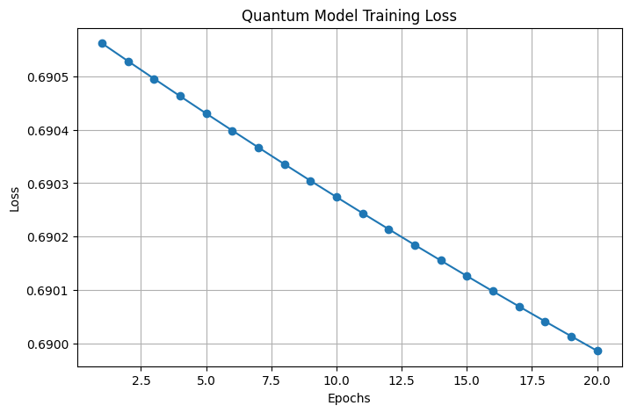

Slide 15
Model Evaluation & Performance Analysis
Measured Accuracy, AUC-ROC, and Precision-Recall Metrics.
Confusion Matrix Analysis to check misclassification.
Compared Quantum vs. Classical Models (Random Forest, SVM).
Why It’s Important
Accuracy alone is not enough → AUC-ROC & Precision-Recall show model performance across different thresholds.
Comparison with classical models helps quantify the advantage of quantum computing.

Slide 16
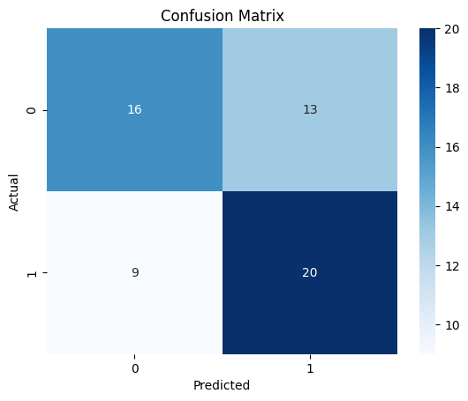
Confusion Matrix
16 true negatives (correct class 0 predictions)
9 false negatives (misclassified class 1 as class 0)
13 false positives (misclassified class 0 as class 1)
20 true positives (correct class 1 predictions)
Takeaway:
Model correctly classifies more class 1 instances than class 0.
False positives are slightly higher, meaning the model sometimes mistakes class 0 for class 1.

Slide 17
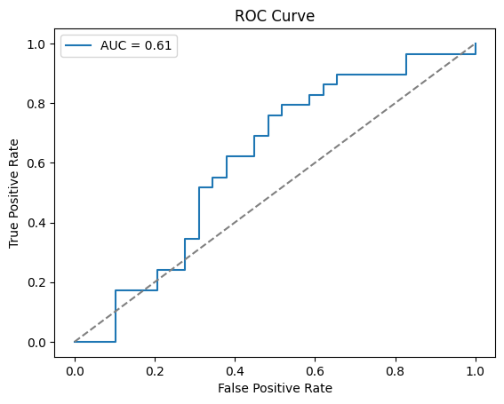
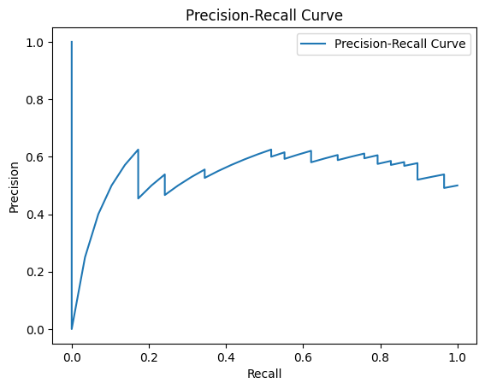
ROC Curve (Receiver Operating Characteristic)
Precision-Recall Curve
The Precision-Recall (PR) curve measures the trade-off between Precision and Recall.
Precision = True Positives / (True Positives + False Positives)
Recall = True Positives / (True Positives + False Negatives)
AUC (Area Under Curve) Score = 0.61AUC measures how well the model distinguishes between classes.
AUC = 1.0 → Perfect classification
AUC = 0.5 → Random guessing
My AUC = 0.61 → Slightly better than random guessing, but needs improvement.
Interpretation:
The model has high precision at very low recall but then fluctuates.
Precision is unstable, meaning the model sometimes makes uncertain predictions.

Slide 18
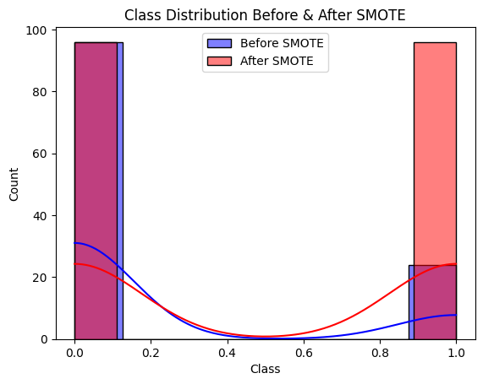
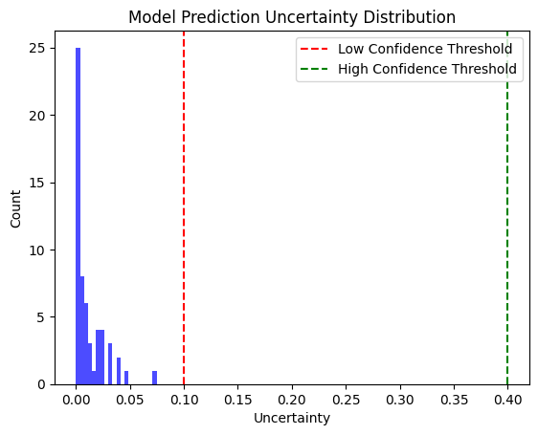
Before SMOTE (Blue Distribution)
The dataset was imbalanced → One class (0 or 1) had significantly more samples than the other.
The minority class had fewer training examples, leading to a potential bias in model predictions.
After SMOTE (Red Distribution)
The dataset is now balanced → Both classes have approximately the same number of samples.
SMOTE generated synthetic samples for the minority class to match the majority class count.
More evenly distributed data improves model fairness and classification accuracy.
Prediction Uncertainty Distribution:
The model struggles with confidence in some predictions.
Uncertainty close to 0.5 suggests that for certain EEG patterns, the model is not sure about classification.

Slide 19
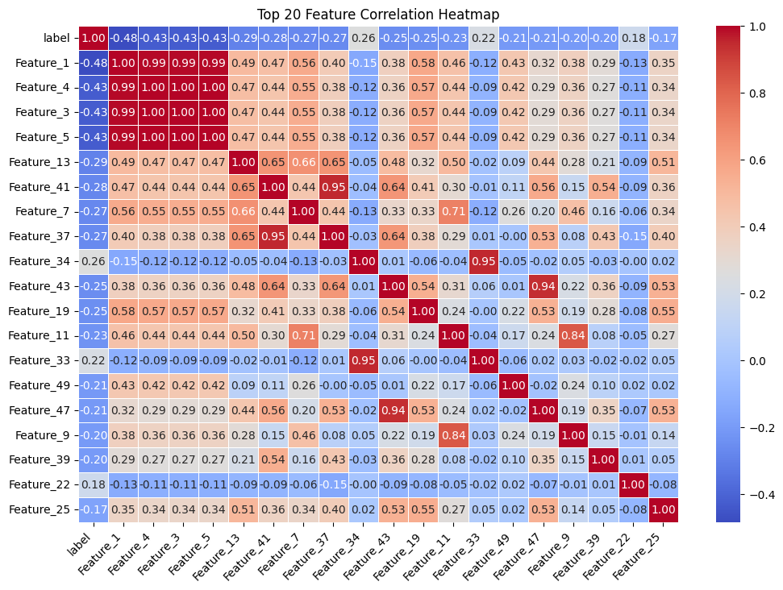

Slide 20
References
Pennylane QML Library
Nielsen & Chuang (2010), Schuld & Petruccione (2018), Pennylane Docs - Quantum ML & Encoding
Cohen (2014), Welch (1967), Scipy Signal Docs
Guyon (2003), Hastie (2009), Scikit-learn Docs

Slide 21
Thanks

