Slide 1

FW893
Metacoupling Science:
Interdisciplinary Frontiers and Global Applications
Spring 2021
https://powerlanguage.net/blog/2019/09/24/powerlanguage-conference-2019-welcome-everyone/welcome/

Slide 2
Introduction
Overview of Syllabus
Global issues and UN Sustainable Development Goals
Q & A

Slide 3
Self-Introduction
Name
Background
Interests

Slide 4
Course Overview
Number of Credits: 1
Class Time: 9:00-9:50 am (Thursdays)
https://msu.zoom.us/j/98860800441?pwd=NjljVXBUbEZ5aGlwOVd4N2o3eXU1QT09
Office Hour: 10:00-11:00
Sign up: https://docs.google.com/spreadsheets/d/1Adw1Uxj7Ygdp2AClRtdG0Yk2rpkQff6Crfjwnk3r92w/edit?usp=sharing
Email appointments for meetings during other times

Slide 5
Course Content
Examine key issues and exciting frontiers
New science of metacoupling (human-nature interactions within as well as between adjacent and distant coupled human and natural systems, e.g., social-ecological systems, human-environment systems).
Metacoupling science helps guide innovative scientific discoveries and create integrated solutions to global challenges in sustainability, conservation, management, policy, and governance.
Important metacoupling concepts, methods, applications to a variety of important scientific, socioeconomic, and environmental issues (e.g., biodiversity, climate change, ecosystem services, energy, environment, fisheries, food, forest, species invasion, land, trade, water, and wildlife), students will have
Opportunities to learn how to write high-impacts papers and communicate with global news and social media.

Slide 6
Grading (Pass or Fail) and Expectations
Read the reading materials before class
Attend every class (unless beyond control and received approval)
Ask and answer questions
Lead discussion
Turn off or silence phones
Do nothing unrelated during class
Have fun☺

Slide 7
Optional Term Project
Objective: Practice writing a paper (e.g., empirical analysis, literature review, synthesis, or perspectives)
Topic: Issues related to metacoupling (telecoupling, pericoupling, and/or intracoupling)
Project Type: Individual or group project.
Suggested Timeline:
Project proposal (topic and outline): February 15
Draft paper: April 10
Final paper: April 30
A project proposal may consist of the following aspects:
Background and motivation for the proposed research
Research goal and objectives
Research questions and/or hypotheses
Methods (e.g., conceptual diagram(s) to illustrate relationships among different research components, data, analysis methods)
Feasibility (e.g., data availability, possible data gaps)
Expected outcomes (e.g., expected research findings)
Significance

Slide 8
Course Schedule
Date | Topic (Guest Speaker if Any)
1/21 | Introduction, Course Overview, Global Issues and UN Sustainable Development Goals
1/28 | Coupled Human and Natural Systems
2/4 | Telecoupling
2/11 | Metacoupling
2/18 | Critiques and Clarifications
2/25 | How to Write High-impact Papers (Dr. Zhenci Xu, The University of Hong Kong)
3/4 | Telecoupled Agent-based Modeling (Dr. Yue Dou, Vrije Universiteit Amsterdam, The Netherlands)
3/11 | Opportunities for Metacoupling Research on Protected Areas (Dr. Vanessa Hull, University of Florida)
3/18 | Human-Wildlife Interactions (Coexistence) (Dr. Neil Carter, University of Michigan)
3/25 | Fisheries as metacoupled human and natural systems (Dr. Andrew Carlson, Princeton University)
4/1 | Amplify Metacoupling Research Impact through Global News and Social Media (Sue Nichols, Assistant Director of Strategic Communication, CSIS)
4/8 | Systems Integration and Governance
4/15 | Europe’s PhD Program in Telecoupling (Dr. Jonas Ø. Nielsen, Humboldt-Universität zu Berlin, Germany)
4/22 | No Class (study day)
4/29 | Reflections and Perspectives (and potential short presentations by those students who choose to do research projects, if any)

Slide 9
Format
Lecture
Q&A
Hands-on exercises
Discussion

Slide 10
Discussion Leaders
2-3 students leading the discussion for each class
Provide a good opportunity for students to practice more leadership skills.
Read the reading materials in more detail
Prepare some questions
Facilitate discussion
Please choose which weeks/topics you would like to take the lead
Visit the google document (https://docs.google.com/spreadsheets/d/1FC0z9qjIpBy8YaNGpQIILq5qmPH-sUG7Z5Guegg9lQ8/edit?usp=sharing).
Write down top 4 preferred ones (1 = highest preference, 2, 3, and 4)

Slide 11
Reading Materials
(PDF of each paper can be downloaded from the GitHub folder at https://github.com/MetaCHANS/Metacoupling-Science-Course/tree/main/readings)

Slide 12
Optional Reading Materials
(PDF of each paper can be downloaded from the GitHub folder at https://github.com/MetaCHANS/Metacoupling-Science-Course/tree/main/readings)
Websites
Telecoupling: www.telecoupling.org
Telecoupling Toolbox: https://telecouplingtoolbox.org/
Global Land Programme’s Telecoupling Working Group: https://glp.earth/how-we-work/working-groups/telecoupling-research-towards-sustainable-transformation-land-systems
CHANS-Net: International Network of Research on Coupled Human and Natural Systems (http://chans-net.org/)
https://sdgs.un.org/2030agenda
Progress and Perspectives
Applications
Methods

Slide 13
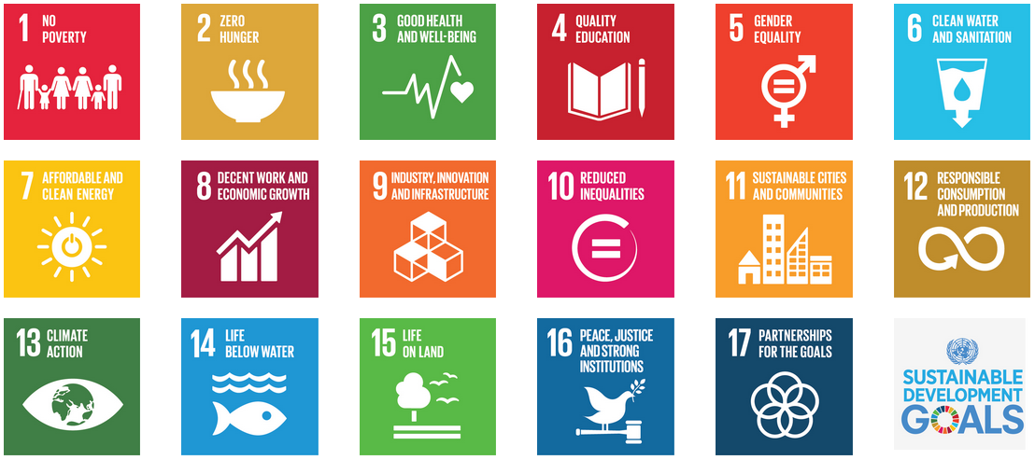
UN’s Sustainable Development Goals (SDGs) * 2030 Agenda Adopted by 193 Nations *
United Nations 2015
Notes:
目标
议程
Convert this into a figure showing domination

Slide 14
Web Site of UN Sustainable Development Goals
https://sdgs.un.org/goals

Slide 15
What Scientists Can Do
Advance Knowledge
Discover hidden phenomena
Understand the causes of global challenges
Assess the progress toward SDGs
Identify potential solutions to advance SDGs
Translate knowledge into action
Policy recommendations
Work with stakeholders to refine and implement recommendations if possible

Slide 16
Q&A

Slide 17
To Do Before Next Class
Sign up on the Discussion Leaders sheet if you have not done so
Read the papers for next week

