Slide 1
A general, geometric construction of coordinates in a convex simplicial polytope
Tao Ju
Washington University in St. Louis

Slide 2
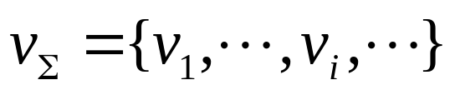


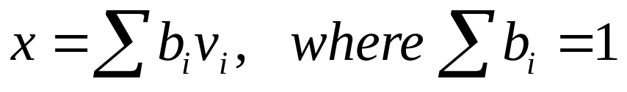


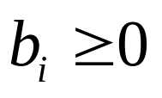
Coordinates
Homogeneous coordinates
  Given points
  Express a new point as affine combination of
  are called homogeneous coordinates
  Barycentric if all

Slide 3
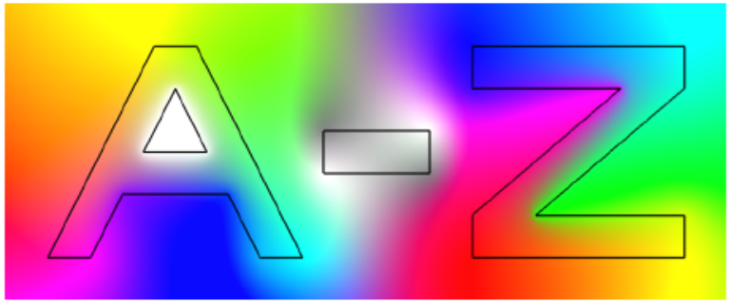
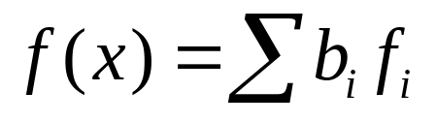

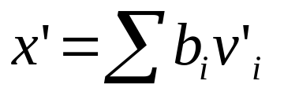
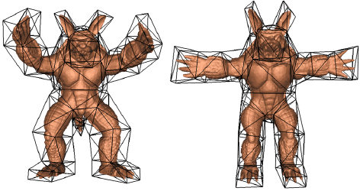
Applications
Boundary interpolation
  Color/Texture interpolation
Mapping
  Shell texture
  Image/Shape deformation
[Hormann 06]
[Porumbescu 05]
[Ju 05]

Slide 4

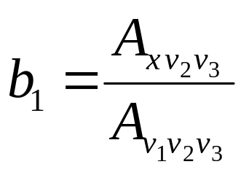


Coordinates In A Polytope
Points form vertices of a closed polytope
  x lies inside the polytope
Example: A 2D triangle
  Unique (barycentric):
  Can be extended to any N-D simplex
A general polytope
  Non-unique
  The triangle-trick can not be applied.

Slide 5
Previous Work
2D Polygons
  Wachspress [Wachspress 75][Loop 89][Meyer 02][Malsch 04]
    Barycentric within convex shapes
  Discrete harmonic [Desbrun 02][Floater 06]
    Homogeneous within convex shapes
  Mean value [Floater 03][Hormann 06]
    Homogeneous within any closed shape, barycentric within convex shapes and kernels of star-shapes
3D Polyhedrons and Beyond
  Wachspress [Warren 96][Ju 05]
  Discrete harmonic [Meyer 02]
  Mean value [Floater 05][Ju 05]

Slide 6




Previous Work
A general construction in 2D [Floater 06]
  Complete: a single scheme that can construct all possible homogeneous coordinates in a convex polygon
  Reveals a simple connection between known coordinates via a parameter
    Wachspress:
    Mean value:
    Discrete harmonic:
What about 3D and beyond? (this talk)
  To appear in Computer Aided Geometric Design (2007)

Slide 7
To answer the question…
Yes, a general construction exists in N-D
  A single scheme constructing all possible homogeneous coordinates in a convex simplicial polytope
    2D polygons, 3D triangular polyhedrons, etc.
The construction is geometric: coordinates correspond to some auxiliary shape
  Intrinsic geometric relation between known coordinates in N-D
    Wachspress: Polar dual
    Mean value: Unit sphere
    Discrete harmonic: Original polytope
  Easy to find new coordinates

Slide 8
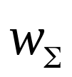
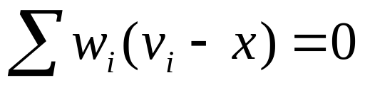
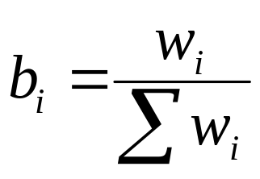
Homogenous Weights
We focus on an equivalent problem of finding weights such that
  Yields homogeneous coordinates by normalization

Slide 9





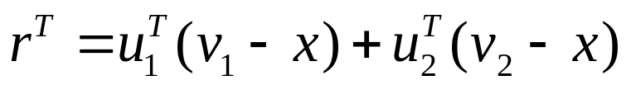
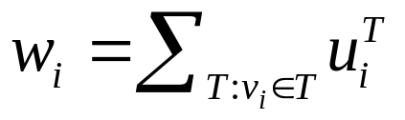
2D Mean Value Coordinates
We start with a geometric construction of 2D MVC
  Place a unit circle at . An edge projects to an arc on the circle.
  Write the integral of outward unit normal of each arc, , using the two vectors:
  The integral of outward unit normal over the whole circle is zero. So the following weights are homogeneous:
v₂
v₁
x

Slide 10

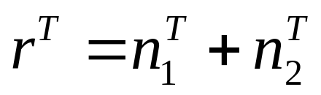
2D Mean Value Coordinates
To obtain :
  Apply Stoke’s Theorem
v₂
v₁
T
T
-n₁
-n₂
x

Slide 11

Our General Construction
Instead of a circle, pick any closed curve
  Project each edge of the polygon onto a curve segment on .
  Write the integral of outward unit normal of each arc, , using the two vectors:
  The integral of outward unit normal over any closed curve is zero (Stoke’s Theorem). So the following weights are homogeneous:
v₂
v₁
x

Slide 12
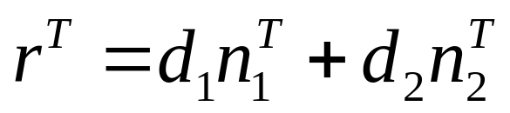
Our General Construction
To obtain :
  Apply Stoke’s Theorem
v₂
v₂
v₁
v₁
d₁
d₂
d₁
x
x
-d₂

Slide 13
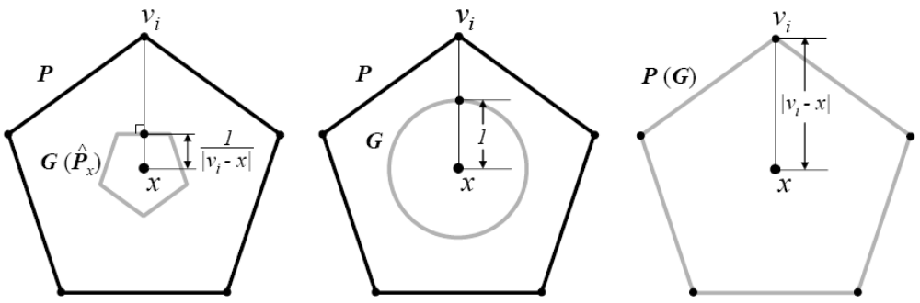
Examples
Some interesting result in known coordinates
  We call the generating curve
Wachspress
(G is the polar dual)
Mean value
(G is the unit circle)
Discrete harmonic
(G is the original polygon)

Slide 14

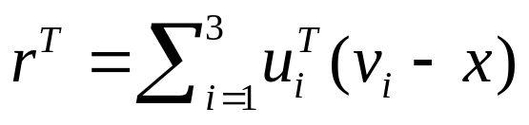
General Construction in 3D
Pick any closed generating surface
  Project each triangle of the polyhedron onto a surface patch on .
  Write the integral of outward unit normal of each patch, , using three vectors:
  The integral of outward unit normal over any closed surface is zero. So the following weights are homogeneous:
v₂
r^{T}
v₃
x
v₁

Slide 15
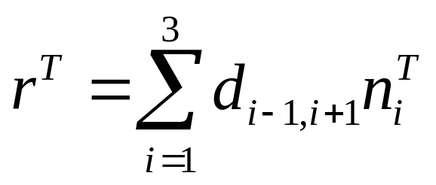
General Construction in 3D
To obtain :
  Apply Stoke’s Theorem
v₂
T
-n₃
r^{T}
d_{1,2}
v₃
x
v₁

Slide 16
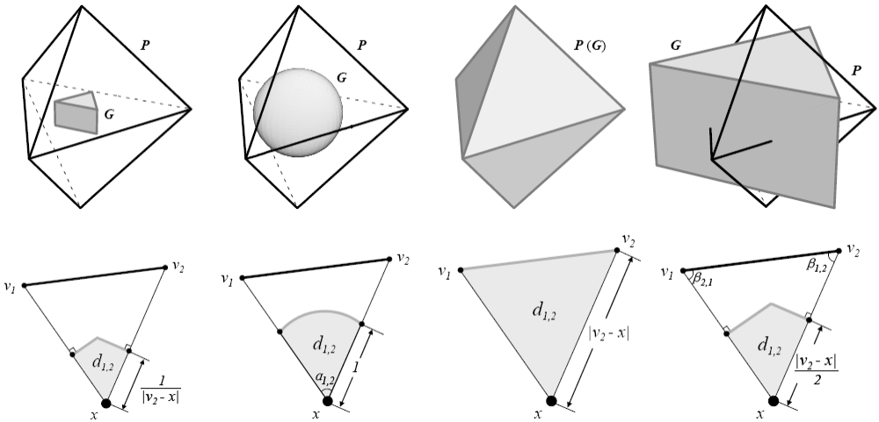
Examples
Wachspress
(G: polar dual)
Mean value
(G: unit sphere)
Discrete harmonic
(G: the polyhedron)
Voronoi
(G: Voronoi cell)

Slide 17
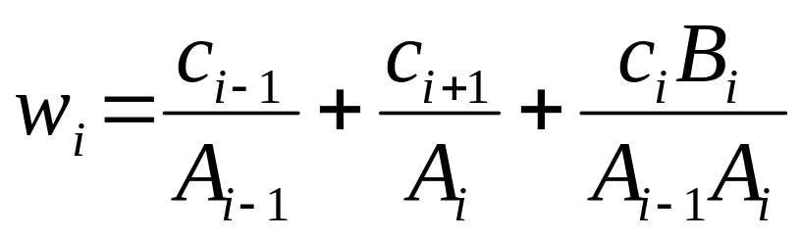
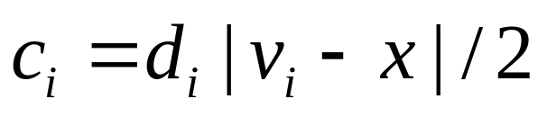
An Equivalent Form – 2D
Same as in [Floater 06]
  Implies that our construction reproduces all homogeneous coordinates in a convex polygon
v_{i}
v_{i-1}
A_{i-1}
A_{i}
v_{i+1}
where
x
v_{i}
v_{i-1}
v_{i+1}
B_{i}
x

Slide 18
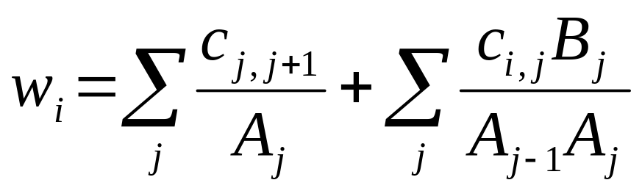
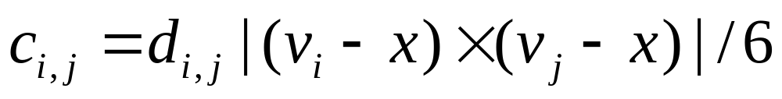
An Equivalent Form – 3D
v_{i}
3D extension of [Floater 06]
  We showed that our construction yields all homogeneous coordinates in a convex triangular polyhedron.
v_{j-1}
A_{j-1}
A_{j}
v_{j+1}
v_{j}
where
x
v_{i}
C_{j}
v_{j-1}
v_{j+1}
B_{j}
v_{j}
x

Slide 19
Summary
For any convex simplicial polytope
Geometric
  Every closed generating shape (curve/surface/hyper-surface) yields a set of homogeneous coordinates
    Wachspress: polar dual
    Mean value: unit sphere
    Discrete harmonic: original polytope
    Voronoi: voronoi cell
Complete
  Every set of homogeneous coordinates can be constructed by some generating shape

Slide 20
Open Questions
What about non-convex shapes?
  Coordinates may not exist along extension of faces
    Do we know other coordinates that are well-defined for non-convex, besides MVC?
What about continuous shapes?
  General constructions known [Schaefer 07][Belyaev 06]
  What is the link between continuous and discrete constructions?
What about non-simplicial polytopes?
  Initial attempt by [Langer 06]. Does such construction agree with the continuous construction?
What about on a sphere?
  Initial attempt by [Langer 06], yet limited to within a hemisphere.

