Slide 1
ISC 2026 · BIRDS OF A FEATHER
Towards a federated European AI Hub
A technical angle
What the artefacts are, how we handle them, and how they could be federated?
Containers
Model weights
Datasets
Embeddings / RAG
Provenance & trust
Distribution
BoF: Towards a federated European AI Hub · ISC 2026
Moderator: Christian Kniep · QNIB Solutions

Slide 2
ISC 2026 · BIRDS OF A FEATHER
Towards a federated European AI Hub
A common hub for models, embeddings, vector DBs & RAG across EuroHPC. Non-commercial, community-driven — short lightning talks + moderated roundtables, live Q&A.
Moderator
EuroHPC
Vendor
Vendor
US perspective
Christian Kniep
Henrik Nortamo
CJ Newburn
Martin Hilgeman
Scott Atchley
QNIB Solutions
CSC
NVIDIA
AMD
ORNL
Container in HPC · session host
EuroHPC Federation Platform
Vendor ecosystem & artifact distribution
Vendor ecosystem & ROCm
Genesis Mission
BoF: Towards a European AI Hub · ISC 2026
hpcw (at) qnib.org

Slide 3
ISC 2026 · SESSION PLAN
Agenda
Four themed segments — short lightning talks priming focused roundtables — then open networking.
1 Building Blocks
What are the building blocks, how do they look, and how do we handle them?
Blobs · OCI images (PyTorch, vLLM) · model weights · spatial data (RAG, embeddings, memory) …
Lightning talk
2 Current State & Challenges
How do we handle them today and what are the challenges?
Perspectives from the US (Genesis Mission) and from EuroHPC
Lightning talks + roundtable
3 Vendor & Project Ecosystems
What do the vendor ecosystems look like?
NVIDIA · AMD
Lightning talks + roundtable
4 The Future
What do we want — and is it achievable?
Design principles, federation models, sovereignty, governance, and a path forward
Extended roundtable (main session)
END BoF closes — networking continues
BoF: Towards a European AI Hub · ISC 2026
Tentative — segments adapt to the room

Slide 4
FRAMING · TERMS FIRST
"Federation" — of what, exactly?
The word hides two different problems. This BoF is about the second — but it stands on the first.
Identity & resource access
Artifacts
the plumbing — who may run what, where
this BoF — the models, data & provenance
Federated AuthN / AuthZ
home credentials at any site (AAI: MyAccessID, eduGAIN, EOSC)
Distribute & discover
models, data, embeddings, containers
Allocation & accounting
compute grants, quotas, usage
Provenance travels with the artifact
cards, lineage, signatures
Inter-site trust agreements
policy & legal alignment
Independent of where it was produced
pull it down anywhere, trust it
Largely the EuroHPC Federation Platform's domain
heavyweight, organisational
Depends on identity federation — but a separate problem
lighter, technical
BoF: Towards a European AI Hub · ISC 2026
Sets the scope before Segment 1
Notes:
Reality check: EuroHPC-level federation is hard to join — so national programmes go ahead with their own stacks, and fragmentation becomes the default. Artifact federation may be the lighter-weight, more joinable entry point — if we don't bolt it onto the heavyweight access layer.

Slide 5
1
SEGMENT 1
Building Blocks
What are the building blocks, how do they look, and how do we handle them?
Blobs · OCI images (PyTorch, vLLM) · model weights · spatial data (RAG, embeddings, memory) …
Lightning talk
BoF: Towards a European AI Hub · ISC 2026

Slide 6
SEGMENT 1 · BUILDING BLOCKS
What are the building blocks?
Grouped by how they behave — because that, not the file type, decides how you handle & federate them.
Heavy & static
Mutable state
Lightweight & coupled
Metadata & trust
strategy: mirror / cache
strategy: sync
strategy: version-control
strategy: index & sign
Container images
PyTorch, vLLM, TGI, CUDA/ROCm
Embeddings & vector indices
continuously rebuilt
Tokenizers & configs
must travel with the weights
Model cards & datasheets
what it is, how trained
Model weights & checkpoints
base, fine-tunes, LoRA, optimizer state
RAG corpora
retrieval knowledge bases
Prompts
system, templates, few-shot
Lineage & provenance
where it came from
Datasets
training, fine-tuning, eval / benchmark
Agent / session memory
stateful, per-run
Skills & tools
MCP servers, function defs
Signatures & attestations
cosign / sigstore
Compiled formats
GGUF, ONNX, TensorRT / ROCm engines
Harness & pipelines
serving config, agent scaffolding
SBOMs
supply-chain integrity
BoF: Towards a European AI Hub · ISC 2026
Segment 1 · Lightning talk

Slide 7
SEGMENT 2 · CURRENT STATE & CHALLENGES
How we handle artifacts today — and the gap
Plenty of pieces already exist across registries, HPC, vendors and adjacent domains. The challenge is what's missing between them.
Model & artifact registries
HPC distribution fabric
Vendor ecosystems
Hugging Face Hub
OCI + ORAS
CVMFS (CERN)
Spack mirrors / build caches
NVIDIA NGC / NIM
AMD Infinity Hub
KServe ModelCars
Ollama
Apptainer / Singularity
EESSI
CNCF OPEA
Federation & national efforts
Supply-chain trust
Solved analogues
EuroHPC Federation Platform (CSC)
Sigstore / cosign
SLSA / in-toto
PyPI / conda mirrors
CERN data federation
Genesis Mission (ORNL)
GAIA-X / AI-on-Demand
SBOM — SPDX, CycloneDX
Linux distro mirror nets
The gap: no sovereign, HPC-native, trust-aware fabric that federates models + data + provenance together — and nobody has solved the cost / egress problem at federation scale.
BoF: Towards a European AI Hub · ISC 2026
US (Genesis Mission) + EuroHPC perspectives

Slide 8
2
SEGMENT 2
Current State & Challenges
How do we handle them today — perspectives from the US and the EU.
US: Genesis Mission (ORNL) · EU: EuroHPC Federation Platform (CSC)
Lightning talks + roundtable
BoF: Towards a European AI Hub · ISC 2026

Slide 9
US perspective
Scott Atchley
ORNL — Genesis Mission (US)
An Overview of the Genesis Mission
The Genesis Mission is a national effort to build new industries, create high-skill jobs, and usher a new era of American discovery through artificial intelligence innovation.
The Genesis Mission’s American Science and Security Platform will connect the world’s best supercomputers, AI systems, and next-generation quantum computers with scientific instruments across the nation, and its intelligence layer will be trained with the scientific datasets and expertise housed in the National Laboratories.
Once complete, it will be the world’s most complex and powerful scientific instrument ever built.
BoF: Towards a European AI Hub · ISC 2026
Segment 2 · Scott Atchley

Slide 10
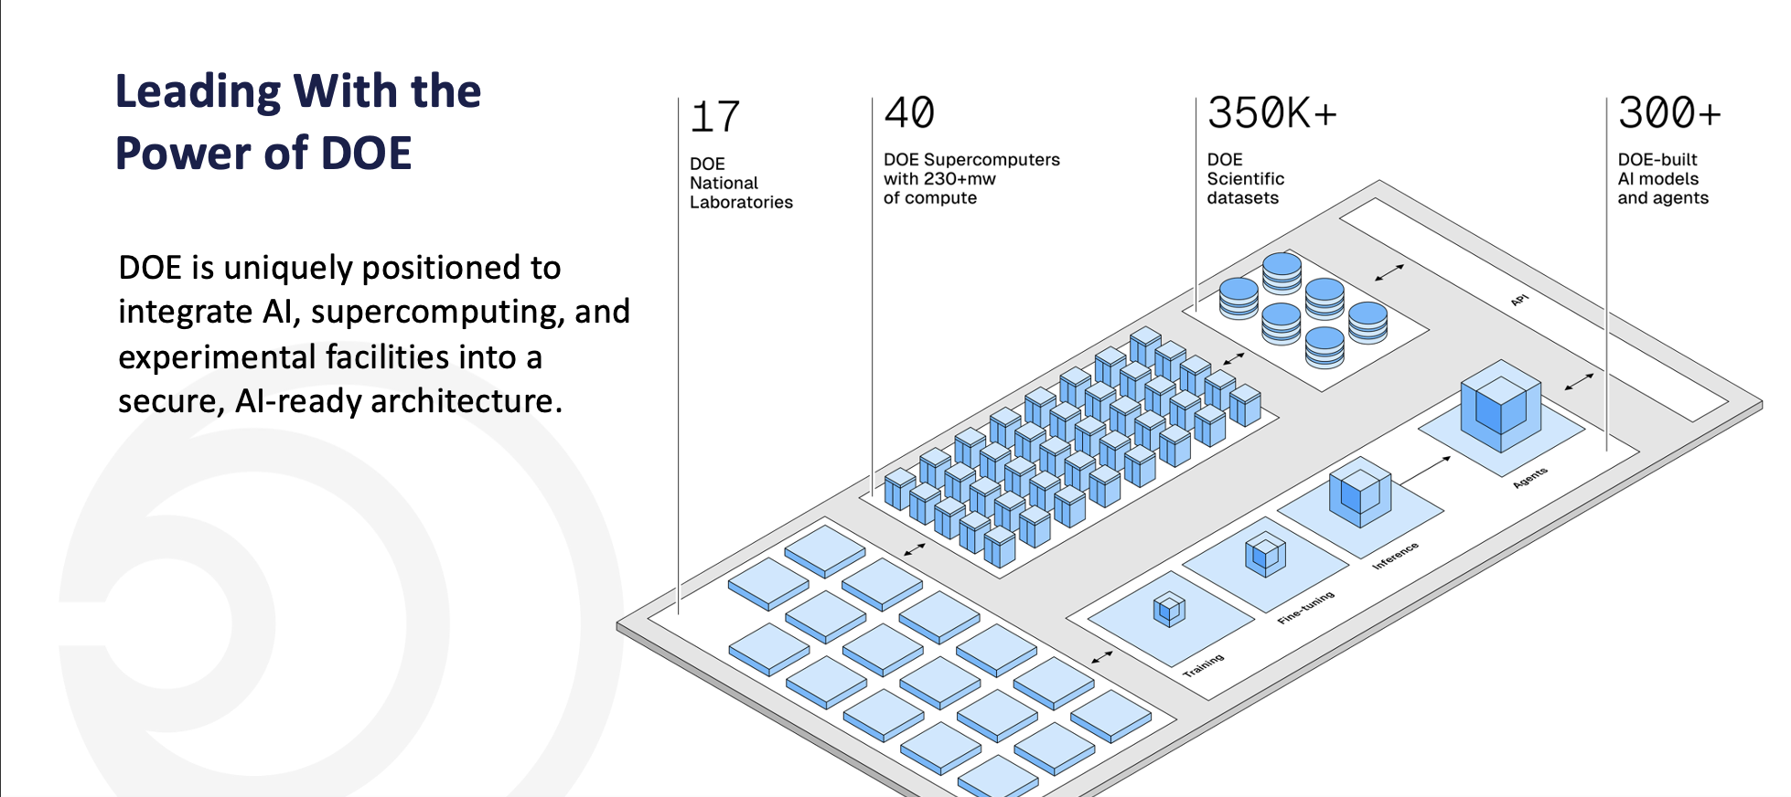
Scott Atchley — Content
Genesis Mission Overview
Add your content here
The platform integrates America’s advanced high-performance computing systems, scientific experimental facilities, data resources, and production capabilities into a single, coordinated AI-driven discovery system.
BoF: Towards a European AI Hub · ISC 2026
Segment 2 · Scott Atchley

Slide 11
Scott Atchley — Content (optional)
(optional)
Genesis Mission Teams
Add your content here
The Labs provide leadership across five teams, as well as leadership for the American Science and Security Platform – the mechanism at the heart of the Genesis Mission.
Data
Building a continuously evolving data ecosystem that curates, connects, and prepares DOE and NNSA data.
Infrastructure
Delivering the software and hardware infrastructure for the American Science and Security Platform.
Models
Delivering a comprehensive portfolio of AI models, agents, and tools.
National Science and Technology Challenges
Public-Private Partnerships
Supporting connections and activity between DOE, NNSA, and external organizations, other government agencies, and international allies.
Focusing on how AI, high performance computing, and data are being applied to address the U.S. government’s cross-cutting priorities.
BoF: Towards a European AI Hub · ISC 2026
Segment 2 · Scott Atchley

Slide 12
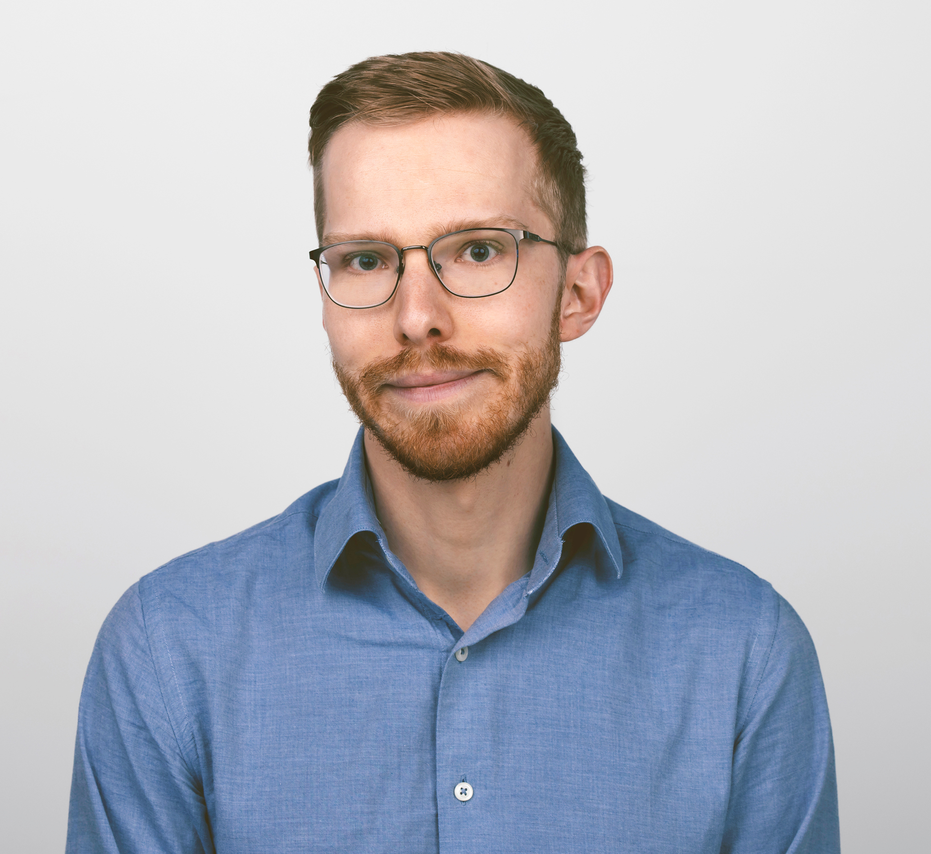
EU perspective
Henrik Nortamo
CSC — EuroHPC Federation Platform (EU)
Federation, going from clusters to a zoo of capabilities and services
Senior Application Specialist at CSC – IT for Science (Finnish national computing center)
Currently working as the technical lead for the EuroHPC Federation platform
BoF: Towards a European AI Hub · ISC 2026
Segment 2 · Henrik Nortamo

Slide 13
Henrik Nortamo
Federation, going from clusters to a zoo of capabilities and services
Within the EuroHPC context, the federation currently covers the existing system which are mostly just large HPC clusters.
  The next-gen, more AI-focused systems, will offer a much wider and higher-level set of features.
Three challenges worth discussing
  Project model:
    Access to capabilities and services are mostly tied to a single project with a fixed duration. Common issues are data migration and access control.
  Storage model:
    Currently compute is the only "currency" which is properly tracked, other capabilities and especially storage is just tacked on. Ok, for data used in a single project / small amounts. Large needs will need a process to be feasible
  Nature of service delivery, what is possible and what do we need
    Same service different address
    Central/common abstraction layer
    "One" Hub, proximity solved by caching / mirrors ?
BoF: Towards a European AI Hub · ISC 2026
Segment 2 · Henrik Nortamo

Slide 14
2
SEGMENT 2
Q&A — Public projects
Open floor — questions on the US (Genesis Mission) and EU (EuroHPC) project perspectives.
Compare the two public-sector approaches before we turn to the vendors.
Q&A · open floor
BoF: Towards a European AI Hub · ISC 2026

Slide 15
SEGMENT 2 · Q&A — PUBLIC PROJECTS
US & EU — differences, commonalities & stakeholders
Comparing the two public-project approaches.
What are the differences and commonalities in the US and EU approaches?
1
Scope, governance, funding model, openness — and what each federates.
2
BoF: Towards a European AI Hub · ISC 2026
Public project perspectives · US & EU

Slide 16
SEGMENT 2 · Q&A — PUBLIC PROJECTS
US & EU — differences, commonalities & stakeholders
Comparing the two public-project approaches.
What are the differences and commonalities in the US and EU approaches?
1
Scope, governance, funding model, openness — and what each federates.
How far beyond the initiating bodies does it reach?
2
US: the DoE / national labs — or wider? EU: the EuroHPC consortium — or also national programmes, industry & academia?
BoF: Towards a European AI Hub · ISC 2026
Public project perspectives · US & EU

Slide 17
SEGMENT 2 · Q&A — PUBLIC PROJECTS
US & EU — differences, commonalities & stakeholders
Comparing the two public-project approaches.
Some AI Factories in EuroHPC seem to already publish on Huggingface.
3
What other ways do you see the AI Hub idea being fragmented already?
4
BoF: Towards a European AI Hub · ISC 2026
Public project perspectives · US & EU

Slide 18
SEGMENT 2 · Q&A — PUBLIC PROJECTS
US & EU — differences, commonalities & stakeholders
Comparing the two public-project approaches.
Some AI Factories already publish on Huggingface.
3
What other ways do you see the AI Hub idea being fragmented already?
How does the EU AI Act / Digital Market Act play a role in federation?
4
Not that we are lawyers of course…
BoF: Towards a European AI Hub · ISC 2026
Public project perspectives · US & EU

Slide 19
SEGMENT 2 · Q&A — PUBLIC PROJECTS
US & EU — differences, commonalities & stakeholders
Comparing the two public-project approaches.
Federating Authentication and access is the foundation. Did the respective projects entertain the idea to broaden the scope?
5
Maybe not b/c it was the MVP conceivable at the time?
BoF: Towards a European AI Hub · ISC 2026
Public project perspectives · US & EU

Slide 20
3
SEGMENT 3
Vendor & Project Ecosystems
What do the vendor ecosystems look like?
Vendor perspectives — NVIDIA & AMD · plus Intel, OPEA, HPE and other projects.
Lightning talks + roundtable
BoF: Towards a European AI Hub · ISC 2026

Slide 21
SEGMENT 3 · VENDOR & PROJECT ECOSYSTEMS
The vendor & project landscape
What each ecosystem brings to artifact distribution — and where optimization meets portability.
NVIDIA
AMD
Intel
NGC catalog · NIM microservices · optimized CUDA containers · TensorRT engines
ROCm stack · Infinity Hub · optimized images · MI-series tuning
oneAPI · OpenVINO · Gaudi · Tiber AI Cloud
CNCF OPEA
HPE
Other projects
Open Platform for Enterprise AI — composable GenAI / RAG blueprints
Integrated systems + software stack
Model hubs · OCI artifact registries · community distribution tooling
BoF: Towards a European AI Hub · ISC 2026
NVIDIA · AMD · Intel · OPEA · HPE
Notes:
The tension: vendor-optimized stacks vs. portable, open formats — what should be standardized across all of them?

Slide 22
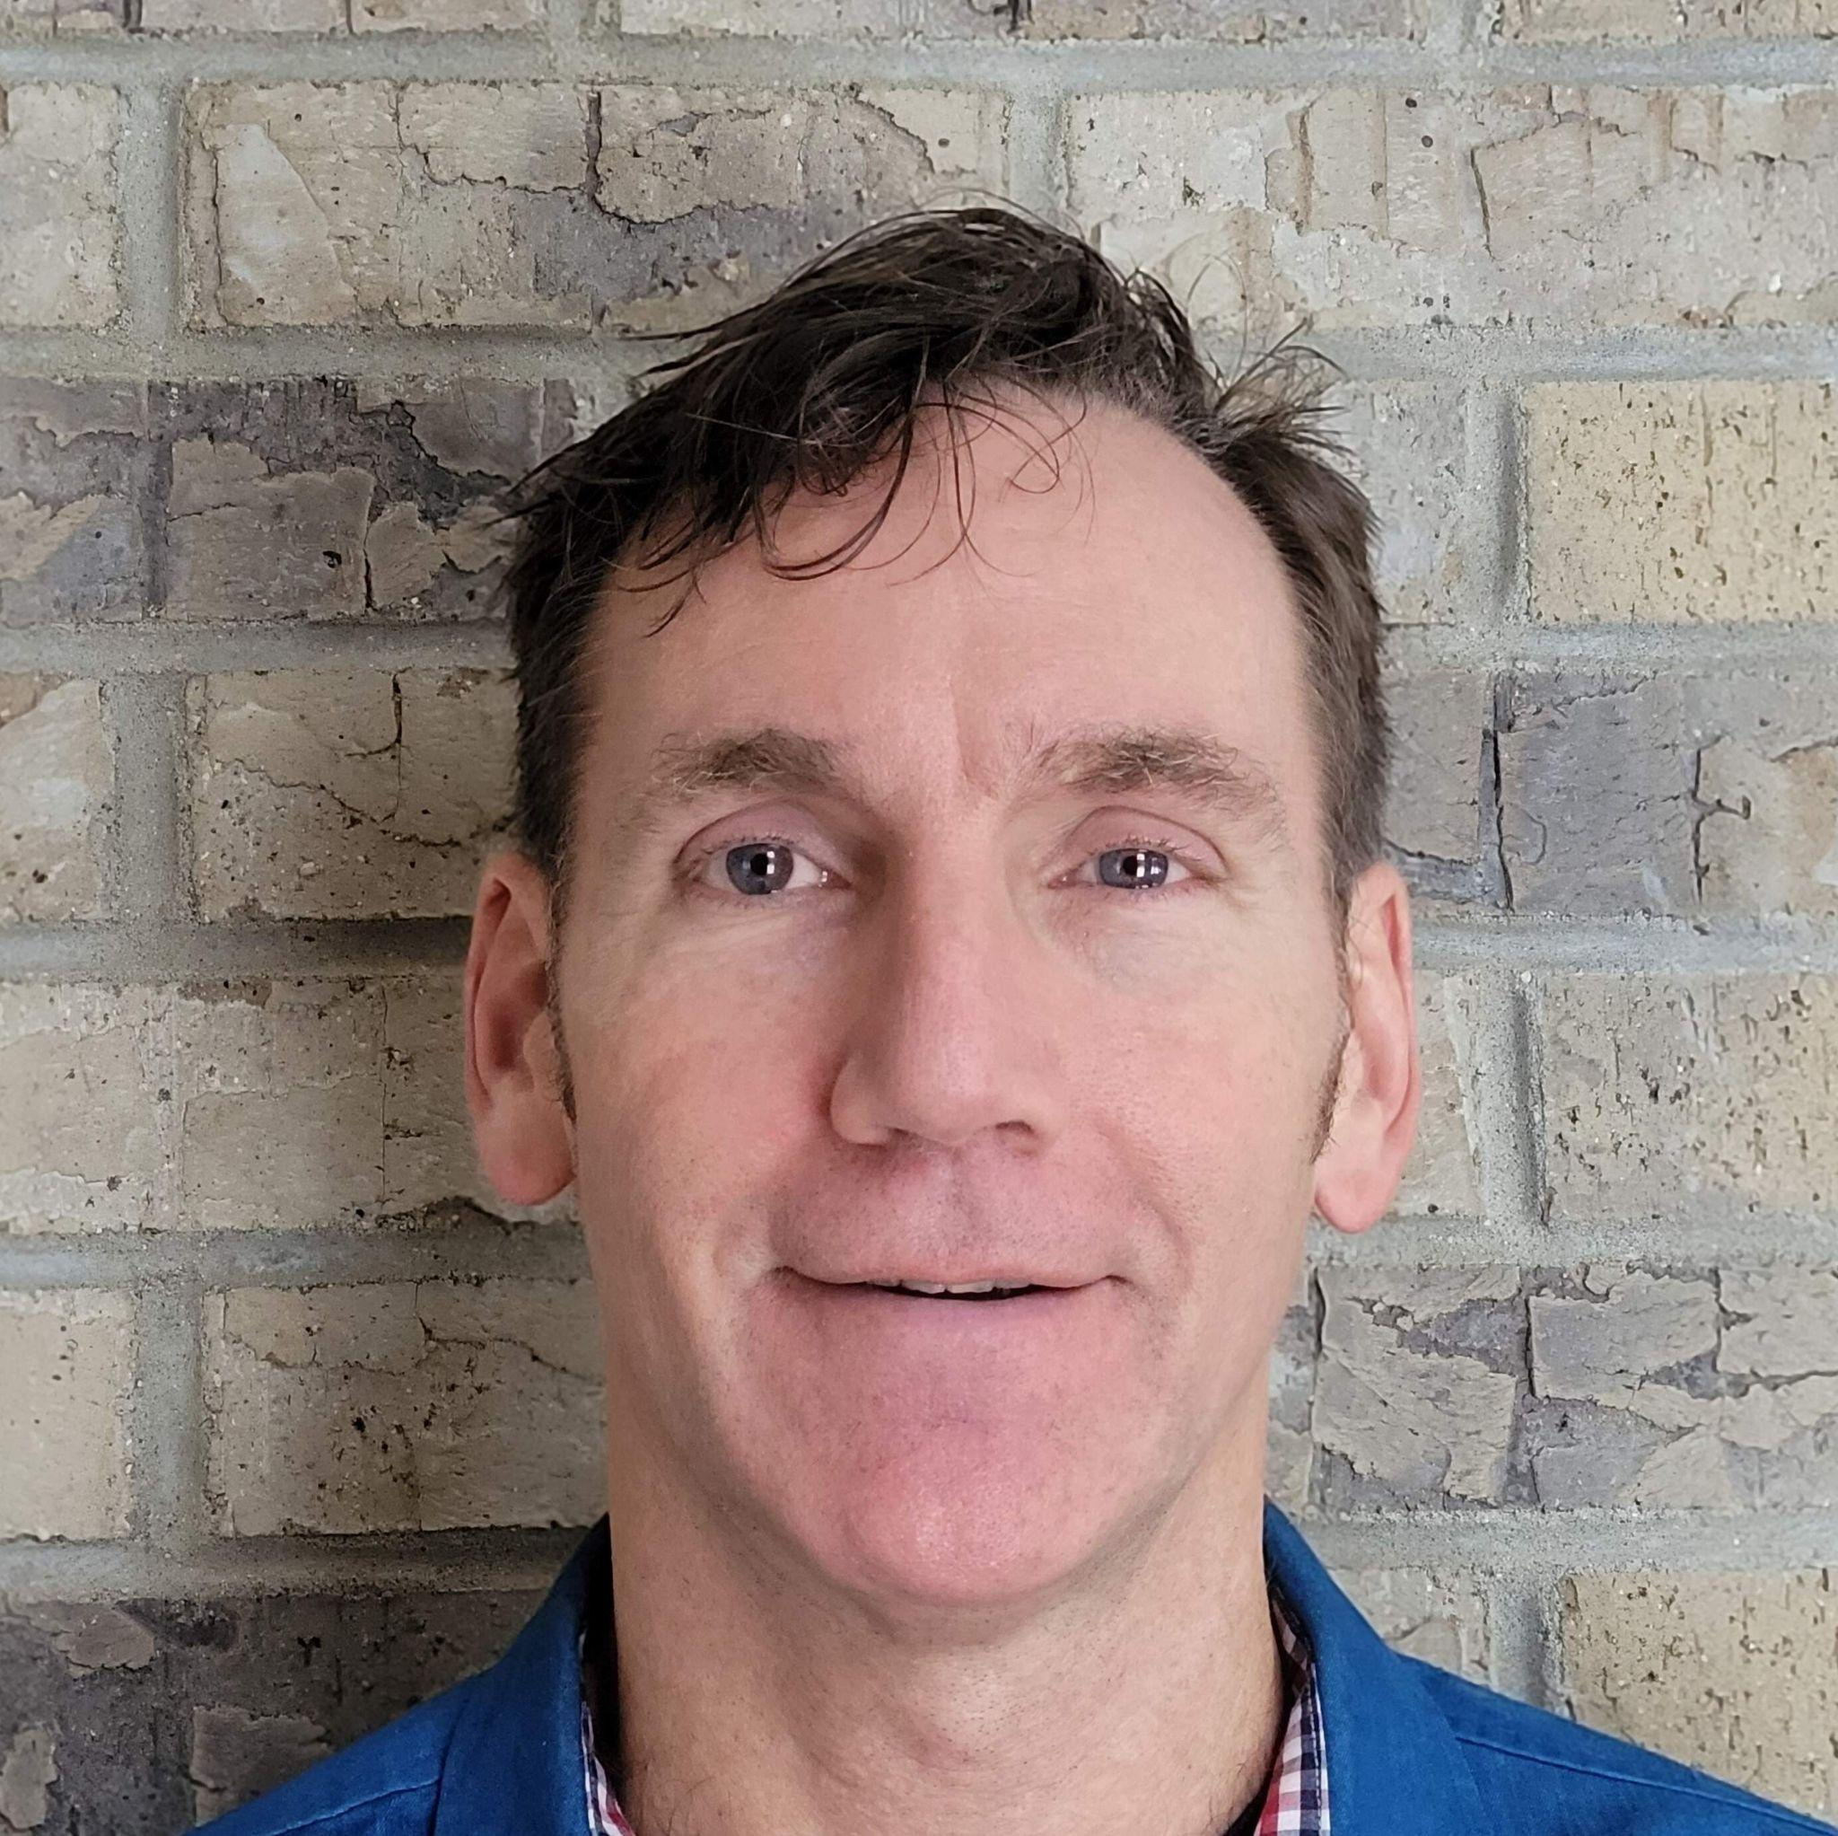
Vendor
CJ Newburn
NVIDIA
Dr. CJ Newburn, Distinguished Engineer, NVIDIA
“Model it vs. buffer it”
CJ drives HPC strategy and the technical IO roadmap in NVIDIA GPU Cloud, focused on pushing the envelope for storage and networking programming models at scale, data center architecture and security, and scaled systems.
He is a community builder with a passion for building an ecosystem that extends the core capabilities of hardware and software platforms from HPC into AI, data science, and visualization. He co-leads the Storage-Next effort to optimize products for IOPs/TCO.
He tinkers with and leverages NVIDIA and vendor products in a lab packed with scaled compute, storage and networking gear to apply and extend new tech. He's delighted to have worked on volume products that his Mom used and that help researchers do their life's work in science that previously wasn't possible
BoF: Towards a European AI Hub · ISC 2026
Segment 3 · CJ Newburn

Slide 23
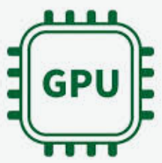

Biggest challenge for HPC data:
Capture insight in shipped model vs. sending raw data
Inference to
keep interesting
Filter,
Real-time
adjustments
Train on
interesting
Ship model vs raw data, synthesize,
digital twin
Transmit with GPUDirect
vs. buffered copies
Examples
Real Time Fast Radio Burst Detection
Real Time Nanoimaging
Climate in a bottle
Data federation mesh
The Weather Company
Vera Rubin Obs/Linac Coh Light src
Index, search
unstr data
Queries on
Indexed data
Notes:
What’s working well in HPCD and managing research data right now? What’s not? What do you the biggest challenges over the next 18-36 months? Skills? Infrastructure? Data Management maturity?
Raw data is too big to buffer and send much less keep
Filter raw data with a model to track only what’s interesting (GPUs by instrument)
Treat the unstructured filtered data as a vector database
Encode it, (incrementally) index it
Make available for remote queries, send back small output sequences
Training a model with new information (Rack of GPUs onsite)
Send that model vs. raw data - could be 1Mx smaller
Users send inference queries to model, onsite or mirrored
Regenerate equivalent synthetic data at distributed sites
Make decisions on the data in real time
Steer and guide real-time data processing

Slide 24
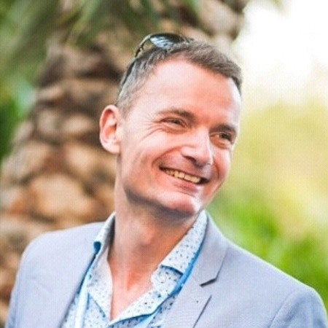
Vendor
Martin Hilgeman
AMD
Principal Member of Technical Staff
A highly motivated, uniquely skilled HPC professional with approximately 25 years of domain expertise. Equipped with important ability to delve into compute performance, infrastructure and workload characterization, often with an innovative approach. Possesses an impressive breadth of knowledge of applications and software tools that run on large-scale computer systems.
Frequently acknowledged for talent to compose and deliver tailored presentations, which clearly translate deeply technical topics into a captivating and informative presentation for a wide array of audiences, including CxO level and other executives.
BoF: Towards a European AI Hub · ISC 2026
Segment 3 · Martin Hilgeman

Slide 25
Martin Hilgeman — Content
BoF: Towards a European AI Hub · ISC 2026
Segment 3 · Martin Hilgeman

Slide 26
Martin Hilgeman — Content
BoF: Towards a European AI Hub · ISC 2026
Segment 3 · Martin Hilgeman

Slide 27
3
SEGMENT 3
Q&A — Vendor ecosystems
Open floor — questions for the vendor & project perspectives.
What helps, what locks in, and what should become standard.
Q&A · open floor
BoF: Towards a European AI Hub · ISC 2026

Slide 28
SEGMENT 3 · Q&A — VENDORS
Vendors — leverage, lock-in & standards
Comparing what the ecosystems offer.
Where do vendor stacks genuinely help — and where do they lock you in?
1
Optimized images, catalogs and microservices vs. portability across NVIDIA / AMD / Intel.
2
BoF: Towards a European AI Hub · ISC 2026
Vendor & project perspectives

Slide 29
SEGMENT 3 · Q&A — VENDORS
Vendors — leverage, lock-in & standards
Comparing what the ecosystems offer.
Where do vendor stacks genuinely help — and where do they lock you in?
1
Optimized images, catalogs and microservices vs. portability across NVIDIA / AMD / Intel.
What should be standardized across vendors and projects?
2
Common artifact formats, metadata and trust — and the role of OPEA and the wider community.
BoF: Towards a European AI Hub · ISC 2026
Vendor & project perspectives

Slide 30
4
SEGMENT 4
Panel Discussion
What do we actually want — and is it achievable?
Open discussion: design principles, federation models, sovereignty, governance, and a path forward.
Extended roundtable (main session)
BoF: Towards a European AI Hub · ISC 2026

Slide 31
SEGMENT 4 · THE FUTURE · DESIGN PRINCIPLE
What needs to be federated vs. what can be reproduced
The cut that shrinks the problem: federate the canonical sources + the recipe; let each site rebuild the rest.
Federate — canonical sources
Reproduce locally — derived
the truth a hub must hold & protect
regenerable caches, not federation problems
Model weights & checkpoints
base, fine-tunes, adapters
Compiled engines
TensorRT / ROCm, ONNX, GGUF — hardware-specific
Datasets & RAG source corpora
training, eval, the raw knowledge
Embeddings & vector indices
rebuild from corpus + embed model
Recipes
training/build scripts, configs, env locks, seeds
Quantizations
GPTQ / AWQ — derivable from weights + recipe
Metadata & trust
cards, lineage, signatures, SBOMs
Agent / session memory
ephemeral, site-local
The judgment call: reproduce only works if the recipe is captured & deterministic — and federate anyway when regeneration cost > transfer + storage cost (e.g. a 70B quant, or an index over billions of docs).
BoF: Towards a European AI Hub · ISC 2026
A candidate design principle for the roundtable

Slide 32
SEGMENT 4 · PANEL DISCUSSION
Guiding questions
For what we do want to optimize?
Foundation model finetuning
Specialized model retraining
Reproducible destillation
Non-uniform quantization
Do we need to decide?
BoF: Towards a European AI Hub · ISC 2026
Questions to be added before the session

Slide 33
SEGMENT 4 · THE FUTURE · TRADE-OFFS
Three pillars — and the floor they stand on
The requirements that should drive the design. Each carries a real trade-off; none stands without shared standards.
Sovereignty & Governance
Trust & Provenance
Performance & Cost
whose rules, whose infrastructure, who pays
can you verify and rebuild it
the part that actually kills federations
Data residency & jurisdiction
Access control & licensing
Who funds & operates it
Signing & attestation
Lineage & reproducibility
SBOM / supply-chain integrity
Moving terabytes, caching, HPC I/O
Storage replicated across N sites
Egress fees & sustainability
Trade-off: keep it in Europe vs. use the best / cheapest compute
Trade-off: verifiable & reproducible vs. velocity
Trade-off: federate everywhere vs. what you can afford to move & store
Foundation — Interoperability & open standards. Shared formats and a common metadata layer are the floor: without them, none of the three pillars stand.
BoF: Towards a European AI Hub · ISC 2026
The trade-offs the roundtable must weigh
Notes:
How open is to open?

Slide 34
SEGMENT 4 · PANEL DISCUSSION
Guiding questions
EuroHPC seems to be about HPC infrastructure and federated access. How do we squeeze in the AI Hub?
1
2
BoF: Towards a European AI Hub · ISC 2026
Questions to be added before the session

Slide 35
SEGMENT 4 · PANEL DISCUSSION
Guiding questions
EuroHPC seems to be about HPC infrastructure and federated access. How do we squeeze in the AI Hub?
What standards can we build upon?
- OpenKnowledgeFormat
- OCI, ORAS?
1
2
BoF: Towards a European AI Hub · ISC 2026
Questions to be added before the session

Slide 36
SEGMENT 4 · PANEL DISCUSSION
Guiding questions
EuroHPC seems to be about HPC infrastructure and federated access. How do we squeeze in the AI Hub?
What standards can we build upon?
- OpenKnowledgeFormat
- OCI, ORAS?
1
2
How do we create something that is open and inclusive w/o pushing our vision down?
3
BoF: Towards a European AI Hub · ISC 2026
Questions to be added before the session
Notes:
CERN pushes their stack down to other centers in order to cooperate and they do not like that.
How do we create something that scales down to the lowest level?

Slide 37
SEGMENT 4 · PANEL DISCUSSION
Guiding questions
EuroHPC seems to be about HPC infrastructure and federated access. How do we squeeze in the AI Hub?
What standards can we build upon?
- OpenKnowledgeFormat
- OCI, ORAS?
1
2
How do we create something that is open and inclusive w/o pushing our vision down?
How do we fund this? What are the carrots / sticks to get sites onboard?
3
4
BoF: Towards a European AI Hub · ISC 2026
Questions to be added before the session
Notes:
Provide a free helpdesk might be taken advantage of. Thus to some degree you need a buy-in from members. How to balance that? Or just throw funding in so that you have a big carrot?

Slide 38
SEGMENT 4 · PANEL DISCUSSION
Guiding questions
EuroHPC seems to be about HPC infrastructure and federated access. How do we squeeze in the AI Hub?
What standards can we build upon?
- OpenKnowledgeFormat
- OCI, ORAS?
5
6
How do we create something that is open and inclusive w/o pushing our vision down?
How do we fund this? Sites do want to get paid for collaboration…
7
8
BoF: Towards a European AI Hub · ISC 2026
Questions to be added before the session

Slide 39
Thank you
The BoF closes — networking continues.
Continue the conversation: hpcw (at) qnib.org
1 · Building Blocks
2 · Current State & Challenges
3 · Vendor & Project Ecosystems
4 · The Future
BoF: Towards a European AI Hub · ISC 2026
Towards a European AI Hub

Slide 40
2. Handling AI data sets: make AI 1st-class citizen in data pipe
Provenance
  Raw data → model → synthesized data
Intellectual property
  Federated learning
  Confidential computing
Life cycles
  Data orchestration and management of labeled data sets
  Policies
Notes:
2. AI is often posed as GPU/compute constrained issue, but often is also a data issue - both input and output. The research community has varying levels of existing data management maturity, with vast amounts of instrument and computationally generated data. We now have AI generated data, and associated issues with growth, provenance, intellectual property and data lifecycles. What do you believe are the most pressing issues we need to deal with in the short, medium and long term for handling AI datasets (both AI readiness and output)?

Slide 41
3. Novel and innovative technologies
Converged storage architectures
  Minimize storage server SKUs across buffering, KV$, index/search
Avoid copying thru buffers
  GPUDirect RDMA from memory to memory over the network
  GPUDirect Storage from storage to GPUs when buffering necessary
Minimize the data that gets moved
  Move processing to data acquisition, accelerate it with GPUs
  Send filtered, processed, modeled data vs. raw data
Selective storage
  Indexed filtered data directly accessible to GPUs
  Model data
  Archived discoveries can be in cold storage
Notes:
3. We are seeing steep increases in the cost of storage components (NVMe, disk, tape) and long availability lead times, which has flow on effects to research data management. What interesting, novel or innovative ideas have you seen in dealing with these issues? What’s next?

