Slide 1
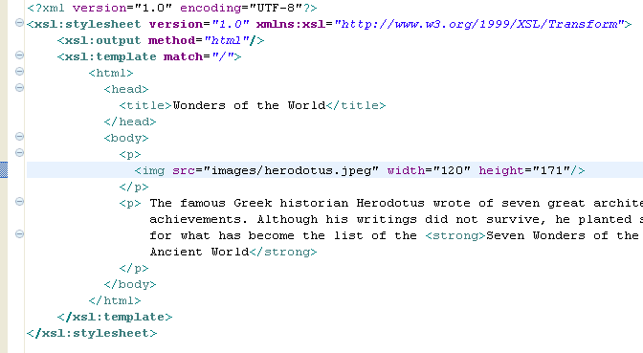

Slide 2
XSLT
Outputting Values:
In order to actually output the content of an XML node we will use
the <xsl:value-of> element.
When the XSLT processor applies the root template it first outputs all the HTML header code. Then when it gets to the xsl:value-of element, it only outputs the value of the first node it finds, which is Colossus of Rhodes.

Slide 3
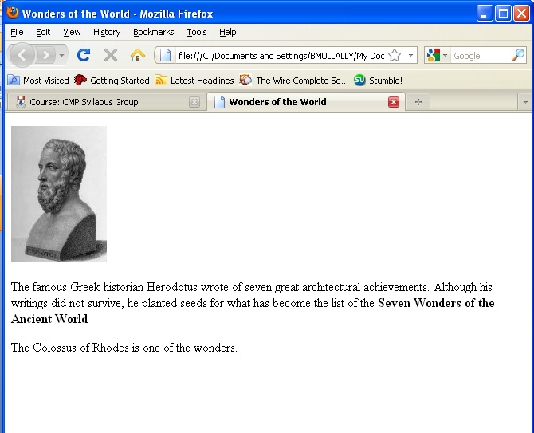
XSLT

Slide 4
XSLT
Outputting Values:
If the select expression (select=“”) matches more than one node in the XML document, only the first nodes value is output.
If I wanted to return the name nodes where the language attribute was equal to “Greek”, I would write:
<xsl:value-of select=“name[@language=‘Greek’]”/>

Slide 5
XSLT
Outputting Values:
If the select expression matches a node, the string value of that node is output. If the node has child elements, the output includes the text contained in those child elements as well.

Slide 6
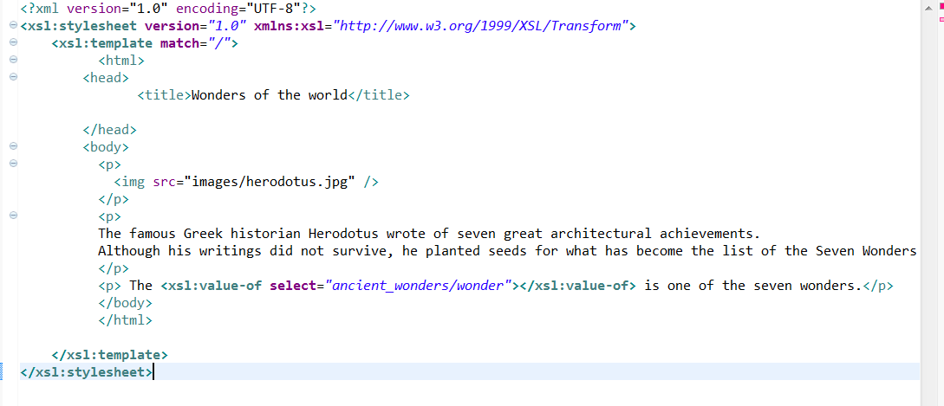
XSLT

Slide 7
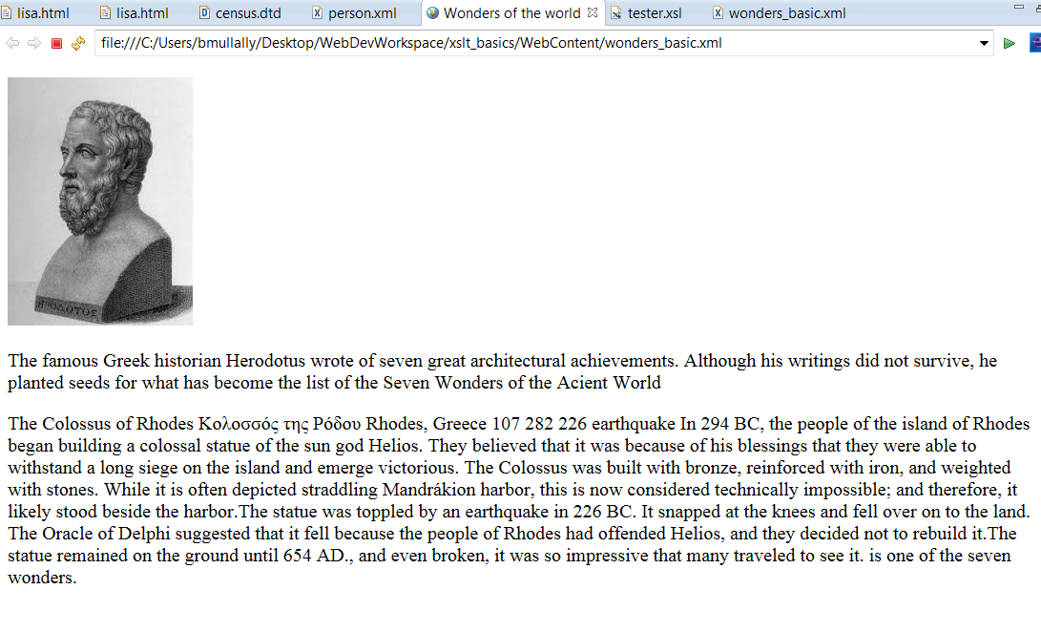
XSLT

Slide 8
XSLT
Outputting Values:
If the select expression matches a node set that is empty, there is nothing to output.

Slide 9
XSLT
Looping over nodes
As you saw in the previous slides the <xsl:value-of> element will only act on one node, even if there are many nodes that it matches.
The <xsl:for-each> element allows you to act on all nodes matched. It processes all the nodes matched by its select attributes, one after the other.
Within the root template you include the following:

Slide 10
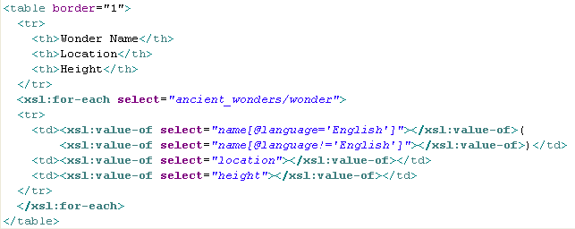
XSLT

Slide 11
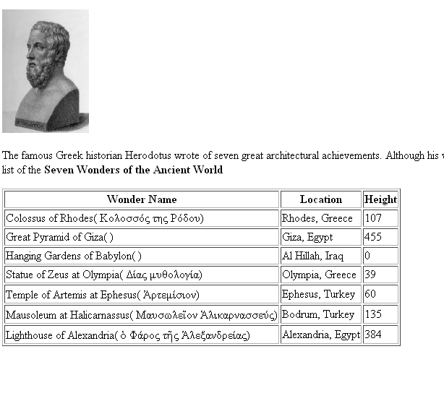
XSLT

Slide 12
XSLT
The xsl:for-each instruction creates a new table row for each wonder of the world.
Once it has processed all of the nodes in the selected set (in this case ancient_wonders/wonder), it continues with the rest of the template.
In general, place the <xsl:for-each> right before the rules that should be repeated for each node to be found.
When accessing nodes to add to a table you put the xsl:for-each before and after the opening and closing tags for the table row.

Slide 13
In the select condition of the xsl:for-each element you can require a specific attribute match by using the
[@attribute=‘expression’].
This is the same syntax as seen in the <xsl:value-of> elements.

Slide 14
XSLT
Processing Nodes Conditionally
It is not uncommon to want to process a node or a set of nodes only if a certain condition is met. The condition is written as an expression. For example, you might want to perform a certain action if a particular node set is not empty, or if the string value of a node is equal to a particular word.
<xsl:if test=“expression”></xsl:if>

Slide 15
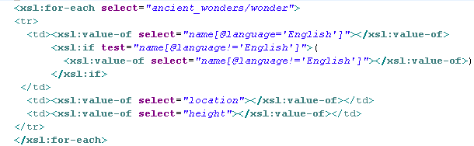
XSLT
The <xsl:if test> condition tests to see if the current node is a name with a language attribute that is not English. If so, then it outputs the value of the name node. If not, then nothing is done. This prevents displaying a set of empty brackets when no other language name exists.

Slide 16
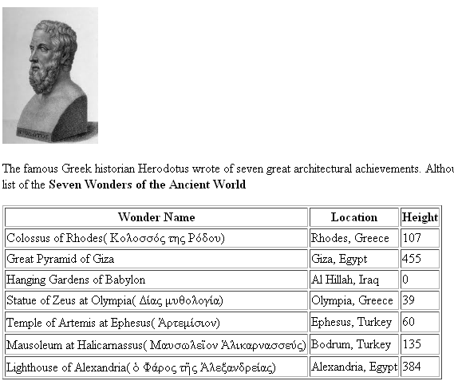
XSLT

Slide 17
XSLT
When referring to a node set in the expression, the test returns true if the node set is not empty; that is, if it contains at least one node.
If you want to be able to specify an alternate result when an expression is false, then you must use <xsl:choose> .
You can test for all sorts of conditions, we will look at constructing more elaborate test expressions later.

Slide 18
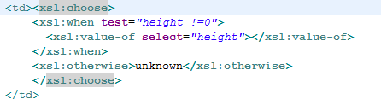
XSLT
Adding conditional choices:
The <xsl:if> instruction only allows one condition and one resulting action. You can use <xsl:choose> when you want to test for several different conditions, and react accordingly to each one. The simplest example of this is when you want to do one action when the condition is true, and another action when it’s false.

Slide 19
XSLT
In the case of multiple conditions, once a condition is found to be true, all the remaining conditions are ignored. The action contained in this first true condition is the only one performed.
By using the <xsl:choose>, instead of showing a height of zero for the Hanging Gardens of Babylon, the word unknown is displayed.

Slide 20
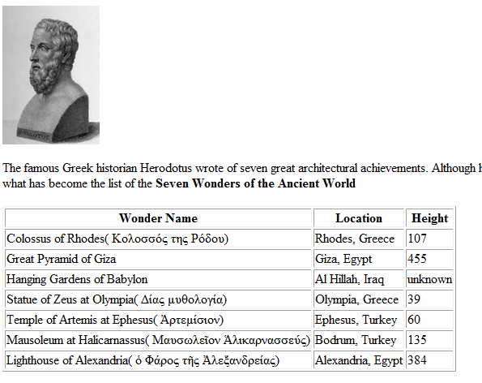
XSLT

Slide 21
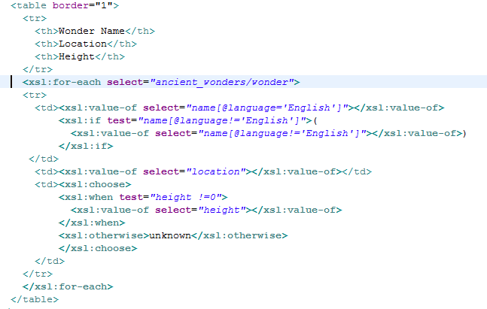

Slide 22
