Slide 1
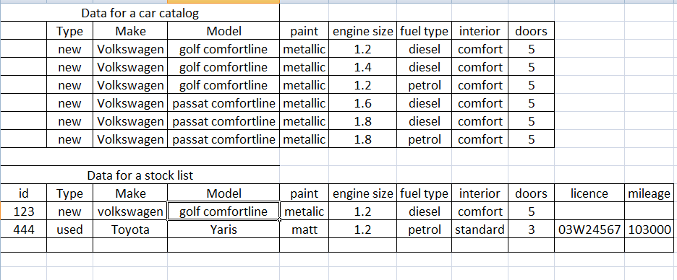

Slide 2
W
XSLT – eXtensible Style Language for Transformations
The car data can be stored in more than one way, it depends on the business use of the data, your interpretation of the description and what the client wants.
The car data shown looks similar but depending on the use we can structure it differently.

Slide 3
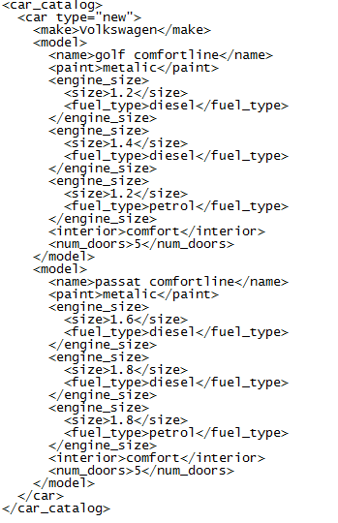
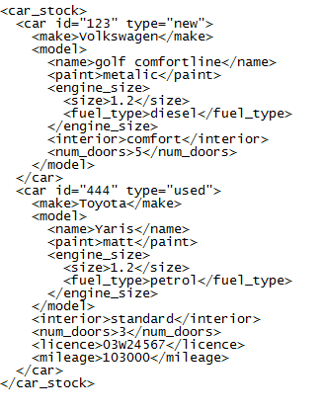

Slide 4
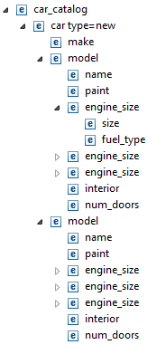
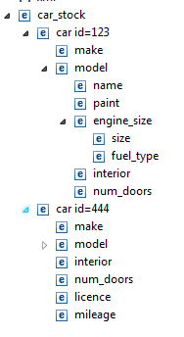

Slide 5
W
XSLT – eXtensible Style Language for Transformations
Rules covered so far:
<xsl:value-of>
<xsl:for-each>
<xsl:if>
<xsl:choose>
<xsl:when>
<xsl:otherwise>

Slide 6
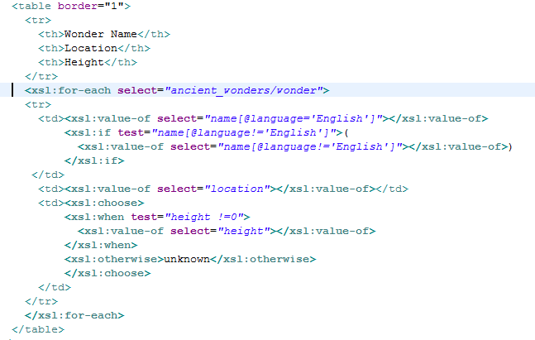
XSLT – eXtensible Style Language for Transformations

Slide 7
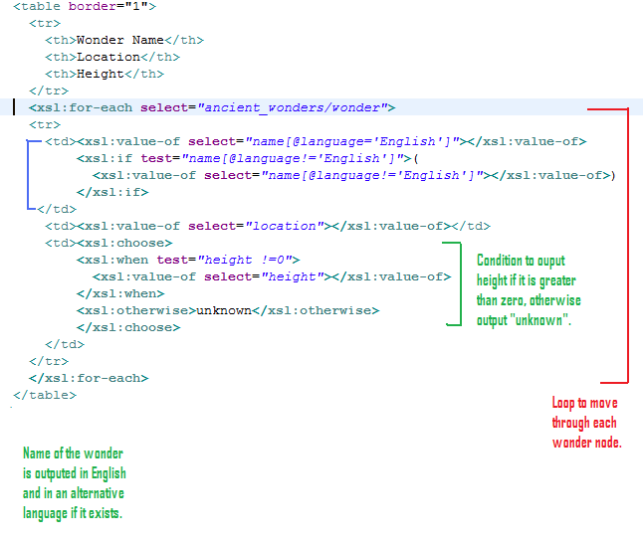

Slide 8
W
XSLT – eXtensible Style Language for Transformations
<?xml version="1.0" encoding=“UTF-8"?>
<CATALOG>
<CD>
<TITLE>Empire Burlesque</TITLE>
<ARTIST gender=“male”>Bob Dylan</ARTIST>
<COUNTRY type=“abbrev”>USA</COUNTRY>
<COUNTRY type=“full”>United States of America</COUNTRY>
<COMPANY>Columbia</COMPANY>
<PRICE>10.90</PRICE>
<YEAR>1985</YEAR>
</CD>
<CD>
<TITLE>Hide your heart</TITLE>
<ARTIST gender=“female”>Bonnie Tyler</ARTIST>
<COUNTRY type=“abbrev”>UK</COUNTRY>
<COMPANY>CBS Records</COMPANY>
<PRICE>9.90</PRICE>
<YEAR>1988</YEAR>
</CD>
</CATALOG>

Slide 9
W
XSLT – eXtensible Style Language for Transformations
Write the xsl instructions to output the following:
All of the details of the first CD element.
Just the title and the artist of the first CD element.
Just the artist of the first CD element that has a female artist.
All of the CD titles and artists.
All of the CD titles and artists and country full name.
All of the CD details, if the country full name is not there output the abbreviated name instead.

