Slide 1
Sorting:
By default, nodes are processed in the order in which they appear in the XML source document.
If you wish to process nodes in some other order, you can add an xsl:sort element when you use xsl:for-each.
Directly after a xsl:for-each element you add :

Slide 2
The select criteria can be an expression that specifies the node key on which the source nodes should be sorted. In this case we are using the node height to sort the wonders.
The sort can be descending or ascending. In this case we are sorting them in a descending order, so the highest wonder first.
If desired, you can specify the data type, the default is text.
Be sure to specify the correct data type, sorting numbers as text gives errors and vice versa.
You can nest xsl:sort elements within other xsl:sort elements.

Slide 3
Generating output attributes:
When you are transforming your XML source document to an HTML or XML document, it is often useful to be able to add attributes and values to a given output element. For example, if you are creating an <img> element or an <a> element, you might need to include the src, width and height attributes to the image element, or the href and target attributes to an anchor element.

Slide 4
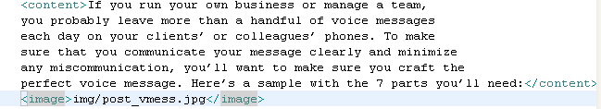
Adding the src attribute to an image element:
XSL file:
XML file:

Slide 5
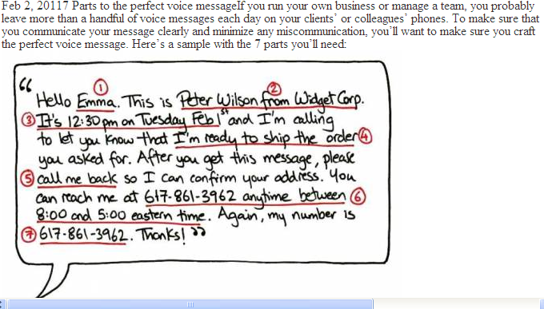

Slide 6
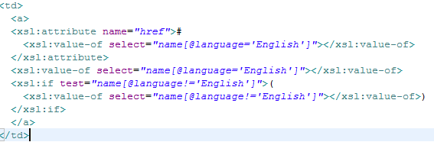
Adding an href attribute to an anchor <a> element. The href value will be set to # and the name of the wonder being processed. In this way each wonder will be linked to its own named reference on the page.
XSL file:

Slide 7
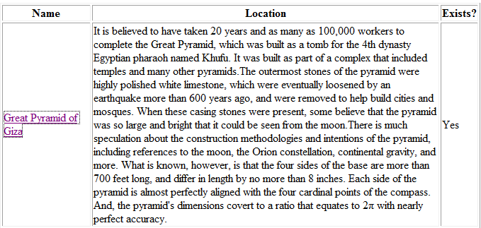

Slide 8
Templates:
The root template is the first thing processed in an XSLT style sheet. This template is the set of rules applied to the root node of the XML source document.
XSLT allows you to create more templates than just the root template. This allows you to create different sets of processing rules to apply to different parts of your XML.
One of the main benefits of using templates is the ability to reuse a template for other nodes in your document. In the same way that one can use functions in most programming languages, you would create a template, and simply apply that template whenever necessary. This eliminates the need to rewrite the exact same processing instructions each time.

Slide 9
To create a template:
Type
<xsl:template match=“name[@language!=‘English’]”>
(<em>
<xsl:value-of select=“.”>
</em>)
</xsl:template>
This new template will italicize the output for the name of each wonder that is not English. It does so by using xsl:value-of select=“.” which returns the value of the current node.

Slide 10
The root template is simply a template with a pattern that matches the root node.
Only the root template is called automatically. All other templates must be applied manually. Otherwise they are ignored.
So how do you apply a template to a specific node in your XML document?
You must use xsl:apply-templates.
This is how you control where and when the transformation described by the template is used in the final document.

Slide 11
Applying a template:
Within any template, you can include the following:
<xsl:apply-templates select=“expression”/>
Expression identifies the node(s) of the XML document whose templates should be applied. The template created previously is now used:

Slide 12
Our code originally had the following:
<xsl:if test=“name[@language!=‘English’]”>
(<em><xsl:value-of select=“name[@langugage!=‘English’]”/></em>)
</xsl:if>
We can replace it with the following:
<xsl:apply-templates select=“name[@language!=‘English’”/>
The template is applied which outputs in italics the current node that meets the criteria i.e. A name that is not in English.

Slide 13
The template applies the style to the current node.
<xsl:template match=“name[@language!=‘English’]”>
(<em>
<xsl:value-of select=“.”>
</em>)
</xsl:template>

Slide 14
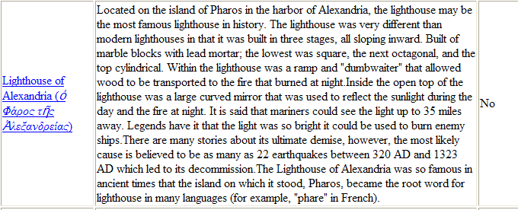

Slide 15
Tips:
If you have multiple templates in your XSL file, the order of the xsl:apply-templates determines the order in which the templates are processed.
If you don’t specify the select attribute the processor will look for and apply a template to each of the current nodes children.
When using xsl:apply-templates, if there is no matching template a template built into the XSLT processor is automatically used.
The xsl:apply-templates element may contain an xsl:sort element.

Slide 16
To output the story for each wonder in a particular format we can use a template.
The template is to output the story in a paragraph, with font face=“Times New Roman” size=“5” and color=“#000080”
How do we do this?

Slide 17
<xsl:for-each select="ancient_wonders/wonder">
<xsl:sort select="height" order="descending" data-type="number" ></xsl:sort>
<tr>
<td>
<a>
<xsl:attribute name="href">#
<xsl:value-of select="name[@language='English']"></xsl:value-of>
</xsl:attribute>
<xsl:value-of select="name[@language='English']"></xsl:value-of>
<xsl:apply-templates select="name[@language!='English']">
</xsl:apply-templates>
</a>
</td>
<td><xsl:value-of select="history/story"></xsl:value-of></td>
<td><xsl:choose>
<xsl:when test="history/year_destroyed!=0">No</xsl:when>
<xsl:otherwise>Yes</xsl:otherwise>
</xsl:choose></td>
</tr>
</xsl:for-each>

Slide 18
Within the for-each loop of the ancient_wonders/wonder node we want to output the story in a particular format, to do this we create a new template for the history/story node.

Slide 19
<xsl:template match="history/story">
<p>
<font color="#000080" face="Times New Roman" size="5">
<xsl:value-of select="."></xsl:value-of>
</font>
</p>
</xsl:template>
We then use that template by applying it within the for-each loop.

Slide 20
<xsl:for-each select="ancient_wonders/wonder">
<xsl:sort select="height" order="descending" data-type="number“></xsl:sort>
<tr> <td> <a>
<xsl:attribute name="href">#
<xsl:value-of select="name[@language='English']"></xsl:value-of>
</xsl:attribute>
<xsl:value-of select="name[@language='English']"></xsl:value-of>
<xsl:apply-templates select="name[@language!='English']">
</xsl:apply-templates>
</a> </td>
<td> <xsl:apply-templates select=“history/story”> </xsl:apply-templates>
</td>
<td><xsl:choose>
<xsl:when test="history/year_destroyed!=0">No</xsl:when>
<xsl:otherwise>Yes</xsl:otherwise>
</xsl:choose></td>
</tr>
</xsl:for-each>

Slide 21
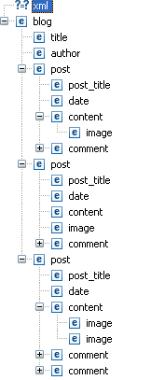
Data elements:
It is very important that the structure of your data is well designed. Where we have data content as well as nested elements it can make it difficult to access content easily using xsl. For the blog you could store the data elements as shown here. However, this would mean that it was difficult to access the both the text in a content element and the image or images in a content element particularly if it varied as to the order of text and images within content. It also isn’t clear which text is associated with which image.

Slide 22
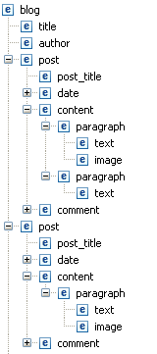
Data elements:
It is more appropriate to store the data in a slightly different format.
This means that a post can have many paragraphs, each with text and in some cases an image. Now we can access and display each paragraphs text and image without difficulty.

Slide 23
