Slide 1
Quality Control

Slide 2
W3C XML Schema
DTDs are chiefly directed toward describing how elements are arranged in a document. They say very little about the content in the document, other than whether an element can contain character data. There is no way to constraint the type of data in an element.
Suppose a census taker submitted a census record with many mistakes in the data entry. For example incorrect date format, some important fields left empty, age impossible etc.

Slide 3
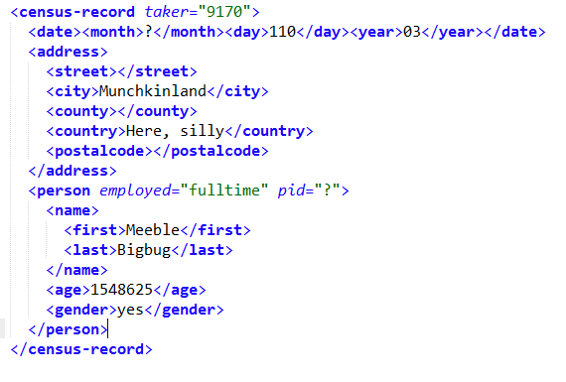
Modularisation

Slide 4
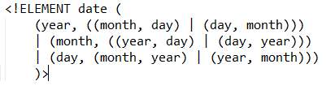
XML Schema
It isn’t hard to write a programme to check datatypes however it is low level and the idea of a DTD is a formal description of a markup language. So we can conclude that DTDs do not go far enough in describing a markup language.
To make matters worse, a DTD will reject trivial errors, such as the incorrect order of the date elements. If we were to write a rule to allow the order of day month and year to be in any order and only occur once each then it would require:
Ugly?

Slide 5
XML Schema
The other limitation of DTDs is the lockdown of namespace. Any element in a xml document must have a corresponding declaration in the DTD. No exceptions.
To address these problems, a new validation system was invented called schema. Like DTDs schemas contain rules that all must be satisfied for a document to be valid.
There are several competing schemas, the one that is sanctioned by W3C is XML Schema. Another proposal called RELAX NG, adds capabilities not found in XML schema.

Slide 6
XML Schema
XML schemas are themselves XML documents (unlike DTDs)
It is more verbose that DTD but still readable
From the census examples this is how you would define the county element:
<xs:schema xmlns:xs=http://www.w3.org/2001/XMLSchema>
<xs:element name=“county” type=“xs:string”/>
</xs:schema>
The xs:element acts like an <!ELEMENT declaration in a DTD.
xs:string refers to a simple type of element, one that is built in to the schema specification. It’s just a string of character data.

Slide 7
XML Schema
xs:string contains any text
xs:token contains text but collapses extra spaces
xs:Qname contains a namespace-qualified name
xs:decimal contains decimal number
xs:integer contains integer number
xs:float contains a 32-bit floating point number
xs:ID, xs:IDREF same as ID in DTDs
xs:boolean true or false
xs:time time HH:MM:SS – timezone
xs:date CCYY-MM-DD
xs:dateTime both of above.

Slide 8
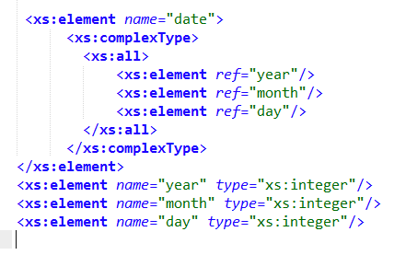
XML Schema
Most elements are not simple however, they contain other elements, attributes, and character data with specialised formats. So schemas contain complex element definitions.
The date element is a complex type because it has special requirements that you must explicitly define. In this case, the type is a group of three elements (in any order), referred to by name using the ref attribute. These referred elements are defined at the bottom to be of type integer.

Slide 9
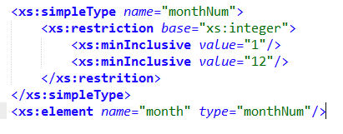
XML Schema
It is possible to refine the date even further. Although the schema will guarantee that each of the subfields year, month, and day are integer values, it will allow some values we don’t want. for example, -12345 is a valid integer, but we wouldn’t want that to be used for month.
The way to control the range of a data type is to use facets. A facet is an additional parameter added to a type definition. You can create a new data type for the <month> element:

Slide 10
XML Schema
We created a named type and called it monthNum. Named types are not bound to any particular element, so they are useful if you’ll be using the same type over and over.
the xs:restriction allows us to derive a more specific type than just xs:integer. Inside are two facets, minInclusive and maxInclusive, setting the lower and upper bounds.
Besides setting ranges, facets can create fixed values, constrain the length of strings and match patters with regular expressions. For example, say you want the postal code to be any string that contains three digits followed by three letters as in the census example.
<postalcode>885JKL</postalcode>

Slide 11
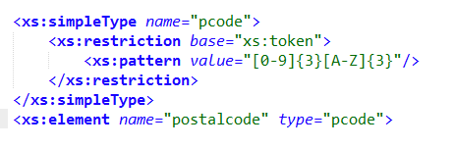
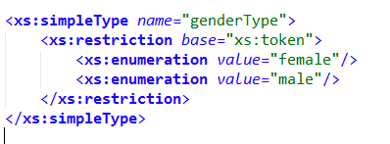
XML Schema
we want to pattern match it to [0-9]{3} and [A-Z]{3}
enumeration is another way of defining a set of allowed values.

Slide 12
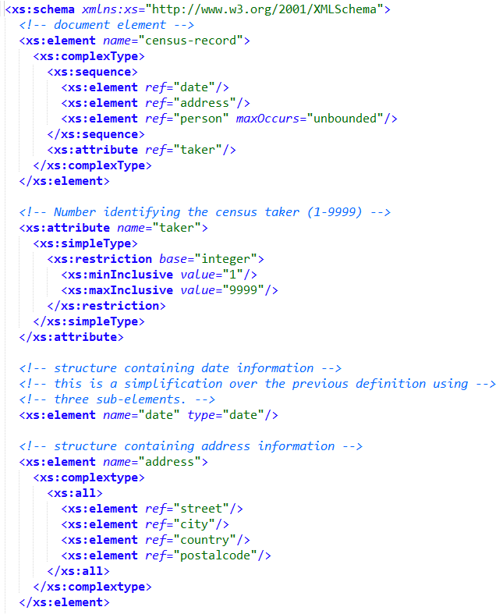
XML Schema

Slide 13
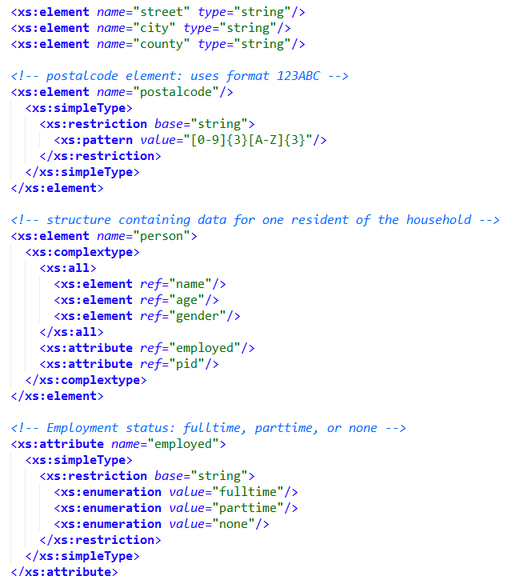
XML Schema

Slide 14
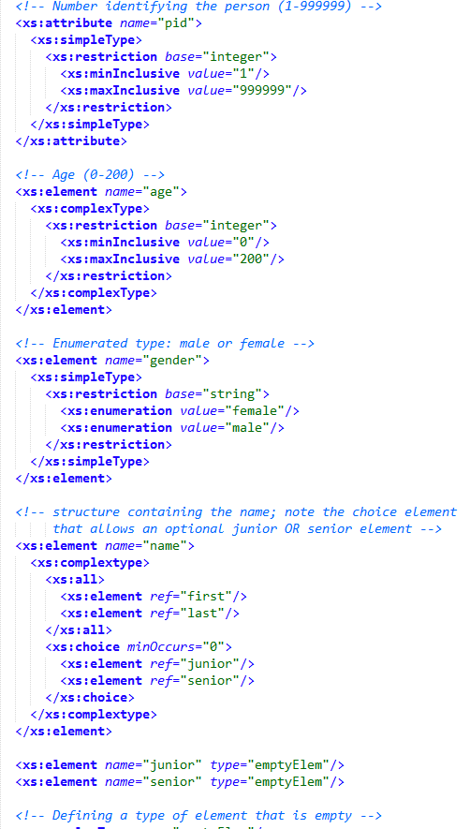

XML Schema

Slide 15
XML Schema
since XML Schema supports a variety of date formats for character data, it makes sense to replace the cumbersome date container and its three child elements with one that takes only text content.
maxOccurs allows an unlimited number of person elements, without it the schema would allow no more than one such element. (default is 1).
A choice element is the opposite of all. Instead of requiring all the elements to be present, it will allow only one of the choices to appear. In that case either <junior/> or <senior/>
minOccurs attribute in the choice is set to zero to make it optional (again default is 1).
Curriously there is no type for empty elements and so you define one for the <junior> and <senior> elements.

