Slide 1
CAP2 MGS3
Planning and Directions

Slide 2
Current

Slide 3
Contigs
Shotgun Metagenome
Contigs
QC
Clean Reads
MetaSpades
HG38 with Alternate Contigs
Nonhuman Reads
Bowtie2
Human Reads
Raw Reads
Human
Reads

Slide 4
GC %, Codon Usage, Stats
Gene Sets
Methyltransferases
Diamond
Custom
Normalized Methyls
Virulence Factors
Custom
Normalized Virulence
Microbe Census
Average Genome Size
Custom
Normalized AMRs
Custom
Functional Profiling
Normalized Functional Profiling
Nonhuman Reads
HUMANn2
Custom
Antibiotic Resistance, genes, drug classes, mechanisms
Alpha Diversity
MEGARes, CARD
Custom
Common
Macrobial Genomes
Custom
Beta Diversity
Kraken, MetaPhlAn, KrakenHLL
Taxonomy
MicrobeDB
Annotations
Common
Pathogen Genomes
HMP
Body Site Similarity
MASH
Macrobial Abundances
Human Reads
Bowtie2
Read Classification Proportions
Custom
Pathogen Abundances

Slide 5
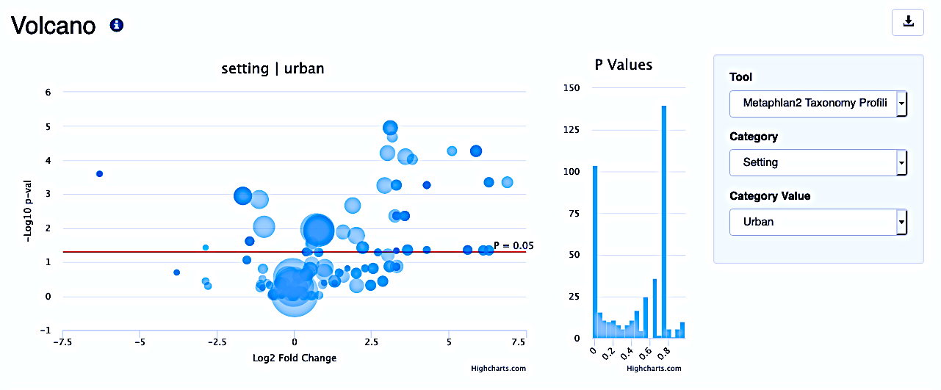

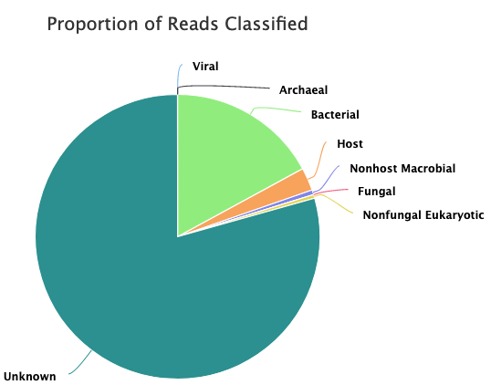
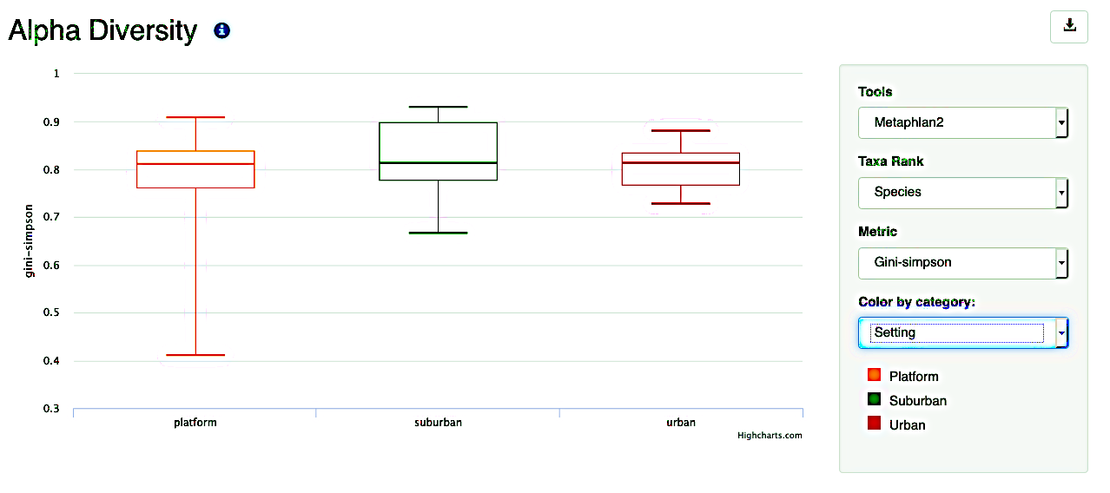




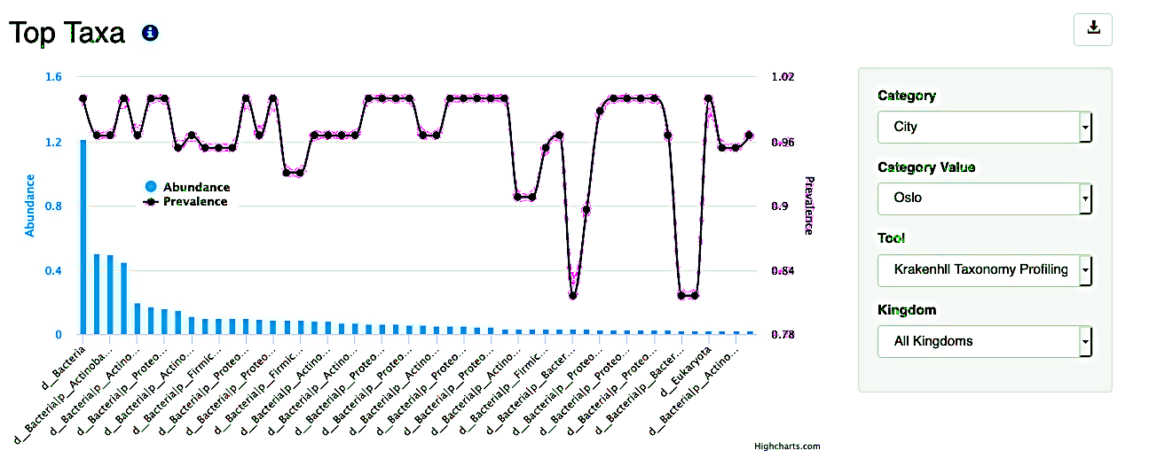
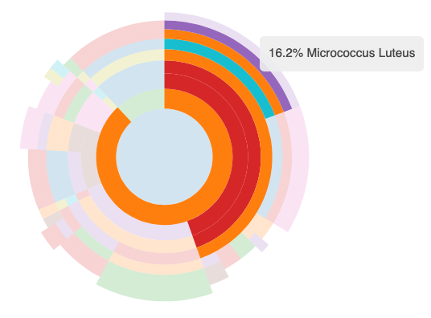


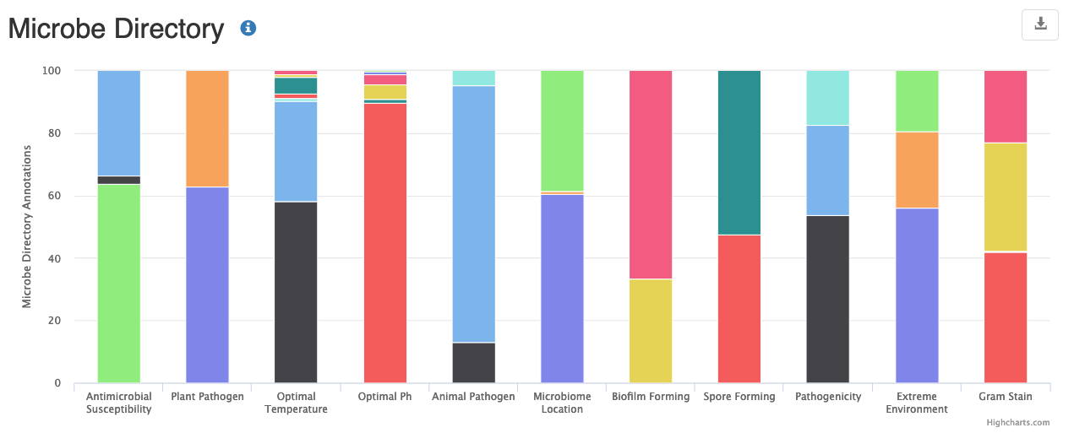
E
B
F
ProjectReport
Define sample groups, add metadata, and run statistical modules
A
C
Upload samples to the hybrid database
Compare samples to background, further analyses
Sample Report
D
Manage permissions, samples, and users
Storage Layer
Middleware
Back End
Front End
Notes:
Flowchart representing the major functions of MetaGenScope. A) Samples are uploaded to a hybrid SQL noSQL database that stores projects, analyses, and metadata B) Groups of samples (projects) are statistically summarized and processed C) individual samples are summarized and compared to background databases like the Human Microbiome Project and the Microbe Directory D) Users are given controls to manage samples, projects, and sharing E&F) Users are presented with a report of interactive plots, some of which are shown here. Plots include descriptive information, filtering controls, highlighted explanations, and selectable tools.

Slide 6
CAP2

Slide 7
Data Coherence and Standardization
Output consistent data in major file formats (JSON, CSV, BAM, etc)
Data pipelines should be check-summed in addition to human versions
Databases should be versioned (CalVer is preferable to SemVer here)
Some data is inherently dynamic
Changes quickly, even within a project (e.g. MAGs)
Analyses on dynamic data make all downstream analyses dynamic
Analyses should be updateable (or very fast)
Question: How to aggregate dynamic data across labs (e.g. MAGs, ML models)

Slide 8
Changes and New Goals
More cohesive analysis framework
Core Pipeline that can be run faster on commodity machines
Coherent tools to log/access standardized analyses
Better automated visualization
Better strain identification
More database agnostic analyses

Slide 9
Specific Changes and Goals
Incorporate database construction into pipeline
Some databases are endpoints (e.g. contig search index)
DBs rebuilt regularly and versioned
Much more stringent QC Pipeline
New Framework: Luigi
Pure python
Enables per-module unit testing
Future pipelines can import modules
Tighter integration with analysis frameworks
CAPalyzer
MetaGenScope
Cloudable
Use less than 128GB of RAM total
Write results to S3+SQL-DB
Containerizable

Slide 10
Quality Control Pipeline
Raw Reads
Zymo Pos. Controls
FastQC
Quality Report
Quality Filtering and Adapter Trimming
Standard QC Pipeline
FilterOS
Hg38, Chimp, Gorilla, Mouse, Rat
CORA
Remove Mapping Reads
Clean Reads
Map to strain genomes
MiQ Scores
Filtered Reads
Find Contamination Seqs
Negative Controls
BayesHammer
Read Error Correction
Non-host Reads
Remove Contaminants
Batch Contaminants
Credit
Johannes Werner

Slide 11
GC %, Codon Usage, Stats
Modified Short Read Pipeline
Modified from CAP1
New to CAP2
Sketch
HMP
Body Site Similarity
MASH
Custom
MetaSUB
SAKEIMA
Sketch
Geographic Similarity
Soil
Clean Reads
HUMANn2 + MICA
Functional Profiling
Taxa - Specific Profiles
HUMAnN2
Titan
Taxonomy
TBD
Strains
Genomes
Microbe Census (Modify to be faster)
Average Genome Size
GRiD
Growth rates
MEGARes, CARD
AMRs

Slide 12
Illumina Reads
Assembly
Nanopore Signal
Nanopore Reads
Guppy
(meta)Flye
Racon
Clean Illumina Reads
Clean Contigs
MeDaka
MetaSPAdes
Pilon
Hg38, Chimp, Gorilla, Mouse, Rat
Microbial Contigs
GraphMap
Credit
Dave Sannino

Slide 13
Contig Analysis
Microbial Contigs
Resistomes
ARTS
Novel
BGCs
Deep BGC
Enhanced Contigs
Predicted BGC
BioSpades
AntiSMASH
BiG-SCAPE
MiBIG 2.0
Rodeo
Taxonomic Annotation
Gene Prediction and Annotation
MetaMaps
Prodigal
HUMANn2
HMMer
Plasmid Annotation
Metabolic Pathway Analysis
PlasFlow
Gene Models
AMRs, Metabolites, etc
Credit
Chandrima Bhattacharya
Kat Kuchin

Slide 14
CAPalyzer Package
Makes Data Packets
Parsing
basic ecological metrics
Taxa abundance normalization
https://github.com/dcdanko/capalyzer

Slide 15
Pangea

Slide 16
Data Model
Sample Library
Group of Samples
E.g. MetaSUB
Sample Group
Group of Samples
Ad-hoc
E.g. ‘Paris’
Many-to-Many
One-to-Many
Sample
One data point
E.g. one swab
'Is’
Analysis Module
A specific tool run on a sample
E.g. Read Count, Paired end fastqs
Analysis Module Field
Useful extra level
For results that should be together
E.g. R1 and R2 in paired end reads

Slide 17
Data Model
Organization
A group of users
E.g. Mason Lab
Sample Library
Group of Samples
E.g. MetaSUB
Sample Group
Group of Samples
Ad-hoc
E.g. ‘Paris’
Many-to-Many
User
A Person
One-to-Many
Sample
One data point
E.g. one swab
'Is’
Analysis Module
A specific tool run on a sample
E.g. Read Count, Paired end fastqs
Analysis Module Field
Useful extra level
For results that should be together
E.g. R1 and R2 in paired end reads

Slide 18
Organization
A group of users
E.g. Mason Lab
Sample Library
Group of Samples
E.g. MetaSUB
Sample Group
Group of Samples
Ad-hoc
E.g. ‘Paris’
Many-to-Many
User
A Person
One-to-Many
Sample
One data point
E.g. one swab
'Is’
Analysis Module
A specific tool run on a sample
E.g. Read Count, Paired end fastqs
Analysis Module Field
Useful extra level
For results that should be together
E.g. R1 and R2 in paired end reads

Slide 19
MGS3

Slide 20
MetaGenScope
TypeScript + ReactJS
Microservice Architecture
Database
Worker Nodes
Redis + RabbitMQ
https://github.com/dcdanko/capalyzer

Slide 21
MetaGenScope- New Features
Upload Samples
Manage samples and sample groups
make new groups
Delete groups
Search groups/samples
Species view (in addition to sample and group)
Gene search in groups
Support long reads
Modules- Group
Dimensionality Reduction
Multi-Axis
Volcano
Alpha diversity
Beta diversity
Rarefaction curve
Average genome size
Top taxa
Microbe directory
Reference comparisons
Top AMR

Slide 22
MetaGenScope- New Features
Modules- Sample
Alpha diversity
Reference comparison
Taxonomy
Pathways
Stats (Read count, GC, etc)
Assembly stats
Microbe directory
Modules- Specie
Alignment to reference
Strain guess
Assembly stats
‘Also found in’
Microbe directory annotations

Slide 23
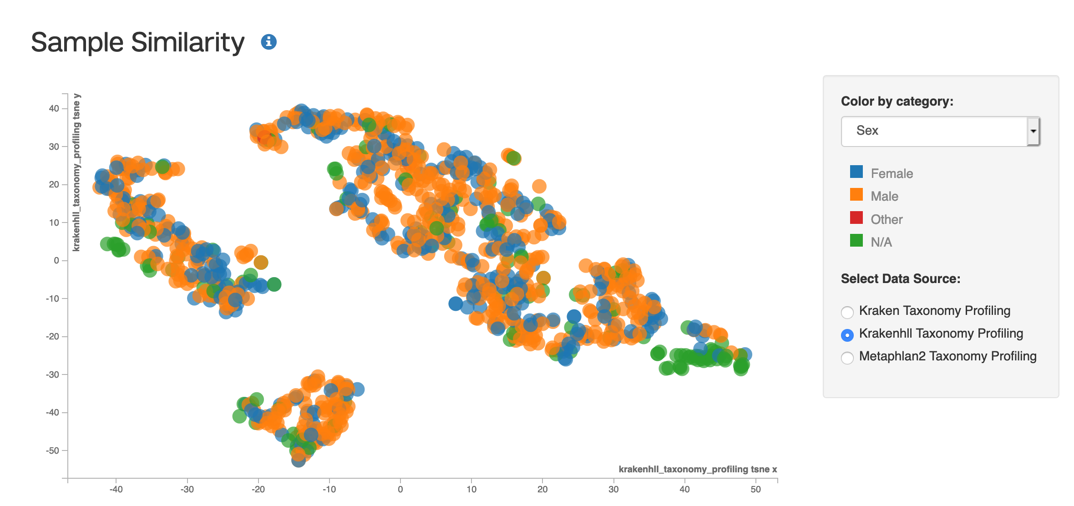

Slide 24
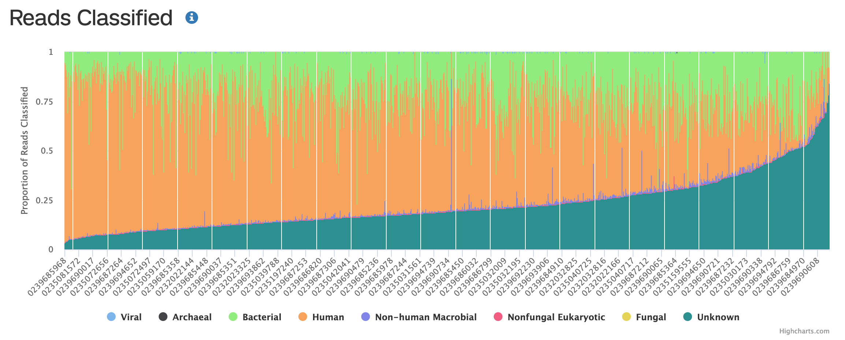

Slide 25
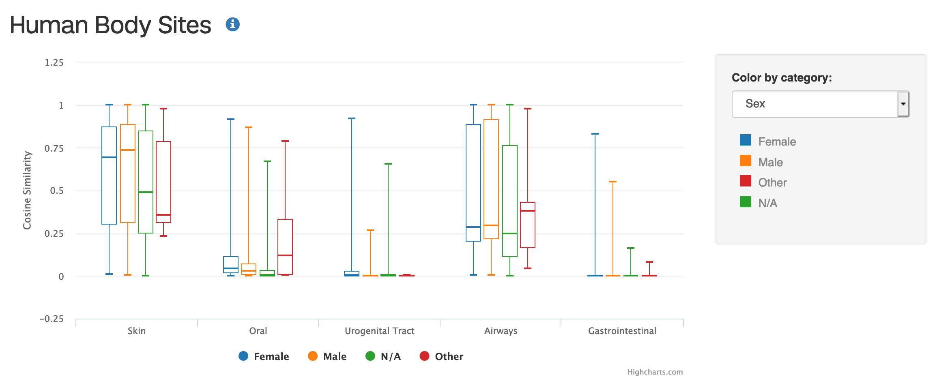

Slide 26
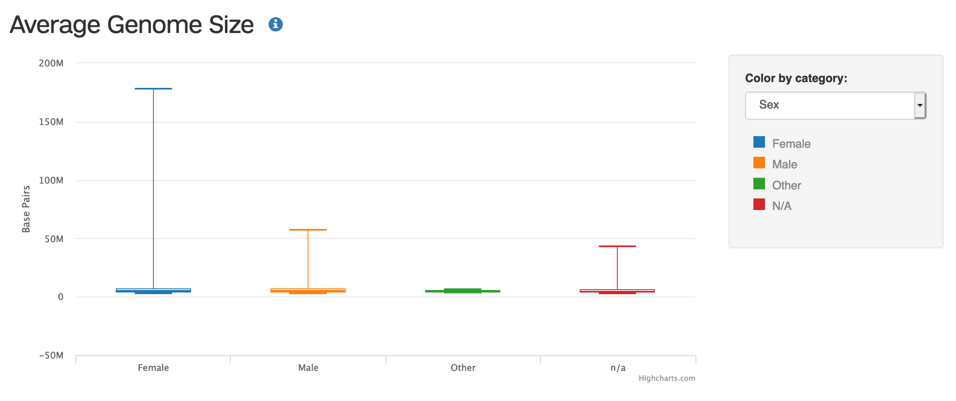

Slide 27
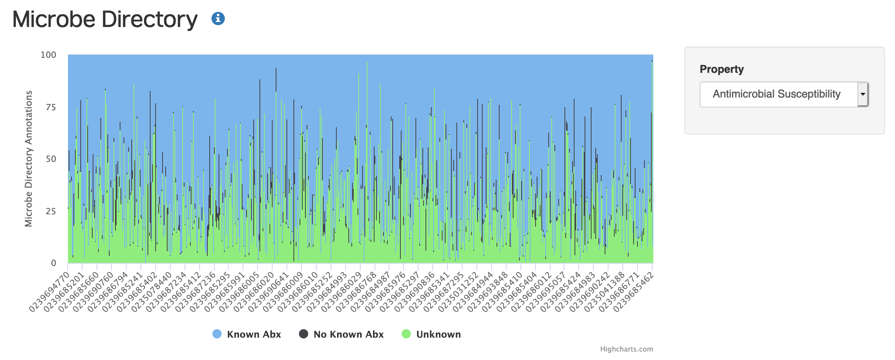

Slide 28
Pipeline Evaluation

Slide 29
Computational Standardization and Controls
Create computational controls
randomly generated sequences (biologicish & random, negative control)
Known taxonomic composition (positive control)
Calibrate workflows
Performance with rarefaction
Performance with different seq types

