Slide 1
SYMPHONY 2026 · VOICE AI BUILDATHON
Heartline
A daily call for the people who raised you.
Meet Sneha, the AI voice that phones your parents every morning, in their own language, on an ordinary phone, and tells you how they are.
No app for the parent
10 Indian languages
Escalates to a human
Notes:
Open with the line: a daily call for the people who raised you. Heartline is the product; Sneha is the voice. One sentence on what it does: she phones a parent on an ordinary phone, in their language, checks medicines and mood, and tells the family.

Slide 2

THE PROBLEM
Parents age alone, and families live far away
194M
347M
~50%
Indians aged 60+ by 2031, up from 138M in 2021
by 2050: one in five Indians will be over 60 (20.8%)
of patients on long-term treatment take medicines as prescribed in developed countries, and fewer elsewhere
MoSPI, Elderly in India 2021 (projection)
UNFPA, India Ageing Report
WHO, Adherence to Long-Term Therapies, 2003
The gap: reminder apps, wearables and portals all need the parent to install, charge or open something. A phone call needs nothing, and every parent already answers one.
Sources: Ministry of Statistics (MoSPI); UNFPA India Ageing Report; WHO (2003). The WHO 50% figure is an often-cited average that later reviews have questioned.
Notes:
Lead with the demographic wave: 138 million over-60s in 2021 heading to 194 million by 2031 (MoSPI projection) and 347 million by 2050 (UNFPA). Then the adherence problem: WHO's widely quoted figure is that about half of patients on long-term therapy do not take medicines as prescribed. Mention the caveat if asked: it is an average, and later reviews question its evidence base. Close on the gap: every existing answer needs the parent to install or charge something.

Slide 3


WHY NOW
Voice AI in India has gone from demo to production
Razorpay x Sarvam
Razorpay Agent Studio
Agents making real calls
Voice-led commerce in Indian languages; Swiggy among the first to pilot it.
A platform for agents on payment rails, with Sarvam's Indic speech stack integrated.
Razorpay reports Hinglish outbound voice agents across churn recovery, adoption and incidents: 35,000+ calls.
March 2026 announcement
March 2026
Vendor-reported, ElevenLabs Summit India 2026
Y Combinator co-presents this buildathon, and the winner earns a YC interview. These deployments serve commerce and collections. Heartline points the same technology at something people never get enough of: care for their parents.
Sources: Storyboard18 and Swarajya (Razorpay x Sarvam, Mar 2026); Razorpay Agent Studio launch coverage; ElevenLabs Summit India 2026 session; Bolna Symphony 2026 page.
Notes:
This slide is the market context judges will recognise. Razorpay and Sarvam announced voice-led commerce in Indian languages in March 2026, with Swiggy piloting. Razorpay also reports 35,000+ outbound Hinglish agent calls; that figure comes from a vendor session, so say 'reported'. The point: the technology is proven for business calls. We apply it to the family.

Slide 4
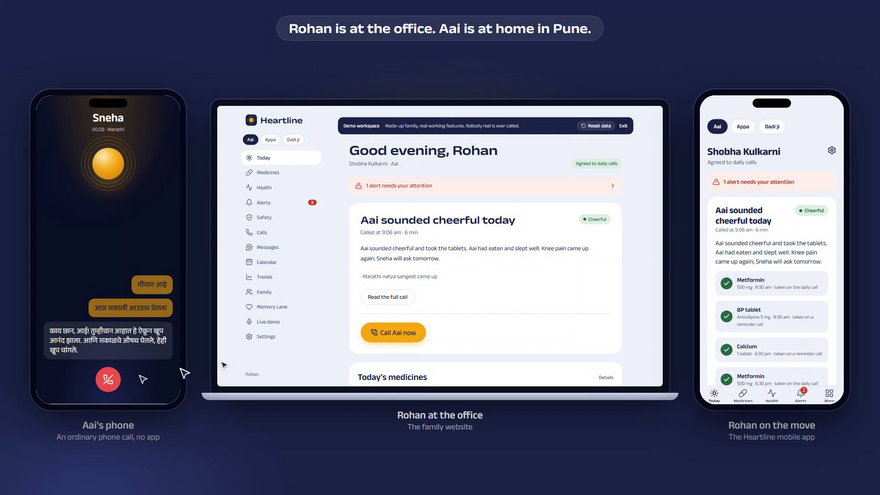


THE SOLUTION
Heartline: one phone call that looks after your parent
Sneha calls, in her language
An AI voice on the parent's ordinary phone. She says who she is and who she is calling for, then has a warm, unhurried chat.
The family sees what matters
A two-line summary, mood, medicines taken, readings and answers, on the website and in the mobile app.
Alerts reach a human
A fall or chest pain alerts the whole family, then emergency contacts in order, until someone takes over.
Live product: Aai's phone, Rohan's laptop at work, and Rohan's mobile app
Notes:
Show the three screens at once. Left: Aai's phone mid-call with Sneha in Marathi. Middle: Rohan's laptop at work. Right: Rohan's mobile app. Nothing is mocked: this is the real product running against a real database.

Slide 5





HOW IT WORKS
From the first ring to the family's phone
1
2
3
4
5
Trigger
Introduce
Understand
Act
Tell the family
A daily window, a due dose, the family's Call now, or the parent calling in.
"I'm Sneha from Heartline, calling on behalf of Rohan." Consent on the first call.
Speech to text, a safety check on every turn, then the model replies with tools.
Confirms doses, logs readings, passes on notes, raises alerts. Each with evidence.
Summary and notification within seconds, and the alert ladder if needed.
A REAL CALL, TRANSLATED FROM MARATHI
Sneha: Namaskar Aai, I'm Sneha from Heartline, calling on behalf of Rohan. How are you today?
Dose confirmed
Rohan's note delivered
Aai: I'm fine. I took my medicine.
Her answer sent back
Notes:
Walk the five steps left to right. Stress step 2: every call opens by saying who Sneha is and on whose behalf she calls; the first call also asks permission. Step 3: the safety layer runs on every turn, before the model answers. Step 4: actions are tool calls with evidence quotes, not guesses. The example is a real Marathi call from the demo.

Slide 6






THE CARE LOOP
Everything a worried son or daughter would want
Daily check-in
Medicine reminders
Photo readings
Notes and questions
A warm chat about mood, meals, sleep and aches.
Short calls, retries, and a family alert on a missed dose.
BP and sugar logged; out-of-range values alert the family.
Rohan's message goes in, and Aai's answer comes back.
Inbound line
Emergency ladder
Weekly trends
Festivals, visits
Parents can call Sneha for today's doses and appointments.
Everyone first, then contacts in order, until a human answers.
A weekly digest of mood, sleep, appetite, adherence and BP.
Greetings in the family's tradition; doctor visits mentioned.
Notes:
Eight capabilities, all built and demonstrated. Pick two to dwell on: the medicine reminder with family alert on a miss, and the emergency ladder. Readings by photo is optional for parents with a smartphone: one big button, the model reads the number, the family is told.

Slide 7
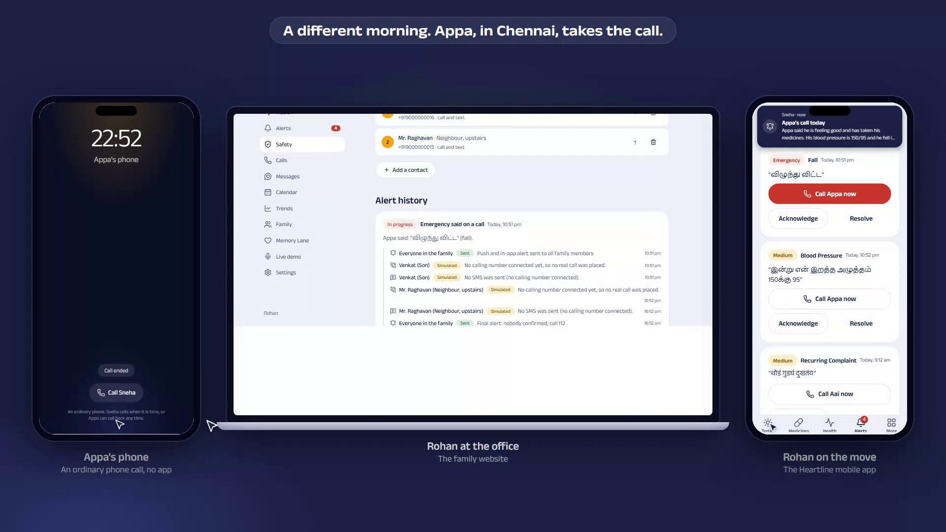




SAFETY AND TRUST
Built for the worst minute, not the average day
Honest by design
Says she is an AI on every call, asks permission first, and stops if declined.
Never gives medical advice
Alerts on thresholds the family set. It records, it does not diagnose.
Evidence for every flag
Each safety decision stores the exact words that triggered it.
Private by default
Appa says he fell: the alert ladder runs, and every step is logged
Text transcripts only; audio is opt-in. Access is limited to the family by row-level security.
Notes:
Judges will ask about safety first. Four answers: honest disclosure and consent, no medical advice, evidence quotes on every flag, and privacy defaults. The screenshot shows the emergency ladder: the whole family is notified, then contacts are called in priority order, and the ladder stops when a human acknowledges. Without a telephony number the call and SMS steps are shown as simulated, and the in-app alerts are real.

Slide 8
ARCHITECTURE
A cascade pipeline behind clean interfaces
Parent's phone
(ordinary call)
Browser demo
(WebRTC, no number)
Family website
Next.js 16
Family app
Expo SDK 57
Telephony adapter: Twilio now, Exotel / Plivo behind one interface
Voice service · Python 3.12, Pipecat 1.12, FastAPI
Supabase
Silero VAD
turn-taking
Speech to
text
Safety check
every turn
LLM +
tools
Text to
speech
Postgres with row-level security, private storage for photo proofs, realtime. Clerk handles sign-in.
Care engine · Escalator · Post-call jobs · Scheduler
Groq: Qwen3.8 27B (chat + vision), gpt-oss-120b (summary, fallback), gpt-oss-20b (safety), Whisper
Providers, languages, voices, models: all set in config
Notes:
Read the diagram top to bottom. Callers reach the voice service either through the telephony adapter (Twilio today, Exotel and Plivo behind the same interface) or through WebRTC for the no-number demo. Inside: VAD, speech to text, a safety check on every turn, the LLM with tools, and text to speech. The pipeline is a cascade on purpose, so each piece can be swapped, including a speech-to-speech model later. State lives in Supabase with row-level security; the website and mobile app share one data API. Nothing is hard-coded: providers, languages, voices and models come from config.

Slide 9



TECH STACK
Modern, open and swappable at every layer
Voice and AI
Web
Mobile
Pipecat 1.12, Python 3.12, FastAPI
Silero VAD, SmallWebRTC
Groq Whisper for speech to text
Qwen3.8 27B for chat and vision; gpt-oss for summary and safety
Next.js 16, React 19, Tailwind 4
Landing page, family dashboard, live demo, admin
One data API shared with mobile
Expo SDK 57 with Expo Router
Reanimated and Skia for the orb
Medicines, health, trends, messages, safety
Data and auth
Telephony and speech
Engineering
Supabase Postgres, RLS on every table
Private storage for photo proofs
Clerk authentication
Twilio today; Exotel and Plivo via the same adapter
Indic speech adapters: Bhashini, self-hosted IndicConformer
Edge TTS for development only
Turborepo and pnpm monorepo
Config-driven providers, languages, models
71 automated tests on the voice service
Notes:
Do not read the list; pick three points. One: Pipecat gives us a real-time cascade with turn-taking tuned for elderly speakers. Two: the same data API serves the web and the mobile app. Three: everything provider-specific sits behind an interface and is chosen from config, so moving to Exotel or Plivo, or to Sarvam voices, is a configuration change plus an adapter.

Slide 10
WHAT MAKES IT DIFFERENT
Zero effort for the parent, the full loop for the family
 | Heartline | Reminder apps | Wearables | Human check-in calls | Basic IVR
Parent installs nothing | Yes | No | No | Yes | Yes
Natural talk in her language | Yes | No | No | Yes | No
Understands what she says | Yes | No | No | Yes | No
Acts: doses, readings, notes | Yes | Partly | Partly | Partly | No
Escalates until a human answers | Yes | Partly | Partly | Partly | No
Daily summary for the family | Yes | Partly | Partly | Partly | No
Zero install
Human in the loop
10 languages, one agent
Notes:
The comparison is of typical capabilities of each category, not of named products. The core claim: Heartline asks nothing of the parent yet still understands them, acts on what they say, and keeps escalating until a human answers. Three one-liners: zero install, human in the loop, ten languages from one agent.

Slide 11
IN SUMMARY
Peace of mind, in her own language.
10
3
1–3 s
Indian languages in the registry; Marathi, Hindi and English launch-ready
surfaces working together: the phone call, the website and the mobile app
typical reply time after the parent stops speaking
WHAT'S NEXT
Production numbers through Exotel or Plivo
Sarvam Indic voices for all ten languages
A pilot with the first families
Testing the mobile app on real devices
Try the live demo
Talk to Sneha in your browser. No sign-up.
Notes:
Land the message: peace of mind, in her own language. Recap what exists today: ten languages in the registry (three launch-ready), three working surfaces, and replies in one to three seconds. Close with the next steps and invite the judges to try the live demo.

