Slide 1
TP1
gene1
TP2
A
TP2
gene2
TP3
ZraI
AjiI
EcoRV
pYPKa
TP1
TP2
gene1
gene2
B
TP2
C
TP3
pYPK0
pYPK0
NotI
TP1
TP2
*
PacI
gene1
D
*
TP2
gene2
TP3
pYPKpw

Slide 2
Promoter 1 (P1)
gene1
Promoter 2 (P2)
Promoter 2 (P2)
gene2
Promoter 3 (P3)
ZraI
AjiI
EcoRV
E. coli suicide vector
P1
P2
gene1
gene2
P2
P3
Yeast vector URA3
Yeast vector URA3
P1
gene1
P2
*
*
P2
gene2
P3
Yeast vector LEU2
NotI
PacI
TP1
gene1
TP2
gene2
TP3
Yeast vector LEU2

Slide 3
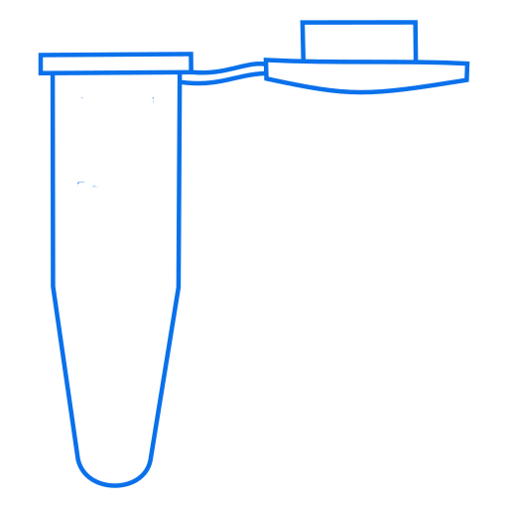

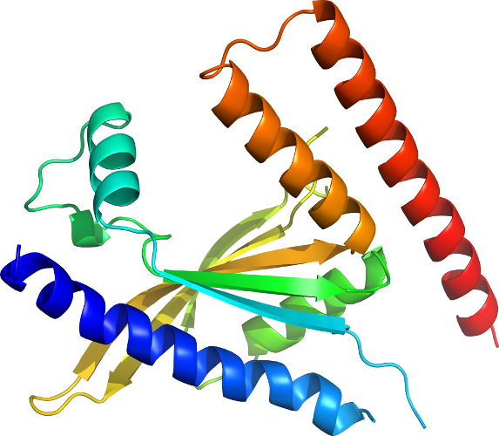
x
x
x
x

Slide 4
x x x x x
x x x x x

Slide 5
pYPKa_N_AbXYZ1
Backbone plasmid name
Insert designation
Enzyme
Z - ZraI
A - AjiI
E - EcoRV
Strain
Designation
Prefix
(Optional)
forbidden letters in prefix, insert designation:
-_!"#$%&'()*+,./:;<=>?@[\]^`{|}~

Slide 6
pYPKpw_PRM1_AbXYZ1_TRM1
Backbone plasmid name
Promoter designation
Gene designation
Terminator designation

Slide 7
ORI yeast
ORI E. coli
Marker E. coli
Marker yeast
mcs

Slide 8
ORI yeast
YEplac181
ORI E. coli
2µ
pBR322
pSH65
Marker E. coli
CEN ARS
CEN ARS
pBR
Marker yeast
mcs
TRP1
amp
URA3
pUG35 CYC1-GFP
KanMX4
YEplac112
YEplac195
crpΔ
pFA6a-GFPS65T-kanMX6
pTA1

Slide 9
YIplac211 URA3
YIplac128 LEU2
YIplac204 TRP1
CEN ARS
CEN_ARS
pBR
LEU2
ampR
HIS3
TRP1
URA3
ΔCRP

Slide 10
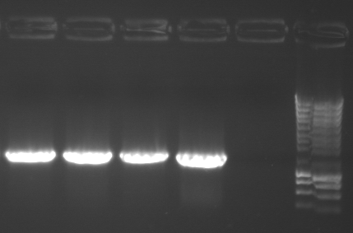
Diagnostic PCR with
Primers 577 and 987
2µ
CEN ARS
CEN ARS
pBR
987
PTA5, pTA6, pTA8 and pTA10
TRP1
amp
URA3
KanMX4
577
crpΔ

Slide 11
2µ
CEN ARS
CEN ARS
pBR
TRP1
amp
URA3
KanMX4
crpΔ

Slide 12
x
x
x
x

Slide 13
x x x x x
x x x x x

Slide 14
amp
CRP
2µ
pUC
CRP
URA3
amp
pUC
2µ
URA3

