Slide 1

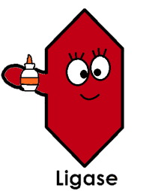
∆crp
...gcaatgagacaagaacgaaaagcgtttacctcggaactctattgta
...cgttactctgttcttgcttttcgcaaatggagccttgagataacat
gaaaagcgtttacctcggaactctattgtagaacccctat...
cttttcgcaaatggagccttgagataacatcttggggata...
AmpR
...gcaatgagacaagaacgaaaagcgtttacctcggaactctattgta
...cgttactctgttcttg
gaacccctat...
cttttcgcaaatggagccttgagataacatcttggggata...
...gcaatgagacaagaacgaaaagcgtttacctcggaactctattgta
...cgttactctgttcttg||||||||||||||||||||||||||||||gaacccctat...
cttttcgcaaatggagccttgagataacatcttggggata...
∆crp
...gcaatgagacaagaacgaaaagcgtttacctcggaactctattgtagaacccctat...
...cgttactctgttcttgcttttcgcaaatggagccttgagataacatcttggggata...
AmpR
5´ to 3´ exonuclease
DNA ligase

