Slide 1
A
gene1
577
B
TP1
TP2
775
TP2
gene2
TP3
468
568
567
467
778
578
ZraI
AjiI
EcoRV
pYPKa
TP1
TP2
gene1
gene2
C
TP2
D
TP3
pYPK0
pYPK0
NotI
TP1
TP2
*
PacI
gene1
E
*
TP2
gene2
TP3
pYPKpw

Slide 2
prom
gene1
term
*
*
prom
gene2
term
CRPΔ
pYPKpw
amp
pUC
2µ
URA3
pTA1
amp
pBR
2µ
LEU2

Slide 3
ORI yeast
YEplac181
ORI E. coli
2µ
pBR322
CEN ARS
Marker E. coli
CEN ARS
pBR
pSH65
Marker yeast
mcs
HIS3
amp
p423GPD
pUG35 CYC1-GFP
crpΔ
pTA1

Slide 4
ORI yeast
YEplac181
ORI E. coli
2µ
pBR322
pSH65
Marker E. coli
CEN ARS
CEN ARS
pBR
Marker yeast
mcs
TRP1
amp
URA3
pUG35 CYC1-GFP
KanMX4
YEplac112
YEplac195
crpΔ
pFA6a-GFPS65T-kanMX6
pTA1

Slide 5
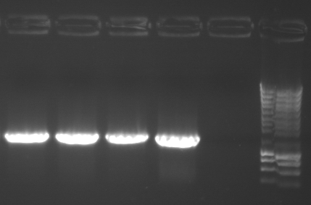
Diagnostic PCR with
Primers 577 and 987
2µ
CEN ARS
CEN ARS
pBR
987
PTA5, pTA6, pTA8 and pTA10
TRP1
amp
URA3
KanMX4
577
crpΔ

Slide 6
2µ
CEN ARS
CEN ARS
pBR
TRP1
amp
URA3
KanMX4
crpΔ

