Slide 1

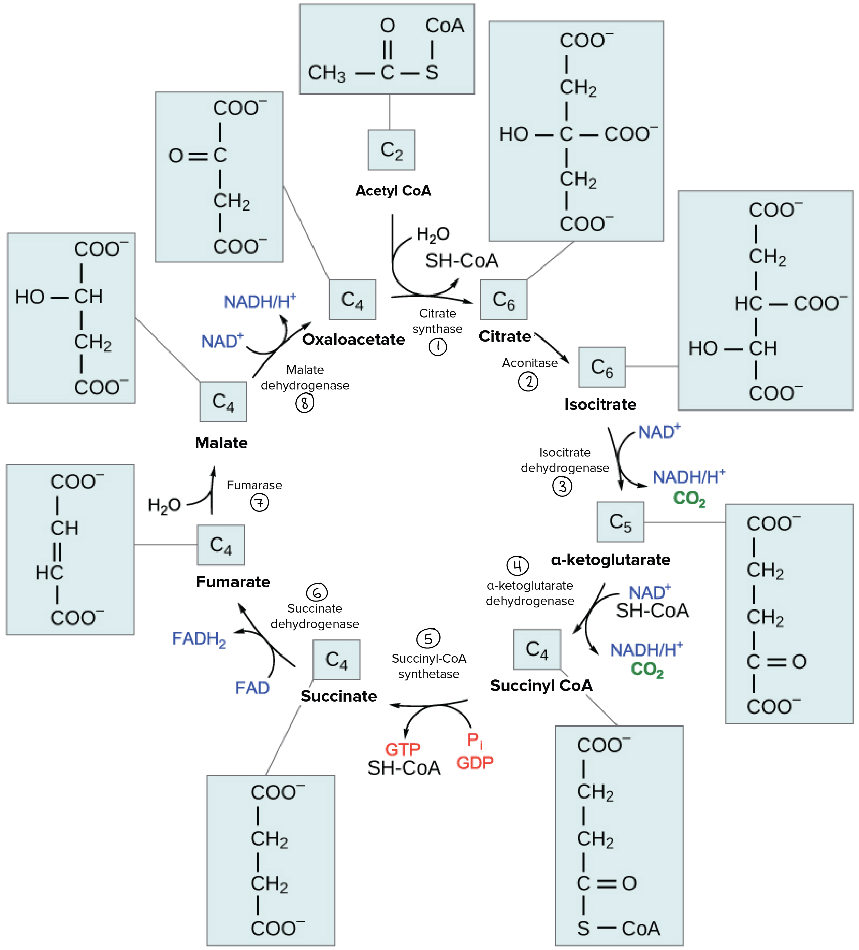
Glucose
Xylose
Glycolysis
PPP
Xylose
Mit
Ethanol
Ac-CoA
Pyruvate
NADPH
TCA
Ac-CoA
FAS
ATP
Fatty acids

Slide 2
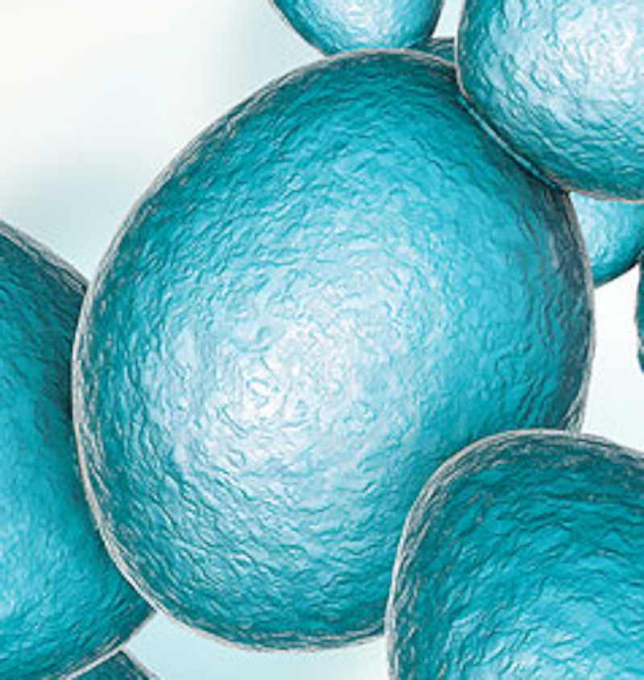
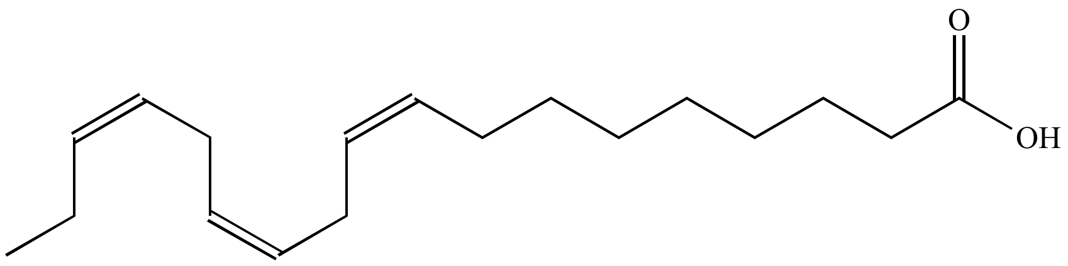
Glucose
Xylose
Glycolysis
PPP
Ac-CoA
Pyruvate
NADPH
TCA
Ac-CoA
FAS
ATP
Fatty acids

