Slide 1
ORI yeast
YEplac181
ORI E. coli
2µ
pBR322
CEN ARS
Marker E. coli
CEN ARS
pBR
pSH65
Marker yeast
mcs
HIS3
amp
p423GPD
pUG35 CYC1-GFP
crpΔ
pTA1

Slide 2
ORI yeast
YEplac181
ORI E. coli
2µ
pBR322
pSH65
Marker E. coli
CEN ARS
CEN ARS
pBR
Marker yeast
mcs
TRP1
amp
URA3
pUG35 CYC1-GFP
KanMX4
YEplac112
YEplac195
crpΔ
pFA6a-GFPS65T-kanMX6
pTA1

Slide 3
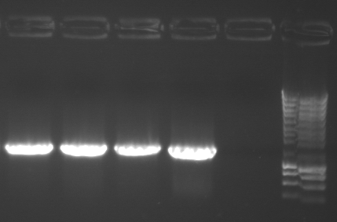
Diagnostic PCR with
Primers 577 and 987
2µ
CEN ARS
CEN ARS
pBR
987
PTA5, pTA6, pTA8 and pTA10
TRP1
amp
URA3
KanMX4
577
crpΔ

Slide 4
2µ
CEN ARS
CEN ARS
pBR
TRP1
amp
URA3
KanMX4
crpΔ

