Slide 1
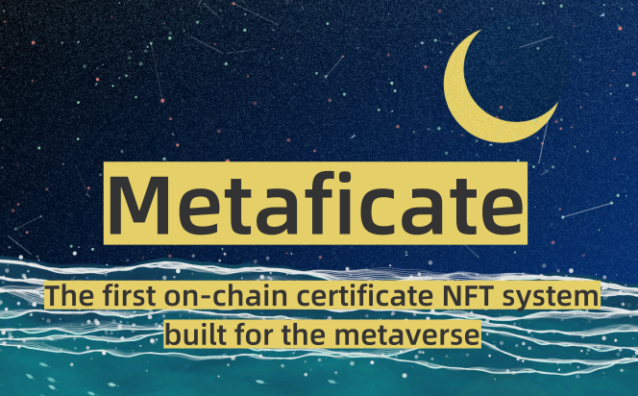
POWERPOINT TEMPLATE
Layer 2 Hackathon

Slide 2
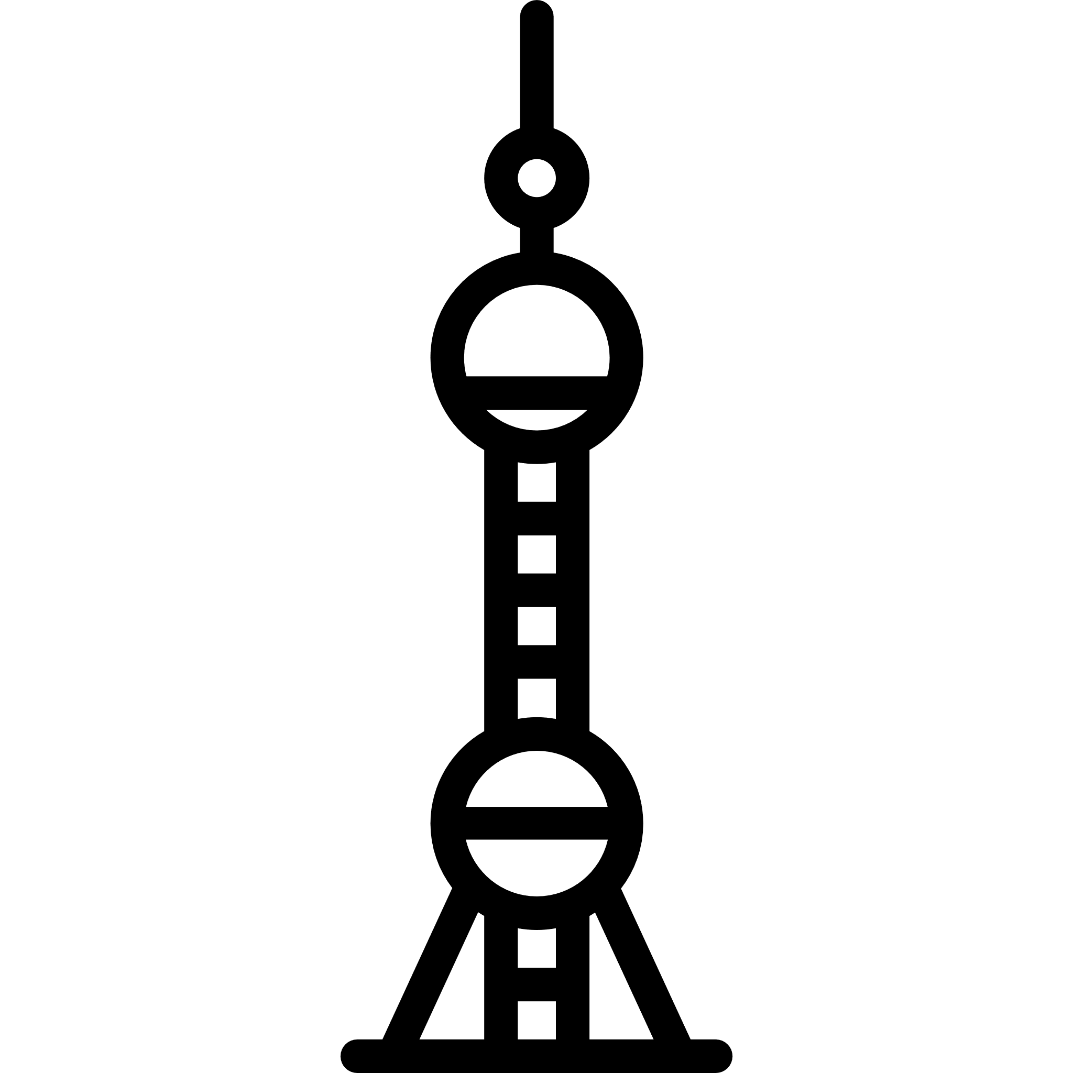









Our Members
Erica
Researcher & Designer
Minato
Backend
Zijian
Smart Contract Develop
Zheming
Frontend

Slide 3
What We Built
The first on-chain certificate NFT system built for the metaverse (In this hackathon, we focus on Chainlink, Polygon and The Graph)

Slide 4
Project Name
Meta
元-链上自证
ficate
plural of ficatameans cool things in Italian
Metaficate
元证
Metaverse
元宇宙
链：没有华丽外衣的元宇宙底层
certificate
证明、认证、结业证书

Slide 5

How It Works
On-chain Data: Metadata stored on Polygon; Chainlink and The graph help call external API calls to query and store data on the chain when generated the NFTs.
Connect & Claim: users connect their MetaMask and click the claim button , the website will guide eligible users to successfully receive their NFTs.
RabbitHole: Users click the button and jump into a tutorials page to learn how to better use the received Metafication

Slide 6
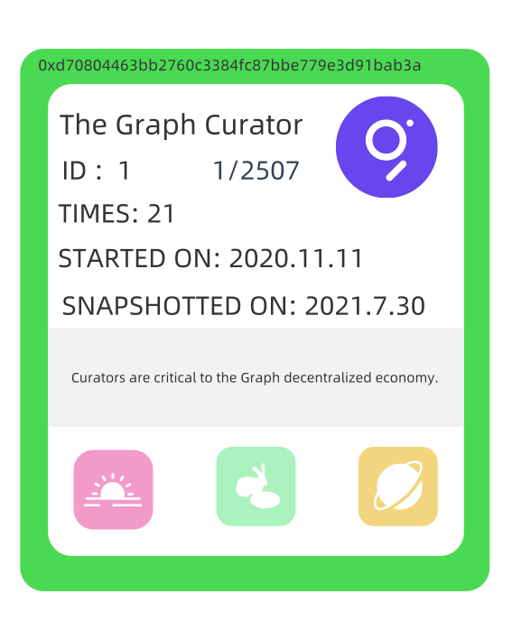
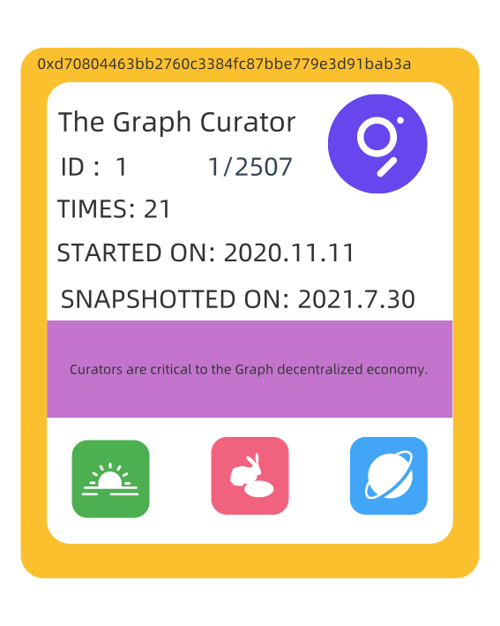
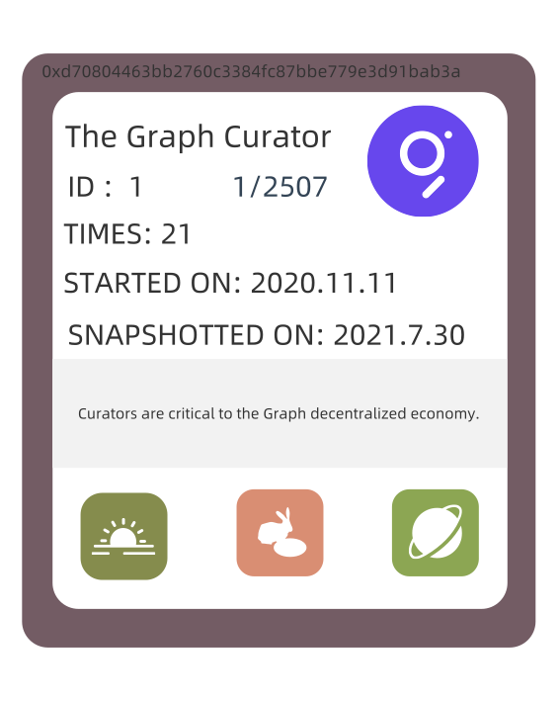
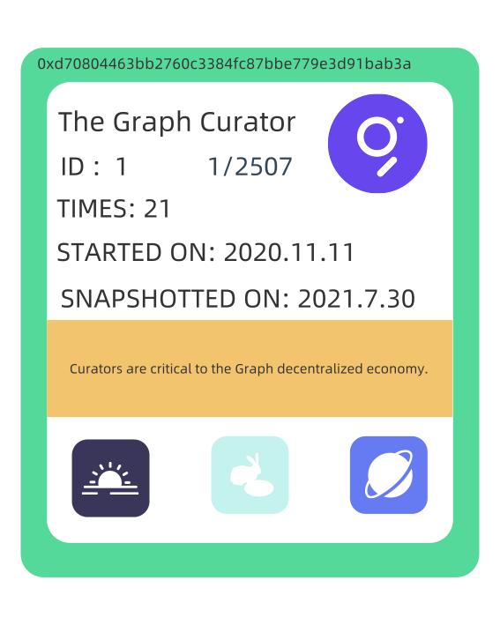
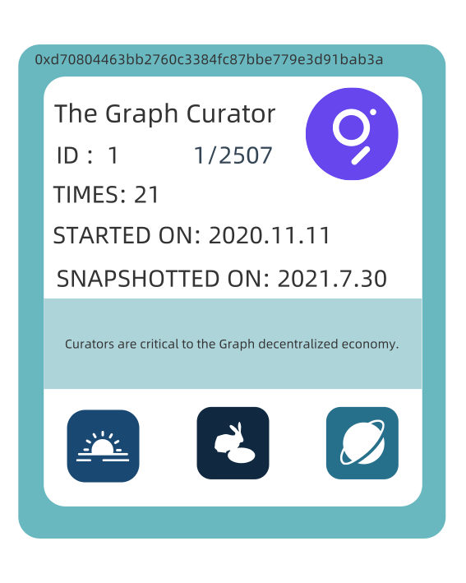
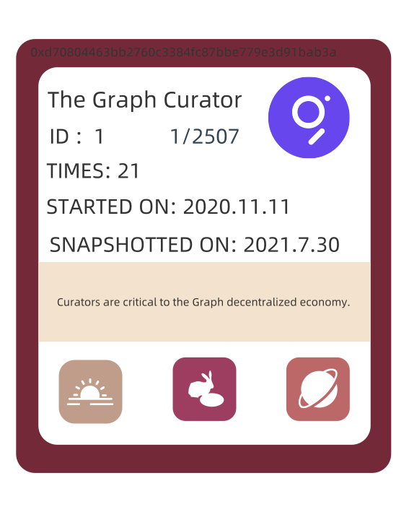
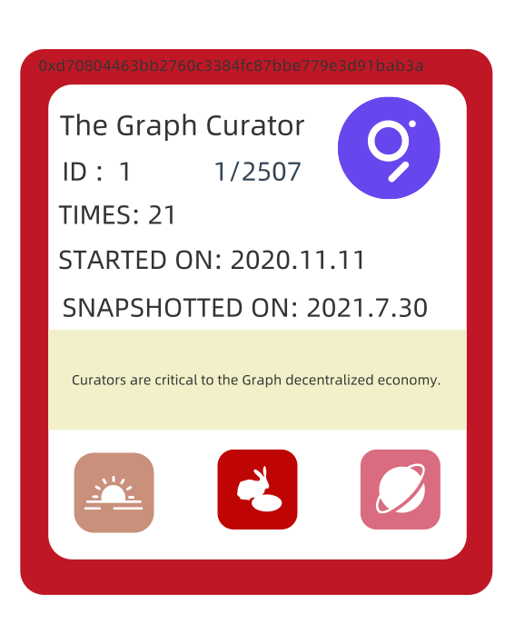
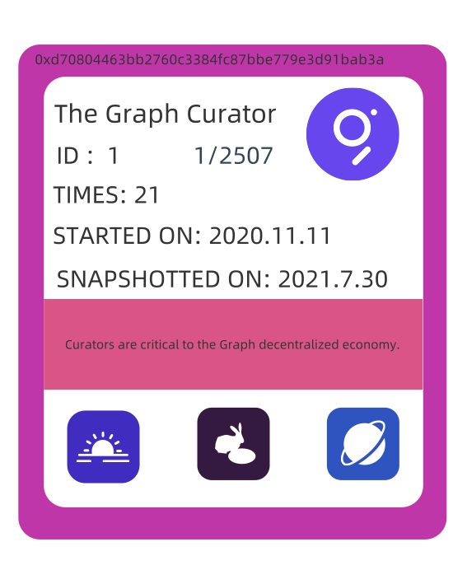
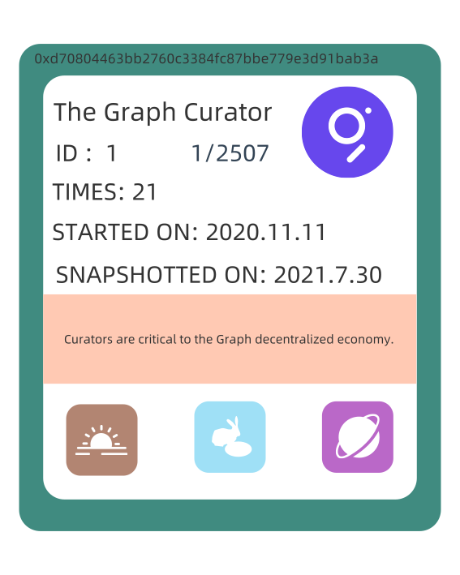
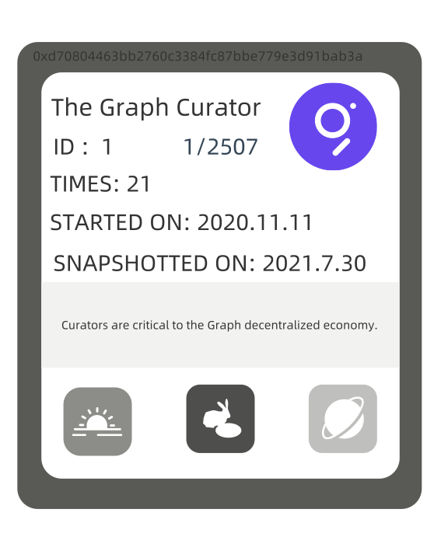
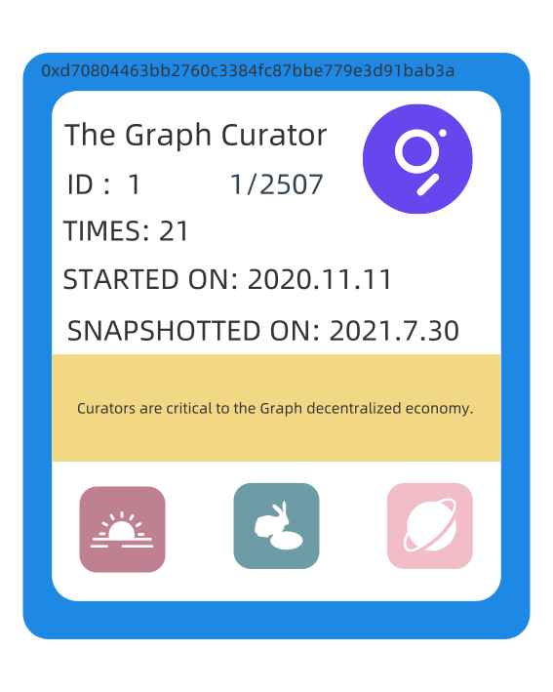
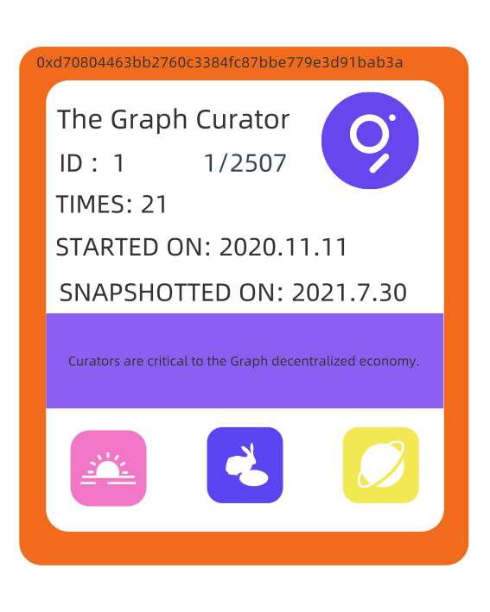
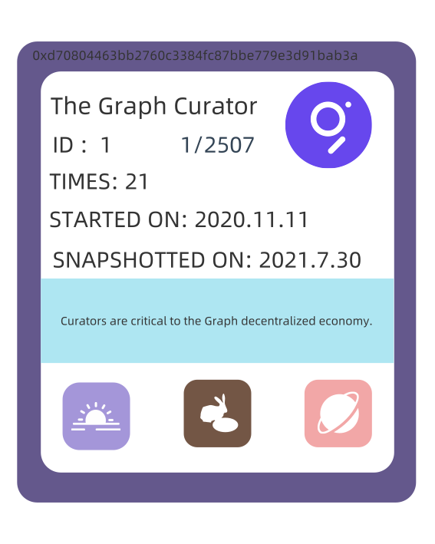
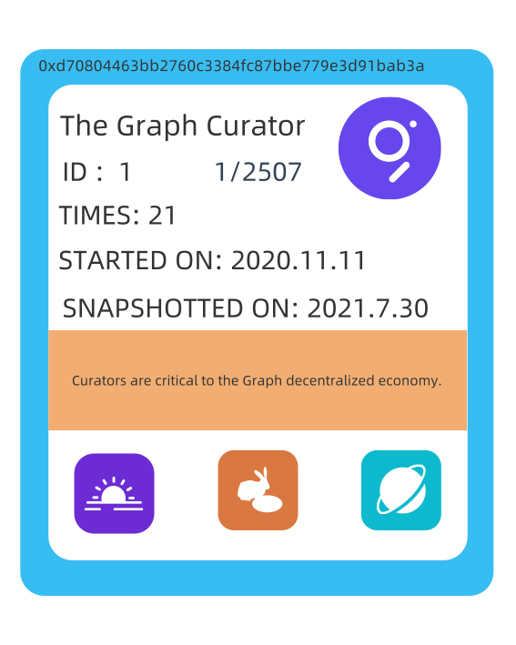
GitHub

Slide 7
How It’s Made
Uses The Graph as the major data source to get the addresses of eligible users and the on-chain data corresponding to these addresses. Relies on multiple subgraphs.
Use Chainlink to enable contracts to call external API. Then use this external API to query the subgraph to get the curator information of the address.
The metadata stored on Polygon chain. When minting the NFT on Polygon, the data in the contract code will randomly and automatically generate a unique NFT.

Slide 8


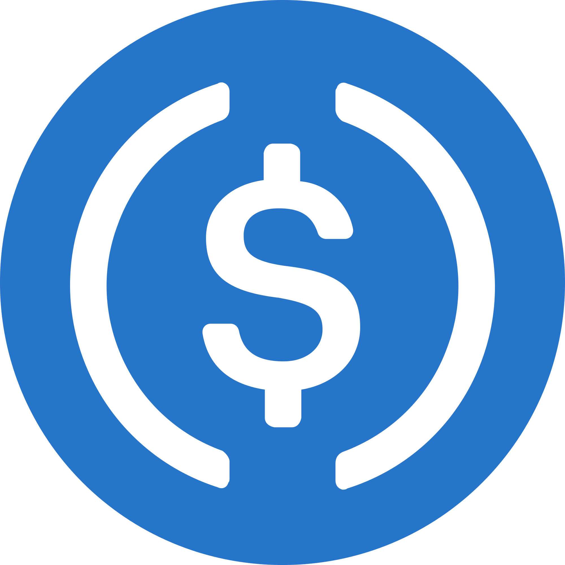
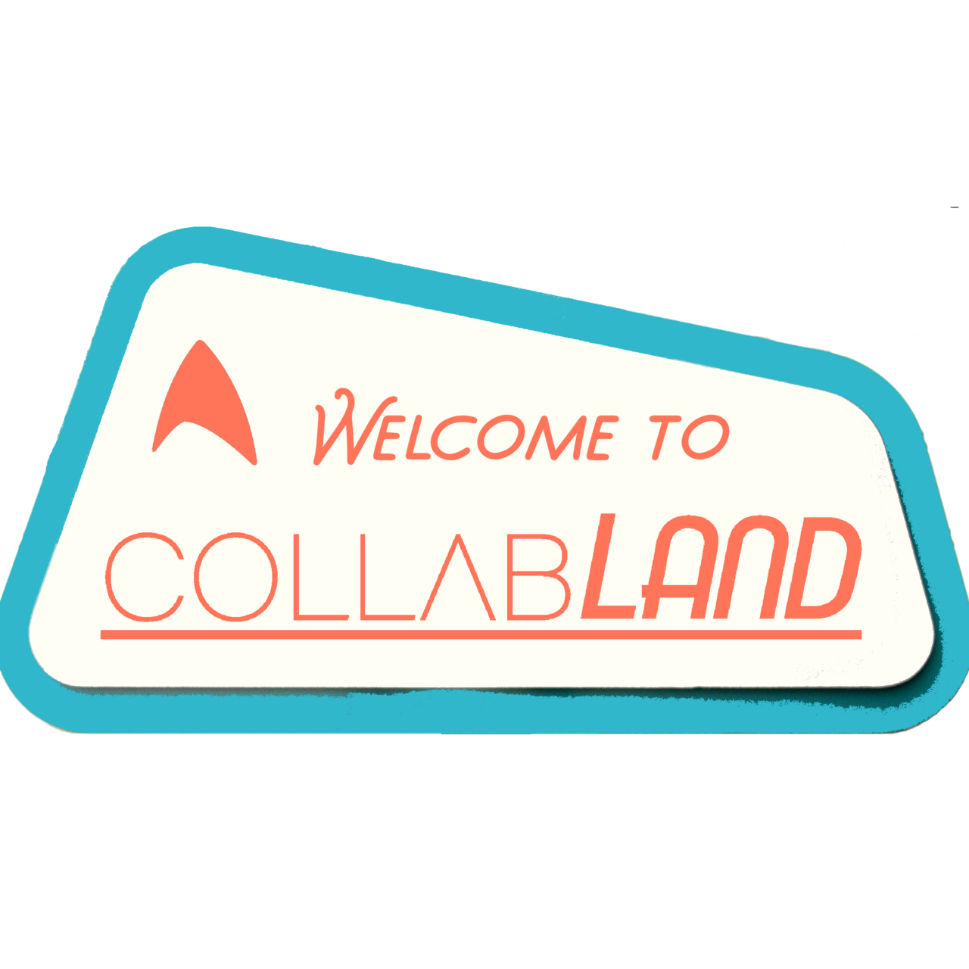



Complete the product and improve the contract security
Future
2. Add support for more layer2 solutions
3. Add payment interfaces and governance tools for the NFTs
4 Write tutorials about the Metafication-related tools
5. other public chains？
6. Create more Metaficates for more web3 projects

Slide 9
Check it out live
https://metafication.com

Slide 10

Thank You!

