Slide 1
Catena-X SME Acceleration Offsite
March 9-11, 2026

Slide 2
Day 0: Monday Agenda
Topic | Work Items | Owner | Time | Duration
Goals & Objectives | Presentation and discussion | All | 9:00-9:30 | 30
Catena-X SME Rollout Plan | Presentation Discussion | Thomas | 9:30-10:30 | 60
Technology and Working Session Overview | Technology stack review Outline what needs to be resolved in working sessions Discussion | Jim | 10:30-11:15 | 45
CSPs: Status, Questions, and Needs | Status review and discussion | Opiquad/Aruba | 11:15-12:00 | 45
Lunch |  |  | 12:00-13:00 | 60
CCM Use Cases Working Session | Proposal and discussion Detailed analysis of required Catena-X adjustments | All | 13:00-14:00 | 60
MVP Design Working Session | Engineering overview Product planning | All | 14:00-15:30 | 90
Detailed Product Requirements for Catena-X | Business & Technical Onboarding | All | 15:30-16:00 | 30
Delivery Plan | Discussion, planning, and agreement | All | 16:00-17:00 | 60

Slide 3
Day 1: Tuesday Agenda
Topic | Work Items | Owner | Time | Duration
Goals & Objectives | Presentation and discussion | All | 9:00-9:30 | 30
Catena-X SME Rollout Plan | Overview Discussion | Thomas | 9:30-10:30 | 60
Technology Review | EDC-V Data Plane Signaling Impact on Tractus-X (Management API, Data Plane) | Jim | 10:30-12:00 | 90
Lunch |  |  | 12:00-13:00 | 60
Onboarding Working Session | Madrid demo Julia to present process flow Process/APIs | All | 13:00-15:00 | 120
CCM Use Case Working Session | Proposal Discussion Plan | All | 15:00-16:45 | 105
Recap | Summary and recap | All | 16:45-17:00 | 15

Slide 4
Day 2: Wednesday Agenda
Topic | Work Items | Owner | Time | Duration
Intro and Recap | Presentation | Thomas | 9:00-9:30 | 30
Onboarding and Use Cases | Continued discussion and planning as needed | All | 9:30-10:30 | 60
Development and Delivery Plan For Tier-1 | Milestones Rollout Next steps | All | 10:30-12:00 | 90
Lunch |  |  | 12:00-13:00 | 60
Development and Delivery Plan For Tier-1, continued | Milestones Rollout Next steps | All | 13:00:14:00 | 60
Working Model and Agreement | Working model and plan for Tier-1 meeting | All | 14:00-16:00 | 120
Recap | Summary and recap | All | 16:00-16:30 | 30

Slide 5
Technology Goals
Accelerate SME onboarding via CSPs at scale
  Make it easy and fast for SMEs to join the dataspace
Overcome technology barriers
  Complete the Catena-X vision: a verifiable and adaptable foundation
Ensure Partner Stability
  Support existing participants while evolving the platform
Deliver in 2026
  Product rollout within the year

Slide 6
Technology Foundation
Enabling SME Onboarding at Scale

Slide 7

Beyond EDC
EDC is just the start. We’re building an extensible dataspace stack that goes far beyond that original vision.

Slide 8
Dataspace Technology Foundation
Onboarding Platforms
Connector Fabric Manager
EDC
Data Planes

Slide 9

Dataspace Technology Foundation
Onboarding Platforms
Connector Fabric Manager
EDC
Data Planes

Slide 10
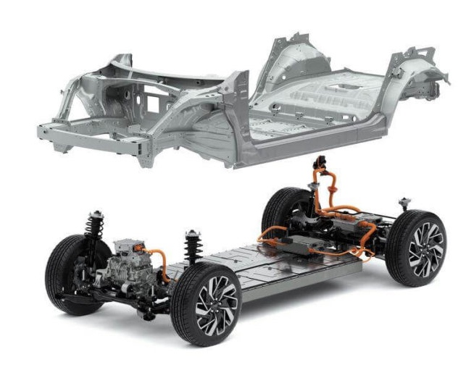
The EDC Platform is Adding Options
Cut costs through virtualization
  Support multiple dataspaces and participants in the same runtime
One code base, one architecture, deploy your way
  We are not re-architecting EDC
  Virtualization features are opt-in
Not just for service providers
  Organizations that participate in more than one dataspace
  Multi-site deployments

Slide 11
Why Virtualization?
Micro optimizations miss the forest for the trees
  Problem is resource consumption, not performance
Runtime-per-tenant model
  Ephemeral runtimes launched on demand
  Still too costly for SMEs
  Exponential operational complexity
    K8S namespaces insufficient for isolation
    Runtime passivation requires complex scheduling
    Failover, resiliency, backups, and migrations are difficult

Slide 12





Virtualization Design
Dataspace 2
Dataspace 1
Configuration-based isolation
  Lightweight isolation contexts created on the fly from persistent configuration
Virtualization Context
  Dataspace context with dynamically loaded policy expressions based on CEL
  Participant context
Message-based state machines
  Efficient compute utilization
Dataspace
Contexts
Participant
Context
Processing Queues

Slide 13


Dataspace Technology Foundation
Onboarding Platforms
Connector Fabric Manager
EDC
Data Planes

Slide 14
An Ecosystem of Data Planes
Data Plane Signaling
  Eclipse Foundation specification
  Control/data plane interop
Data Plane Core
  Eclipse Foundation project
  SDKs - Rust, Go, Java, .NET
  Facet-RS Library
    Rust-based reusable building blocks
  Siglet
    Small agents that bundle the Rust SDK and Facet-RS libraries
EDC will be control plane-only
Enable rapid integration of industry data formats and protocols through reusable components

Slide 15






Building Data Planes
Custom
Wire Protocol
Custom
Wire Protocol
& Features
Custom
Wire Protocol
& Features
Custom
Wire Protocol
& Features
Token Client
Token Provider
Authentication
JWT Generator
Lock Manager
Object Storage auth proxy
Data Plane
Signaling
SME
Connector
3. Return JWT

Slide 16






Using Siglets to Build Data Planes
Siglets are agents that provide key data plane functionality.
When deployed with a Siglet, provider data planes only need to validate JWTs and use claims for access control
Consumer data planes use the Siglet Token Client API to manage access tokens.
CSP App/
Transport Component
(Data Plane Specific)
Tier-1 App/
Transport Component
(Data Plane Specific)
Siglet
Siglet
3. Validate
JWT
2. Operation
1. Get token
3. Create and sign JWT
Wire Protocol
Data Plane
Signaling
Data Plane
Signaling
2. Start
5. Start
SME
Connector
Tier-1/OEM
Connector
1. Start Transfer
4. Return JWT
DSP

Slide 17

Dataspace Technology Foundation
Onboarding Platforms
Connector Fabric Manager
EDC
Data Plans

Slide 18


Introducing CFM
New Eclipse Foundation Project
Extensible DevOps platform
  Standardized automation to remove operational complexity
Tenant and resource management
  Simple resource management API
  Workflow-based provisioning
Agent-based messaging architecture
API
Tenant and Resource Manager
Provision Manager
Pluggable Agents

Slide 19




End-to-End Architecture
Onboarding
Platforms
Connect diverse onboarding and management front-ends
JAD demonstrator
  Ready-to-use reference implementation
    Onboarding Frontend
    CFM
    EDC
API
CFM
Automation
Routing
Config
Dataspace
Profiles
EDC & Data Plane
Runtimes
Participant Provisioning
EDC

Slide 20
Impact on Tractus-X
Planning a Path Forward

Slide 21
EDC-V and Tractus-X EDC
$ echo "EDC-V" > /dev/null
Tractus-X EDC is a reference implementation, EDC-V is for running EDC as a service
Tractus-X does not need an EDC-V distribution
Tractus-X EDC should continue to use the “classic” EDC deployment mode

Slide 22



EDC Impact on Tractus-X
Key EDC Project Goals
Plan
Recommendations
Use Data Plane Core project, Siglets
Build use-case-specific data planes and incorporate directly into apps
Data Plane Deprecation
EDC data plane framework is deprecated and will be removed
EDC will be a control plane only
Phase out many Tractus-X EDC extensions (see Andrea’s analysis)
Create new policy functions using CEL
Replace code validation with JSON-Schema-based validation
Some extensions may be required (e.g., contract retirement)
Dynamic Runtime
CEL-based policy functions
Schema-based validation framework
Configurable scope mappings
Offers the possibility of “in-place” upgrades
~80% uses cases are supported out-of-the-box without custom extensions
Management API v4/5
CEL-based policy functions
Schema-based validation framework
Configurable scope mappings
Offers the possibility of “in-place” upgrades
Simplify the Management API by limiting Json-LD
Upgrade relevant applications now

Slide 23
Deliverables
Working Sessions: Onboarding, Use Case Protocols, and Product Plan

Slide 24







Deliverables
Day 1: Tuesday
Onboarding API
Fully automated business and technical processes
Rock-solid Bring-Your-Own-Wallet (BYOW) support
Use Case Protocols
Production-ready use case protocol specifications
Streamlined and simplified CX-135 and CX-125 interaction flows
SME
CSP
Onboarding API
Neptune
Operating
Company
DSP 1.0
Use Case
APIs
SME
CSP
CX-135 Neptune
Day 2: Wednesday
Tier-1/
OEM
Product Plan
MVP
Pricing and availability
Working model
Network Rollout Plan
Aligned with Catena-X
Innovator vs. classic tracks
Enable progress without blocking on full network alignment
DSP 0.8
Classic
Supplier
CX-135

Slide 25
Onboarding API
Fully automated business and technical processes

Slide 26


From Single Platforms to Ecosystems
No single onboarding model can reach all SMEs
An open dataspace ecosystem enables many onboarding platforms
Onboarders become acquisition engines, driving global scale
Opiquad and Aruba demos

Slide 27
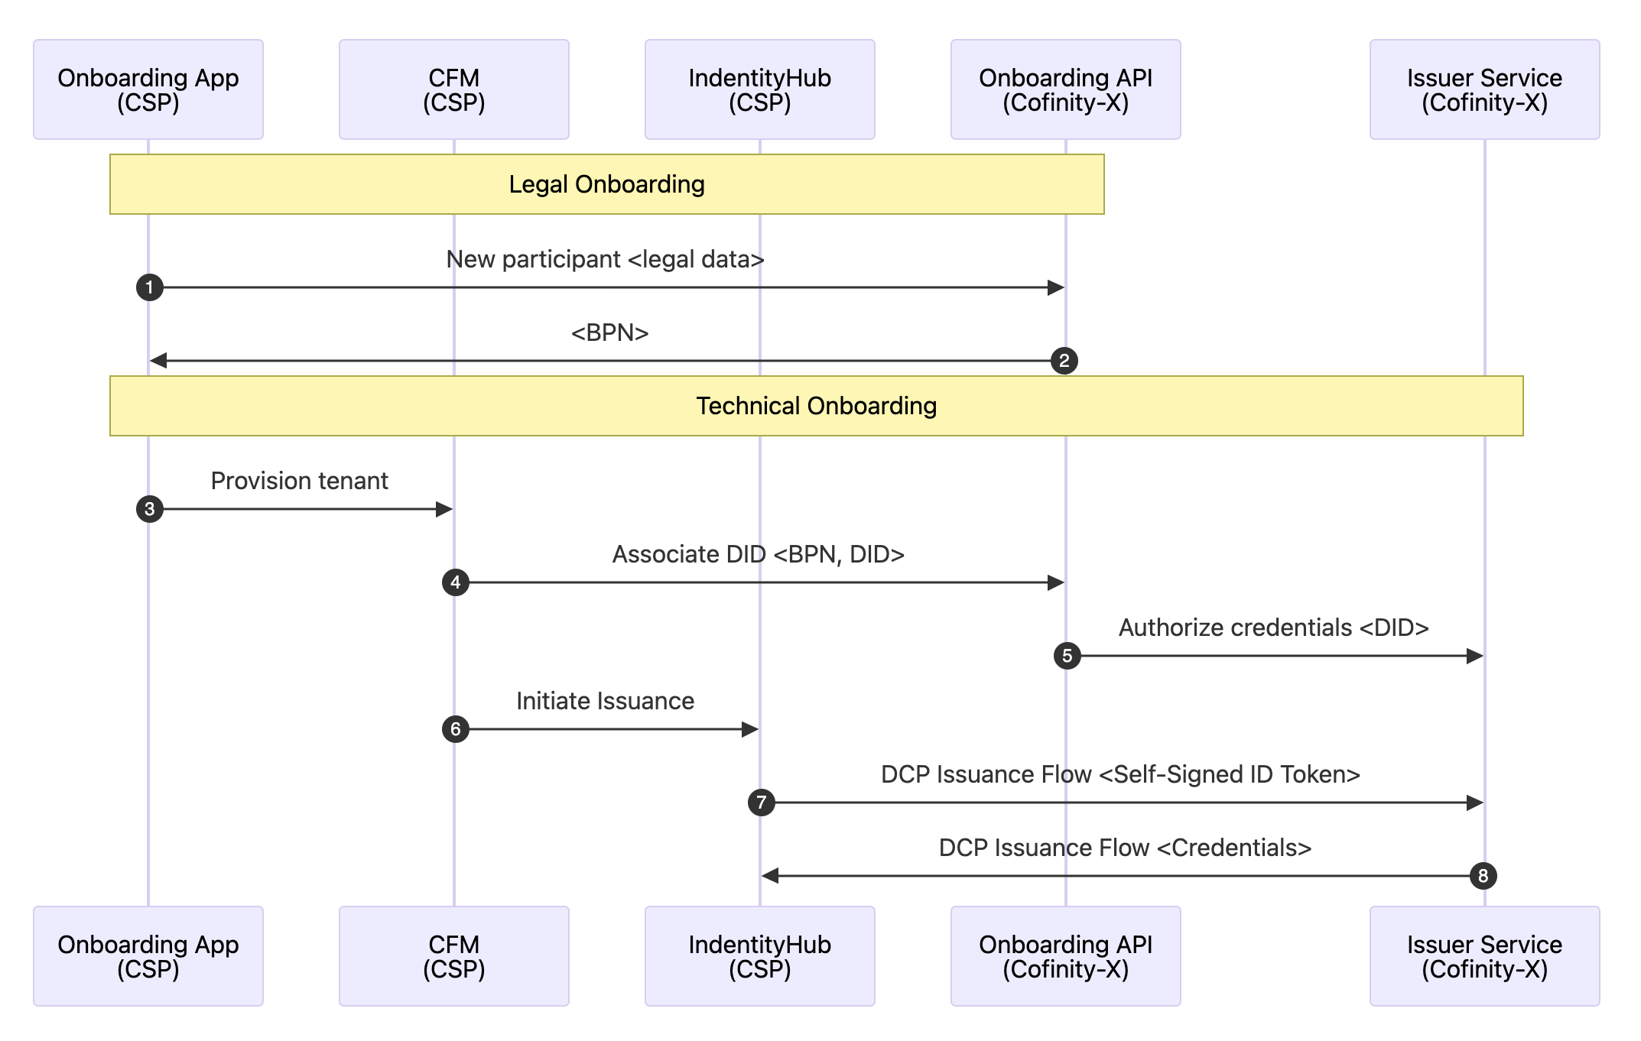
Automated Onboarding API
Single point of contact for an SME
Fully automated end-to-end
Separation between legal and technical onboarding
Legal onboarding produces a BPN
Technical onboarding only requires an attestation step
  Associate BPN with DID
  Signed ID token used as proof to issue credentials (DCP)
Onboarding API Security
  OAuth 2 Client Credentials

Slide 28
Use Case Protocols
Company Certificate Management (CCM)

Slide 29
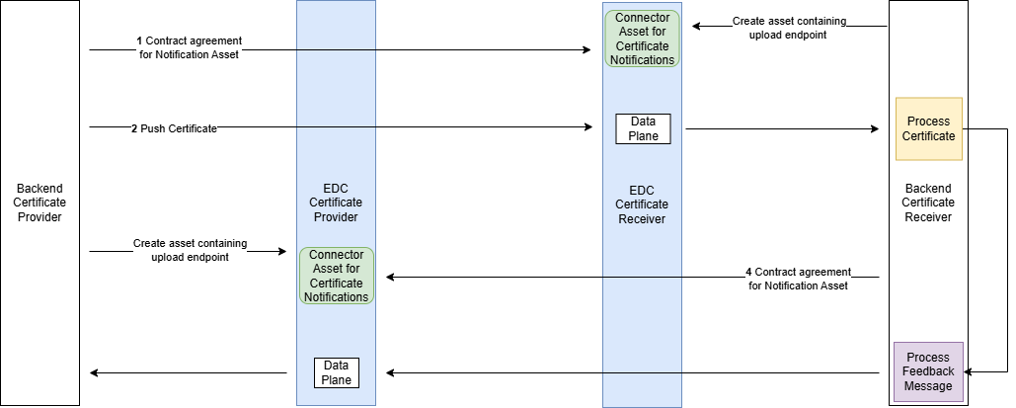
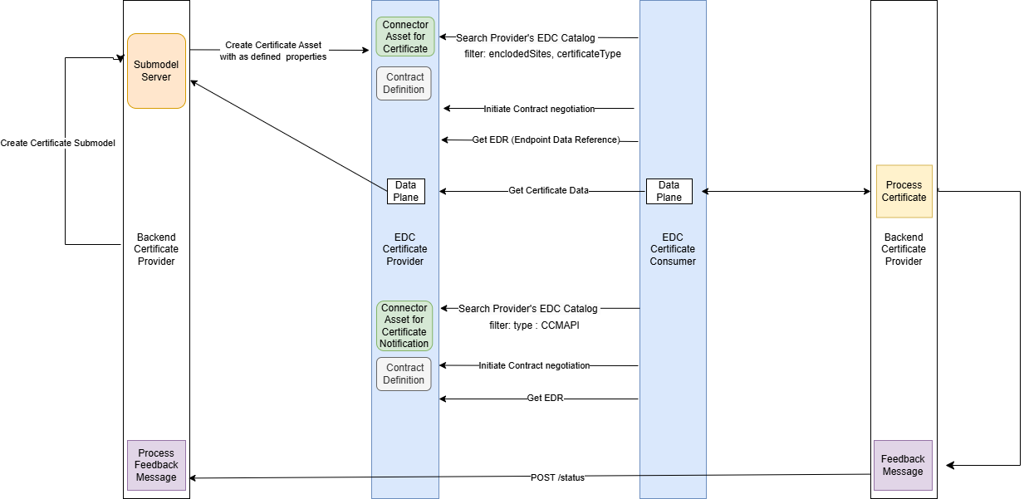
CX-135 Certificate Management: Structural Issues
Push flow
Best Practices
Non-aligned push vs. pull flows
Contracts should originate with the data provider, not the consumer (push)
Conformity
No normative specification language or compliance framework
Tied to EDC, an implementation, not a specification
Pull flow
Consistency
Contradictory requirements for CX-125, CX-135, and CX-151
Need to align with EDWG Data Plane Signaling
Evolution
No schema definitions
Lack of a versioning strategy will lead to future disruption

Slide 30
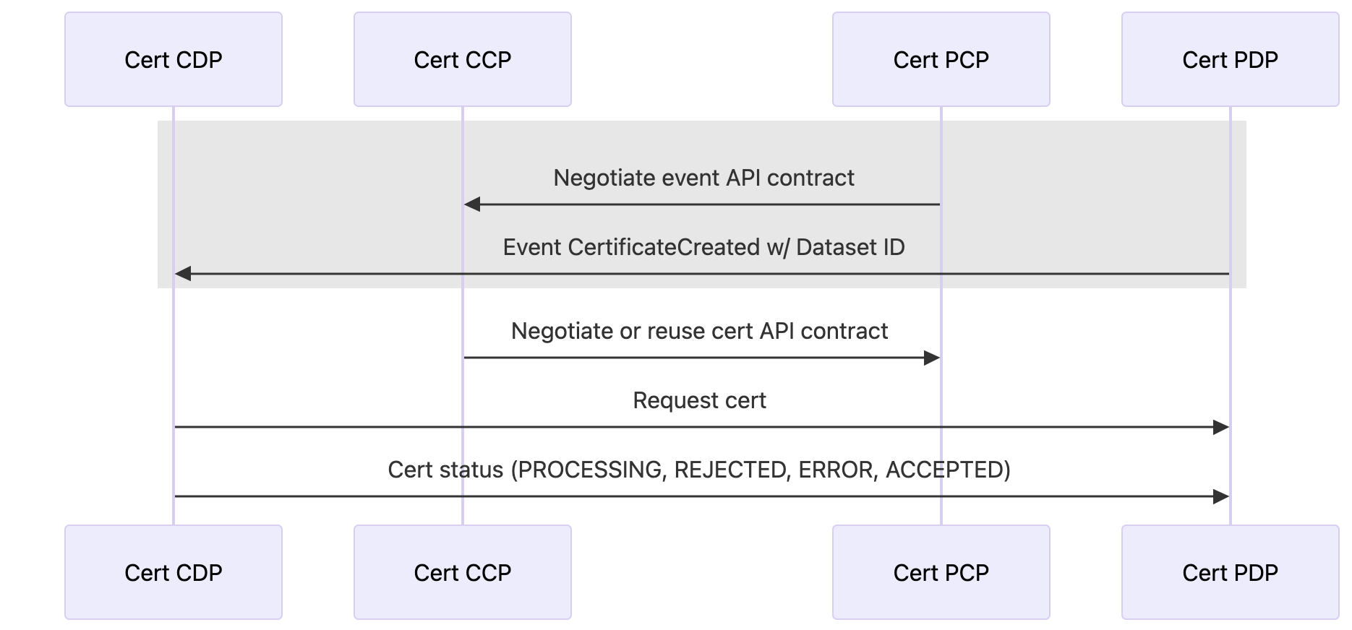
CX-135 Desired State
One flow
One simplified flow for push and pull
Certificate contracts originate with the provider
Based on EDWG and CNCF specifications for cross-dataspace interoperability
Architected evolution
Rapidly deliver other use cases
Based on EDWG and CNCF specifications
CX-135 CCM
CX-125 Traceability
CX-151 Industry Core Message
CNCF Cloud Events
DPlane-Sig HTTP API Profile
DPlane-Sig Token Refresh Profile

Slide 31
CCM Proposed Protocol
CDP – Consumer Data Plane
CCP – Consumer Control Plane
PCP – Provider Control Plane
PDP – Provider Data Plane

Slide 32

CCM Notification Scenario
SME
Connector
Find Consumer Notification API via Catalog
Tier-1/OEM
Connector
SME
Tier-1/OEM
Negotiate Consumer Notification API access and start
DSP 1.0
Event trigger
Find Provider Certificate API
Negotiate Provider Certificate API access and start
2. Find dataset & negotiate a contract
DP-Sig
DP-Sig
4. Send event
Certificate created notification
CCM
Endpoints
1. Receive notification
1. Connect to partner
Get certificate
2. Get certificate
3. Upload certificate
CCM Endpoints
CCM App
Certificate status
3. Send status
CCM App

Slide 33
CCM Pull Scenario
SME
Connector
Tier-1/OEM
Connector
SME
Find Provider Certificate API
Tier-1/OEM
DSP 1.0
Negotiate Provider Certificate API access and start
DP-Sig
1. Connect to supplier
DP-Sig
1. Connect to partner
Get certificate
2. Get certificate
CCM Endpoints
3. Upload certificate
Certificate status
3. Send status
CCM App
CCM App

Slide 34
CCM Proposal
DSP Catalog Dataset – HTTP Profile
{
"@id": "urn:uuid:3dd1add8-4d2d-569e-d634-8394a8836a88",
"@type": "Dataset",
"hasPolicy": […],
"datasetType": [
"CertificateNotificationAPI"
],
"distribution": [
{
"@type": "Distribution",
"format": "https://w3id.org/dplane-sig/http",
"specMetadata": [
{
"url": "...",
"specType": "xregistry"
}
],
"accessService": ”…"
}
]
}
datasetType – Conveys the type of data offered (defined by Data Plane Signaling)
specMetadata – Conveys endpoint, schema, and versoining information
CX-135 CCM
CX-125 Traceability
CX-151 Industry Core Message
DSP DataAddress – Token Refresh Profile
{
"endpointType": "https://w3id.org/dplane-sig/http",
"endpoint": "https://example.com",
"endpointProperties": [
{
"name": "https://w3id.org/dplane-sig/token",
"value": "TOKEN-ABCDEFG"
},
{
"name": "https://w3id.org/dplane-sig/authType",
"value": "bearer"
},
{
"name": "https://w3id.org/dplane-sig/refreshToken",
”value": "REFRESH-TOKEN-ABCDEFG"
},
{
"name": "https://w3id.org/dplane-sig/expiresIn",
"value": "300"
},
{
"name": "https://w3id.org/dplane-sig/refreshEndpoint",
"value": "https://example.com/authorization/refresh"
}
]
}
CNCF Cloud Events
DPlane-Sig HTTP Profile
DPlane-Sig Token Refresh Profile
DataAddress properties to transmit access and refresh tokens

Slide 35
CCM Proposal
Notification message structure
{
"specversion": "1.0",
"type": "CertificateCreated",
"source": "urn:bpn:BPNL0000000001AB",
"id": "a1b2c3d4-5e6f-7a8b-9c0d-1e2f3a4b5c6d",
"subject": "BPNL0000000002CD",
"time": "2025-05-04T07:00:00Z",
"datacontenttype": "application/json",
"dataschema": "https://w3id.org/catenax/certificate.json",
"data": {
"certificateId": "cert-123",
"datasetId": "dataset-ccm-cert-abc123",
"certificateType": "ISO9001",
"validFrom": "2023-01-25",
"validUntil": "2026-01-24",
"locationBpns": ["BPNA000000000001"]
}
}
CX-135 CCM
CX-125 Traceability
CX-151 Industry Core Message
CNCF Cloud Events
DPlane-Sig HTTP Profile
DPlane-Sig Token Refresh Profile
CloudEvents defines:
Message structure,
Headers
Payload (data)

Slide 36
CCM Proposal
Notification message structure
{
"specversion": "1.0",
"type": "CertificateCreated",
"source": "urn:bpn:BPNL0000000001AB",
"id": "a1b2c3d4-5e6f-7a8b-9c0d-1e2f3a4b5c6d",
"subject": "BPNL0000000002CD",
"time": "2025-05-04T07:00:00Z",
"datacontenttype": "application/json",
"dataschema": "https://w3id.org/catenax/certificate.json",
"data": {
"certificateId": "cert-123",
"datasetId": "dataset-ccm-cert-abc123",
"certificateType": "ISO9001",
"validFrom": "2023-01-25",
"validUntil": "2026-01-24",
"locationBpns": ["BPNA000000000001"]
}
}
CX-135 CCM
CX-125 Traceability
CX-151 Industry Core Message
CNCF Cloud Events
DPlane-Sig HTTP Profile
DPlane-Sig Token Refresh Profile
CX-151 addresses too much – separate pieces:
Notification Framework
Digital Twin Guidance
API Specifications
EDC asset structure
Identifiers
Conformance Assessment
Industry Core Message defines
subject contents (DID or BPN)
datacontenttype as JSON
Required dataschema

Slide 37
CCM Proposal
Client Notification API
Provider Certificate API
DSP Catalog Dataset – HTTP Profile
{
"@id": "urn:uuid:3dd1add8-4d2d-569e-d634-8394a8836a88",
"@type": "Dataset",
"hasPolicy": […],
"datasetType": [
"CertificateNotificationAPI"
],
"distribution": [
{
"@type": "Distribution",
"format": "https://w3id.org/dplane-sig/http",
"specMetadata": [
{
"url": "...",
"specType": "xregistry"
}
],
"accessService": ”…"
}
]
}
CX-135 CCM
CX-125 Traceability
CX-151 Industry Core Message
CNCF Cloud Events
DPlane-Sig HTTP Profile
DPlane-Sig Token Refresh Profile
Notification message structure
{
"specversion": "1.0",
"type": "CertificateCreated",
"source": "urn:bpn:BPNL0000000001AB",
"subject": "BPNL0000000002CD",
"id": "a1b2c3d4-5e6f-7a8b-9c0d-1e2f3a4b5c6d",
"time": "2025-05-04T07:00:00Z",
"datacontenttype": "application/json",
"dataschema": "https://w3id.org/catenax/schemas/ccm/certificate-created.json",
"data": {
"certificateId": "cert-550e8400-e29b-41d4-a716-446655440000",
"datasetId": "dataset-ccm-cert-abc123",
"certificateType": "ISO9001",
"validFrom": "2023-01-25",
"validUntil": "2026-01-24",
"locationBpns": ["BPNA000000000001"]
}
}
CX-135 defines
API endpoints
datasetType contents
data payload

Slide 38
Product Plan
MVP, Pricing and Availability, Working Model

Slide 39
Product Plan
MVP – EDC team, CSPs, Catena-X, Cofinity-X
  Features, component architecture, and identification of all required work streams
  Agreement today
Pricing and availability - CSPs
  CSPs to provide a detailed product plan and presentation
  Include pricing and dates (Beta, GA)
  Identify required Catena-X inputs
Working model – EDC team, CSPs, Catena-X, Cofinity-X
  Agree on working model and responsibilities
  Agreement today

