Slide 1
Building a DIY Brain computer interface
George Panicker

Slide 2
About me
I’m an undergraduate student at Srishti as well as an associate and researcher at the Indian Sonic Research organization. My interests span new media, creative technology, audio synthesis , Extended reality and Biosignal/Neural interfaces

Slide 3
Advantages of OpenBci vs commercial eeg headset
Higher signal to noise ratio (better accuracy)
More channels than commercial 1 channel EEG headset (4 to 16)
Open source hardware and software
Most affordable research grade BCI available to the public
Communication protocols like OSC allow for non-medical applications
The Chip can be used to pick up EMG and ECG signals as well

Slide 4
Basic requirements
Your chipset
4 channel Ganglion
8 channel Cyton
16 Channel Cyton + Daisy
Your electrodes (usually included)
Snap electrodes
Clip electrodes
Soft gel electrodes (If you’re going the cap route)
Dummy electrodes
Wires
Power source:
Battery pack
Lithium-ion battery (Internal powering)
A 3d printer for the printed headset (ideal)

Slide 5
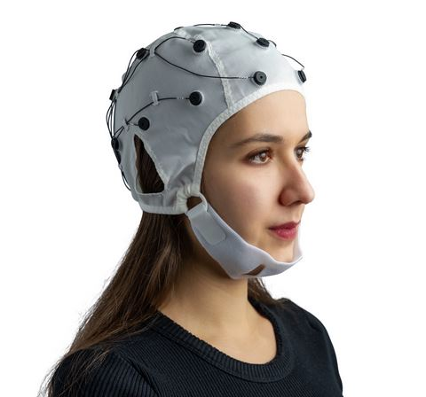
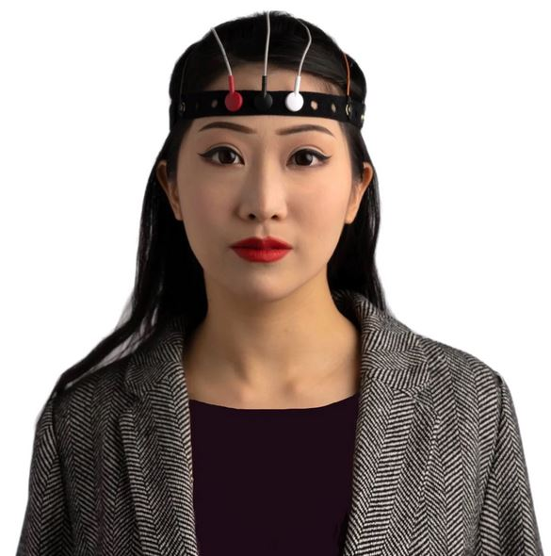
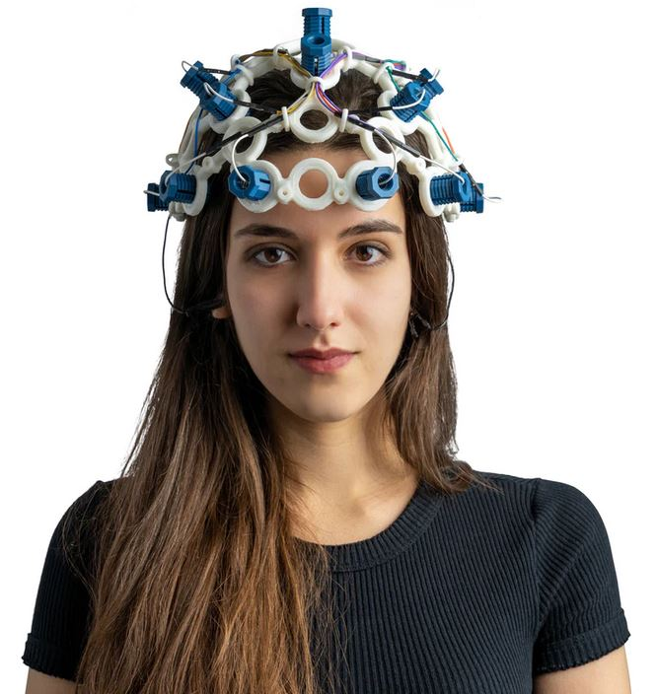
Possible ways to build your headset
Soft-cap
Band
Printed Headset

Slide 6
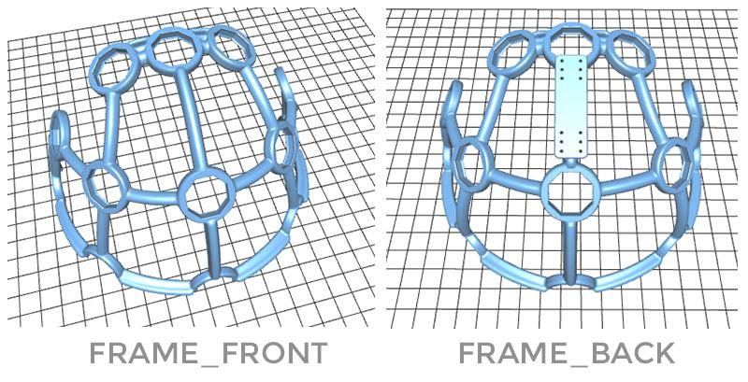
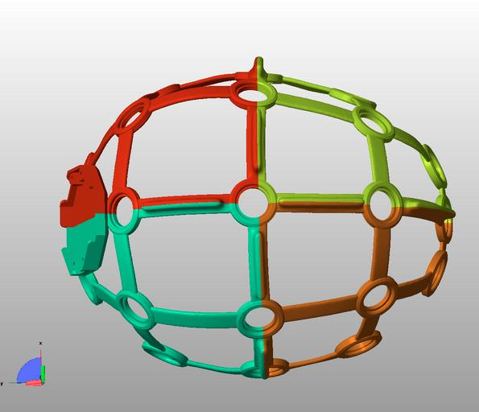
3d printing your headset
You can download the ultracortex stereolithography (.stl) files and its parts from the OpenBCI website
Files will probably need to be converted to Gcode format via Cura
Printer beds tend to be medium sized to small sized. The entire headset fitting is unlikely.
It is advisable to split the headset into 4 ideally if you’re printing the medium or large fit.
If you’re working with the small size version, the downloaded files will already have the headset half-split. Print time is around 4 to 6 hours.
Splitting can be done in Rhino, Freecad, sketchup etc. Do not use Blender.
Size small is recommended so that the closeness of the cathodes can pick up better signals

Slide 7
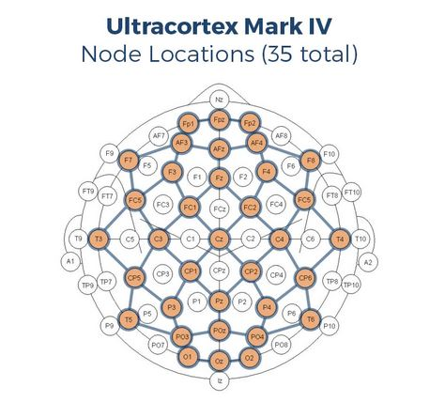
How to set it all up
Assembly instructions are available on the OpenBci youtube channel
There are 32 possible positions for node placements. Dummy electrodes and active electrodes have to follow existing placement conventions
Your earclip electrodes should be placed ideally close to your chip as well as your ear. T5 and T6 are ideal.
In addition, there are wire clips you can print that will make wiring a streamlined process and not a tangled mess

Slide 8
Things to note
There will be EMF signal noise from surrounding electronics and metals. So keep note of your environment.
Parts can be loose when you screw them in. Be very careful of losing important parts such as the earclips.
If going the soft gel cap route, it is important to follow procedure and use electrode gel because of signal interference from stuff like sweat
Internal power such as a a lithium ion is advisable versus the included battery pack

Slide 9
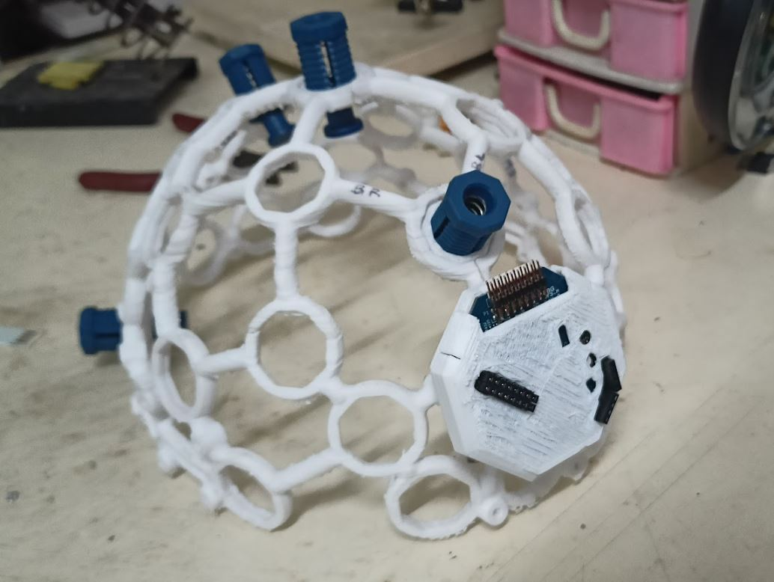
Future plans
Future plans at the ISRO include a possibility of using “intentionality” as a means to interact with devices. I am also looking to learn from Nikhil and develop a neurofeedback process utilizing music and colour theory through a combination of OSC, Touchdesigner and PureData/SuperCollider.
In addition, neural interface experiments using EMG biosignals via Myoware/arduino are a possibility worth exploring considering integration possibilities with OpenBCI chips. Topics such as machine listening, Butterworth Bandpass filters and FFT’s may be useful here.

Slide 10
Notes.
When checking for a signal, make sure you have rich harmonics. If there’s a mostly flat line coupled with a pulsating spike, you are most likely not picking up anything. In that case, check your temperance values from the openBCI GUI. Once your signals are clear, it should give a clear signal. If not, make sure resistance factors such as hair and sweat is out of the way. Screw your cathodes in more so that skin-skin contact is present, as this will help picking up a signal. Once your rich signal is present, that should

Slide 11
Thank you :)

