Slide 1
Indian Geography
Physical geography of India

Slide 2
Geological history of India
Physiography of India
Indian weather: seasons
Climatic regions of India
Soils of India

Slide 3
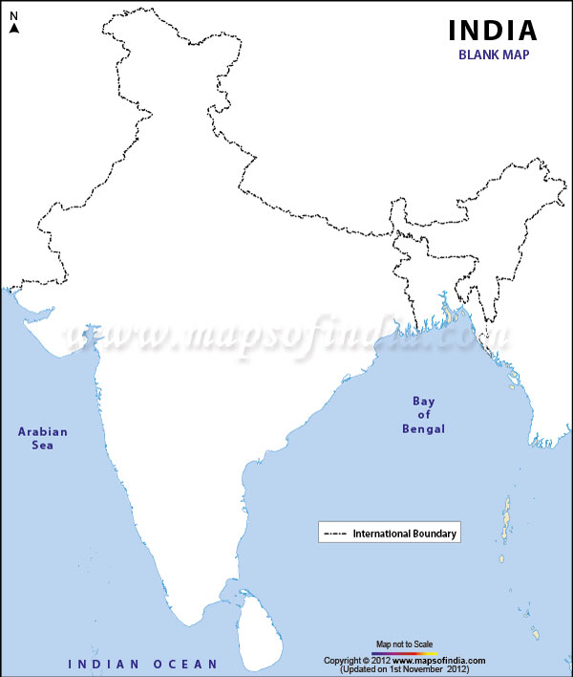
3 proto-continents
Rift valley
Son
Aravalli
Narmada
Damodar
Singhbhum
Mahanadi
Godavari
Dhrawad
Notes:
Pre Cambrain :
Pre gondwana---> collision three landmass aravali singhbum and dharwar , those gaps (lineaments) where rivers flows now
All aravali ,singhbum eroded
Geosyncline created , landmass got filled and made mountains eg: aravli ,satpura , vindhya , EG , Bijawal
Now Gondwana :
Lineaments Activation , disturb , two more places got faulting and submergence , rift valley created in which now river flows damodar , mahanadi + forest also submerged which ultimately made Coal
WG : lineament rifting ---> cracks developed
Mesozoic :
Reunion hotspot
Tertiary times :
Tethys --> himalaya
Jerk in WG got broken af and gave west to east slope--> south eastern slope
(WG = Horst) --> Peninsula got tilted east when this fell
Lastly Himalayan rivers came to give plains

Slide 4
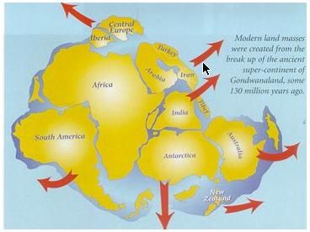
Crack over western coast
Break up from Gondawana

Slide 5
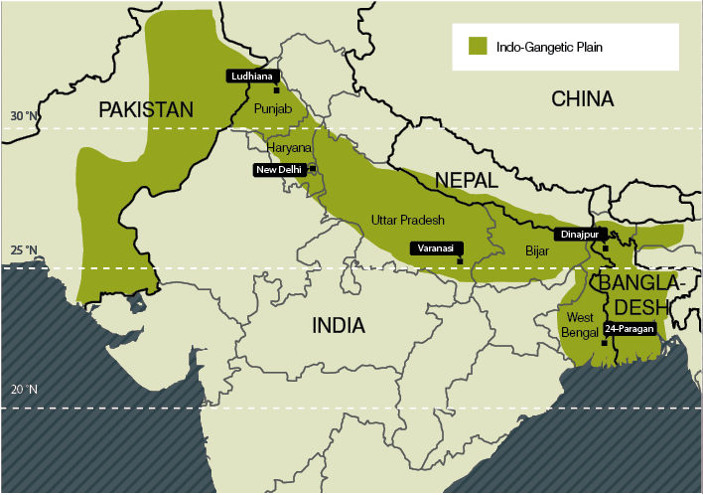
Western Ghats
Northern Plains
Slope: South eastern

Slide 6
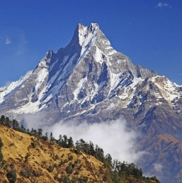
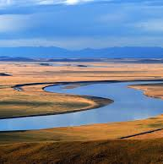
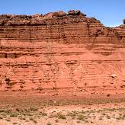
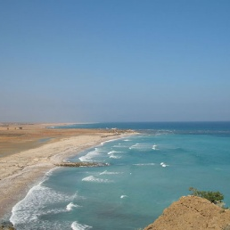
Physiography of India
Northern mountains
Northern plains
Peninsular plateau
Coastal plains

Slide 7
Indian peninsular plateau
Pre-Cambrian old region
8 divisions:
N-C highlands
S-C highlands
Eastern plateau
North Deccan
South Deccan
Western Ghats
Eastern Ghats
Meghalaya uplands

Slide 8
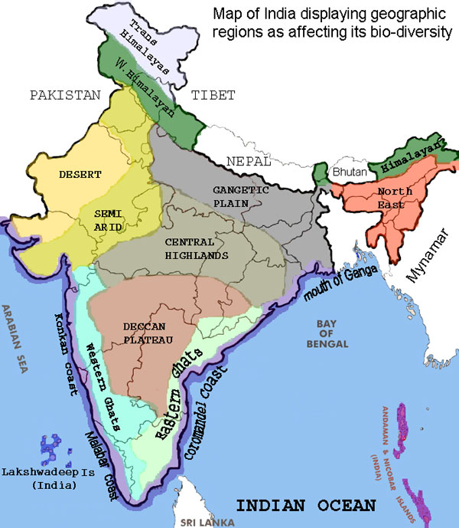
Indian peninsular plateau
N-C highlands
S-C highlands
Eastern plateau
North Deccan
South Deccan
Western Ghats
Eastern Ghats
Meghalaya uplands

Slide 9
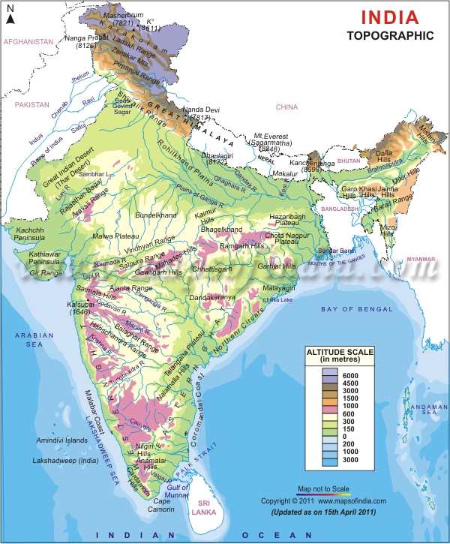
N-C highlands
Aravalli
Mahabharat Uplands
Madhya Bharat Pathar
Bundelkhand
2
3
1
4

Slide 10
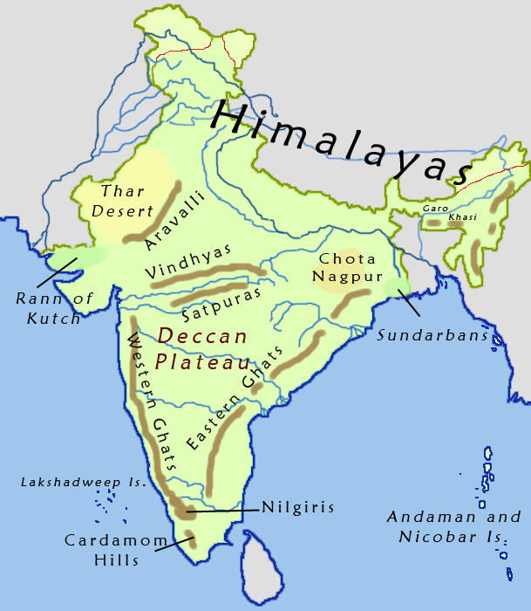
Aravalli range
One of the oldest mt range
Sedimentary, metamorphosed rocks – marble, quartzite
From Palanpur to Delhi ridge
Source of Sabarmati, Luni and Banas (tri. Chmbal)

Slide 11
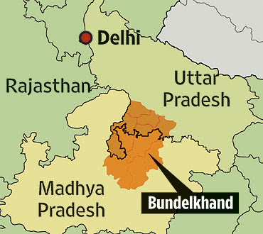
Bundelkhand
Granite, gneissic rocks
Drought-prone – low agro-productivity
Jhansi, Gwalior, Hamirpur

Slide 12
S-C highlands
Vindhyan range
Malawa plateau
Narmada valley
2
1
3

Slide 13
Vindhyan range
From GJ to Bihar
Rifting- southern slope steeper than northern slope

Slide 14
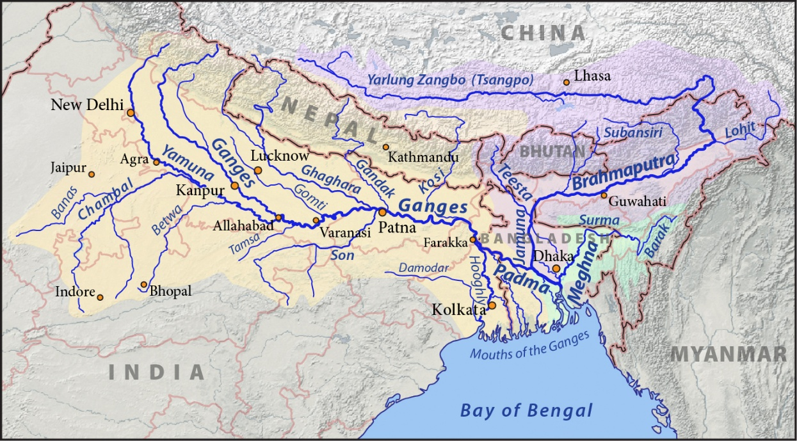
Vindhyan range
Source of many north flowing rivers
Chmabal, Sindh, Betwa and Ken
(tributaries of Yamuna)
Water divide of central India
Vindhyan range

Slide 15
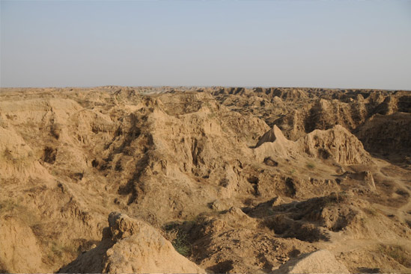
Malawa plateau
Located btwn Arvalli and Vindhyan range
Semi arid region
Faulty agro-practice- high soil erosion – gully erosion- ‘Chambal badlands’
Historically known as Khandesh

Slide 16
Eastern plateau
Baghelkhand
Garhjat hills,
Rajmahal hills,
Mahanadi basin,
Dandkarnya
Chotanagpur plateau
3
1
6
2
4
5

Slide 17
Chhota Nagpur plateau
Craton of Singhbhum – metallic mineral rich
Rifting along Damodar valley – 2 parts
N. – Hazaribaug Plateau
S. – Ranchi plateau
Damodar and Mahanadi
Rifting – coal formation
Unique coal + iron combination
Hazaribaug plt
Ranchi plt

Slide 18
Chhota Nagpur plateau
Rajmahal hills NE edge of Chhota Nagpur plt.
Garhjat hills – southern edge of Chhotanagpur plt
Rajmahal hills
Garhjat hills

Slide 19
Chhota Nagpur plateau
Radial drainage
1) North koel, (tri. Of Son),
2) Damodar, Barakar
3) Subarnrekha
4) South koel rivers (tri. Of Brahmani)
Subarnarekha river
North koel river
South Koel
Chhota Nagpur plateau

Slide 20
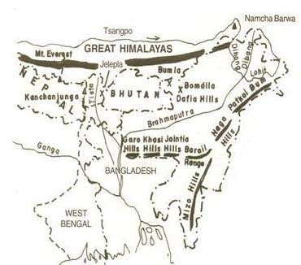
Meghalaya Plateau
3 parts of plateau
Garo-Khasi-Jaintia
Garo (Nokrek), Khasi (Shillong)
Mikir, Regma, Barail ranges
Kapilli river separates mikir, Regma & Barail from Meghalaya plateau
Mikir hills
Regma hills
Kapilli river

Slide 21
Meghalaya Plateau
Extension of Peninsular block
Separated from Chhotanagpur plateau
Down warping along Rajmahal –garo hills = ‘malda gap’
Ganga-Brahmaputra flow through the Malda gap
Rajmahal hills
Malda gap

Slide 22
Meghalaya Plateau
Hills are not very high
Not effective in blocking the rain bearing winds – reach till Arunachal Pradesh
But pass with funnel effect – heavy rainfall in Meghalaya
But inadequate storage – water shortage
Monsoon winds

Slide 23
Deccan traps
India pass over Reunion hot spot
Basaltic lava flow
Layer over layer of lava formation
Look like steps – traps

Slide 24
North Deccan
Satpura range (Rajpipla, Gawilgarh, Mahaev, Maikal, Amarkantak plt.)
Maharastra plateau
Satpura range
MH plateau

Slide 25
Satpura range
fold mt. of Archaenean –then faulting
Rajpipla (GJ)
Gawilgarh (MH)
Mahadeo (MP),
Maikal (Chh)
Highest peak – Dhupgarh (Mahadeo)
3
4
2
1

Slide 26
Satpura Range
Amarkantak plateau- east of Maikal range
Source of Narmada and Son (tri. Of Ganga)
Betul plateau – south of Mahado hills
source of river Tapi, Pench/ Wainganga river (Tri. Of Godavari)
3
4
2
1
Amarkantak plateau
Betul plateau

Slide 27
UPSC
Question
Q. Which one of the following rivers originate in Amarkantak?
Damodar
Mahanadi
Narmada
Tapi
Ans. c)
Prelims
2007

Slide 28
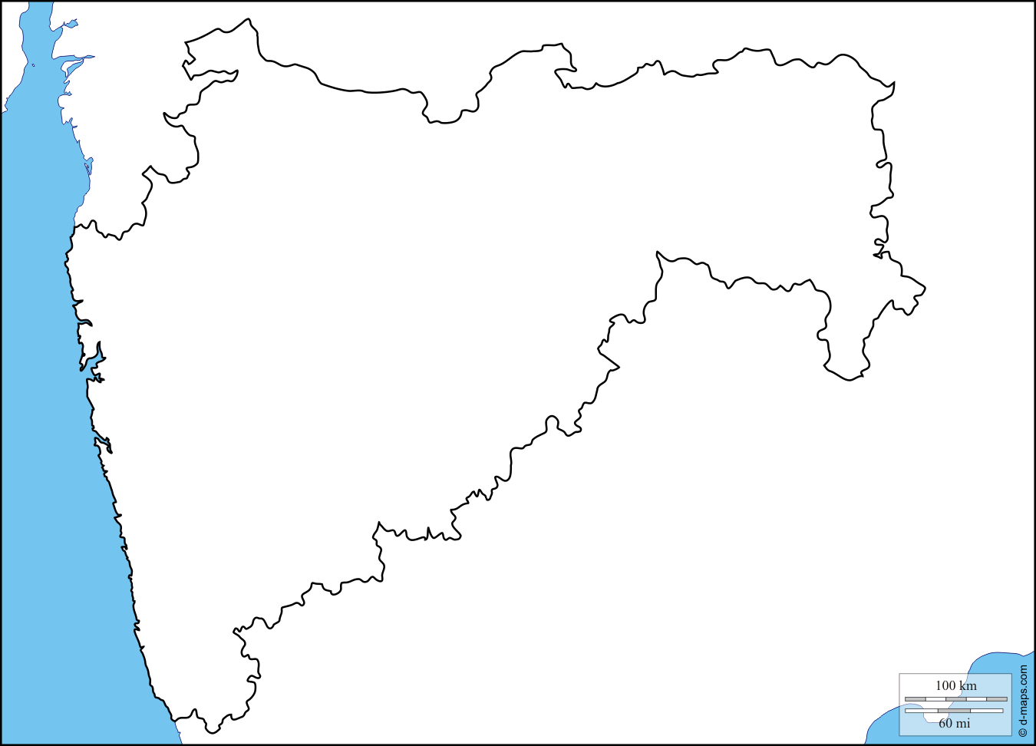
MH plateau
Shield –crystalline rocks
Overland by lava flow
In south merge with KN plateau and in east with Telangana plateau
Ajanta
satmala
MH plateau
Balaghat
Harishchandra
Western Ghats
Telangana plt
KN plt

Slide 29
South Deccan
1) KN -Dharwad plt
One of the oldest physiographical region
2) Telangana plateau
2

Slide 30
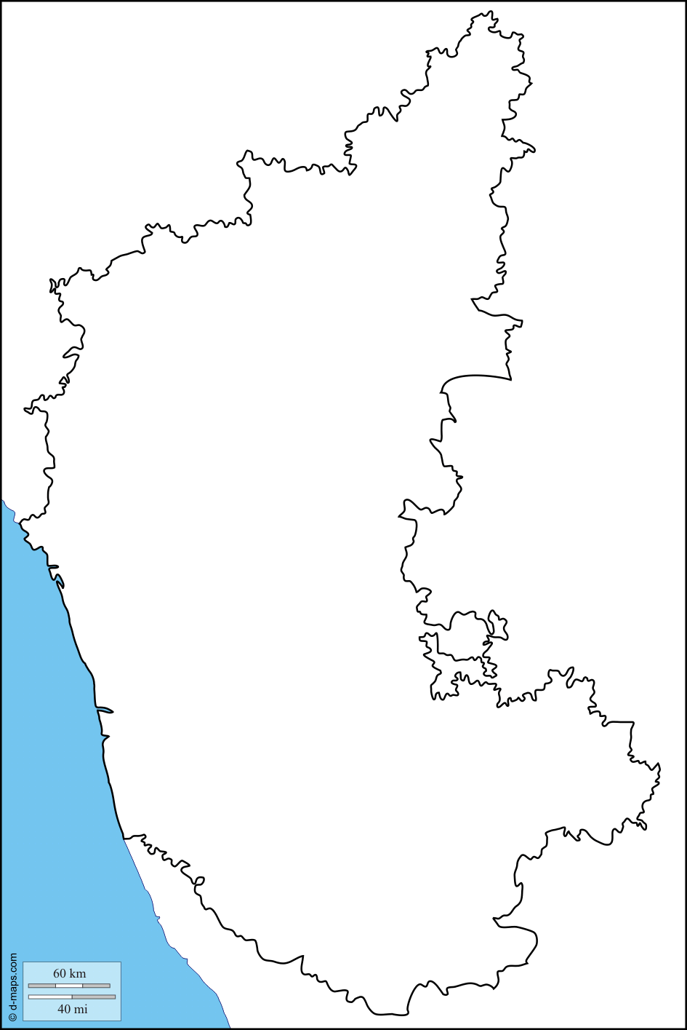
KN plateau
Baba budan hills, Maidan and Malnad
Malnad = forested Maidan = arid
Highest peak of Baba Budan = Mulangiri
Maidan
Malnad
Baba budan hills
plain
Banglore plateau

Slide 31
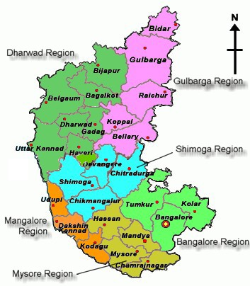
Dharwad plateau
The most oldest sedimentary rocks of India
Ancient Dharwad craton (shield) – metallic mineral rich region
Shimoga, Tumkur and Chitradurg, Chikmaglur of KN – mineral rich

Slide 32
Dharwad plateau
Iron and limestone
Bellary (KN) and upto Ratnagiri (MH) – Fe ore
Kemangundi and Kudremukh mines (near Chikmaglur)

Slide 33
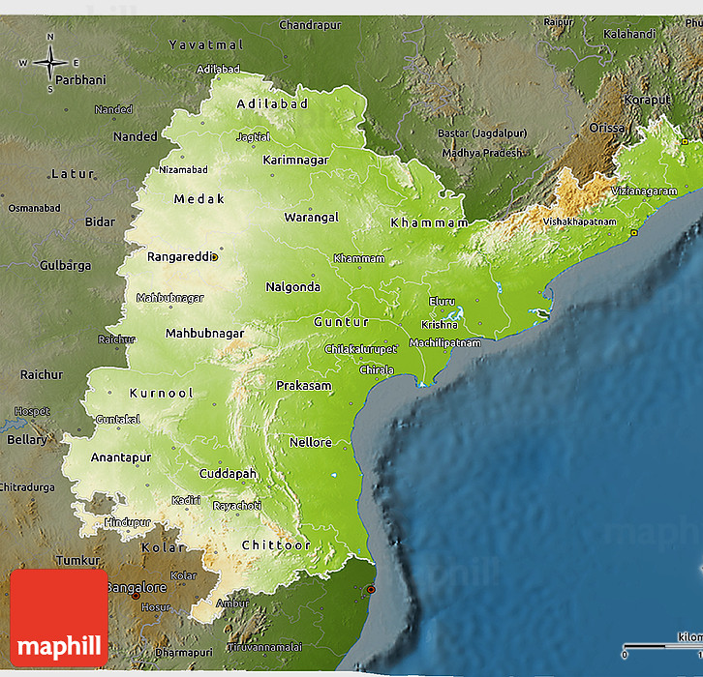
Telangana plateau
Arachaean gneisses
Avg. elevation 500-600m
Southern portion higher than northern part
North – Satmala hills
South Sheshachalam hills, Rayanseema plt
Drained by Godavari, Krishna and Penneru
Satmala hills
Telangana plateau
Godavari river
Krishna river
Sheshachalam hills
Penneru river
Benglore plateau

Slide 34
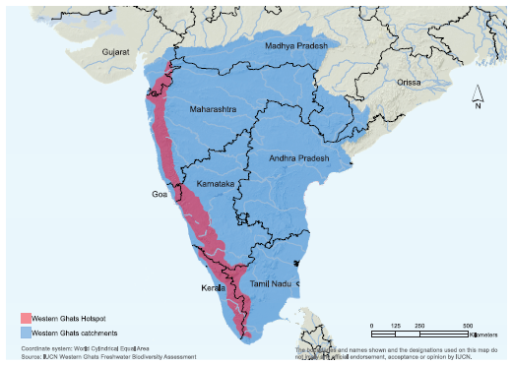
Western Ghats
GJ-MH-KN-TN-KR
Ajanta – Satmala – Balaghat – Harishchandra
Highest peak: Anaimudi
Passes:
Thalghat – Btwn Mumbai-Nashik
Bhor ghat – btwn Mumbai -Pune
Satmala
Ajanta
Balaghat
Harishchandra

Slide 35
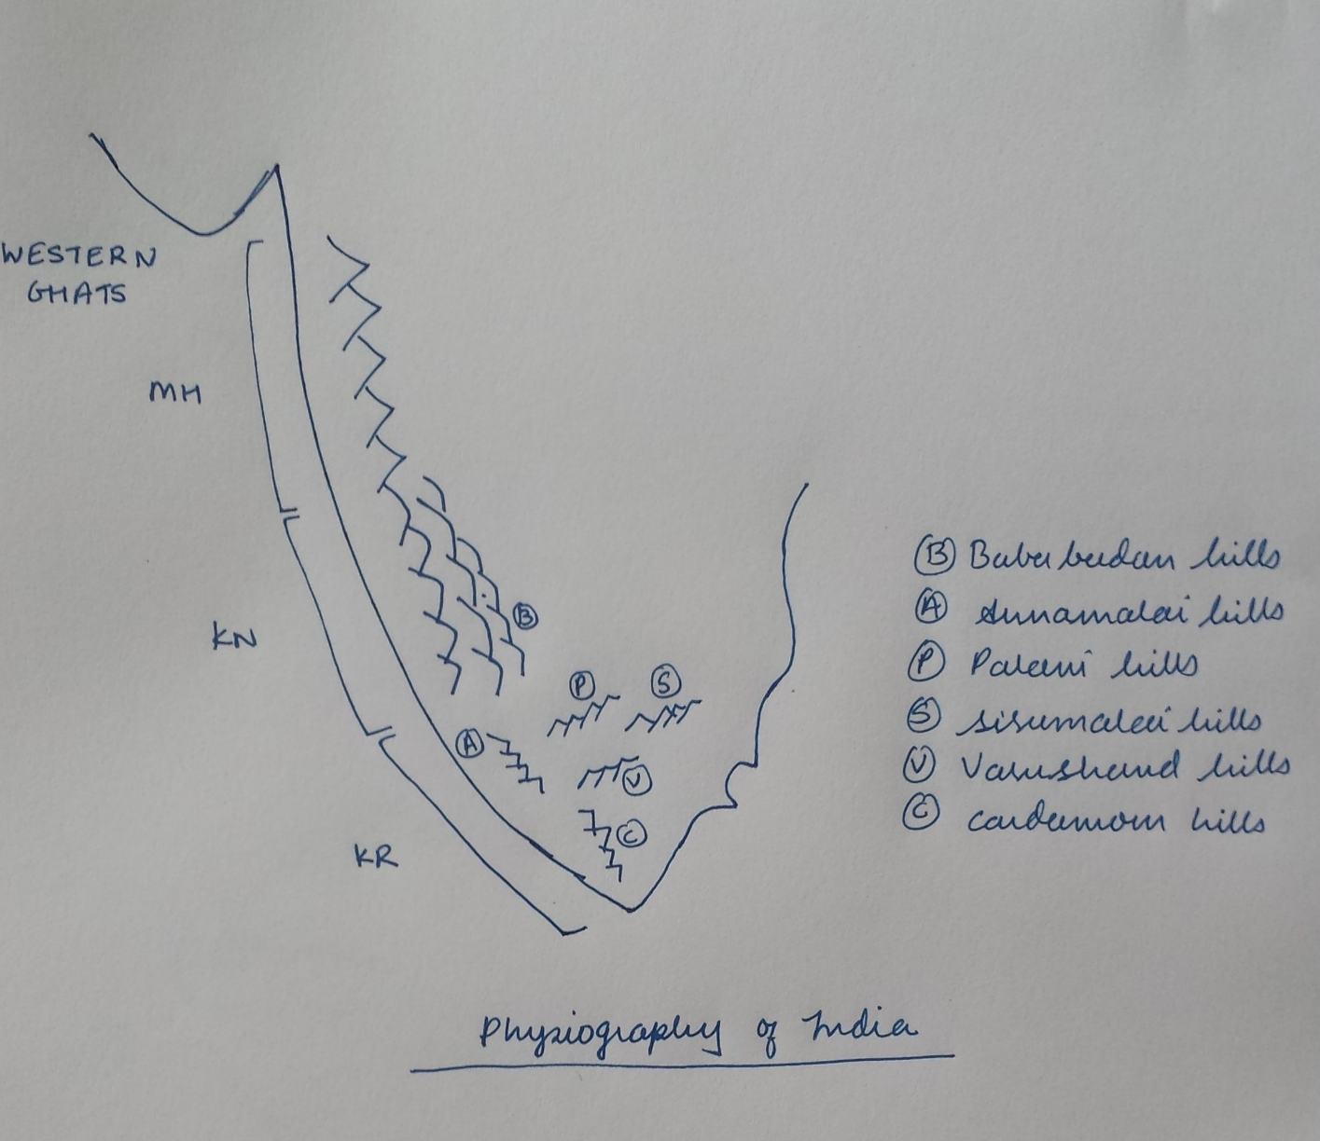
Western Ghats: Rainfall pattern
More rainfall in KN
Steeper in MH, lower and broader in KN
KR – isolated hills – rain bearing wind pass between gaps

Slide 36
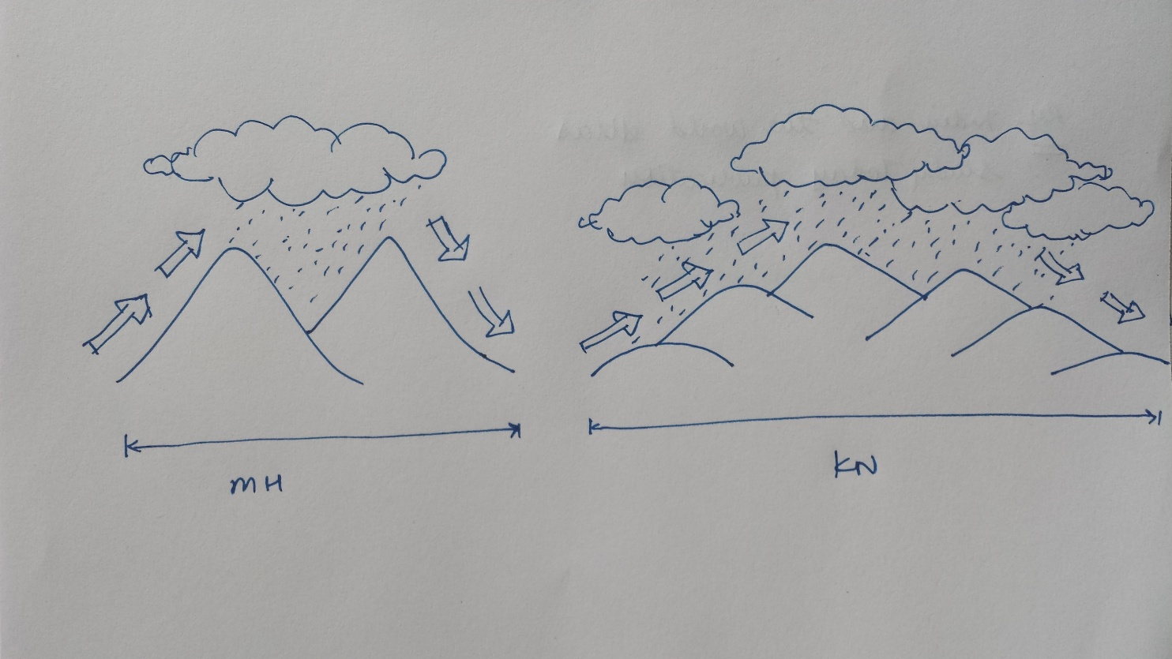
Western Ghats: Rainfall pattern
KN:
Gentle slope= Air parcel can retain energy and speed for a long time, allowing cloud droplets to grow and precipitate as rainfall.
In Karnataka, mountains are continuous. No gaps= Clouds can’t easily escape to leeward side.

Slide 37
Western Ghats: ecology
Western Ghats- UNESCO world heritage site (evergreen to thorn)
KN-TN-KR region:
SHOLA forest –biosphere reserve –unique BD – above 2000m
Stunted tropical montane forest

Slide 38
Western Ghats: ecology and agriculture
KN-KR-TN region:
Bandipur-Waynad-Mudumalai NP
Largest population of leopards
leopards + tigers+ wild dogs
TN – tea-coffee
KN –rubber, coffee, cashew plantation
KR- spices

Slide 39
Eastern Ghats
Discontinuous range
lower than western Ghats
Northern circas
Nallamalla
Palkonda
Javadi
Shevroy
Highest peak: Armakonda
2
1
3
4
5

Slide 40
Eastern Ghats
Laterite soils
Bauxite deposits:
Malaygiri
Niyamgiri
Baflai mali
Panchpat mali
POSCO plant, Niyamgiri
`11
3
2
4

Slide 41
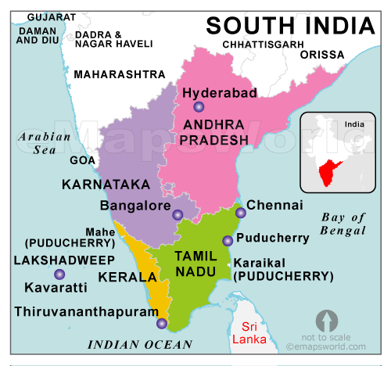
Southern hill complex
South of Western Ghats but geologically not part of Western Ghats or Eastern Ghats
Nilgiri,
Anamalai
Palani
Kardamom hills
1
3
2
4

Slide 42
Southern complex
Palghat – btwn Nilgiri and Annamalai hills
Shenkotta gap– btwn Cardamom
Hill stations:
Nilgiri – Ooty
Annamalai – Munnar
Palani hills - Kodaikanal
Nilgiri
Palani
cardamom
Annamalai

Slide 43
UPSC
Question
Q. Which one of the following is correct sequence of hills starting from north to south?
Nallamalla –Nilgiri –Javadi –Anamalai hills
Anamalai – Javadi –Nilgiri- Nallamalla hills
Nallamalla –Javadi – Nilgiri- Anamalai hills
Prelims
2005

Slide 44
UPSC
Question
d) Anamalai – Nilgiri – javadi- Nallamalai
Prelims
2005

Slide 45
Hills of South India
Nallamalla
Javadi
Nilgiri
Palani
cardamom
Annamalai

Slide 46
UPSC
Question
c) Nallamalla –Javadi – Nilgiri- Anamalai hills
Ans. C)
Prelims
2005

Slide 47
UPSC
Question
Q. Which of the following hills are found where Western Ghats and Eastern Ghats meet?
Anamalai hills
Cardamom hills
Nilgiri hills
Shevroy hills
Prelims
2008

Slide 48
Physical map of Southern India
Ans. C)
Nilgiri hills

Slide 49
UPSC
Question
Q. Which of the following is not correct?
Western Ghats are relatively lower in their northern region
The Anaimudi is highest peak in western Ghats
Tapi river lie south of Satpura
The Narmada and Tapi river valley are said to be old rift valleys
Ans. A)
Prelims
2005

Slide 50
Importance of Peninsular plateau
Peninsular plateau – oldest and most stable region
Rich in minerals – iron, limestone, bauxite
98% of Gondwana coal
Peninsular: ‘Regur’ black soil important for cotton and sugarcane cultivation
Plantation agriculture in hilly areas: tea, coffee, rubber, spices, cashews

Slide 51
Physiography of India
Northern mountains
Northern plains
Peninsular plateau
Coastal plains

Slide 52
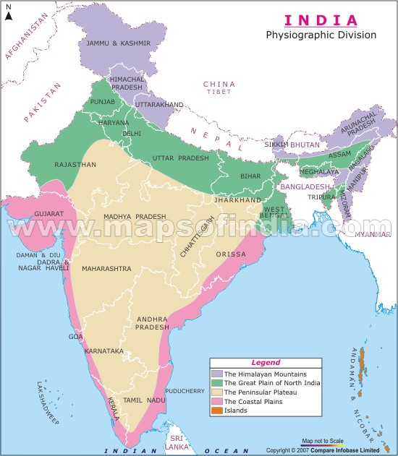
Coastal plains
From Rann of Kutch to Sundarban
Western coastal plain
Eastern coastal plain
1
2

Slide 53
Western coastal plain
Narrower than Eastern coastal plain
Steeper fast flowing rivers – No alluvial deposits
Rivers form Estuaries and not deltas
Good for Port development

Slide 54
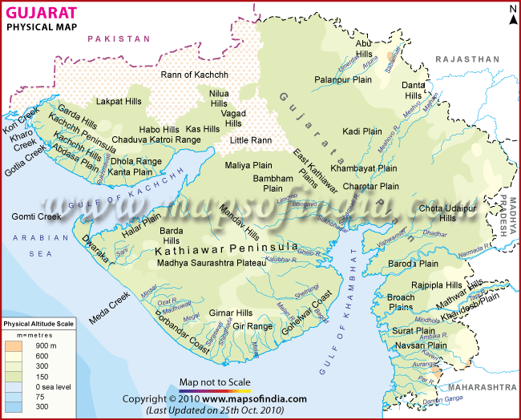
Western coastal plain
Formation of 2 gulfs: gulf of Khambhat and gulf of Kutchh
Narmada, Mahi,Tapi and Sabarmati flow into Gulf of Khambhat
Kathiawar: radial drainage
Islands: Alia bet, Pirotan island, Diu
Baidar, Kora, Kurumbhar Is in g. of Kutchh
Sabarmati
Mahi
Narmada
Tapi

Slide 55
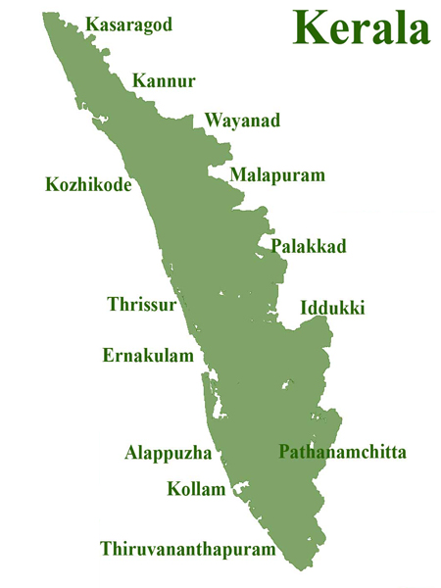
Western coastal plain
KR coast/Malabar coast:
Vembnad lake
Periyar river merge near Vembnad lake
Inner side – Ernakulam and outward side - Kochi
Periyar river
kochi
Vembnad lake
Annamalai hills

Slide 56
Eastern coastal plain
Broader
Large rivers –extensive delta formation
Mahanadi delta
Godavari delta
Krishna delta
Kaveri deltas

Slide 57
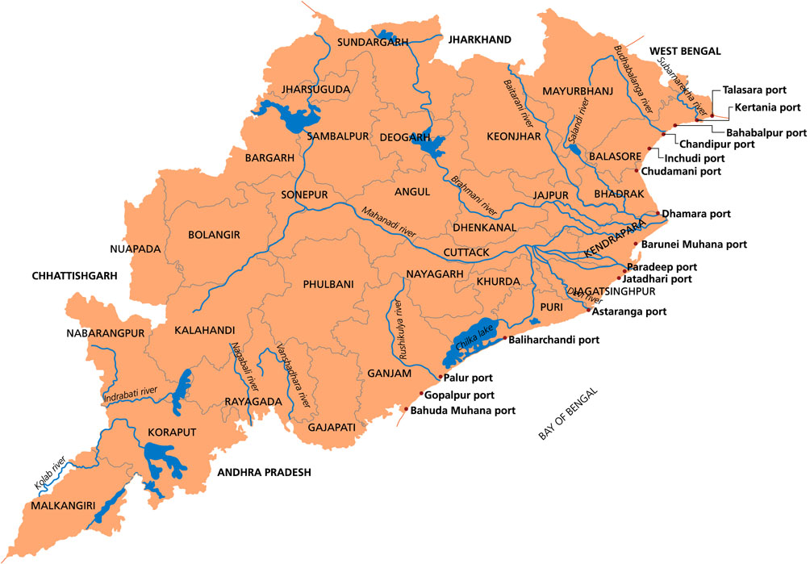
Eastern Coastal Plain
Odisha coast:
Wheeler Is. –missile testing
Chilka lake (biggest)
Olive ridley turtles –Ganjam coast- (nr. Mouth of Rushikulya river)
Wheeler Is.
Chilka lake
Rushikulya river

Slide 58
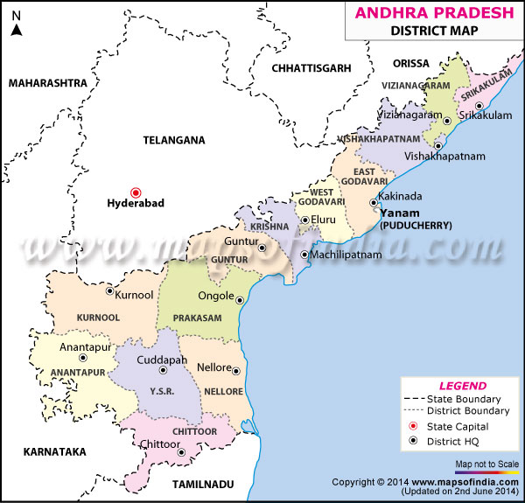
Eastern Coastal plains
Andhra coast:
Kolleru lake –deltaic lake (Goadavari and Krishna rivers)
Pulicut lake – split bar Shriharikota Is. (ISRO rocket launching station)
Kolleru lake
Pulicut lake +Shriharikota Island

Slide 59
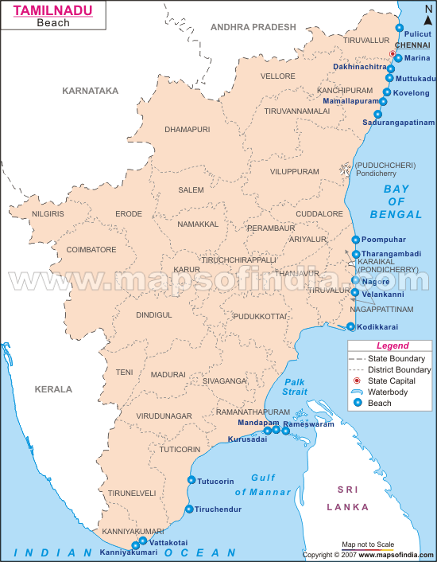
Eastern Plain
Palar river
TN coast:
Winter rainfall
Rameshwaram – Pamban Island – last point – Dhanushkondi
Gulf of Mannar – biosphere reserve
Ram setu issue
Javadi hills
Shevroy hills
Kaveri river
Cardamom hills
Vaigai river

Slide 60
Physiography of India
Northern mountains
Northern plains
Peninsular plateau
Coastal plains

