Slide 1
Indian Geography
Physical geo of India

Slide 2
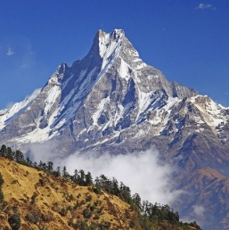
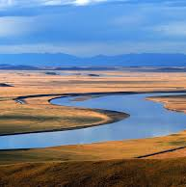
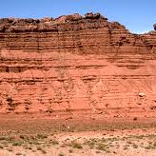
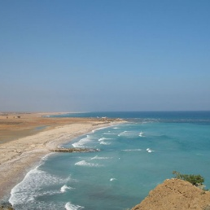
Physiography of India
Northern mountains
Northern plains
Peninsular plateau
Coastal plains

Slide 3
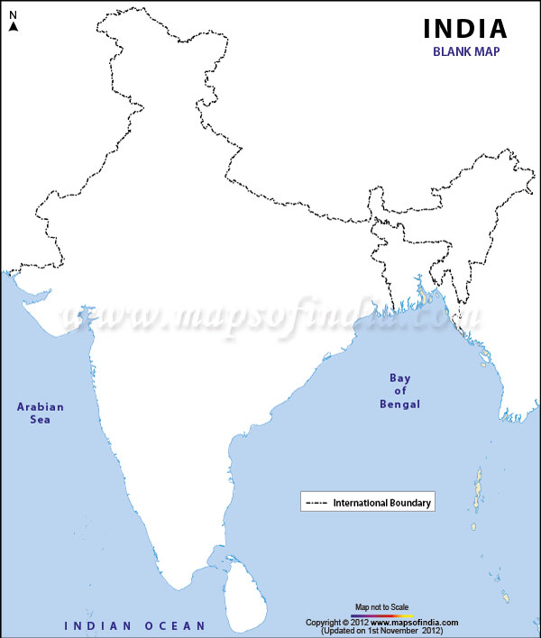
Northern mountain complex
Trans-Himalayas
Himalayas (Nanga parbat to Namcha barwa)
Trans-Himalayas ( Karakoram, Ladakh and Zaskar)
Purvanchal
Himalayas
Purvanchal

Slide 4
Northern mountain complex
Trans-Himalayas
Himalayas (Nanga parbat to Namcha barwa)
Trans-Himalayas ( Karakoram, Ladakh and Zaskar)
Purvanchal
Himalayas
Purvanchal

Slide 5
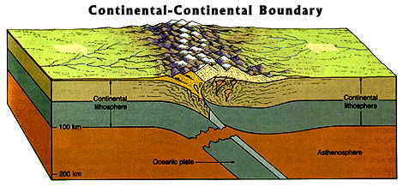
The Himalayas
C-C plate collision
Fold mt., tertiary young mt., sedimentary rocks of marine origin
Not a single range but series of chain of mountains

Slide 6
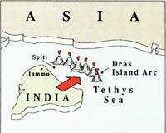
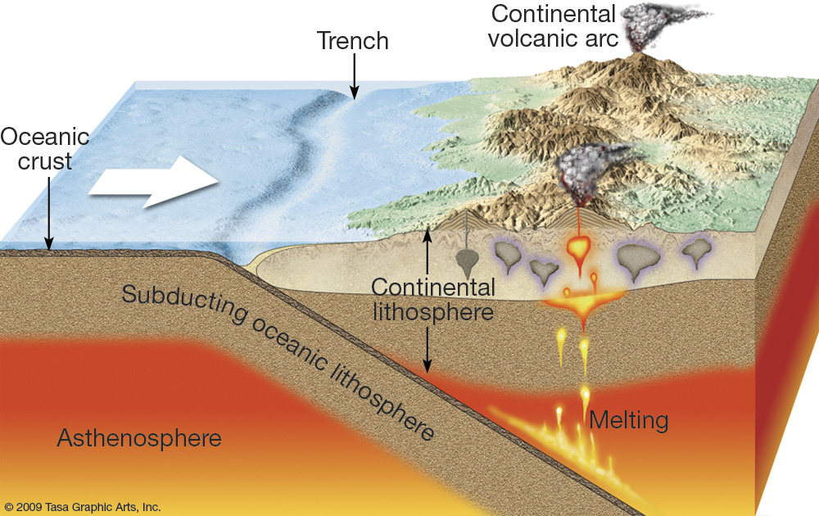
Phases of formation of Himalayas
Dras-kohistan islands
Karakoram ranges

Slide 7
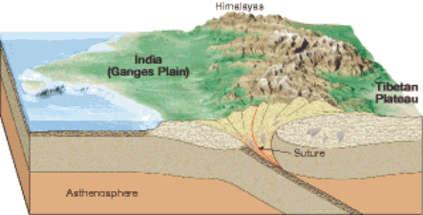
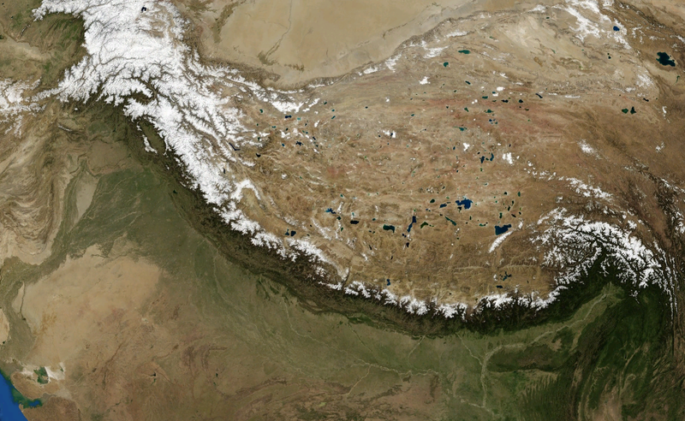
Phases of formation of Himalayas
Upliftment of Great Himalayas
Upliftment of mid-Him

Slide 8
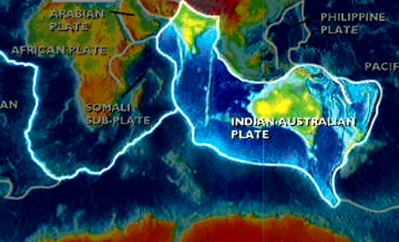
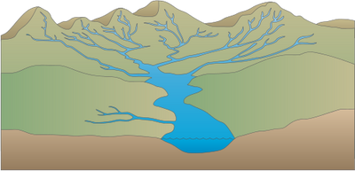
Phases of formation of Himalayas
Upliftment of Shiwaliks
Still rising

Slide 9
North south division of Himalayas
Great Himalayas (Himadri)
Middle/ lesser Himalayas (Himachal)
Shiwaliks (Outer Himalayas)
1
2
3

Slide 10
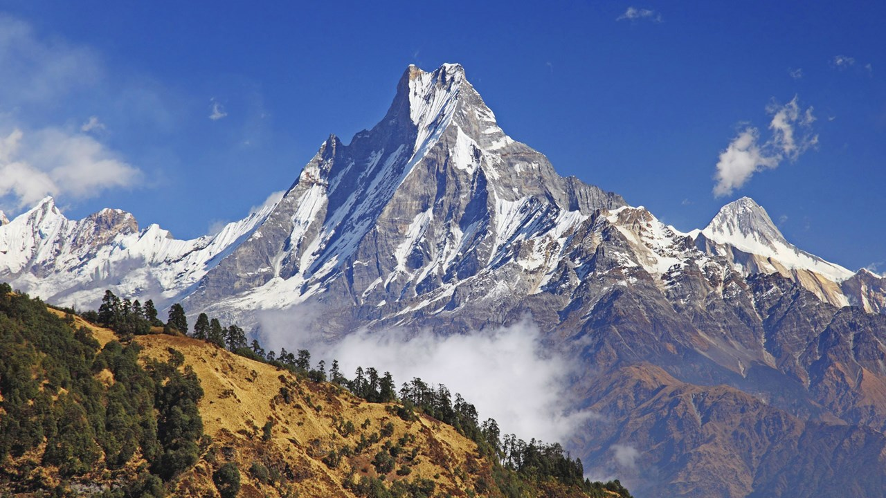
Great Himalayas
Highest and most continuous mountain range of the world
Crystalline rocks
Mount Everest, Kanchenjunga, Makalu, Dhaulagiri, Mansalu, Annapurna
Nanda devi, Kamet, Gurla Mandhata

Slide 11
Middle Himalayas
Mid/lesser-Him (Himachal)– discontinuities –
Pir Panjal
Dhauladhar
Nag tibba
Masoorie
Kumaon hills
Mahabharat (Nepal)
1
2
3
4
5
6

Slide 12
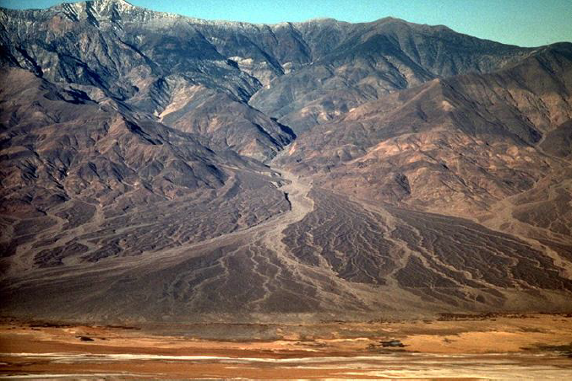
Shiwaliks
Upliftment of foothills of Himalayas
Fluvial in origin – alluvial fans, coarse deposits brought by Himalayan rivers
Closer to great Him in Nepal – disappear after river Gandak

Slide 13
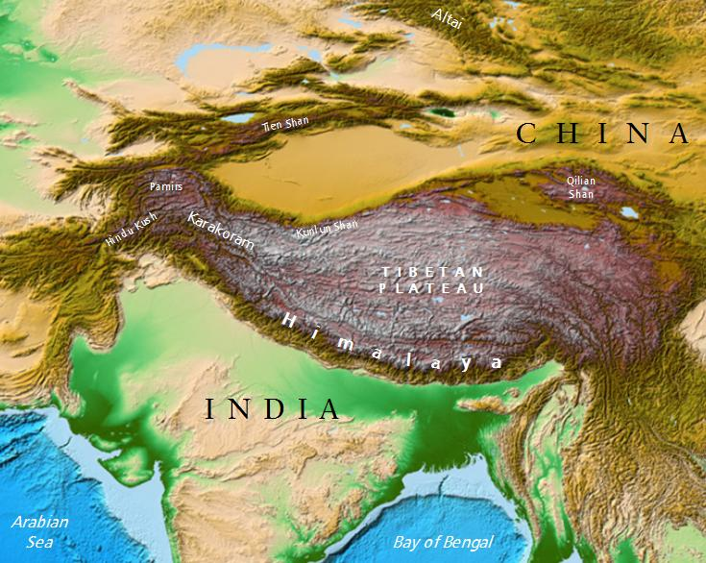
Structure of Himalayas
1) Aravalli and Assam hills – strong push.
Middle peninsula –sagged- convex shape of Himalayas
2) Sharply bent towards southward - sudden end
Western bend near Nanga parbat and eastern near Namcha Barwa
Called syntaxial bend

Slide 14
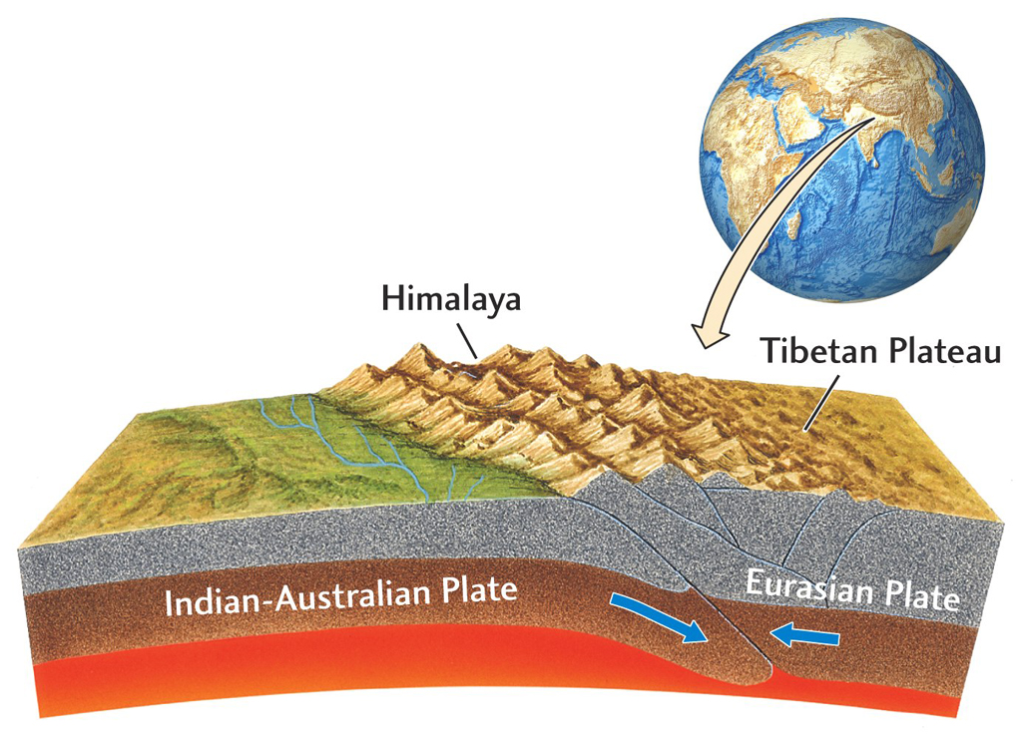
Structure of Himalayas
Great Himalayas and Shiwaliks hog-back structure
Gentle sloping northern face – southern face steep slope
Northern side rest against Tibetan plt
Snow accumulation on southern side
Notes:
Great himalaya - > crystalline rocks
Everest,kanchenjung,annaourna,nanda devi , kamet
Middle himalayas --> discontinous as stress from both sides upper and shivaliks
Shivaliks --> Alluvial fan upliftment
Syntaxial bend : indian plate only till there then post reaction
Tibet side see himalaya ==> smooth , gradual
HP view himalaya --> Steep
As tibetan plateu already there , himalaya upliftment with tibetan plateu and thus more glacier in tibet side as its gradual compared to the steep side
Indian Side
Tibetan Side
Indian Side

Slide 15
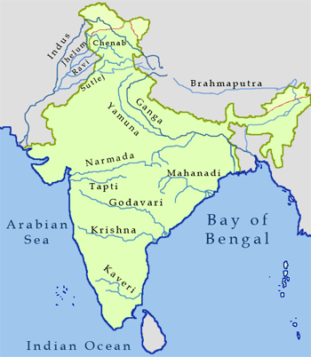
Antecedent rivers
Don’t as a water divide – river cut across – antecedent rivers
Indus, Satluj, Brahmaputra, Kosi
Rate of erosion of rivers are higher than rate of upliftment of Himalayas

Slide 16
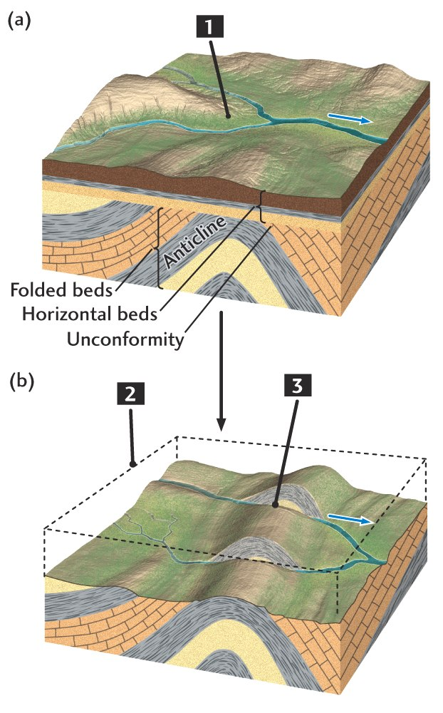
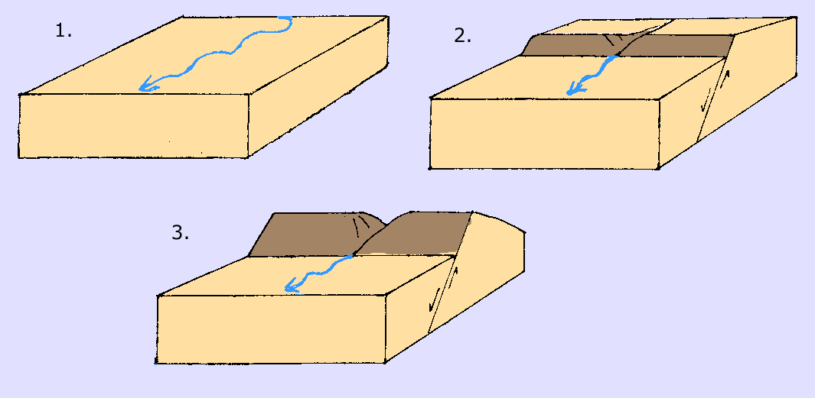
Erosion process of rivers
antecedent
Superimposed rivers
Notes:
Generally himalayan rivers => antecedent
And peninsular -> superimposed

Slide 17
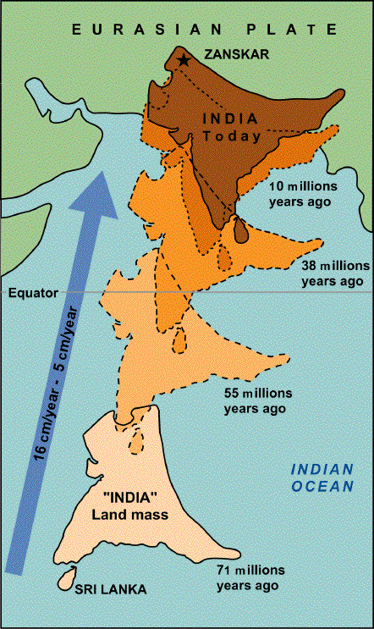
Western and eastern Himalayas
Indian plate first collide at its north-western part to Eurasian plate
Eastern part still not collided

Slide 18
Western and eastern Himalayas
Indian plate then rotate clockwise – NW part as hinge
collision of eastern edge
Both the portion is now attached to Eurasian plate

Slide 19
Western and eastern Himalayas
Indian plate again rotate anti-clockwise
Now NE part as hinge
Western part get away from the Eurasian plate partially
Western portion moves southward
Notes:
Thus eastern himalaya narrower and western himalaya broader

Slide 20
Western and eastern Himalayas
NW edge released
Western Himalayas spread out
Western Himalayas broaden
That’s why, shiwaliks gets closer to Great Himalayas in Eastern part than in western part

Slide 21
Western and Eastern Himalayas
Western him
Western Himalayas:
From Indus to Kali river
Eastern Himalayas:
From Kali river to Brahmaputra river
Eastern him

Slide 22
Difference between W and E Himalayas
Western Himalayas
Eastern Himalayas
Great Him, Middle Himalayas (Dhualadhar, Pirpanjal, Kumaon, Massoorie range)
Great Himalayas +
Middle Himalayas : Nepal Him (Dudwa, Muree, Churia) NE Him (Dafla, Miri, Abor, Mishmi)

Slide 23
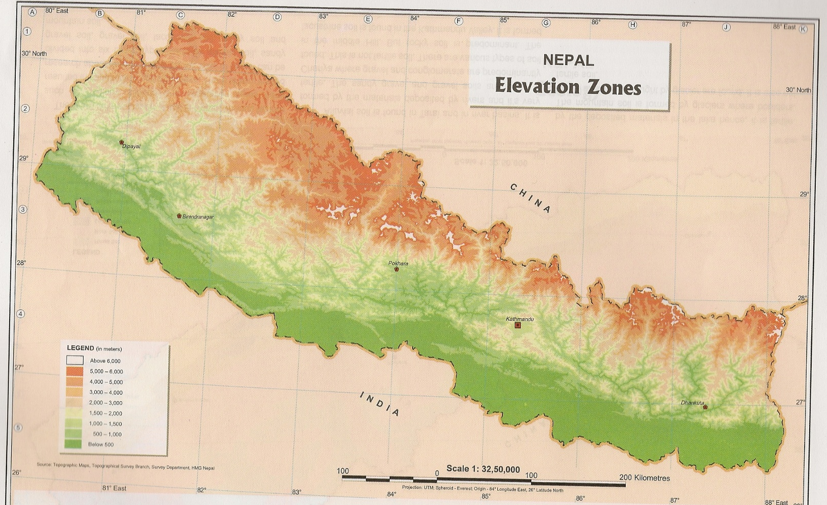
Nepal Himalayas Himalayas
Western him
Eastern him
Dhaulagiri
Great Himalayas
Annapurna
Mansalu
Dudhwa
Everest
Makalu
Muree
Churia
Kanchenjunga

Slide 24
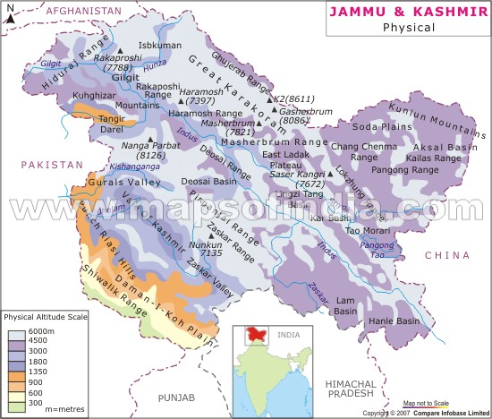
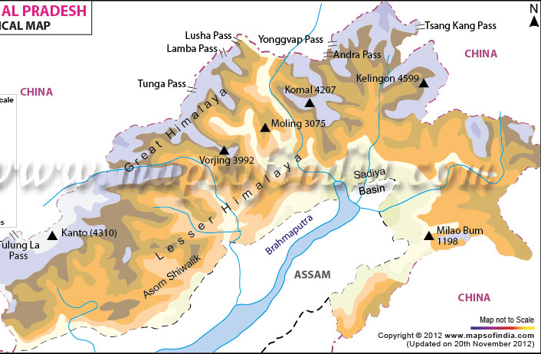
West and East Himalayas
Karakoram
Mishmi
Abor
Pirpanjal
Ladakh
Miri
Zaskar
Dafla
Great Himalayas
Kanchenjunga
Dhauladhar
Notes:
Karakoram --> Volcanic mountain range

Slide 25
Difference between W and E Himalayas
Western Himalayas
Eastern Himalayas
Lower and gradual slope
Peaks= k2, Godwin Austin, Gasherbrum, Masherbrum
Located on higher latitude –colder
Don’t act as barrier for north-west monsoon -drier
Higher and steep-sudden slope
Peaks= Everest, Makalu, Annapurna, Dhaulagiri
Located on lower latitude –warmer
Active barrier of south west monsoon winds -wetter
Notes:
Western himalaya lower and broader

Slide 26
UPSC
Question
Q. The alpine vegetation in western Himalayas is found only upto a height of 3000m while in Eastern Himlayas it is found upto a height of 4000m. The reason for this variation in same mountain range is that:
a) Eastern Himalayas are higher than western Himalayas
Prelims
1995

Slide 27
UPSC
Question
b) Eastern Himalayas are nearer to equator and sea than Western Himalayas
c) Eastern Himalayas get more rainfall than western Himalayas
d) Eastern Himalayan rocks are more fertile than western Himalayas
Ans. C)
Prelims
2010
Notes:
C most important for vegetation . D not relevant , nothing like that

Slide 28
East-West division of Himalayas
Kashmir Him- PN
(Indus -Satluj)
Kumaon Him
(Satluj -Kali)
Nepal him
(Kali - Kosi)
Sikkim Him
(Kosi - Teesta)
Assam Him
(Teesta - Dihang)

Slide 29
Kashmir-PN Himlayas
Karakoram, Ladakh, Zasakar, Pir panjal, Dhaula dhar
Zozila pass btwn Kashmir and Ladakh
Valleys, duns, lakes
Karakoram
Zozila pass
Pirpanjal
Ladakh
Zaskar
Great Himalayas
Dhauladhar

Slide 30
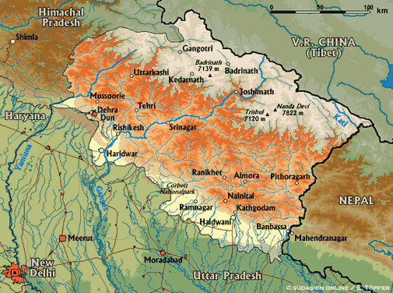
Kumaon Himalayas
West – Garhwal Himalayas
East –Kumaon Himalayas
Nandadevi, Kamet, Badrinath, Kedarnath, Gangotri
Source of Ganga, Yamuna
Nainital and Bhimtal -lakes
Great Himalayas
Garhwal
Kumaon
Shiwaliks

Slide 31
Nepal Himalayas
Tallest section of Himalayas
Great Himalayas –peaks –Dhaulagiri, Annapurna, Mansalu, Everest, Makalu
Kathmandu valley
Dhaulagiri
Great Himalayas
Annapurna
Mansalu
Dudhwa
Everest
Makalu
Kali river
Muree
Karnali river
Kathmandu valley
Churia
Gandak river
Kanchenjunga
Kosi river

Slide 32
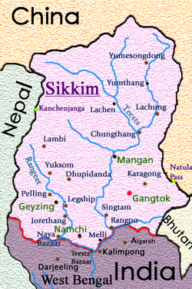
Sikkim Himalayas
Peak: Kanchenjunga
Teesta originate near Kanchenjunga
Jelep la pass- tri-junction of India- China-Bhutan
Kanchenjunga
Jelep la pass
Notes:
Chumbi valley near jelepa pass

Slide 33
Assam Himalayas
Himalayas –narrower
Lesser Himalayas close to great Himalayas
Peaks: Namcha Barwa, Kula Kangri
Bengal ‘Duars’
Diphu pass- tri-junction of India- China-Myanmar
Mishmi
Abor
Diphu pass
Miri
Dafla
Notes:
Bengal Duars ==> sudden upliftment of himalayas (Gateway of himalayas) --> Tea Cultivation
Tea requires rainfall plus no water stagnation in roots thus hill areas best

Slide 34
UPSC
Question
Q. Nanda devi peak forms part of:
Assam Himalayas
Kumaon Himlayas
Nepal Himalayas
Punjab Himalayas
Ans. B)
Nandadevi - Uttarakhand
Prelims
2003

Slide 35
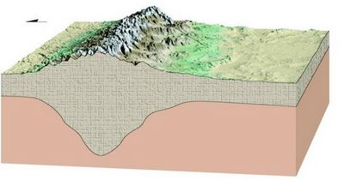
“Duns” formation
When river initially blocked by rising mt.
it spreads out –form lake
river
lake

Slide 36
“Duns” formation
Lakes dry out when river find weak rocks to cut across the mt.
Dry lakes = ‘Duns’
Between great and mid-Him
Dehradun btw Shiwaliks and masoorie range
lake
river

Slide 37
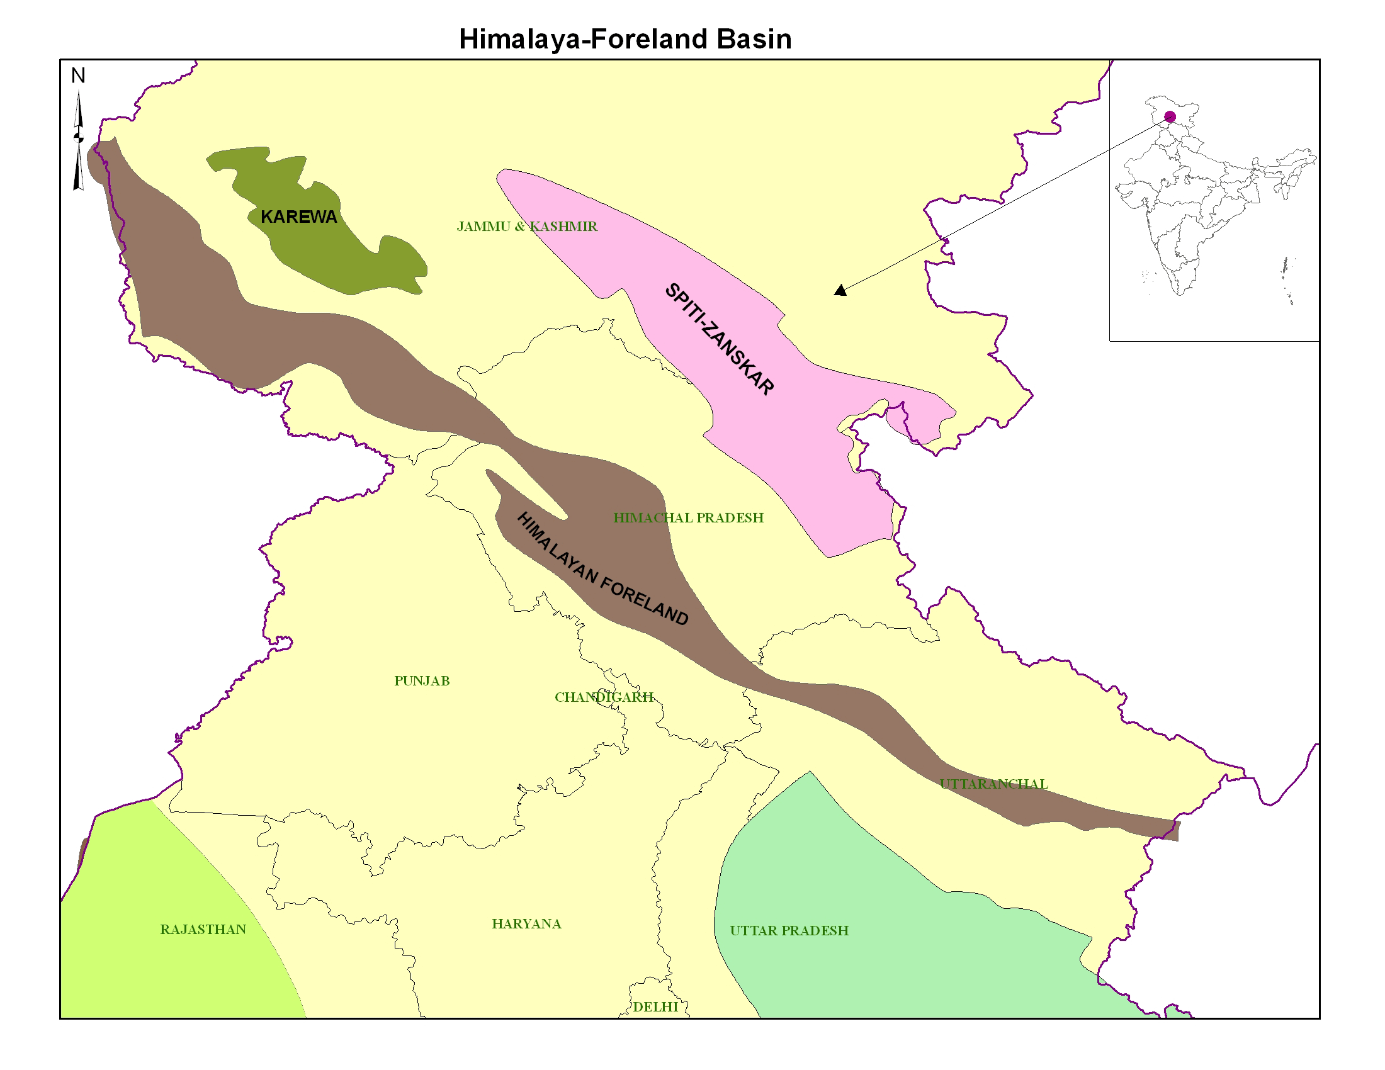
Karewas
Flat-topped terraces of Kashmir valley on flanks of Pir Panjal
made up of clay, sands from old deltaic fans
Fertile land

Slide 38
Importance of Himalayas
Prevents cold Siberian wind to enter into India
No Himalayas –No Tibet – No rainfall- India would have been desert
Himalayas split STWJ into 2 branches – winter rain
Source of perennial rivers – great fertile plain
Notes:
Check LP created in tibet
STWJ brings winter jet which wont be there w.o himalayasa
Perenial Rivers , Noither plains
Forest Wealthg

Slide 39
Importance of Himalayas
Forest wealth – great Himalayan NP –unique Bio diversity
Minerals – coal (Anthracite) at kalakot, Nickel, Copper, lead, zinc, gold, silver
Most of them cannot be exploited due to adverse geo conditions
Notes:
Coal at chotanagpur not great grade , low quality , Bituminous/lignite
Himalaya-> anthracite at kalankot , kashmir but not allowed to mine
Peat-->lignite-->subbituminous/---> bituminous---->Anthracite
Increasing Heat and pressure. Anthracite is best and bituminous is most popular in industry as the most abundant
Anthracite -> hard coal
Bituminous -> Soft coal

Slide 40
UPSC
Question
Q. If there were no Himalayan range, what would have been the most likely geographical impact on India?
Much of the country would experience the cold wave from Siberia
Indo-Gangetic plain would be devoid of such extensive alluvial soils
Prelims
2010

Slide 41
UPSC
Question
3. The pattern of monsoon would be different from what it is at present.
Which among the above is/are correct?
1 only
1 and 3
2 and 3
1,2,3
Ans. D)
Prelims
2010

Slide 42
UPSC
Question
Q. When you travel in Himalayas, you will see following:
Deep gorges
U-turn river courses
Parallel mountain ranges
Steep-gradient causing land-slides
Which of the above can be said to be evidence for Himalayas being young fold mountains?
Prelims
2012
Notes:
Himalaya -> young so steep
Parallel ranges and discontinous thus river many U turns and gorges

Slide 43
UPSC
Question
1 and 2
1,2 and 4
3 and 4
1,2,3 and 4
Ans. D)
Prelims
2012

Slide 44
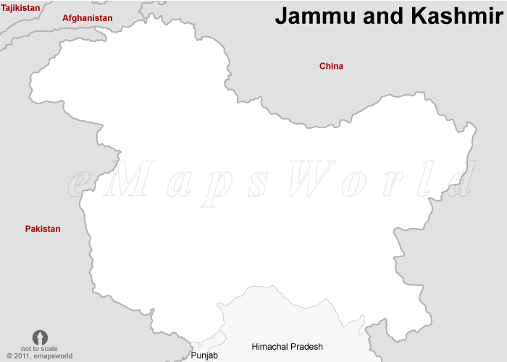
Trans-Himalayas
Immediately north of Great Himalayas
Most of them lie in Tibet
Karakoram
Ladakh
Zaskar
Kailash
Avg. elevation 3000m
1
2
3
4

Slide 45
Ranges and peaks
Karakoram | Ladakh | Kailash | Zaskar
K2 | Rakapokshi | Kailash | Nanga Parbat
Gasherbrum

Slide 46
Trans-Himalayas
Karakoram is home of the greatest glaciers of world outside polar regions
Siachin, Baltoro, Biafo, Hispar- Glaciers
Watershed btwn India and Turkmenistan
Karakoram
Ladakh
Zaskar

Slide 47
Trans-Himalayas
Deosai mt. part of ladakh range
Origin of Suru river (tri.of Indus)
Kailash range is off-shoot of Ladakh range
Indus river passes between Ladakh and Zaskar range
Deosai mountains
Shyok river
Suru river
Ladakh range
Indus river
Notes:
Suru obsequent triut. Kargil located at it

Slide 48
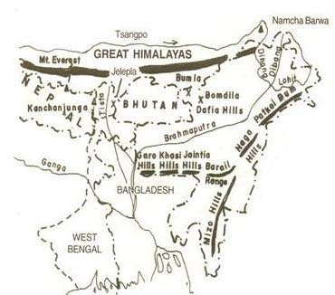
Purvanchal
Eastern Himalayas
Same orogeny that of Himalayas
Patkaibum, Naga hills, Manipuri hills, Mizo hills
Elevation decrease from north to south
Notes:
Garo , khasi , jaintia, mikr, meghalaya hills not part of purvanachal but extension of peninsular plateau

Slide 49
Purvanchal
Mt. | details
Patkai bum | Border between Arunachal Pradesh and Myanmar
Naga hills | Highest peak – mt. sharamati Form water shed between India and Myanmar
Manipuri hills | Border between Manipur and Myanmar Source of R.Manipuri(tri.Chindwin, Myanmar)
Mizo hills | Highest peak – blue mt.

Slide 50
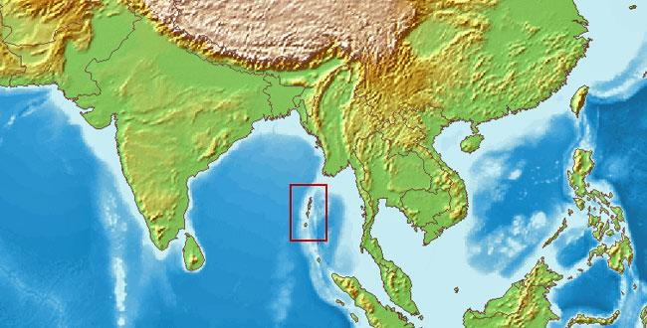
Purvanchal
Extension of Purvanchal continues in Myanmar as Arakan yome –then Andaman and Nicobar Islands
Purvanchal
Arakan yoma
Andaman and Nicobar
Notes:
Andaman extension of purvanahcal , arkan yone

Slide 51
Physiography of India
Northern mountains
Northern plains
Peninsular plateau
Coastal plains

Slide 52
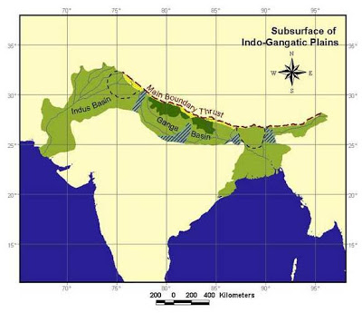
Northern plains
Youngest physiographic feature in India
Depositional flood plain created by Himalayan rivers
Indus
Ganga-Yamuna
Brahmaputra
1
2
3

Slide 53
Northern Plains
One of the largest, continuous and extensive plains
Fertile plain- flat topography -historically settled –dense population
30% of the world’s population on 10% of world’s agro-land

Slide 54
NS division of Northern plains
Bhabhar
Terai
Bangar
Khadar

Slide 55
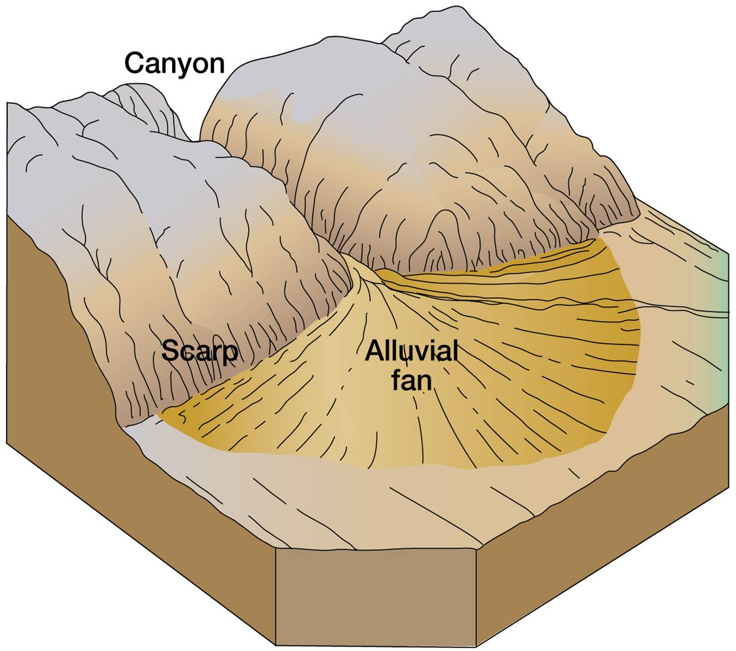
N-S division of N.Plains
Bhabhar = alluvial fans of Himalayan rivers – coarse depo – large boulders
High porosity and permeability
Rivers disappear
Not good for cultivation

Slide 56
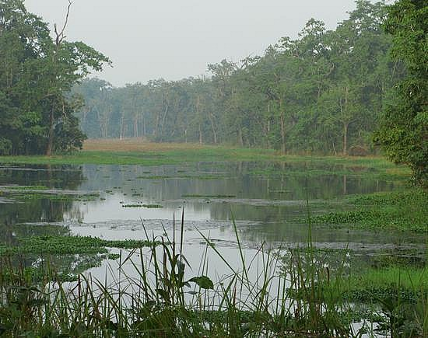
N-S division of N.Plains
Terai:
Bad drainage
Rivers re-appears –swamps, marshy
Naturally sal forest
Terai of Bengal and Bihar more developed

Slide 57
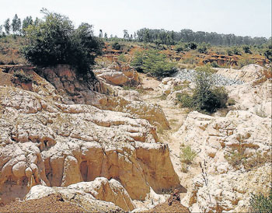
N-S division of N.Plains
Bangar:
old flood plains of rivers - Dry land
Colcareous concretion -Kankar

Slide 58
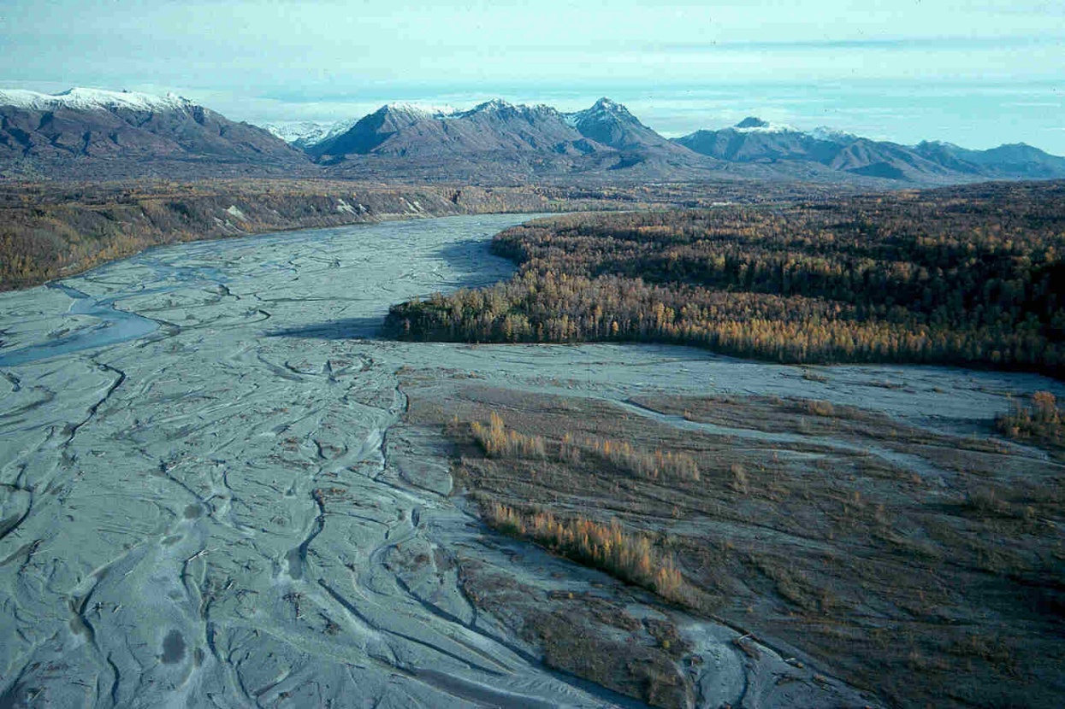
N-S division of N.Plains
Khadar – new flood plains – fresh river deposition
Slope btw Bangar and Khadar:
PN- ‘Dhayas’, UP- ‘Khol’, Bengal – ‘Bhils’, Bihar –’Taal’

Slide 59
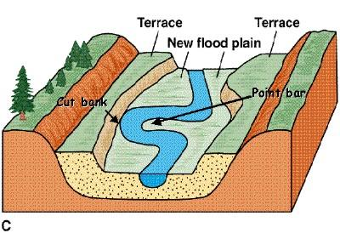
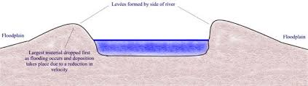
Flood plain of a river
Bangar and Khadar
river
Old Flood plain
Old Flood plain
New Flood plain
Old Flood plain
New Flood plain

Slide 60
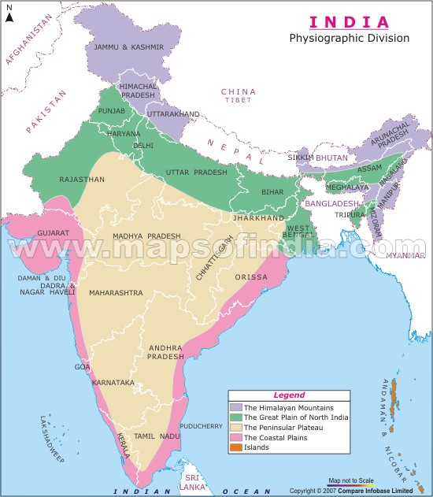
Northern Plains
East-West division of plain
RJ plains (Indus)
PN plains (Indus)
Gangetic plains
Assam plains (Brahmaputra)
2
1
3
4

Slide 61
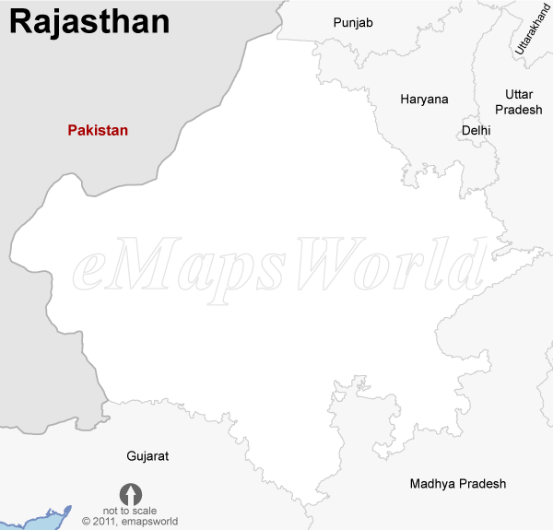
RJ Plains
West of Aravalli
North: Gangasagar region
Extension of PN plains of Indus
West of Aravalli: Rajasthan Bagar
Drained by river Luni
Luni merged into Rann of Kutchh
Gangasagar region
Thar desert
Rajasthan Bagar
Aravalli range
Luni River
Notes:
Luni only river to merge into inland and not sea

Slide 62
RJ Plains
Rajasthan Bagar: fluvial grasslands –RJ steppe
Very fertile –Rohi tracts
Western most RJ- marusthali/ Thar desert– sand dunes “Dhrians”
Thar desert
Rajasthan Bagar
Aravalli range
Luni River

Slide 63
RJ Plains
SW plains: marine origin
While north movement- Indian plate’s western margin – marine transgression – marine depo. – oil and gas reserve – salt lakes
Extend to Kutchh
Gangasagar region
Thar desert
Rajasthan Bagar
Aravalli range
SW plains
Notes:
SW rajasthan : a theory that india while travelling might be tilted and thus it was submerged once and then came back up because of WG breaking and thus tilting east
Evidence of submergence : Calcerous rocks , Oil and Gas reserves , Salt Lakes

Slide 64
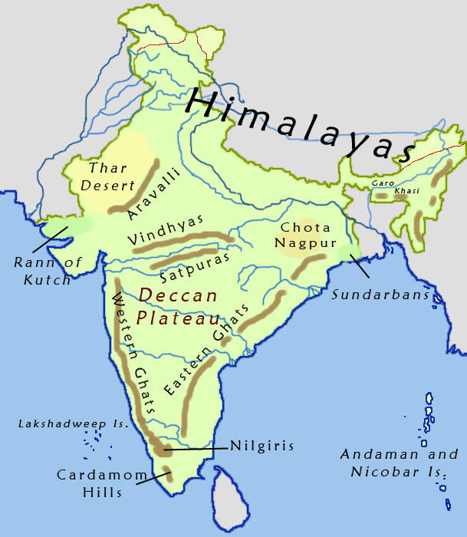
Deserts in RJ
Tropical desert
Off-shore trade winds + local reason – Aravalli parallel to SW monsoon – no orographic rain
Soil is fertile – but moisture deficiency – cultivable if relclaimed

Slide 65
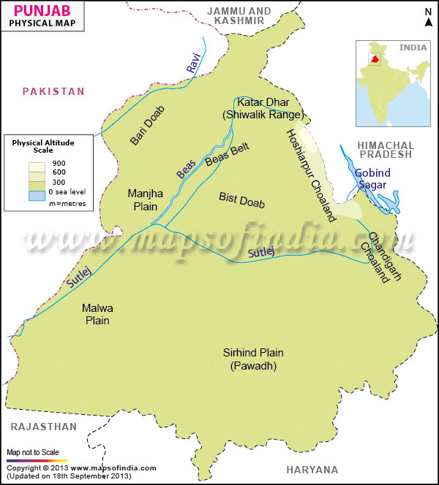
Punjab Plains
Fluvial plains –Ravi, Beas and Sutlej (tri. Of Indus)
Khadar plains: fertile but limitations
Aridity
Basin topography (bad drainage) - salination
Ravi River
Beas River
Satluj River
Notes:
Green revolution applied here
Currently stagnated as basin topogrophy makes all rainwater stagnant
Over irrigatiin

Slide 66
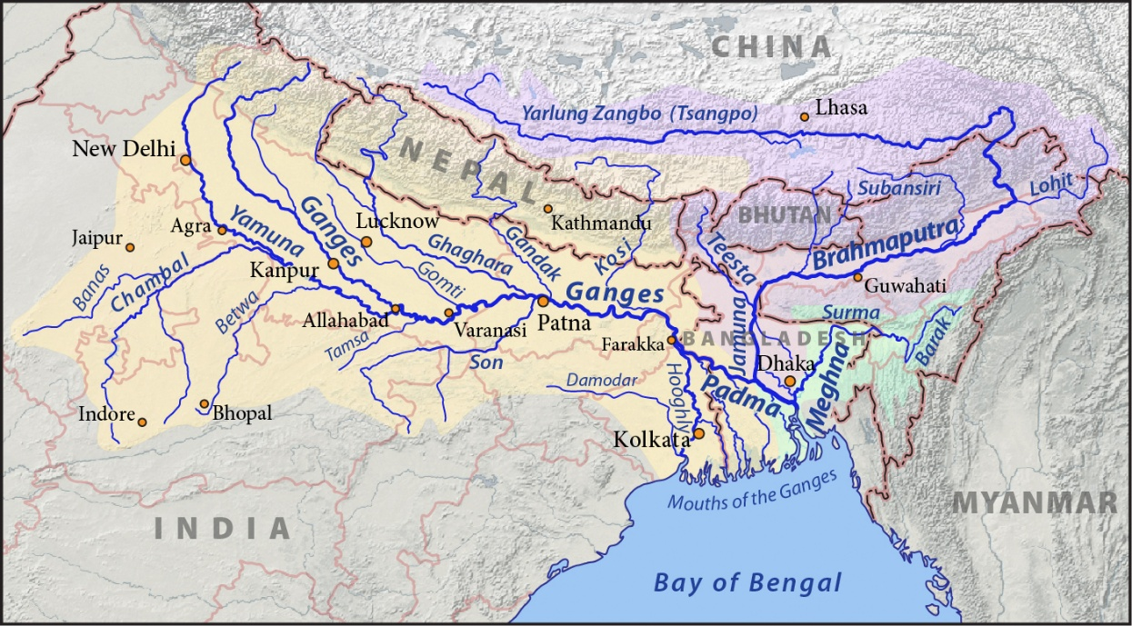
Gangetic Plains
Divisions:
Upper Gangetic plains
Middle Gangetic plains
Lower Gangetic plains
1
2
3

Slide 67
Gangetic Plains
Upper ganga plains
From Yamuna to Ghaghara plains
Rohilkhand plain
Sandy deposits

Slide 68
Gangetic Plains
middle ganga plains
Kosi plain
Called Magadh / Awadh /Anga plain
Flood-prone, shifting of river course of Kosi

Slide 69
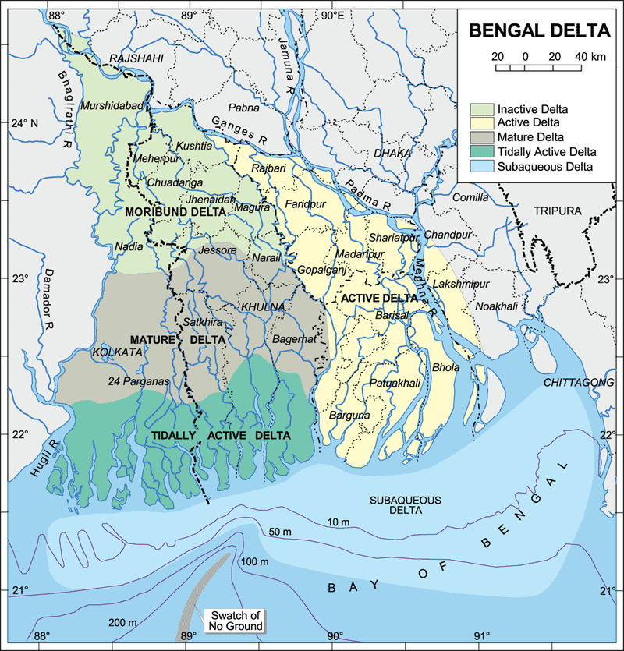
Gangetic Plains
Lower ganga plains
Ganga enters WB
Sundarban delta
Lowland-almost sea level
Sagar Island
Lothian Is. (N.P)
Bengal tigers

Slide 70
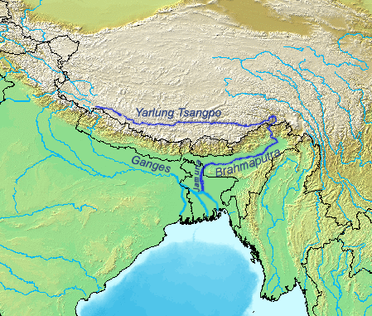
Assam Plains
Brahmaputra largest river of India (volume)
Origin Mansarovar lake- enters as Dihang in Arunachal Pradesh
River course narrow- numerous stream flow -flood prone
Kailash mt.
Notes:
River course narrow as surrounder by mountains

Slide 71
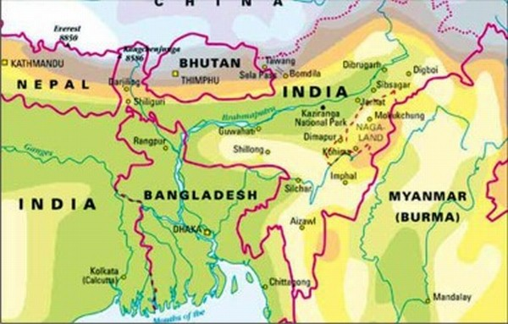
Assam plains
Streams from north –swift flowing – form alluvial fans
Manas
Subansiri,
Streams from south plt. –smooth flowing-
3) Dibang
4) Lohit
Dhansiri
Kapilli
Manas
Dihang
Subansiri
Lohit
Dhansiri
Kapilli
Naga hills
Garo
Khasi
Jaintia
Barail range

Slide 72
Geological history of India
Physiographical regions of India
Northern mountains
Northern plains

