Slide 1
Position(Real)
stepPosition(Integer)
cycleTime
Time

Slide 2
Initial condition
”scale” is known = steps/mm
Position(Real)
stepPosition(Integer)
initialPosition
initialStepPosition
cycleTime
Time

Slide 3
End condition
”scale” is known = steps/mm
Position(Real)
stepPosition(Integer)
initialPosition
initialStepPosition
commandedPosition - 3 examples here
cycleTime
Time

Slide 4
StepPosition for end
”scale” is known = steps/mm
Position(Real)
stepPosition(Integer)
commandedPosition - 3 examples here
stepPosition =
floor(commandedPosition*scale)
initialPosition
initialStepPosition
cycleTime
Time

Slide 5
Check for no step
”scale” is known = steps/mm
Position(Real)
stepPosition(Integer)
if initialStepPosition == stepPosition
take no step
goto update and return success
initialPosition
initialStepPosition
commandedPosition
stepPosition
cycleTime
Time

Slide 6
Check for too many steps
too high frequency
”scale” is known = steps/mm
Position(Real)
stepPosition(Integer)
commandedPosition
stepPosition
initialPosition
initialStepPosition
commandedPosition
stepPosition
approximateFrequency = abs(initialStepPosition - commandedStepPosition)/cycleTime
if approximateFrequency > maxAllowedFrequency
take no step
goto update and return error
cycleTime
Time

Slide 7
Line equations
”scale” is known = steps/mm
intitialStepPosition != stepPosition
frequency slow enough
Position(Real)
stepPosition(Integer)
commandedPosition
commandedStepPosition
initialPosition
initialStepPosition
stepPos = k Time + m
k = (commandedPosition - initialPosition)/cycleTime
m = initialPosition
Time = 0 at initial Time (nominal lcnc time)
cycleTime
Time

Slide 8
Check for too flat slope
”scale” is known = steps/mm
intitialStepPosition != stepPosition, must take step
frequency slow enough
Position(Real)
stepPosition(Integer)
commandedPosition
stepPosition
initialPosition
initialStepPosition
Avoid problems with numerical precision at flat slope.
k * cycleTime * scale = amount of a step to take
if that amount < 0.01 (for example), just take a step in the
right direction half-way into cycleTime.
We know we must take a step due to previous checks.
cycleTime
Time

Slide 9
”scale” is known = steps/mm
intitialStepPosition != stepPosition, must take step
frequency range ok
Tstart
Position(Real)
stepPosition(Integer)
Tstart
For positive k:
Tstart = ((InitialStepPosition+1)/scale - m)/k
For negative k:
Tstart = (InitialStepPosition/scale - m)/k
initialPosition
initialStepPosition
Tstart
cycleTime
Time

Slide 10
”scale” is known = steps/mm
intitialStepPosition != stepPosition, must take step
frequency range ok
Tstart is known
Frequency
Position(Real)
stepPosition(Integer)
Tstart
initialPosition
initialStepPosition
Frequency = slope of curve, k * scale
Frequency = k * scale
Tstart
cycleTime
Time

Slide 11
”scale” is known = steps/mm
intitialStepPosition != stepPosition, must take step
Frequency range ok
Tstart is known
Frequency is known
Number of steps
and direction
Position(Real)
stepPosition(Integer)
commandedPosition
commandedStepPosition
Tstart
initialPosition
initialStepPosition
nSteps = commandedStepPosition - initialStepPosition
sign(nSteps) = direction
sign(k) = direction
Tstart
commandedPosition
stepPosition
cycleTime
Time

Slide 12
Prepare for next cycle
Position(Real)
stepPosition(Integer)
initialPosition <= commandedPosition
initialStepPosition <= commandedStepPosition
initialPosition
initialStepPosition
initialPosition
initialStepPosition
initialPosition
initialStepPosition
cycleTime
Time

Slide 13
Pulses
Position(Real)
stepPosition(Integer)
Tstart
T=1/frequency
Tstart
Tstart
Tstart
Tstart
cycleTime
Time

Slide 14
Pulses
Note. Time scale is different in this and following slides
Position(Real)
stepPosition(Integer)
Pulse train is defined by
Tstart + Tjitter
frequency
nSteps
T=0 is measured from SM2 interrupt, which seems to happen within 2-3 μsecs
Therefor, Tjitter = 5 μsecs
cycleTime
Tjitter
Tstart
Tstart
T=1/frequency
Tstart
Tjitter
Tjitter
Tstart
Tstart
Tstart
Time

Slide 15
Starting the pulse train
Note. Time scale is different in this and following slides
Position(Real)
stepPosition(Integer)
Use HardwareTimer (stm32duino)
Take one of the 1-channel timers 10,11,13,14 on STM32F4 (AN4013)
startTimer->attachInterrupt(startTimerCB); // At constructor time
startTimer->setOverflow(Tjitter+Tstart, MICROSEC_FORMAT); // Now
startTimer->ressume(); //
Let the timer run for Tjitter+Tstart usecs, then it calls startTimerCB (below)
pulseTimer->setMode(pulseTimerChan, TIMER_OUTPUT_COMPARE_PWM2, stepPin);
pulseTimer->setOverflow(uint32_t(frequency), HERTZ_FORMAT);
pulseTimer->setCaptureCompare(pulseTimerChan, 50, PERCENT_COMPARE_FORMAT); // 50%
pulseTimerSteps = abs(nSteps);
pulseTimer->resume();
// Use local copy of nSteps, so it doesn’t accidentally gets overwritten.
cycleTime
Tjitter
Tstart
Tstart
T=1/frequency
Tstart
Tjitter
Tjitter
Tstart
Tstart
Tstart
Time

Slide 16
Ending the pulse train
Note. Time scale is different in this and following slides
Position(Real)
stepPosition(Integer)
PulseTimer runs and calls pulseTimerCB at end of every PWM pulse
Number of steps to do are counted down and when 0, stop the pulseTimer
--timerPulseSteps;
if (timerPulseSteps == 0)
pulseTimer->pause();
cycleTime
Tjitter
Tstart
Tstart
T=1/frequency
Tstart
Tjitter
Tjitter
Tstart
Tstart
Tstart
Time

Slide 17
Problem with this approach

Slide 18
The end is unpredictable and collides with next step’s pwm train
Position(Real)
stepPosition(Integer)
Tstart can be predicted accurately
The end of the pulse train also, Tend = Tstart + nStep / frequency
A problem occurs when Tstart,2 happens before Tend (Tstart,2 = Tstart for the next cycle)
At Tstart and Tstart,2 the pwm timer is reloaded. If that happens before the pwm pulse train is finished, problems occur.
At constant speed, every 1 ms we see a part of an overall long pulse train, just take a 1 ms piece and make pulses.
That’s what this procedure does. This works generally fine at constant speed, I think.
At increased and decreased speed, during acceleration, Tstart,2 is not what one think at first. It will be shorter or longer
and the situation described above occurs, when the pwm timer gets reloaded before it is finished.
The rising edge of the pwm pulse is in the right place, but everything that comes may not be.
It can not be like that.
Tend
cycleTime
Tjitter
Tstart,2
Tstart
Tstart
T=1/frequency
Tjitter
Tjitter
Tstart
Tstart
Tstart
Time

Slide 19
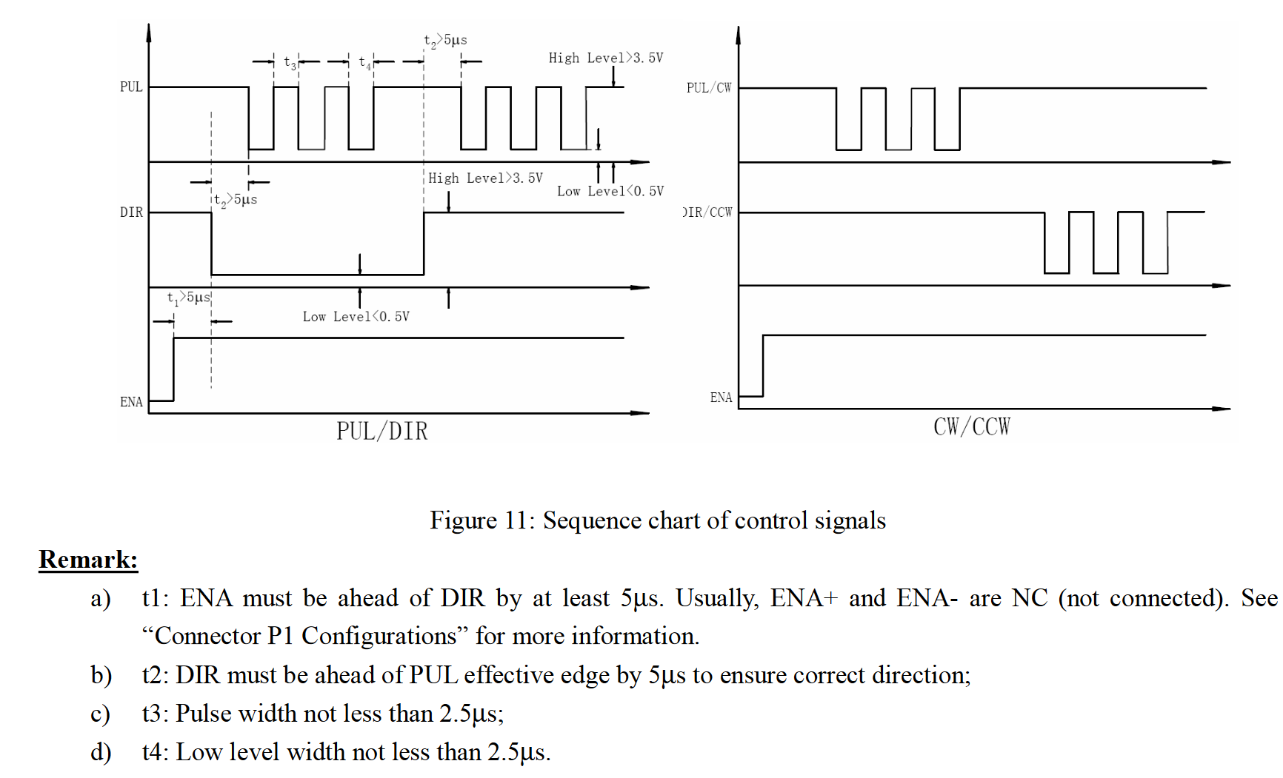
Remedies
1. Skip Tstart and distribute pulses inside cycleTime window, keeping clear of the start and end
2. Modify pulse shape to use the most narrow pulse allowed by the driver
3. Don’t check for complete pulse at period update, but on capture/compare.
4. Keep frequency as before
5. Use end time of previous pulse when setting the time for the first pulse
Not perfect.
It will often happen that there are n and n+1 pulses in adjacent cycles. This will result in frequency jumping up and down.
2.5+2.5 usec => 5 usec and max 200 kHz. I don’t need that much. Say 5+5 usecs => max 100 kHz.
cycleTime
Tjitter
T=1/frequency
Interrupt here

Slide 20
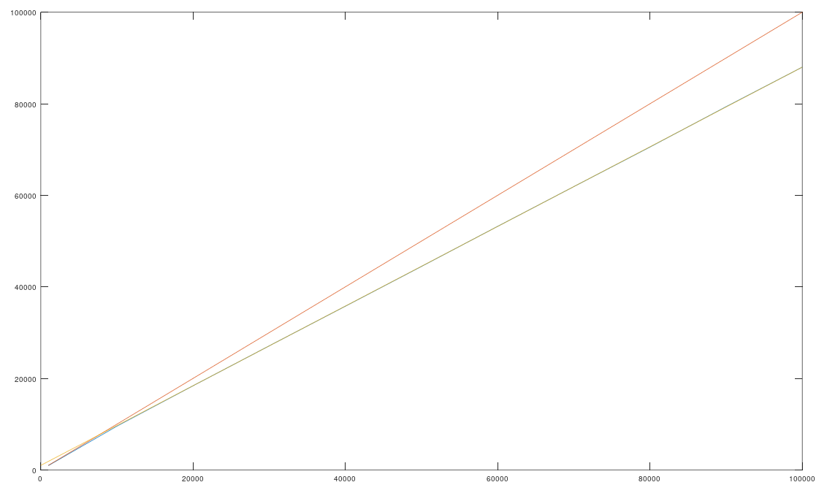
Timer
>> f=[1 10 20 30 40 50 60 70 80 90 100]*1e3
f = 1000 10000 20000 30000 40000 50000 60000 70000 80000 90000 100000
>> fo=[956 9560 18390 27111 35768 44461 53221 61898 70539 79367 88000]
fo = 956 9560 18390 27111 35768 44461 53221 61898 70539 79367 88000
>> plot(f,fo, f, f, [f(end) 0],[fo(end) 1000])
>> k=(fo(end)-1000)/f(end)
k = 0.8700
>> m=1000
m = 1000

