Slide 1

D’oH!

Slide 2
What is D’oH?
D’oH is an automated dough making machine. Its purpose is to make the baking process easier by removing the need to measure ingredients by hand.
D’oH היא מכונה המכינה בצק בצורה אוטומטית. מטרתה היא להפוך את תהליך האפייה לפשוט ומהיר יותר ע"י הסרת הצורך במדידה ידנית של חומרי הגלם.

Slide 3
HARDWARE
The hardware is based on 4 main components:
The rail
The scale
The containers
The hall effect.

Slide 4
HARDWARE
The Progress so far:
We’ve created a working stepper-motor based rail. The rail is controlled by a stepper motor, which is in return controlled by Bluetooth commands.
We’ve created a working prototype of the big container, opening and closing using a servo motor and a string.
We’ve combined Bluetooth commands to control the rail and the container at the same time.
What’s next:
Finishing the big containers (sealing, aesthetics, etc.)
Working on the small containers.
Creating a scale using the load cell.
Waiting on the hall effect sensor.

Slide 5
SOFTWARE
The app lets the user create dough recipes, save them, and then send them off to be created by the hardware.

Slide 6
SOFTWARE
The Progress so far:
Login page (user name and password).
Main page (History, stats, settings).
Configuration page (configuring containers to ingredients).
Recipe creating page.
Basic interaction with the Bluetooth device.
What’s next:
Building a wider options app according to our original planning.
Adding integration with the cloud.
Adding integration with the Bluetooth device.

Slide 7
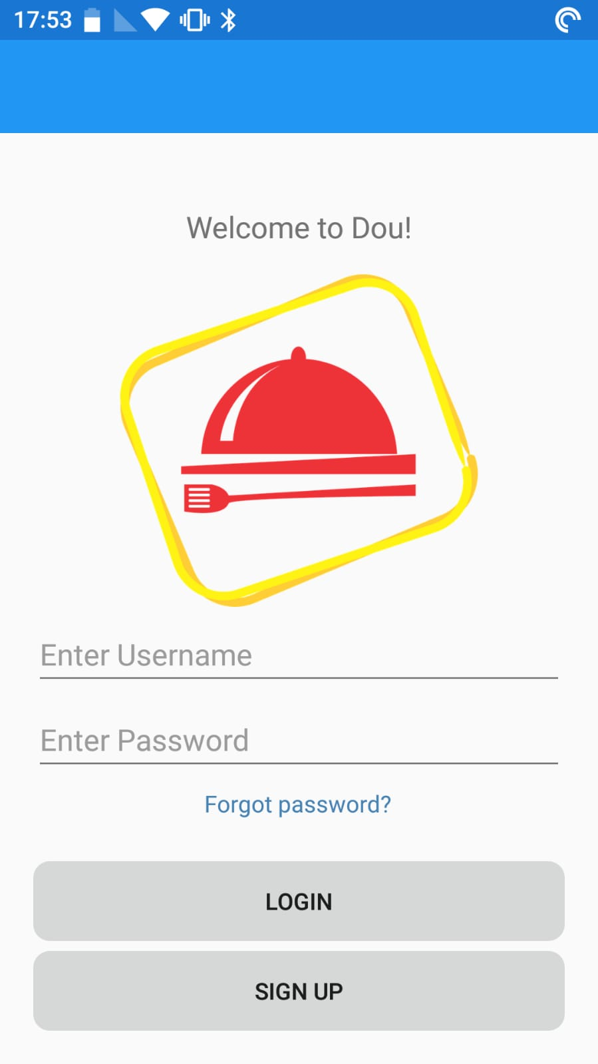
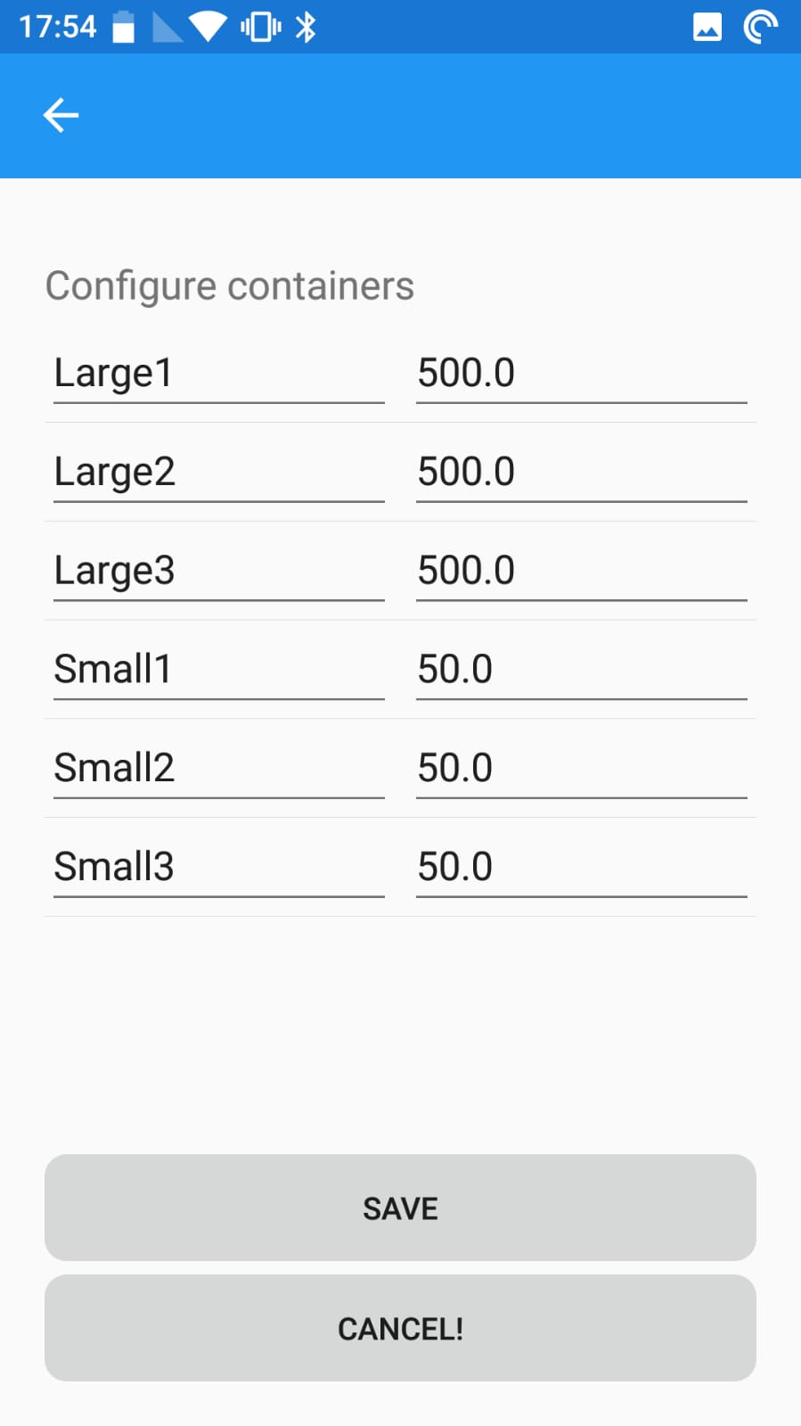
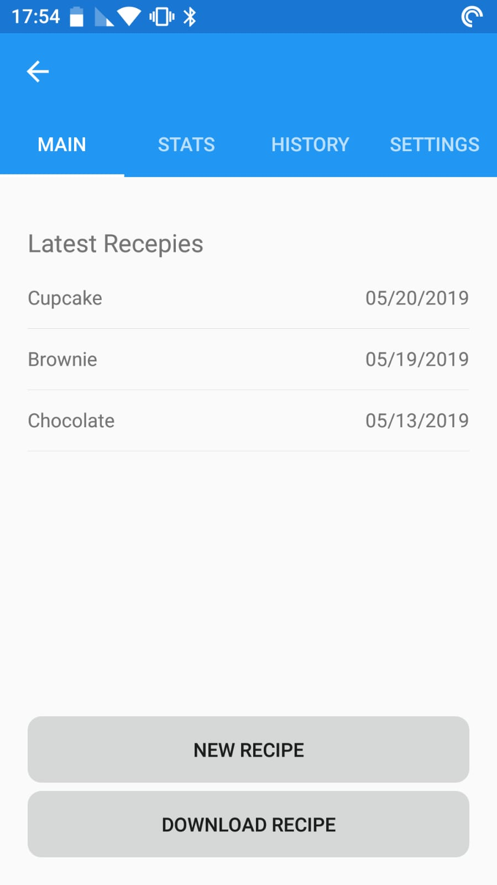
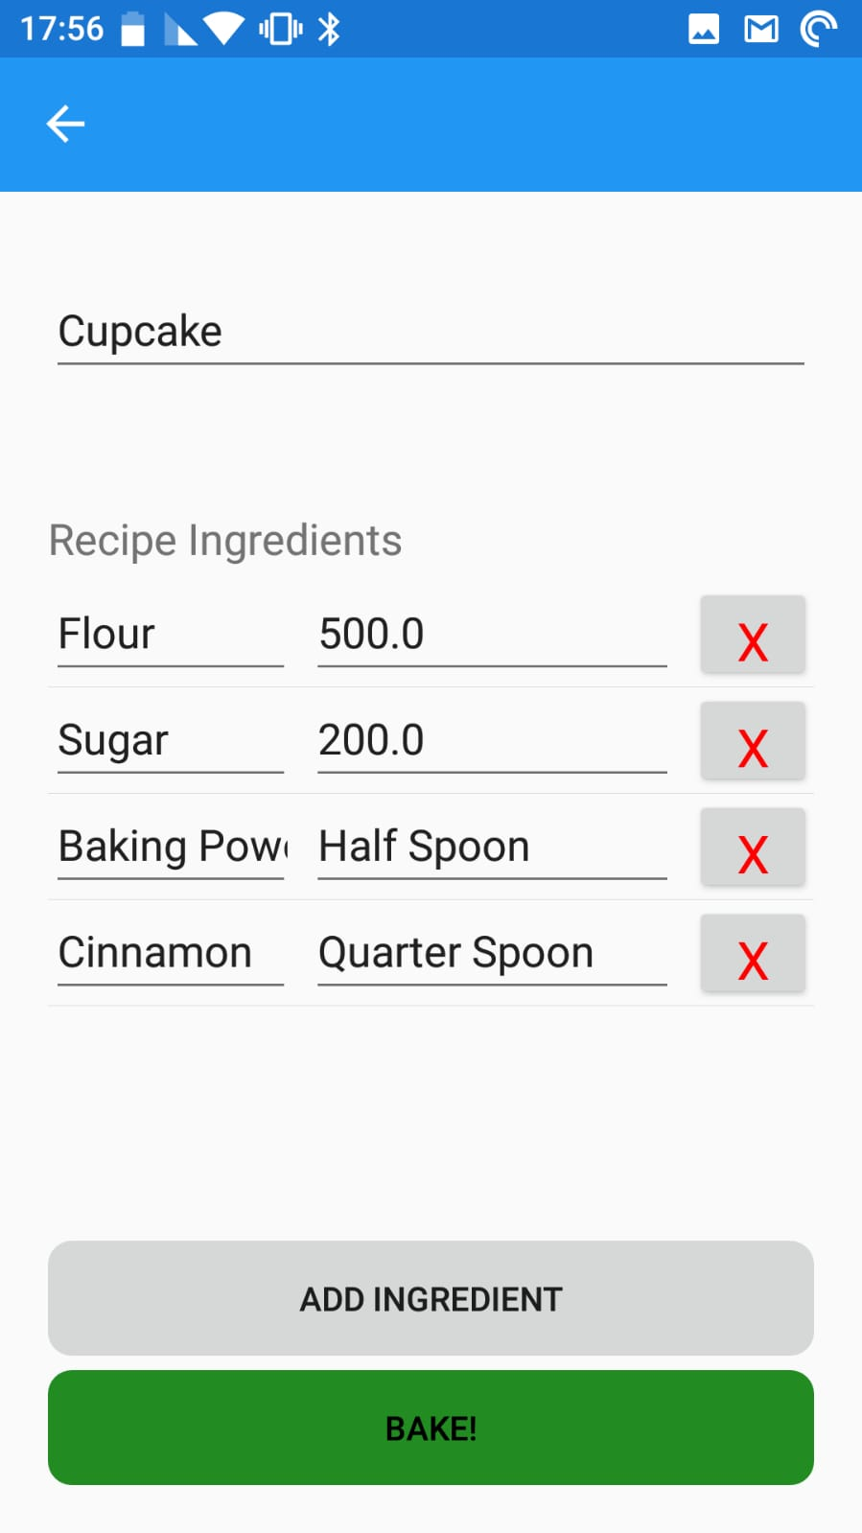
SOFTWARE

Slide 8
CLOUD
The cloud will hold all computation functions needed for the project. For example:
Calculating remaining amount per containers based on previous jobs.
The cloud will hold all necessary databases for the project. For example:
Users database
Recipes per user database
Ingredients conversion database.

