Slide 1

Detecting malicious URLs
AI for Cybersecurity final examination project
Dario Capecchi

Slide 2
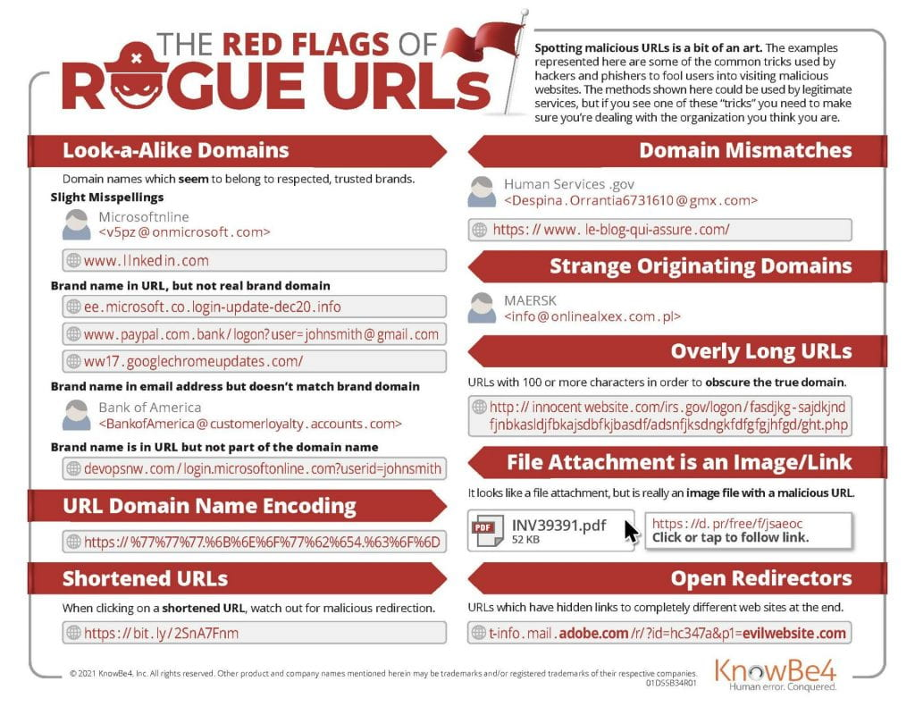
Goal of the project
Malicious URLs are a common cybersecurity threat, and are often involved in phishing attacks or spreading malware; users usually rely on experience to avoid them
A possible countermeasure is to detect URLs that have a high probability of being malicious and warn the user about them
Discovering common patterns in malicious URLs that differentiate them from legitimate ones could be useful to detect them
Train a classifier using a set of pre-labeled benign and malicious URLs

Slide 3
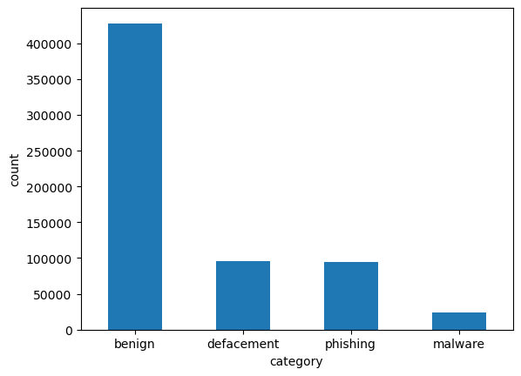
Data exploration
A dataset of labeled URLs classified in 4 categories: benign, defacement, phishing and malware
The dataset contains about 650k records and is imbalanced towards benign URLs
It was built by combining different URL datasets and removing extra features, keeping only URLs and labels
No features are specified except the URL itself and its class
Has only a small amount of duplicates
https://www.kaggle.com/datasets/sid321axn/malicious-urls-dataset

Slide 4
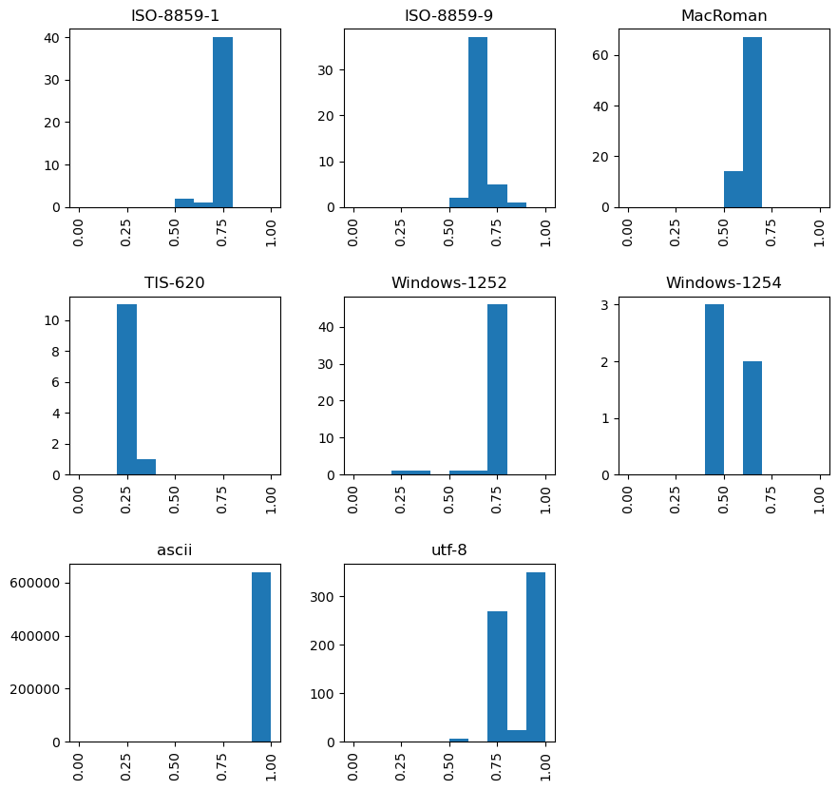
Data cleaning
Duplicates are removed keeping the last entry
Checking character encoding can reveal malformed or corrupted URL strings and can also be used as a feature for classification
Encodings determined using the chardet library
Each encoding is associated with a confidence metric, which can be used to spot corrupted strings

Slide 5
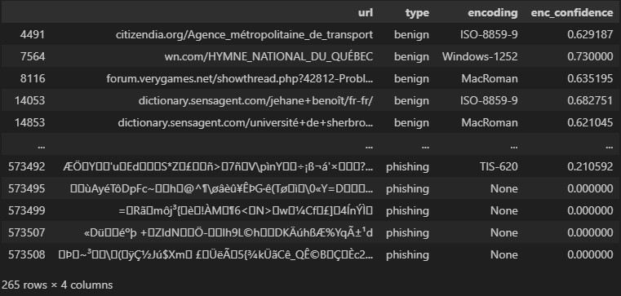
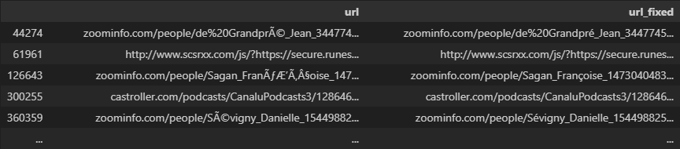
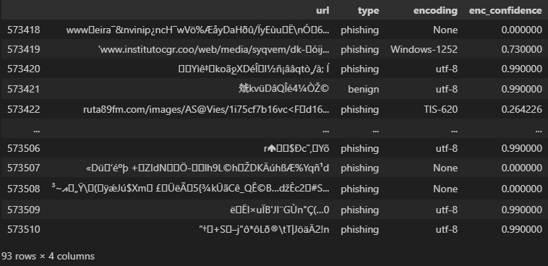
Data cleaning
(1)
By trying some queries, we observe that there are some URL strings with broken encoding (1)
Some URLs can be fixed using the ftfy library (2) which attempts to fix common encoding errors
Low-confidence and unidentified encodings are removed. From manual inspection, we see they are contiguous and can be deleted (3)
(2)
(3)

Slide 6
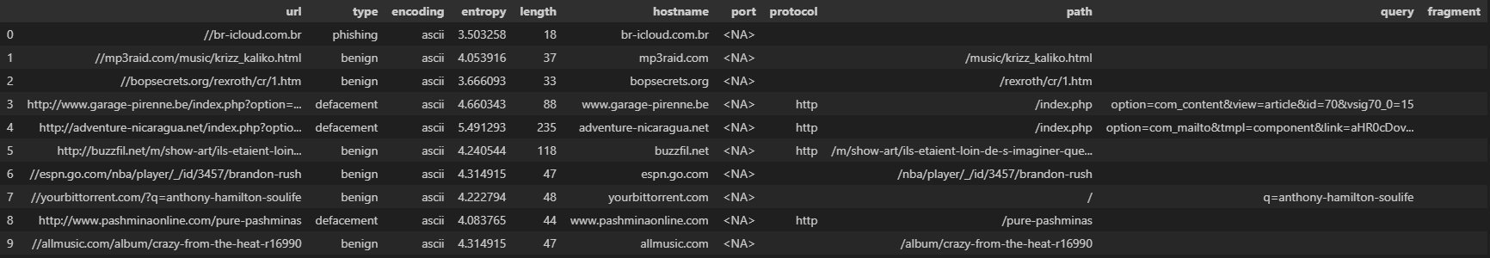
Feature extraction
Malicious URLs want to deceive the user by appearing legitimate
We perform feature extraction by considering both generic string features and others specific to the structure of an URL
Other text processing such as stemming was not done because URLs are very different in structure compared to natural language
No information was retrieved from the pages they may link to
Strings are prepared for parsing by prepending // to allow parsing of abnormal URLs
URLs are parsed with urllib.parse and split into components
String length and Shannon entropy are extracted as generic string features

Slide 7
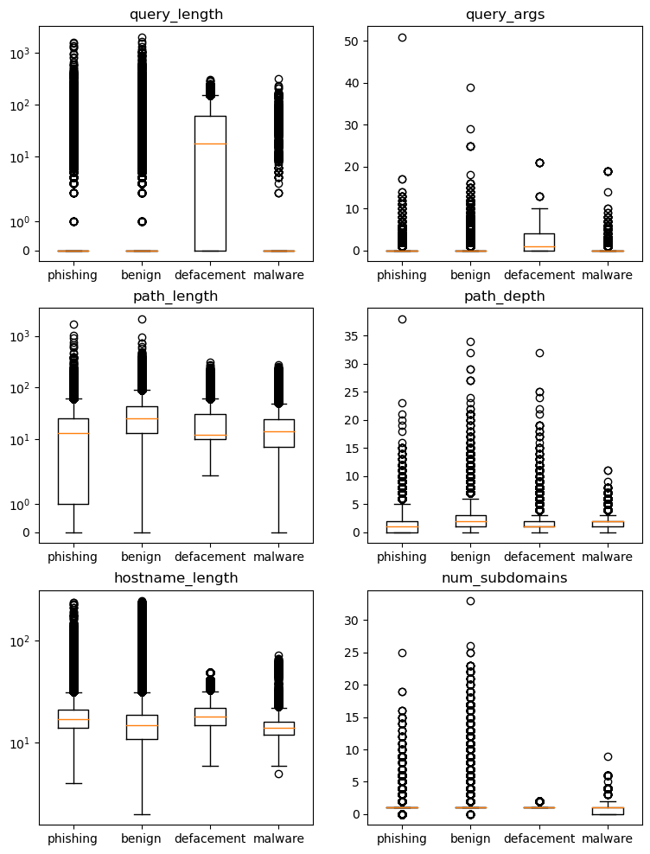
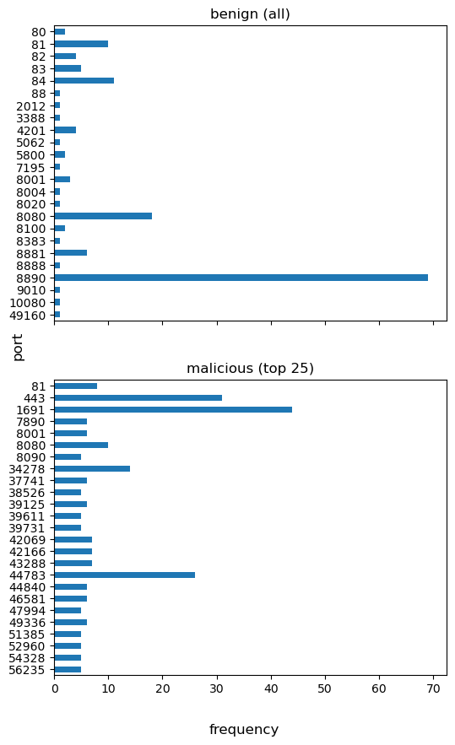
Feature extraction
Explicit port numbers may correlate with malicious URLs, since legitimate ones rarely use them; same for IP addresses
Longer hostnames or with many subdomains may be an attempt to deceive the user into thinking it is a trusted website
Length and number of query parameters may indicate presence of payloads
Path length and depth, presence of fragments were also extracted

Slide 8
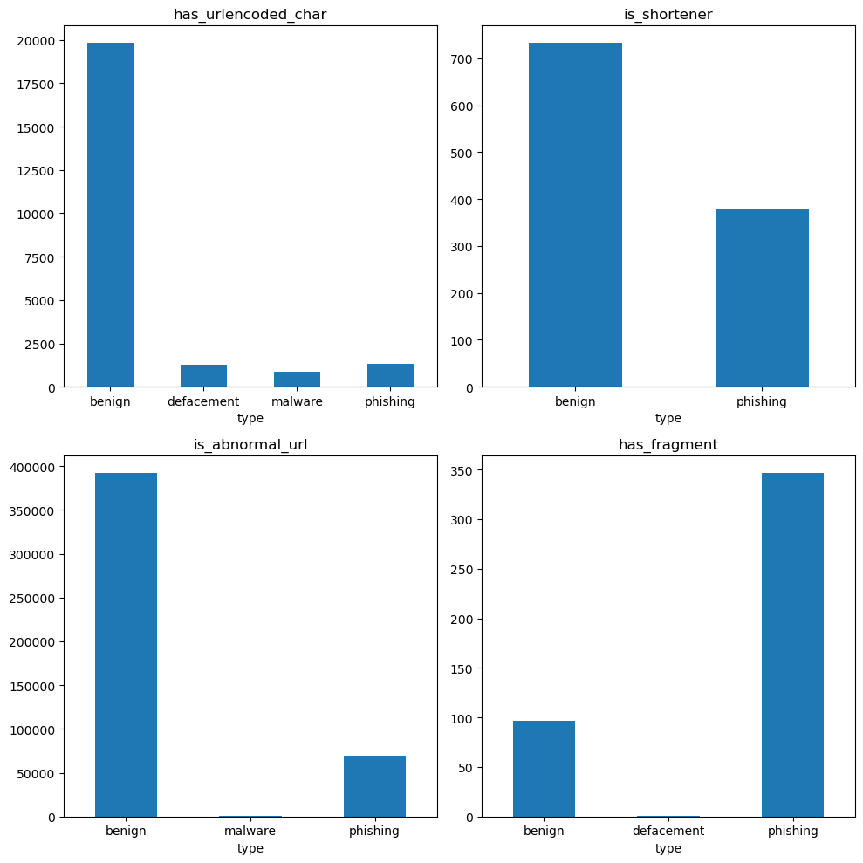
Feature extraction
Use of URL shorteners could attempt to hide unfamiliar domains
URL-encoded characters may hint at the presence of a payload
Abnormal urls (lacking the protocol name) are more commonly used
A fragment could be used to lead the victim to the malicious part of the page

Slide 9
Training set
Categorical features
We drop the original URL string and its components
One-hot encoding is used for the character encoding and protocol features
TLDs are dropped, because they would increase dimensionality significantly with one-hot encoding (about 900 features)
Imbalance treating
Considering the binary classification case yields a more balanced dataset (about 1:2 ratio)
2 different problems: binary and multi-label classification
Initial idea: oversampling, but SMOTE cannot deal with categorical variables
Dataset numerosity is high (smallest class has 32k samples → Use random undersampling without replacement
Feature scaling
By taking advantage of pipelines, normalization is done only for those classifiers that need it
Uses StandardScaler to achieve mean = 0 and std = 1

Slide 10
Training and cross-validation
Consider binary and multi-label classification, with and without undersampling
Stratified 10-fold cross validation to mitigate overfitting and improve performance estimation
Classifiers used:
Decision tree, random forest as popular choices for classification
Gaussian naïve Bayes as a very efficient alternative
Multilayer perceptron neural network as better alternative to NB when features are correlated
Stochastic gradient descent is another efficient classifier that scales well with large datasets
Metrics used: accuracy, precision, recall, f1-score
Multiclass precision/recall/f1-score is calculated by counting total TP, FP, TN and FN
Confidence threshold for Wilcoxon test is 5%
RandomForestClassifier
DecisionTreeClassifier
GaussianNB
MLPClassifier
StratifiedKFold
(optional)
RandomUnderSampler
StandardScaler
RBFSampler
SGDClassifier

Slide 11
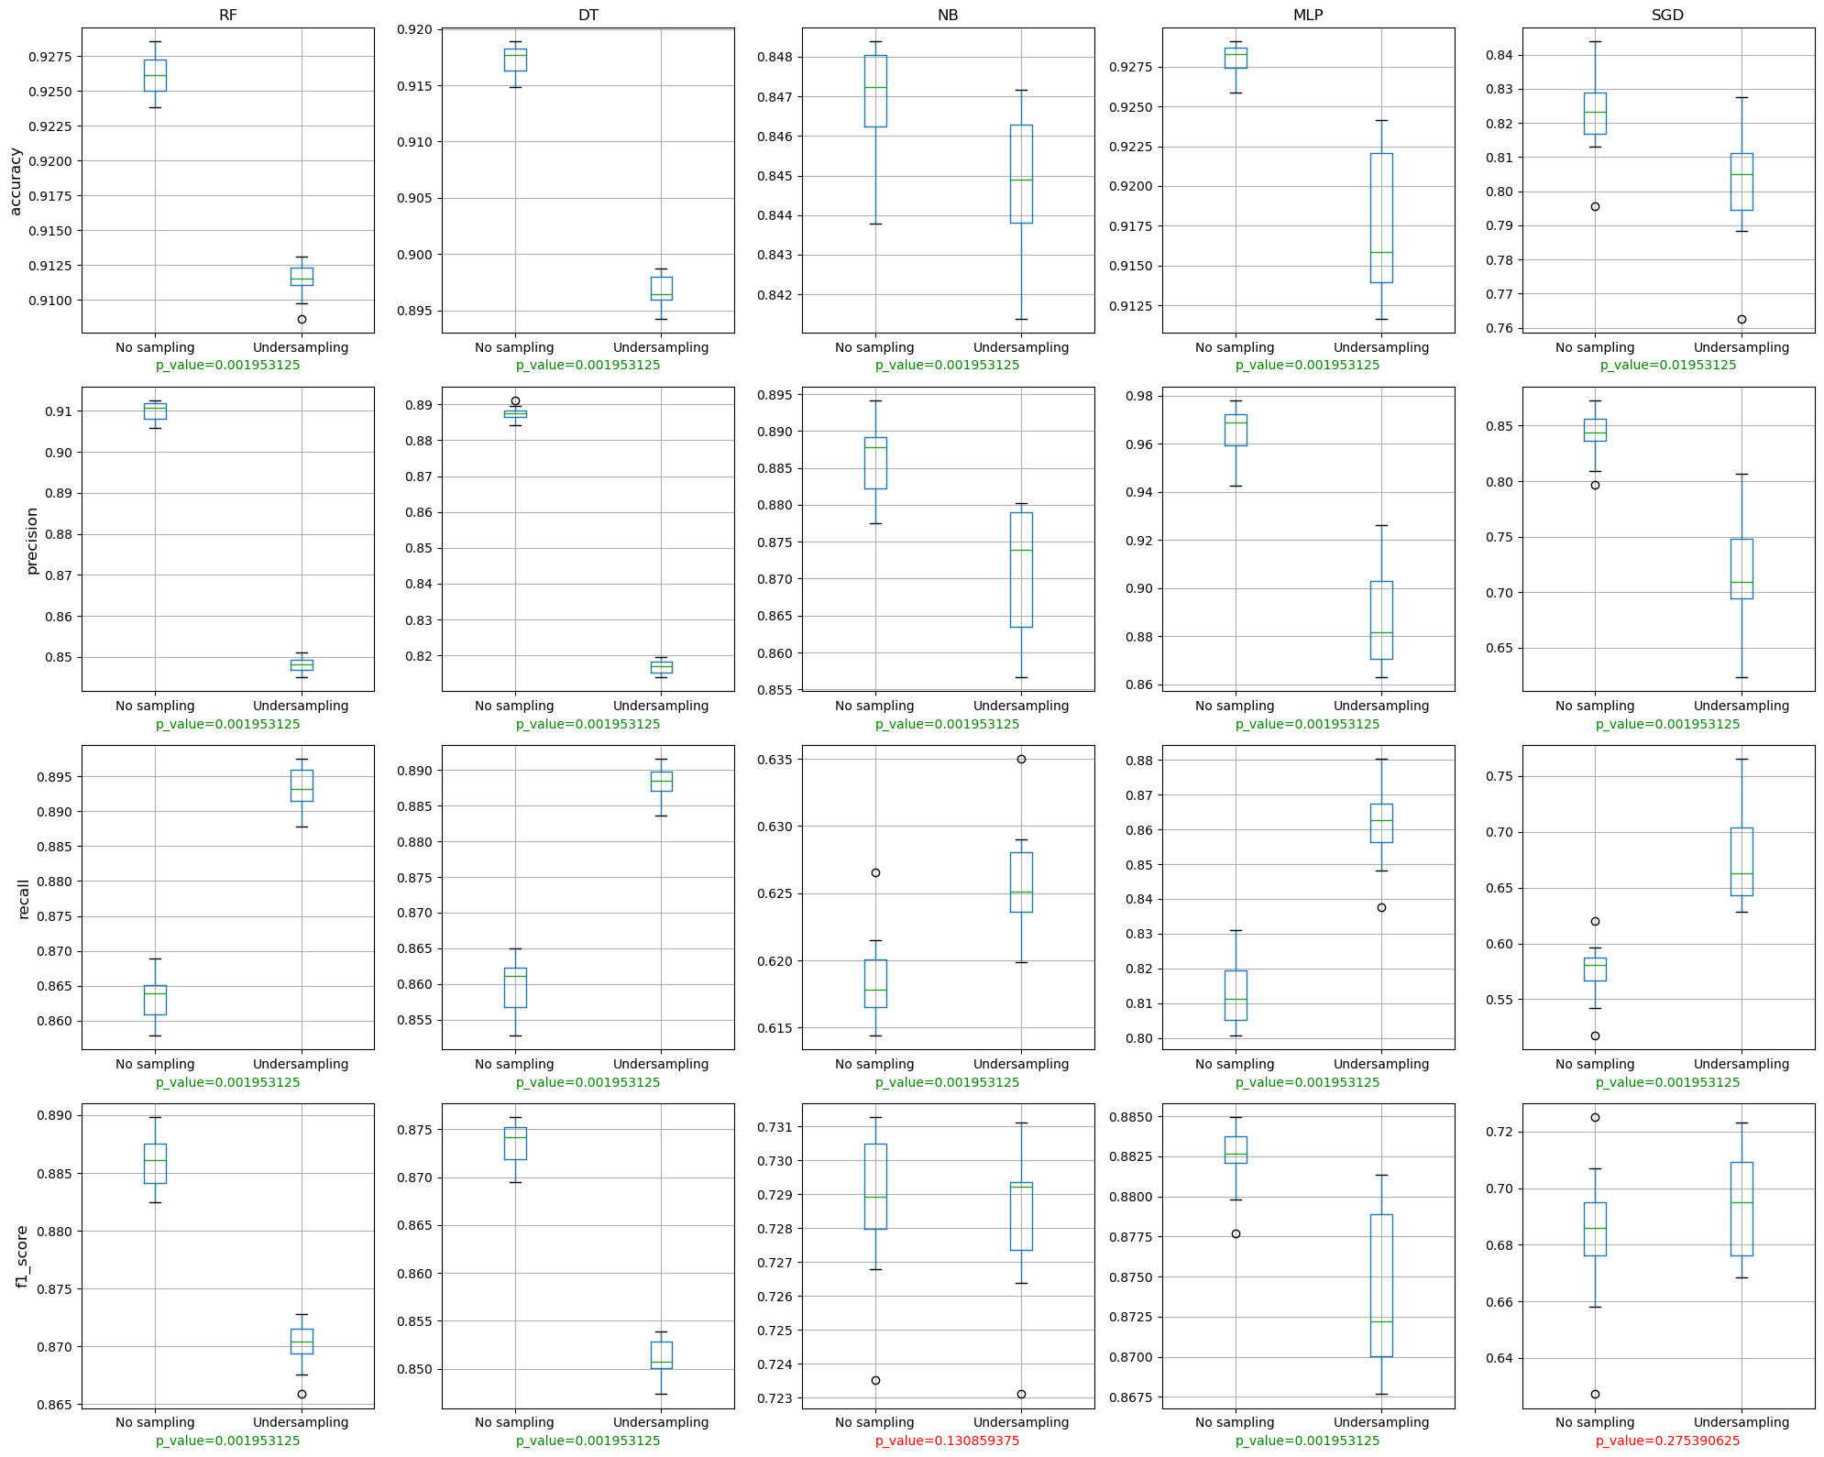
Cross-validation results: binary
RF and MLP offer the best performance. Decision tree follows closely
Random undersampling improves recall, but reduces precision, leading to an overall lower f1-score. Accuracy is also worse

Slide 12
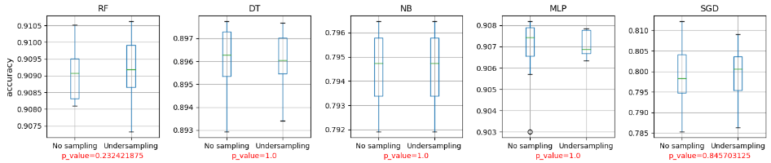
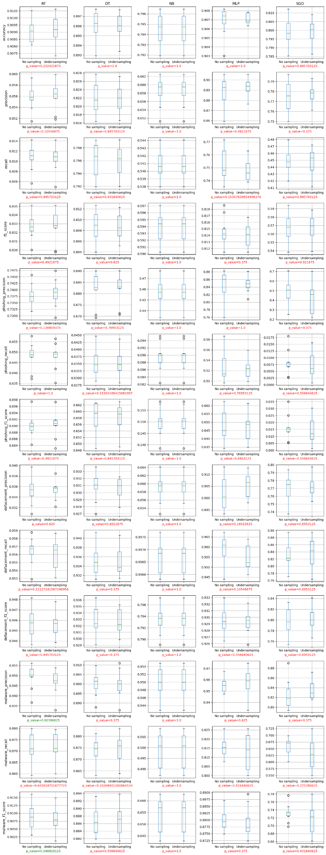
Cross-validation results: multi-label
RF and MLP have the highest f1-scores and accuracy
Phishing URLs have significantly lower scores compared to other categories
Defacement metrics are higher than malware
Undersampling has no significant effect, we cannot reject the null hypothesis

Slide 13
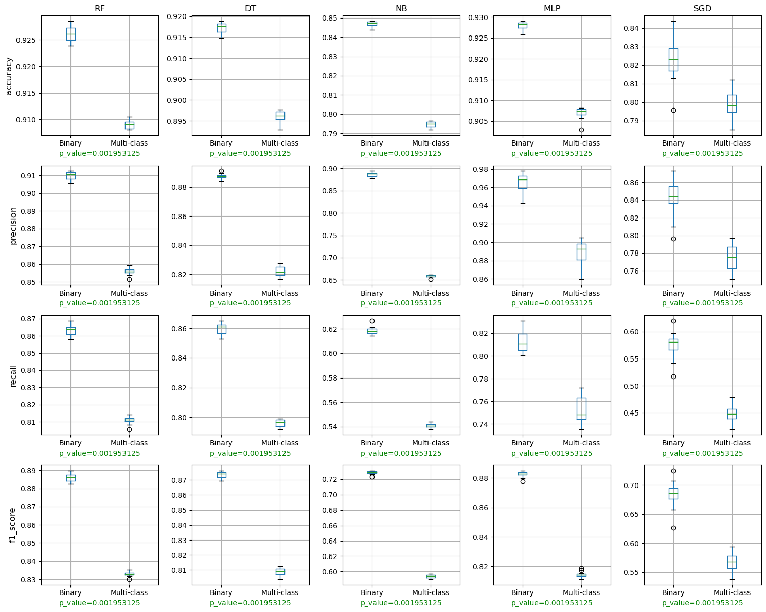
Results
The best classifiers are random forest and multilayer perceptron
Under-sampling does not improve overall performance, in fact it makes it worse in the binary classification case
For the sake of malicious URL detection, binary classification is more accurate than the multi-label approach

Slide 14
Possible improvements
Extract more features that could be correlated with malicious URLs, such as
Presence of base64, hexadecimal or other kinds of text encoding
Homograph characters that could be used to deceive the user
Presence of "spoofed" hostnames in other parts of the URL
Specific words such as "admin", "user", "password", etc.
Do not limit feature extraction to just URL strings, and try to retrieve information from websites
WHOIS query to infer domain owner
HTML/javascript parsing to detect malicious code
Attempt to use oversampling, or a combination of under and oversampling to improve classifier performance
For example, SMOTENC from imbalanced-learn can work with categorical features as well as numerical ones
Use models that support categorical features, or use alternative ways of encoding them instead of one-hot encoding
Optimize classifier hyper-parameters

