Slide 1







Smart Campus Sustainability & Carbon Footprint Monitoring System
A full-stack IoT + analytics web application (EcoSphere AI)
Yajat M Rawal · S Surendar · Surya Swaminathan · Shivraj Singh
Guide: Dr Arun Nehru J, Assistant Professor, Dept. of CSE (Emerging Technologies)
21CSC203P Advanced Programming Practice · October 2026

Slide 2


The idea in one slide
Today
Our system
Campus checks electricity and water bills once a year
Carbon footprint calculated by hand in Excel
Leaks and AC left on overnight go unnoticed
IoT meters send readings every minute
Software converts them to CO2 automatically
Algorithms raise alerts within hours
What is measured gets managed.

Slide 3
Technology stack (100% free and open source)
Frontend
React 19 · TypeScript · Vite · Recharts · Leaflet maps
Backend
Python 3.12 · Django 5 · Django REST Framework · JWT
Database & maths
SQLite (PostgreSQL ready) · NumPy · ReportLab PDFs
IoT layer
ESP32 / smart meters → HTTP JSON API (simulator for demo)
Rs. 0 licence cost · runs on a normal laptop

Slide 4


System architecture
IoT devices
Django REST API
SQLite database
React web app
Energy meters
Water meters
CO2 sensors
Validates data
Carbon engine
Alerts & forecast
Readings
Emission factors
Alerts, users
Dashboards
Charts & map
Reports
HTTP POST + JSON
Django ORM
REST API + JWT
Labels under the arrows show how each part talks to the next

Slide 5



Step 1: Collecting sensor data
Every meter sends a small JSON message to our API every minute
Device key
Only registered gateways can send data
POST /api/ingest/
X-Gateway-Key: 6e73...bc69
{
"readings": [
{ "serial": "EM-ACA",
"value": 42.5,
"interval_minutes": 15 }
]
}
Validation
Unknown meter or bad number → rejected
Quality flag
Impossible values stored but marked 'suspect'
Bulk save
Thousands of readings saved in one query

Slide 6
Step 2: Storing it in the database
Django models (Python classes) become SQL tables automatically
1 → many
1 → many
Building
Meter
Reading
name, type, area, occupants
serial, kind (power/water)
time, value, quality
1 → many
Alert
EmissionFactor
User
type, severity, status
activity, value, date
username, role
About 78,000 hourly readings for 120 days of demo data

Slide 7
Step 3: Converting energy to carbon
CO2 (kg) = Activity × Emission factor
Worked example
Three scopes (GHG Protocol)
1,000 kWh
× 0.716
= 716 kg
1
Fuel we burn: diesel, LPG
2
Electricity we buy
electricity used
kg CO2 per kWh (CEA)
CO2 emitted
3
Water, waste, commuting
Factors are stored with a 'valid from' date, so updating the CEA value never changes old reports.

Slide 8
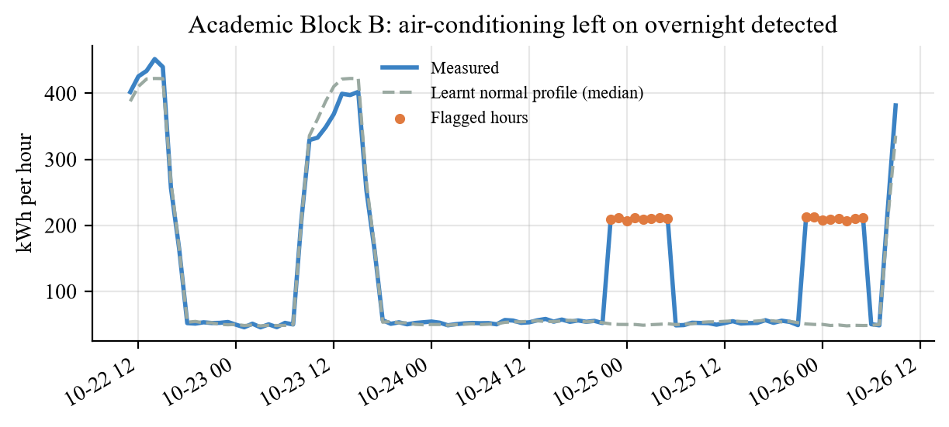



Step 4: Detecting waste automatically
1. Learn normal
Median usage for each hour, from the last 4 weeks
2. Compare
Is this hour far above normal? (robust z-score > 4)
3. Alert
Create a work order with the estimated cost
Result: AC left on overnight in Academic Block B was caught the same night (about Rs. 11,600 wasted per night). All 6 planted faults found, 0 false alarms.

Slide 9
Step 5: Predicting next month's demand
Inputs
Day of the week
Holidays & vacations
Temperature
Long-term trend
Linear regression
NumPy least squares
Accuracy 97.6% · dips are weekends and holidays · +1 °C ≈ +935 kWh/day

Slide 10



REST API and security
How a user logs in and gets data
Login
JWT token
API request
Role check
username + password
valid 30 minutes
token sent in header
admin / facility / student
GET /api/analytics/overview/ → KPIs and carbon totals
GET /api/analytics/live/ → live building status
GET /api/analytics/forecast/ → 30-day forecast
PATCH /api/alerts/12/ → resolve an alert
GET /api/reports/ghg.pdf → download PDF report

Slide 11
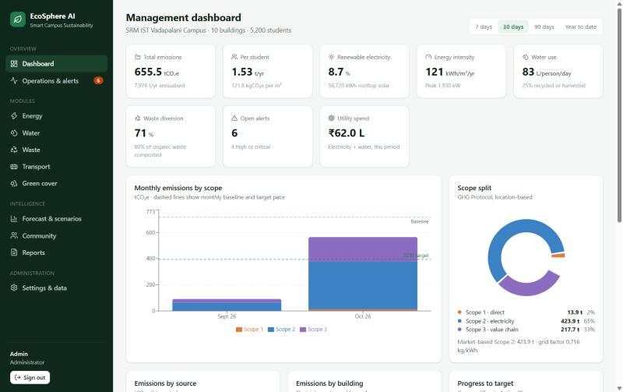




Frontend: the web dashboard
13 pages
Dashboard, energy, water, waste, alerts…
Live updates
React Query refreshes every 30 s
Charts & map
Recharts + Leaflet / OpenStreetMap
Responsive
Works on laptop and phone
Built with React 19 + TypeScript, bundled by Vite

Slide 12
Testing and results
18 / 18
6 / 6
97.6%
0.2 s
automated tests pass
faults detected
forecast accuracy
API response time
7,975
tonnes CO2e per year
1.53 t per student
Electricity is about two-thirds

Slide 13

From sensor readings to climate action
IoT data in → carbon, alerts and forecasts out
Thank you
Python + Django REST API with a GHG carbon engine
Automatic anomaly detection and demand forecasting
React dashboards for admins, facility staff and students
Next: real ESP32 meters, MQTT and AI-based AC control
Questions welcome

