Slide 1
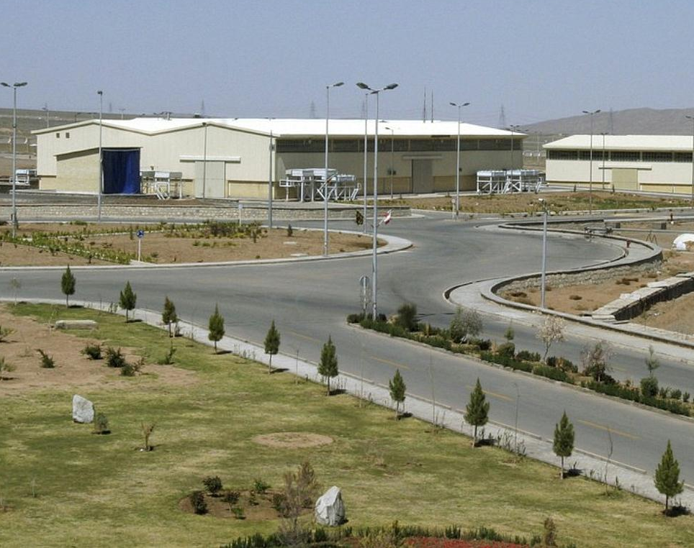
Stuxnet Worm Attack
Timmy Jenkins
CSCI 405 Principles of Cybersecurity
Charleston Southern University
Professor Patrick Hill
2/23/2025
Notes:
Natanz Uranium Enrichment Complex. Iran. Located in Natanz County, Isfahan Province

Slide 2
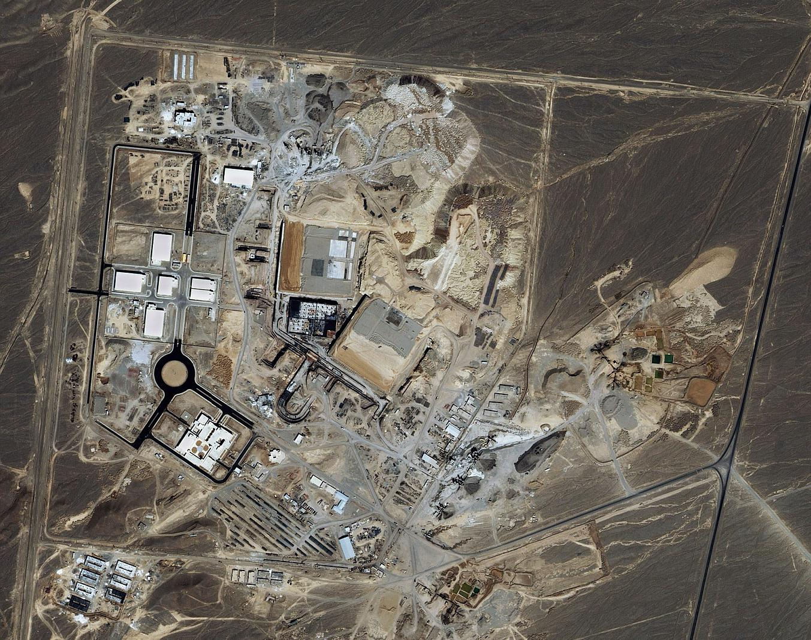
What happened?
The Natanz nuclear enrichment complex in Natanz, Iran, was hit by a sophisticated cyber attack between 2007 and 2010. This multi-national attack, allegedly carried out by the United States, Germany, France, Denmark, Israel, and Great Britain, caused catastrophic damage to the facility’s centrifuges (Reuters, 2021).
The ultimate goal was to stall the enrichment process for diplomatic reasons, resulting in the destruction of about a fifth of Iran’s uranium enrichment capabilities.
Notes:
- The Stuxnet attack aimed not at total destruction but at strategic disruption. By delaying Iran's uranium enrichment, the attackers hoped to buy time for diplomatic solutions. This cyber weapon set a historical precedent as the first known malware to cause real-world physical damage to industrial infrastructure.
- The picture is a surveillance photograph of the Natanz Nuclear Facility

Slide 3
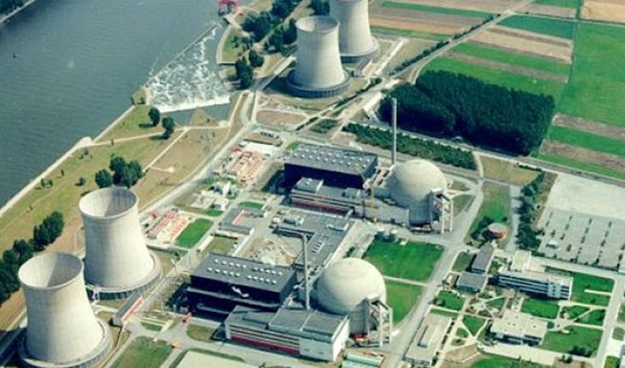
Where did the attack take place?
The Bushehr power plant was initially believed to be a primary target, but the Natanz Enrichment Facility was ultimately the main focus (Iran Watch, 2002).
Operated by members of the Atomic Energy of Iran and the Islamic Revolutionary Guard, Natanz is Iran’s primary location for nuclear material enrichment (Wikipedia, 2020).
Personal computers of workers at the Bushehr power plant were also infected during the attack.
Notes:
While early reports speculated that the Bushehr power plant was the main target, investigations revealed that Natanz, Iran’s primary uranium enrichment facility, was the actual focus. The infection of personal computers at Bushehr was likely collateral damage, showcasing how malware can unintentionally spread. Natanz’s critical role in Iran’s nuclear program made it the ideal target for the Stuxnet worm.
As of today, the only facility in all of Iran that is technically allowed to continue enrichment operation is Natanz, although future plans of expansion are unknown.

Slide 4
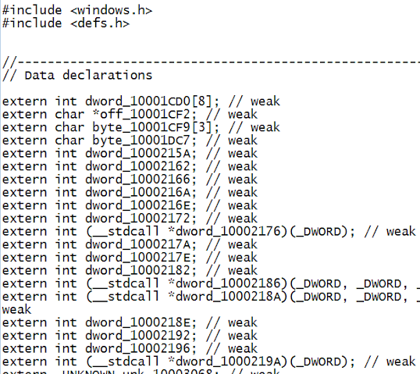
What is the Stuxnet Worm?
Cyberweapon allegedly developed by the United States and Israel.
Originally thought to be developed around 2005.
It was designed to target SCADA systems (Supervisory Control and Data Acquisition systems) (Zetter, 2015).
It has widely believed that this is the worm that is responsible for the cyber attack that caused extreme damage to the Iranian nuclear program.
Notes:
Picture is sample code from the actual worm.
Stuxnet was revolutionary because it demonstrated how cyberattacks could cause physical destruction. By targeting SCADA systems that controlled the centrifuges at Natanz, it exposed vulnerabilities in critical infrastructure that could be exploited in future conflicts.

Slide 5
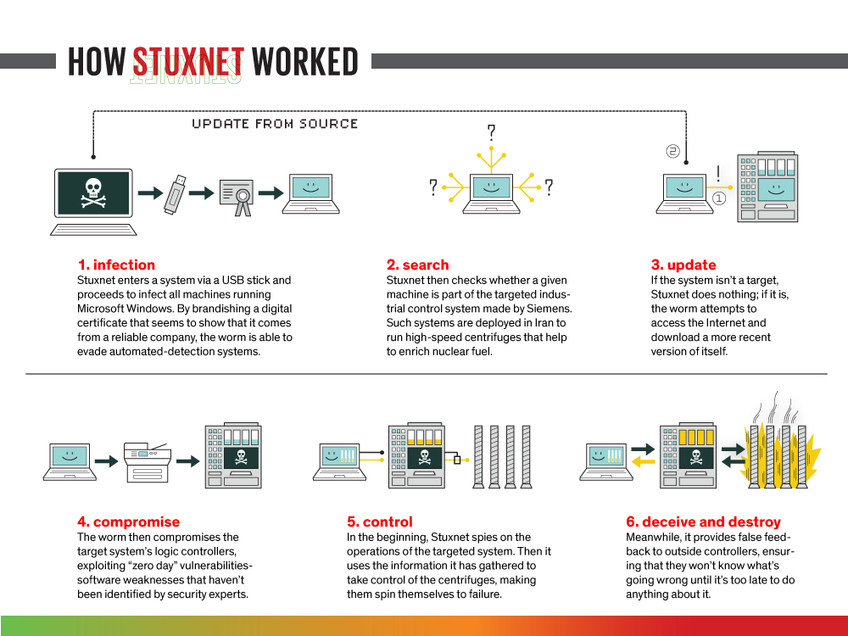
How does it work?
The worm is an unusually complex program.
Likely took a team of very experienced individuals to develop such a complicated program.
It specifically targets programmable logic controllers using zero-day flaws and focuses on Microsoft operating systems and Siemens Step 7 software (Zetter, 2015).
Programmed to remain undetected by traditional means.
Notes:
- Programmable Logic Controllers work by allowing automation of electronic and mechanical processes.
- Stuxnet’s complexity came from its use of four zero-day vulnerabilities, making it nearly impossible to detect before it was too late. Its stealthy approach allowed it to manipulate the centrifuges while feeding normal data back to operators, leaving no immediate signs of sabotage.
- Zero day flaws are issues with software, hardware and firmware that are not immediately apparent upon release. This means that there can be a length of time before a fix is implemented.
- The worm was just a half megabyte in size!

Slide 6
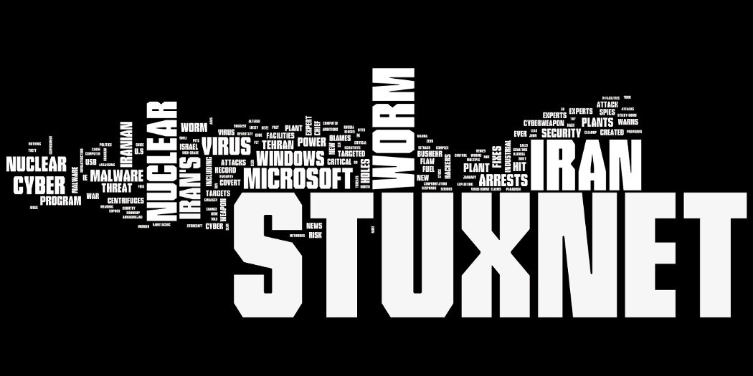
Who was involved?
No one has openly admitted to being involved in the attack or development of the worm.
However, it is widely accepted that Stuxnet was developed by the United States and Israel (Zetter, 2015).
Developed under the code name “Operation Olympic Games”. Development took place between at least two US presidents.
Individual software engineers have never been identified. Although many believe it was at least a small group.
Involvement of intelligence agencies such as the NSA and Israel's Unit 8200 has been suggested (Wired, 2011).
Notes:
- Operation Olympic Games is a covert and still fairly denied sabotage campaign that was directed at Iran.
It is significant because it signifies the first known use of a cyber super weapon. A successful one at that.
- The operation, code-named “Operation Olympic Games,” reportedly began under President George W. Bush and was continued under President Barack Obama (Zetter, 2015).

Slide 7
Why was this attack developed and carried out?
Iran was believed to be in the early stages of acquiring materials to build nuclear weapons (Reuters, 2021).
Other counties have sought to prevent the spread of Nuclear Proliferation.
Iran had made many political threats in the past towards the United States and her allies.
Iran had also violated treaties regarding nuclear enrichment (Wikipedia, 2020).
Notes:
Nuclear Proliferation is the spread of nuclear weapons, fissionable material and weapons grade building materials.

Slide 8
When did this attack occur?
General consensus is that the attacks occurred between 2007-2010
Notes:
The actual time has not been established clearly. There were on going investigations of when certain personal computers were hit but not exact dates of when the enrichment facilities started noticing something was wrong.

Slide 9
How was the attack carried out?
The attack was introduced using USB devices due to the facility’s air gap, which prevented typical network infections (The Hacker News, 2011).
This meant that the attack had to be carried out by a person. Either willing to do it or doing it unknowingly.
Once inside, the Stuxnet worm infected the internal control network and used a man-in-the-middle attack to deceive monitoring systems (Hacker Noon, 2019).
It was never meant to spread to the internet but it did.
Notes:
- Air Gap means that a system has no connection to the external internet. It operates on its own network. Generally speaking, there is a physical gap in the network.
- It is believed that an insider—whether knowingly or unknowingly—introduced the infected USB into the network. Once inside, Stuxnet used a man-in-the-middle attack to intercept and modify data sent between the centrifuges and the control systems, masking the malicious actions while physically damaging equipment.

Slide 10
How was the attack carried out? –cont.
After the Stuxnet worm successfully breached the air gap, the internal control network for the centrifuges became infected.
The Stuxnet used a man-in-the-middle style attack to trick the operation systems from realizing that there was a problem. When the system tried to send the warning messages, the Stuxnet used a loop back capability to display false information thus avoiding detection.
Stuxnet manipulated the speed of the centrifuges, causing them to spin at dangerous rates before slowing down suddenly. This cycle of acceleration and deceleration caused stress fractures, leading to mechanical failures (Hacker Noon, 2019).
There was no way to diagnose why the centrifuges were breaking down.
Notes:
- Man in the middle attack is an attack in which a threat actor positions himself in the middle of a conversation, usually between a user and a program or application. Their mission is to either listen in for information or become an imposter in order to trick the user into giving up sensitive data.
- The brilliance of Stuxnet lay in its subtlety. By varying the speed of the centrifuges in a controlled but destructive manner, it caused gradual damage without triggering immediate alarms. Meanwhile, the control system displayed normal readings to operators, preventing any quick diagnosis of the real issue. This delayed Iran’s ability to detect the sabotage, extending the effectiveness of the attack.

Slide 11
Unintended Consequences.
Stuxnet eventually spread beyond its intended target. It is believed that an infected USB or laptop left the facility, unintentionally releasing the worm into the wild (Wired, 2011).
It is speculated that this occurred the same way the original attack did. There was an infected laptop or USB device that left the facility and connected to an outside network somewhere else.
Affected countries include, Iran, Indonesia, India, Azerbaijan, United States, Pakistan and more.
More advanced Malware was created in the aftermath after Stuxnet was studied in-depth.
Notes:
- Flame, Duqu and Triton are thought to be related to Stuxnet and have been encountered in the real world already.
- Though designed to be contained, Stuxnet’s complexity led to unintended consequences. It spread when an infected USB or laptop left the Natanz facility and connected to an outside network. This accidental release allowed cybersecurity experts to capture, study, and dissect the worm. Its release into the public domain marked a turning point in cyber warfare, as its code became available for analysis, leading to the evolution of similar, more aggressive malware strains.

Slide 12
Further actions taken and reactions to Stuxnet
Iran publicly condemned the attack as an act of cyber warfare and intensified its focus on cybersecurity, establishing a dedicated team to prevent future incidents (Cryptome, 2010).
Iran had since then built a team of cyber security experts tasked with training and preventing future attacks. Possibly even being able to launch attacks in the future.
Notes:
- Iran’s response was twofold: improving its defensive cybersecurity capabilities and potentially developing its own offensive strategies. The incident deepened tensions with the United States and Israel and sparked debates about the ethical use of cyber weapons. Many nations viewed Stuxnet as a wake-up call, realizing that industrial systems worldwide could be vulnerable to similar attacks.

Slide 13
Conclusion.
Stuxnet is easily one of the most powerful cyber attacks to date. It was designed by some of the most knowledgeable programming experts in the world. The planning and execution that went into this operation is shrouded in so much secrecy, the world may never know who had a hand in it.
Even though the worm has been heavily scrutinized by experts across the world now, they still don’t know who made it. That is the most important piece of the puzzle. This kind of cyber attack could be weaponized again, against other targets if necessary, so long as the same kind of people are working on the operation. This operation highlights just how important the future of Cyber Security really is.
Notes:
- Stuxnet’s legacy lives on in modern cybersecurity. It serves as a case study in both the power and risks of cyber weapons.
- While it achieved its intended goal, the unintended consequences remind us that cyber warfare can have far-reaching effects. As technology evolves, so too must the strategies to protect critical infrastructure from similar threats.

Slide 14
Works Cited
Cryptome. (2010). Natanz uranium enrichment complex, Iran, 2002–2010.
http://cryptome.org/eyeball/natanz/natanz.html
FAS. (ca. 2005). Bushehr nuclear power plant. Federation of American Scientists.
https://nuke.fas.org/guide/iran/facility/siemens_pwr_bilbis_a.jpg
Hacker Noon. (2019, July 31). Stuxnet, or how to destroy a centrifuge with a small piece of code.
https://hackernoon.com/stuxnet-or-how-to-destroy-a-centrifuge-with-a-small-piece-of-code-66se283f
The Hacker News. (2011, July 19). Stuxnet source code released online - download now.
https://thehackernews.com/2011/07/stuxnet-source-code-released-online.html
IEEE Spectrum. (2015, February 26). The real story of Stuxnet.
https://spectrum.ieee.org/the-real-story-of-stuxnet
Iran Watch. (2002, September). Natanz enrichment facility 2.
https://www.iranwatch.org/sites/default/files/Natanz-092002.jpg
Reuters. (2021, October 25). Iran feeds highly enriched uranium into more machines at Natanz, IAEA says.
https://www.reuters.com/world/middle-east/iran-feeds-highly-enriched-uranium-into-more-machines-natanz-iaea-2021-10-25
Wikipedia. (2020, April 3). Natanz. Wikimedia Foundation.
https://en.wikipedia.org/wiki/Natanz
Wired. (2011, February 11). Stuxnet: Five main targets.
https://www.wired.com/2011/02/stuxnet-five-main-target/
Zetter, K. (2015). Countdown to Zero Day: Stuxnet and the launch of the world’s first digital weapon. Broadway Books.

