Slide 1


2022
Web3BBS
make exposure fairly

Slide 2
problem
Monopoly
Web2 Giant
The giants make the internet convenient, then, they own the internet.
Twitter
Instagram
Facebook
Google
Youtube
7k
92k
23k
724k
3,456k

Slide 3
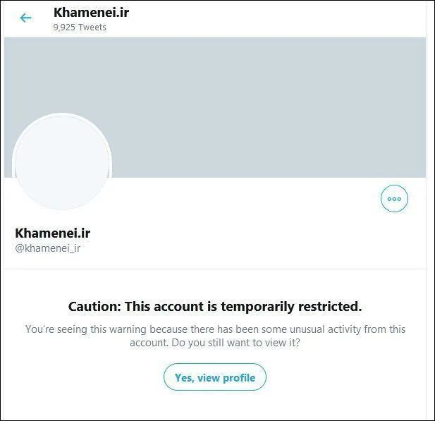
problem
In 2021, twwiter "temporarily restricts" Iran 's highest leader Hamenei account, so that it cannot vote.
delete speech
Facebook and Instagram also began to delete many speech that supported Iran.
forbidden
no way
Iran try to communicate Instagram, but no way.
No One
Hear U
PART I

Slide 4
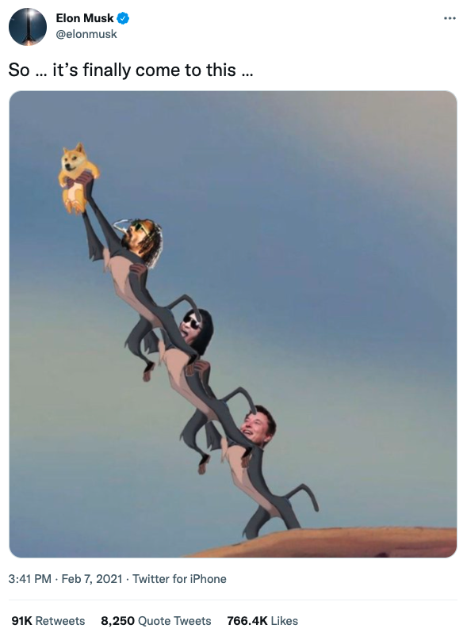
problem
hot
what ever Elon say, each speech of Elon's will be read more than 100K.
hot speech
cold
what ever u say, each speech of yours will be read less than 100.
They Hear
The KOL
PART II

Slide 5
purpose
Dapps
we need
A Web3 BBS
Smart
Contract
Economy
1.Accounts and contents can't be delete (on Chain)
2.Every content has fair exposure (smart contract)
3.Dapp lego (SocialFI)
4.Token Economy
Web3
onChain

Slide 6
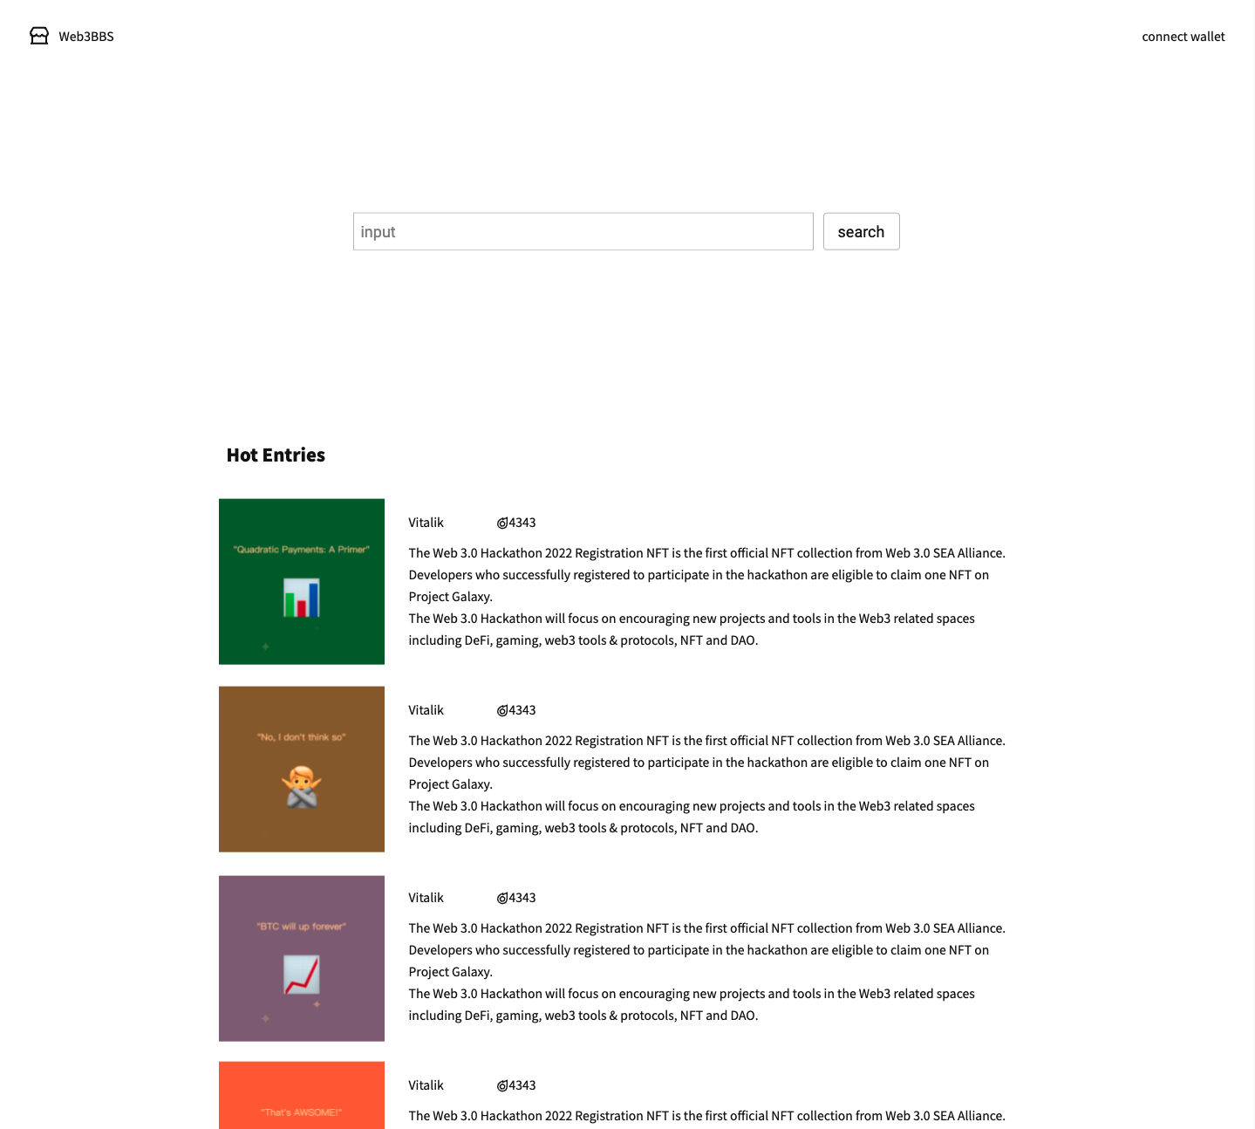
preview
Home page
Every entry is a NFT, mint by user.
Hot = Like.
The hot value of entry is auto calculate in smartcontract.
The only way to change hot value is pointing, which means people hold their stablecoin to point to the NFT, rather than move the currency.

Slide 7
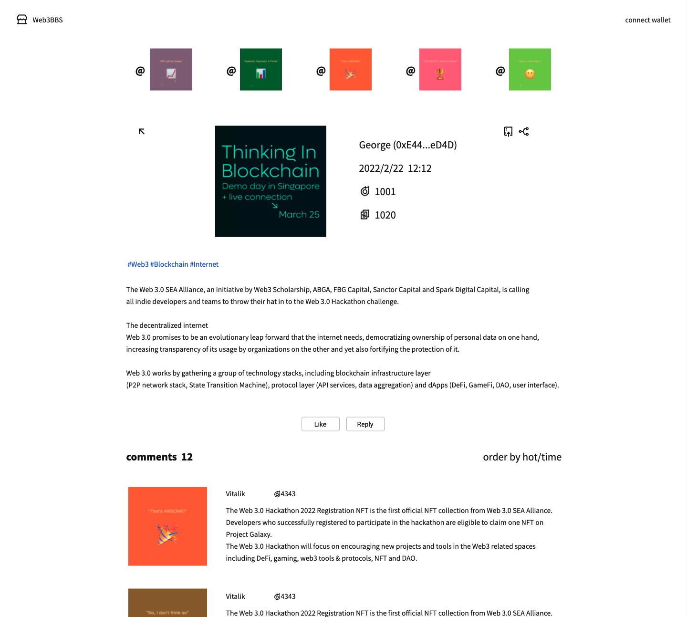
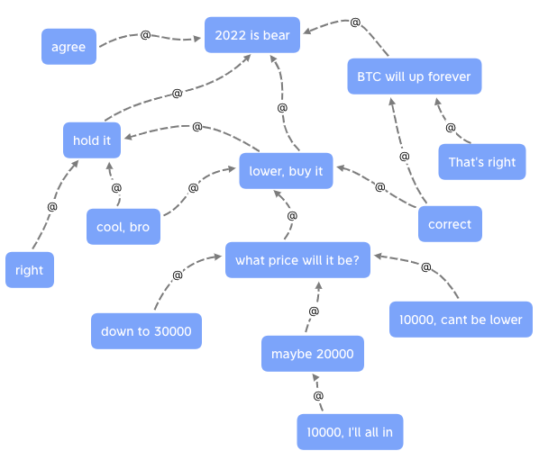
preview
Entry page
Entry can @ other entries.

Slide 8
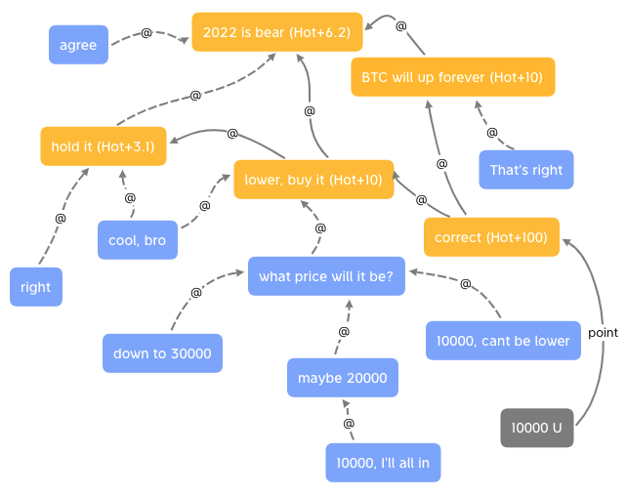
preview
Entry page
Entry can @ other entries.

Slide 9
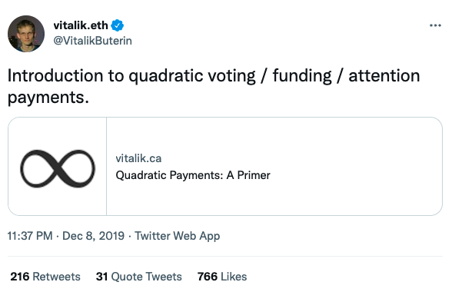
preview
Entry page
Entry can @ other entries.
https://vitalik.ca/general/2019/12/07/quadratic.html

Slide 10
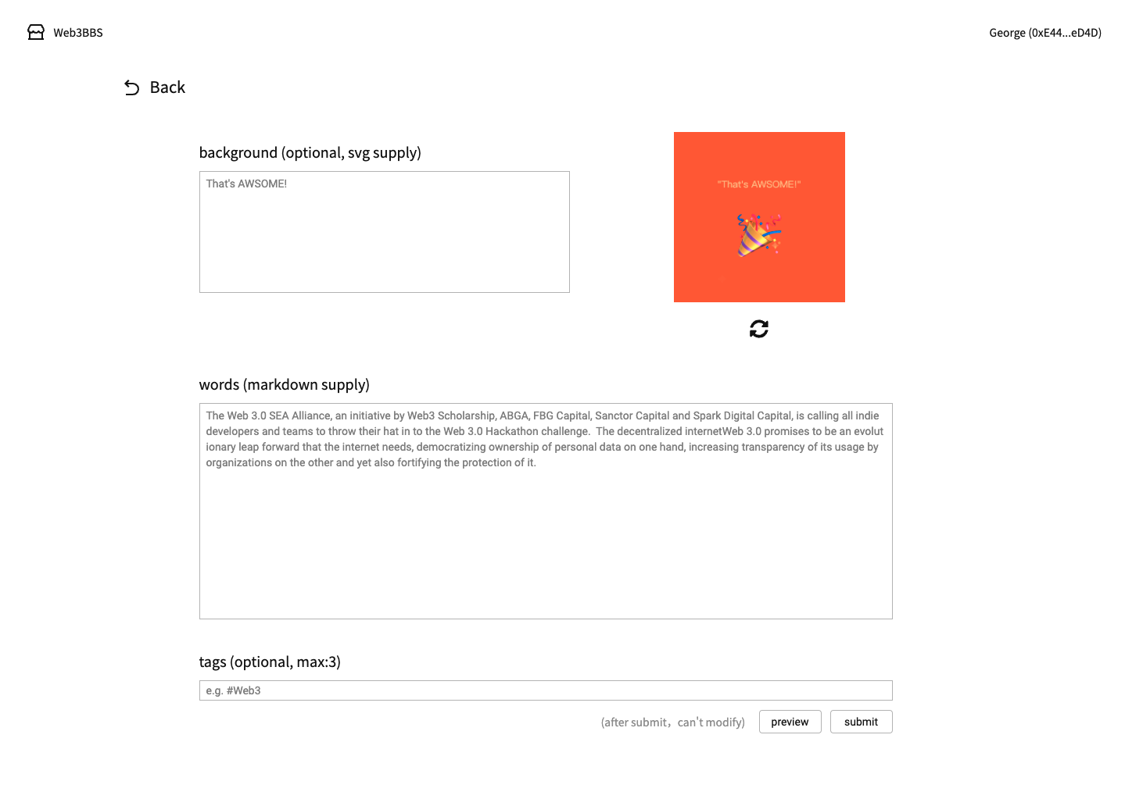
preview
Mint page
Supply PNG/JPG/SVG.
or Text.

Slide 11
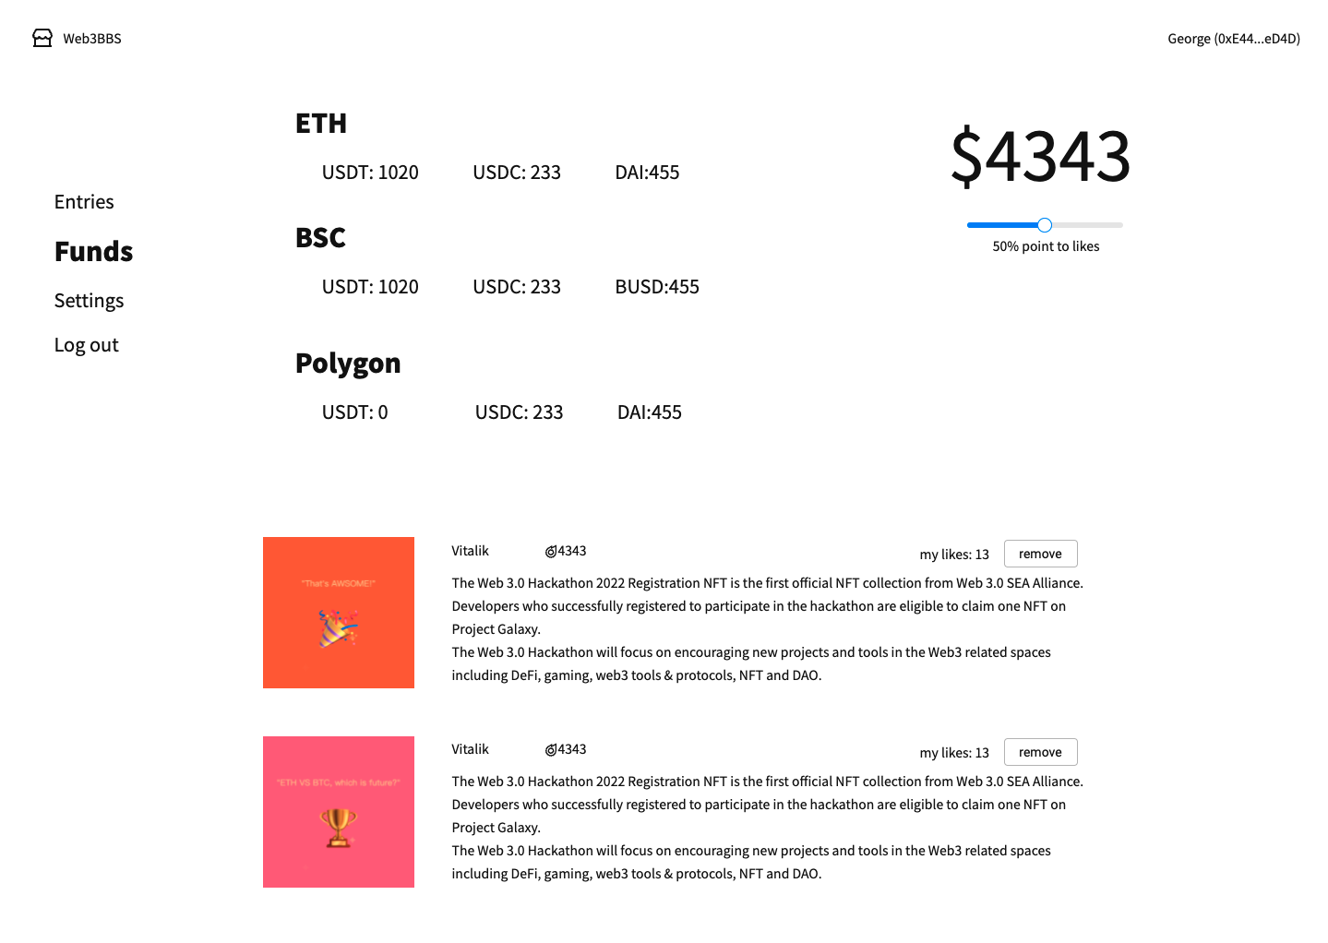
preview
Funds page
Hold stablecoin to point to the entry NFT.
More stablecoin, more power.
Safe, without approving or staking.

Slide 12
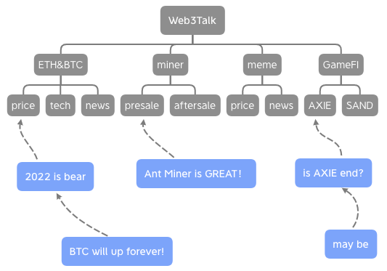
SocialFI
base on Entry NFT
A Standar BBS
Entry NFTs can use to be sections、posts and replies.
Push the author's other entrise, it'll be Web3 Twitter.

Slide 13
SocialFI
Web3
Community
base on Entry NFT
Web3
News
Dapps LEGO
Web3
Raddit
Write once, show everywhere.
For user, one entry NFT can mined multiple tokens.
For dapp, with many entry NFTs, it'll launch much easier.
Web3
Twitter
Web3
BBS
Entry
NFT

Slide 14
Technical
Blockchain
Solidity
02
Solidity
01
Blockchain
Build a no gas fee chain.
AR or IPFS to save contents.
Entry NFTs.
EVM Wallet to login.
03
Oracle
Oracle
RPC&Backend
START
Get stabelcoin data from ETH\BSC\Polygon, and set to our chain.
Analyse contract data.
Data reading much faster.
04
RPC&Backend

Slide 15
Timeline
2022
2022
2022
S1
S2
S3
POC
TEST
LAUNCH
Proof Of Concept
Very similar to the launch version
Everything goes well!

Slide 16
2022
谢谢观看
THANK YOU
https://github.com/Web3BBS 85392015@qq.com

