Slide 1


2022
METAPO
make exposure fair
Notes:
大家好，我来介绍一下METAPO。一个Web3社交网络，通过公平的曝光量算法，建立SocialFI。
Hello everyone, let me introduce METAPO. A Web3 social network, through a fair exposure algorithm, to build SocialFI.

Slide 2
problem
Monopoly
Web2 Giants
The giants made the internet convenient, and then, they owned the internet.
Twitter
Instagram
Facebook
Google
Youtube
7k
92k
23k
724k
3,456k
Notes:
众所周知，我们当下的Web2已经被巨头垄断，他们让互联网便利，然后，他们拥有了互联网。
As we all know, our current Web2 has been monopolized by giants, they made the Internet convenient, and then they owned the Internet.

Slide 3
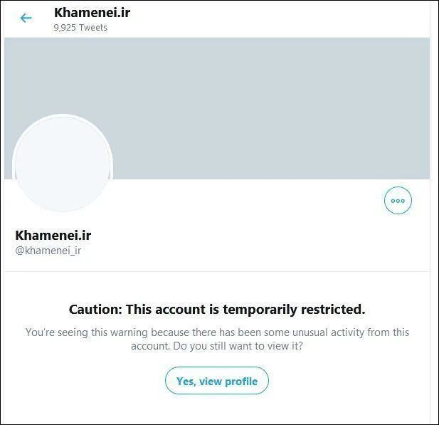
problem
In 2021, twwiter "temporarily restricts" Iran 's highest leader Hamenei account, so that it cannot vote.
delete speech
Facebook and Instagram also began to delete many speech that supported Iran.
forbidden
no way
Iran try to communicate Instagram, but no way.
No One
Hears U
PART I
Notes:
那么问题来了，2021年，twwiter暂时限制了伊朗最高领导人的账户，让他无法发声。Facebook和Instagram也删除了很多支持伊朗的言论，在这种情况下，我们听不到伊朗的声音。当前，俄罗斯也遭到了同样的待遇。今天是俄罗斯，明天可能就是你和我。这是问题的第一部分，没人听你。
So here comes the problem. In 2021, twitter "temporarily restricts" Iran's highest leader account, so that it cannot vote. Facebook and Instagram have also removed many speech that supported Iran, and in that case, we don't hear Iran's voice. Russia is currently being treated the same way. Today is Russia, tomorrow may be you and me. This is part I of the problem, no one hears you.

Slide 4
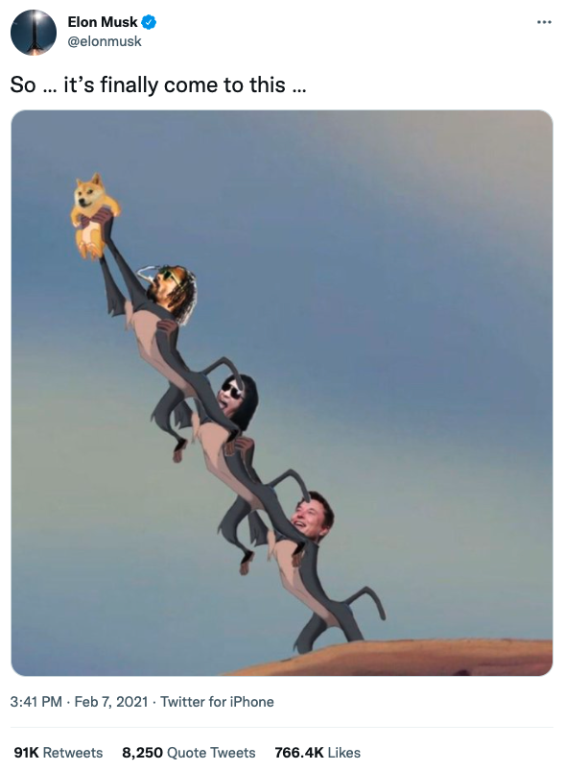
problem
hot
what ever Elon say, each speech of Elon's will be read more than 100K.
hot speech
cold
what ever u say, each speech of yours will be read less than 100.
They Only
Hear KOLs
PART II
Notes:
问题的第二部分，他们只听KOL的。这是马斯克发的一条推特，被转发了91000次。他说在他们几个KOL的宣传下，狗狗币终于飞向月球。这就是twwiter的热门言论，有什么深刻见解吗？我不这么认为。事实上，无论马斯克说什么，他的每句话都有10000人以上读过，而无论你说什么，哪怕深刻的见解，都不会有超过100人读。是的，我说的就是我自己，以及大部分跟我一样的人。
Part II of the problem, they only hear KOLs. This is a tweet from Musk that has been retweeted 91,000 times. He said that under the promotion of several of their KOLs, Dogecoin finally to the moon. This is the hot on twitter, any insights? I don't think so. In fact, what ever Elon say, each speech of Elon's will be read more than 100K, and what ever u say, each speech of yours will be read less than 100. Yes, I'm talking about myself, and most people like me.

Slide 5
purpose
Dapps
we need
A Web3 Social
Smart
Contract
Economy
1.Accounts and contents can't be deleted (on chain)
2.Every content has fair exposure (smart contract)
3.Dapp lego (SocialFI)
4.Token Economy
Web3
onChain
Notes:
所以我们需要一个Web3社交网络，这个世界需要一个Web3社交网络。它应该满足以下几点：1.账户和内容都不能被删除，应该记录在区块链上；2.每个内容都能得到公平的曝光，我们用智能合约来实现这一点；3.Dapp乐高，像DEFI一样的SocialFI；4.通证经济，其实，我们认为如果没有通证经济，Metapo就跑不下去的话，那就是有问题的。所以我们早期并没有发币计划，而是希望通过项目迭代，发现及解决潜在问题，让项目在没有代币的情况下也能跑下去。不过我们也支持建立在Metapo之上的其他项目有他们的通证，即SocialFI。
So we need a Web3 social network, the world needs a Web3 social network. It should have the following points: 1. Neither account nor content can be deleted, they should be recorded on the blockchain; 2. Every content has fair sxposure, we use smart contracts to achieve this; 3. Dapp Lego, SocialFI like DEFI; 4. Token economy, in fact, we think that if without token economy, Metapo may fail, then there must be something wrong. Therefore, we did not plan for token offering in the early stage, but hoped to find and solve potential problems through project iteration, so that the project can run without token economy. However, we also support other projects built on Metapo to have their token, as SocialFI.

Slide 6
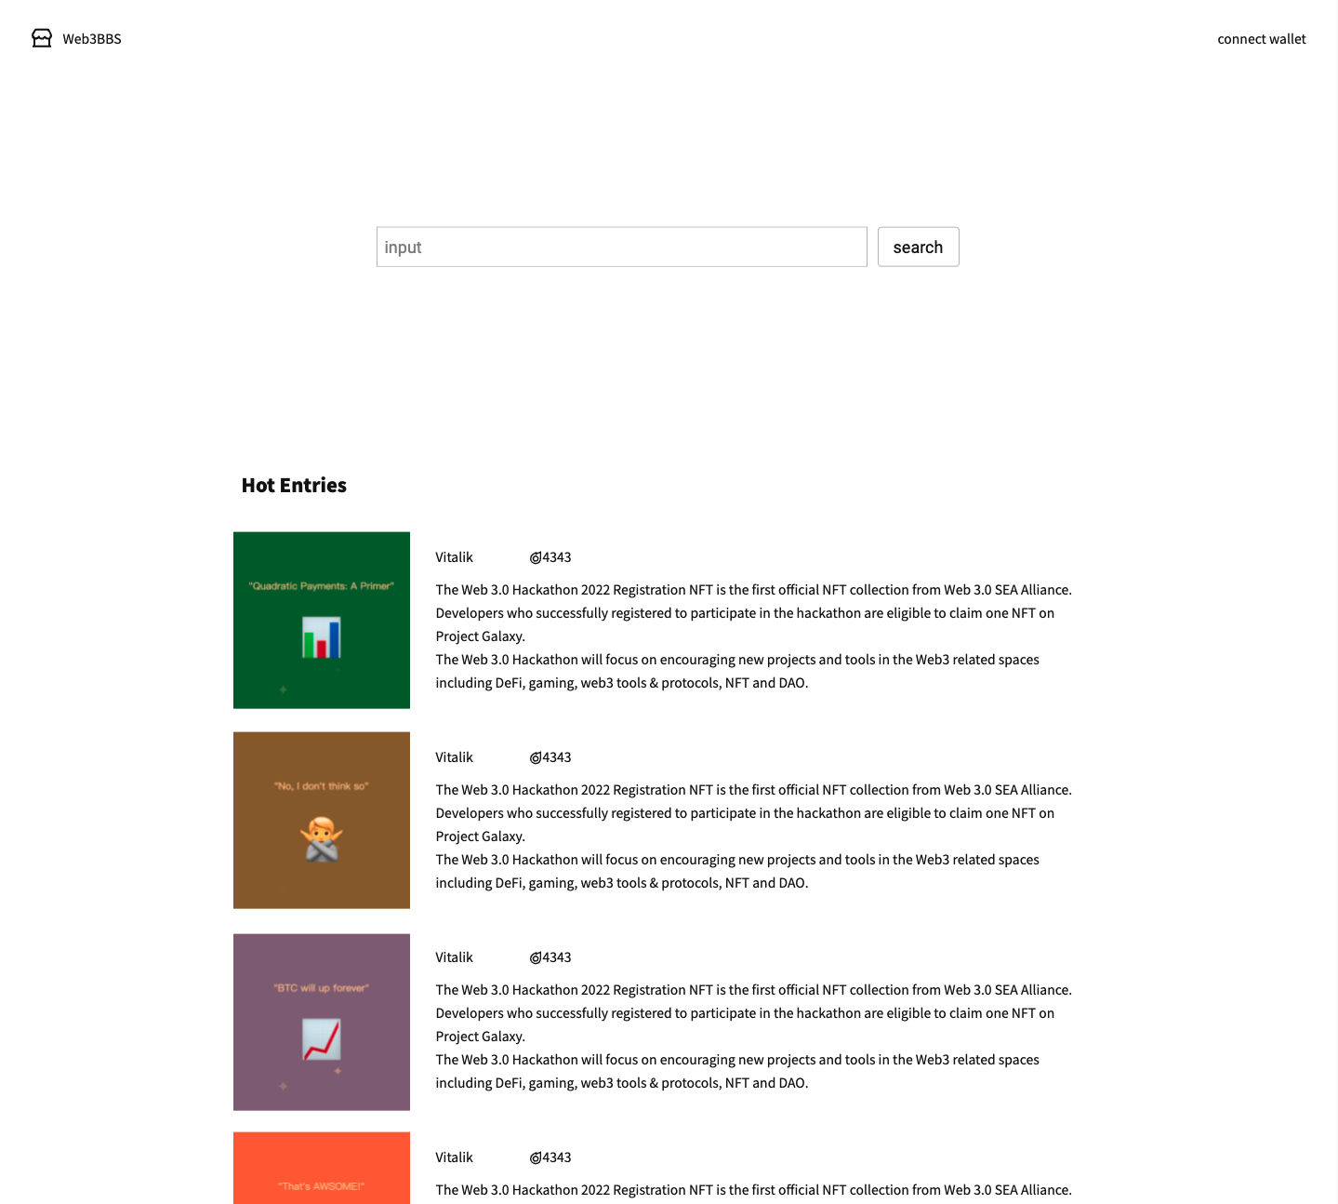
preview
Home page
Every entry is an NFT, mint by user.
Hot = exposure.
The Hot value of entry is auto calculate in smart contract.
The only way to change Hot value is pressing the Like button.
Notes:
这是Metapo的预览，首页有点像google，用来搜索帖子。每个帖子是一个NFT，由用户铸造，Mirror把这样的帖子叫做Entry，好吧，那我们也这么叫。排名是按照热度值排的，热度即曝光量。由于热度值是在智能合约里计算出来的，所以唯一能改变热度值的办法就是用户点击喜欢按钮，下面我将详细介绍这种算法。
This is a preview of Metapo, the homepage looks like google for searching posts. Each post is an NFT, minted by user, Mirror calls such a post an Entry, well, then we call it that too. The ranking sorts by the Hot value, Hot is exposure, which is calculated in the smart contract, so the only way to change the Hot is for the user to click the like button. I will introduce this algorithm in detail below.

Slide 7
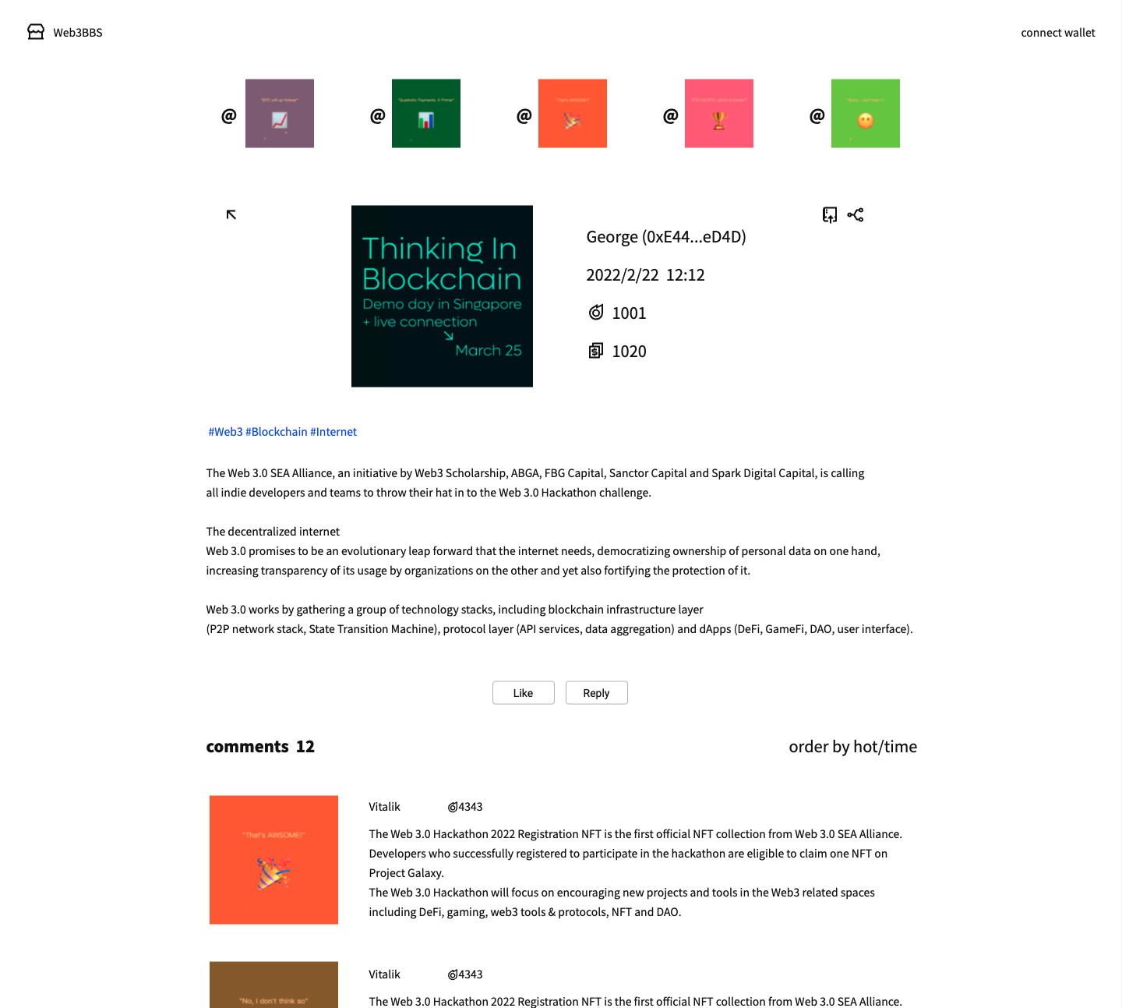
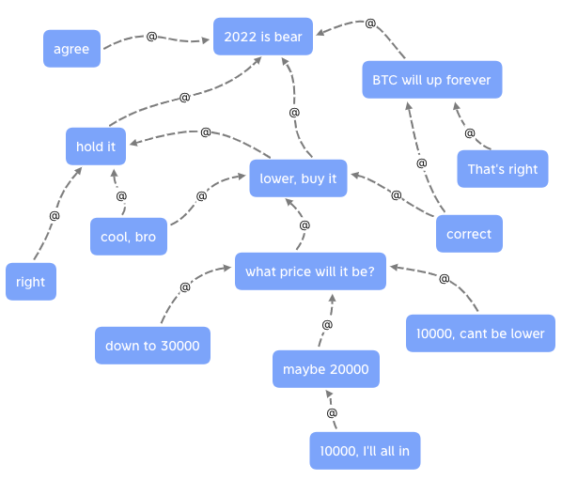
preview
Entry page
Entry can @ other entries.
Notes:
这是Entry页面，Entry可以@其他Entry，这样，每个Entry都是对其他Entry的评论，如页面上方所示，你可以同时@多个Entry，即评论别人的评论。下方就是@了你这条Entry的其他Entry，作为评论。如右图所示，我们得到了一个Entry图，它很像圆桌会议或是高峰论坛，我们用内容之间的关联取代人之间关联，突出内容本身，那么问题来了，如何突出那些精彩的内容？
This is the Entry page, Entry can @ other Entry, in this way, each Entry is a comment on other Entry, as shown at the top of the page, you can @ multiple Entry at the same time, that is, comment on other comments. Below is the other Entry that @ your entry, as comments. As shown on the right, we get a comment map, which is very similar to a roundtable or a summit forum. We make the relationship between contents instead of the relationship between people, and highlight the content itself, then the question is, how to highlight those wonderful contents?

Slide 8
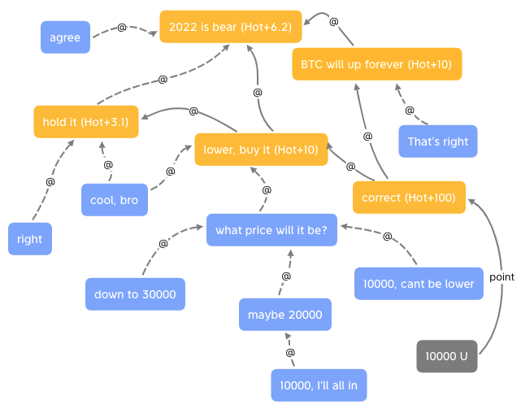
preview
Entry page
Hot added to up and up.
Notes:
比方说，我创建10000个账号，然后全都评论了我自己的一个Entry，那么我的这条Entry是不是很热门？当然不是，我们借鉴了DEFI里的抵押规则，大家用钱投票！开个玩笑，不过很类似，我们通过预言机把用户的稳定币数量映射到Metapo，比方说你有5000USDT在ETH，5000BUSD在BSC，那么在Metapo，你就有10000票可以投，完全不会动到你的资产。假设你投了10000票给correct这个Entry，黄色那个，那么它@的Entry也会增加Hot，上线的上线也会增加Hot，不过Hot的增加值是递减的。我们认为，如果某个Entry本身没多少票，但是它带来了很多投票，那么它也是有价值的。
For example, I create 10,000 accounts, and all of them comment on one of my Entries, so is this entry of mine very popular? Of course not, we borrowed the staking rules as in DEFI, and everyone voted with money! Just kidding, but very similar, we use the oracle to point the number of users' stablecoins to Metapo. For example, if you have 5,000 USDT in ETH and 5,000 BUSD in BSC, then in Metapo, you have 10,000 votes to vote, and your money will not move at all. Suppose you vote 10,000 for the correct Entry, the yellow one, then its @ Entry will also increase the Hot, and increase up and up, but the increase value of the Hot is decreasing. We believe that if an Entry itself doesn't have many votes, but it brings in a lot of votes, then it's also valuable.

Slide 9
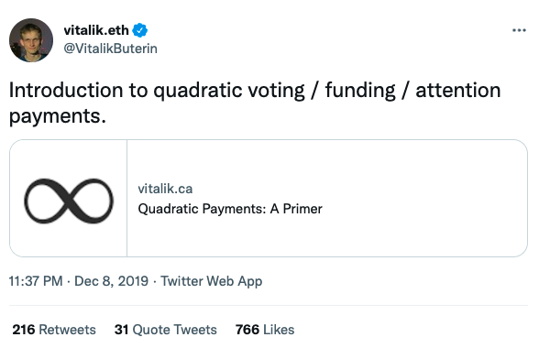
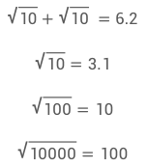
preview
Entry page
Using quadratic voting.
$$\sqrt{10}+\sqrt{10} =6.2$$
$$\sqrt{10}=3.1$$
$$\sqrt{100}=10$$
$$\sqrt{10000}=100$$
https://vitalik.ca/general/2019/12/07/quadratic.html
Notes:
根据Vitalik介绍的二次方投票算法，10000的投票，取二次方根得到100，所以Entry的Hot增加100，correct之上的，Hot增加10，即100的二次方根，再往上，Hot增加3.1，即10的二次方根，最上面的增加了6.2，是因为有两个Entry指向了它。这就是二次方投票，它大幅削弱了票数的影响力，平衡了人数和票数的关系，让Hot不容易被巨鲸控制，也不会被一堆的小号控制。在这基础上，可能发展出很有意思的东西，比如写作即挖矿之类的通证经济，不过正如我开头所说的，Metapo还没有这个计划，其他建立在Metapo之上的项目可以这么做。
According to the quadratic voting algorithm introduced by Vitalik, for 10,000 votes, take the quadratic root to get 100, so the Entry's Hot increases by 100, above the Entry, the Hot increases by 10, that is, the quadratic root of 100, and then goes up, Hot increased by 3.1, which is the quadratic root of 10, and the top increased by 6.2 because there were two Entries points to it. This is quadratic voting, which greatly weakens the influence of votes, balances the relationship between the number of people and the number of votes, and makes Hot not easy to be controlled by the whales, and it cannot be controlled by alts of one person. On this basis, interesting things may be developed, such as token economy, writing as mining, but as I said at the beginning, Metapo has no token plan at present, but other projects built on Metapo can do so.

Slide 10
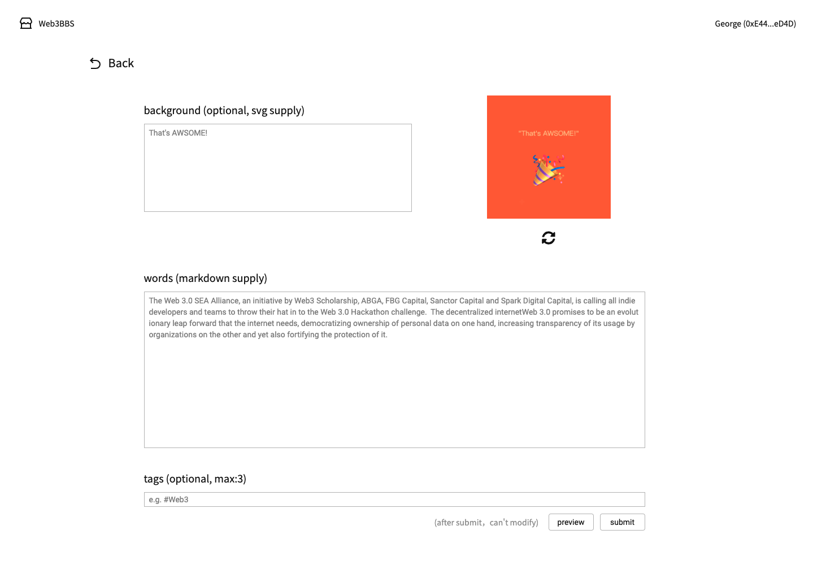
preview
Mint page
Supply PNG/JPG/SVG.
or Text.
Notes:
我们看一下发表Entry的页面，上面的部分是自定义缩略图，就像youtube的视频缩略图一样，作为NFT的图像，支持PNG、JPG和SVG，如果你只填了文字，系统将自动生成图像。下面的部分是内容。当你点submit按钮的时候，内容将上传至AR，然后在合约里生成NFT，并绑定对应的AR地址。
Let's take a look at the mint page. The upper part is a custom thumbnail, just like the YouTube video thumbnail, as an NFT image, PNG, JPG and SVG are supported. If you only fill in the text, the system will automatically generate an image. The downed part is the content. When you press the submit button, the content will be uploaded to AR, and then NFT will be minted and bound to the AR address.

Slide 11
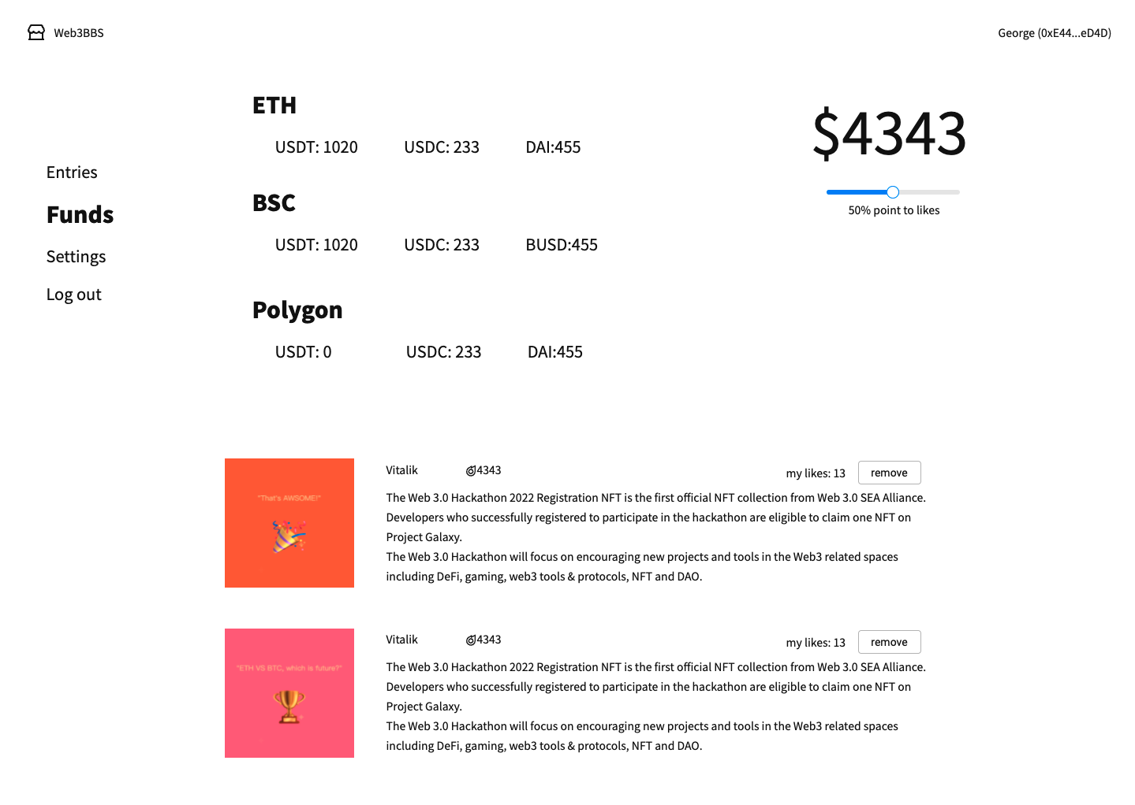
preview
Funds page
Holding stablecoin to point to the entry NFT.
Money is power.
Safe, without approving or staking.
Notes:
在资产页面，我们可以看到我们在其他链上有哪些稳定币，数值的总额通过预言机同步到Metapo。不需要授权或者抵押，很安全，你只需要登入，就拥有了Metapo balance，用来给喜欢的Entry投票。你可能会问，如果我把USDT转给我的小号，那我是不是有双份的Metapo balance？不会，因为Metapo balance是动态的，会随着你稳定币资产而变化，当你转移USDT时，你的Metapo balance也会变少。对于加密货币用户来说，这很棒！我们知道在DEFI，由于各种安全漏洞和危险操作，你的钱还是你的钱吗？这不止是个提问而且是个问题，但是在SocialFI，你依然拥有金钱的力量，并且，你的钱还是你的钱。
On the Funds page, we can see how many stablecoins we have on other chains, and the total value is synchronized to Metapo through the oracle. Without approving or staking, it is safe, you only need to log in and you will own a Metapo balance, to vote for your favorite Entry. You may ask, if I transfer USDT to my alt account, do I have a double Metapo balance? No, because the Metapo balance is dynamic and will change with your stablecoin, when you transfer USDT, your Metapo balance will also decrease. for cryptocurrency users, that is great! We know that in DEFI, due to security bugs and dangerous operations, is your money still your money? That is not only a question but also come to be a problem. But in SocialFI, you still own the power of money, and your money is still your money.

Slide 12
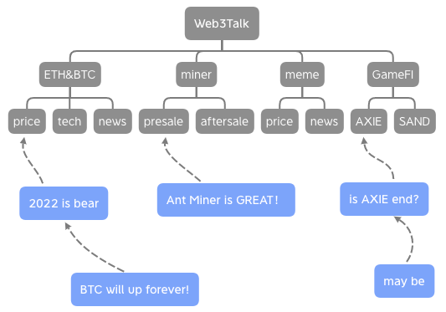
SocialFI
base on Entry NFT
A Web3 BBS
Entry NFTs can be used as sections、posts and replies.
Push the author's other entrise, it'll be Web3 Twitter.
Notes:
基于Entry NFT，可以实现Web3 BBS。图中蓝色Entry作为帖子和回复，灰色Entry作为板块分类，我们得到一个叫作Web3Talk的论坛，把这些论坛组合在一起，那就是Web3Raddit，给用户推送作者的其他Entry，那就是Web3Twitter。
Based on Entry NFT, a Web3 BBS can be builded. In the figure, the blue Entries are used as posts and replies, and the gray Entries are used as sections. then we get a forum called Web3Talk, and combine these forums, that will be Web3Raddit, and push the author's other entries, that will be Web3Twitter.

Slide 13
SocialFI
Web3
Community
base on Entry NFT
Web3
News
Dapps LEGO
Web3
Raddit
Po once, showing anywhere.
For user, one entry NFT can mined multiple tokens.
For dapp, based on many Entries, it will be much easier to launch.
Web3
Twitter
Web3
BBS
Entry
NFT
Notes:
Web3新闻, Web3社区, 等等。形成Dapps乐高，实现Po一次，哪都展示。对用户来说，一NFT多挖，对Dapp来说，基于海量的Entry，项目的启动将会容易很多。尤其是公平的曝光量，让小项目也能被大家看到。如果你是KOL，也欢迎你在Metapo介绍你的项目，让大家评论评论，我相信会有一些有深刻的评论涌现出来，然后大家又可以针对这些深刻的评论展开评论。
The Web3 News, The Web3 Community, and so on. To be the Dapps Lego, Po once, showing anywhere. For user, one NFT can mined multiple tokens, for Dapps, based on many Entries, it will be much easier to launch. Especially fair exposure, so that small projects can be exposured. If you are a KOL, you are also welcome to introduce your project on Metapo. I believe that some interesting comments will come out, and then lots of comments will reply to these interesting comments.

Slide 14
Technical
Blockchain
Solidity
02
Solidity
01
Blockchain
Build a no gas fee chain.
BSC L2 or AVAX subchain
Entry NFTs.
EVM Wallet login.
03
Oracle
Oracle
RPC&Backend
START
Get stabelcoin data from ETH\BSC\Polygon, and set to our chain.
Collect and process contract data.
04
RPC&Backend
Notes:
Metapo的技术架构由4部分组成。1.区块链，我们会搭建一个无gas费的链，可能会用BSC的L2，或者是Avalanche的子链，并且用AR来存储内容；2.Solidity，用于Entry NFT，支持EVM钱包登入；3.Oracle，从ETH、BSC、Polygon上获取稳定币数据，然后写入到我们的链上；4.RPC节点和后端，收集和处理合约的数据。
The technical architecture of Metapo consists of 4 parts. 1. Blockchain, we will build a chain with no gas fee, maybe a Layer2 of BSC, or subchain of Avalanche; 2. Solidity, used for Entry NFT, and EVM wallet login; 3. Oracle, Get stabelcoin data from ETH\BSC\Polygon, and set to our chain; 4. RPC and backend, collect and process contract data.

Slide 15
Timeline
2022
2022
2022
S1
S2
S3
POC
DEV
LAUNCH
Proof Of Concept
We need more developers
Everything goes well!
Notes:
我们计划在今年上线，第一季也就是现在，是POC阶段，概念证明；第二季是开发测试阶段，需要更多的开发者；第三季度上线，希望一切顺利！
We plan to launch this year, season 1, now it is the POC stage, proof of concept; season 2, the development stage, and more developers are needed; season 3, launch! Hopes everything goes well!

Slide 16
2022
谢谢观看
THANK YOU
https://github.com/Web3BBS 85392015@qq.com
Notes:
就这样，谢谢大家！
That's it, thank you!

