Slide 1
AI for Autonomous Agents in Games and Simulations
Computer Science (G400)
Presented by James King
4th February 2014

Slide 2
Outline
This presentation will cover…
Why AI is important for many simulation games
Case study: Ashes Cricket 2013 & Dwarf Fortress
Project scenario
Approaches to be used and compared
Subsumption architecture in action
How will the BDI architecture work?
Comparing approaches
Final recap & questions
Notes:
Before I start, here’s a quick rundown of the main topics I’ll be covering related to my project.
I’ll start by explaining the context of the problem, and looking at a couple of games that exhibit how important well-designed AI is for simulation games.
Next I’ll describe the particular scenario for this project, and discuss my two proposed approaches.
We’ll have a look at how the first approach - a Subsumption architecture - works, then see it in action with a short video.
Following that will be a description of the second approach, which will implement a Beliefs Desires Intentions model. That’s yet to be implemented, although most of its design is done.
The final stage of the project will be an analytical comparison between the two approaches, and I’ll be discussing how I intend to perform that comparison.
And finally I’ll quickly recap what we’ve covered.
So, for the project context…

Slide 3
AI for simulation games
Construction and Management Simulation (CMS) games may involve a large number of autonomous agents that are indirectly controlled by a human player that assigns tasks.
These agents are expected to:
Achieve player-given tasks with reasonable efficiency
Act with self-preservation in mind (when relevant)
Behave naturally with no immersion-breaking actions
Be computationally inexpensive
Notes:
This project focusses on the problems faced when designing AI for strategy games where players indirectly control agents by allocating tasks.
These challenges can be divided into 4 main areas:
Firstly, agents are expected to act autonomously to achieve these tasks and are often required to plan how to do so.
Next, in games where environmental threats or antagonistic agents exist, autonomous self-preservation may be required.
They should avoid jarringly unnatural behaviours. Nothing’s worse than seeing a character trying to walk through a wall.
And they can’t be too performance intensive. Your game may need to support hundreds or thousands of agents within the same environment, and probably isn’t targeted for supercomputers.
Let’s look at a couple of examples that demonstrate how important AI can be for a game’s success…

Slide 4
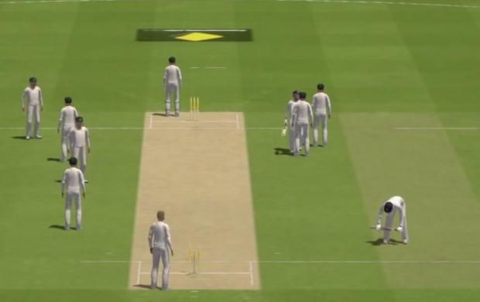
Ashes Cricket 2013
© 2013 505 Games
Notes:
Let’s consider some poorly implemented agent AI first, and its repercussions.
Ashes Cricket 2013 was released in November last year, after being pushed back from a planned June release due to “quality concerns”.
The product that went up for sale was a heavily broken game, with the most evident aspect being terrible AI.
Fielders would repeatedly throw the ball in a cycle or stand around facing each-other, batters would run through other players, the pitcher would spin on the spot without moving their legs…
In terms of the four points I listed on the last slide, it failed at achieving assigned tasks efficiently and behaving naturally.
After a barrage of criticism the game was pulled from sale a few days after release, and is the only instance I can think of where a game was officially cancelled after being released.
The publisher ended up giving full refunds for anyone who bought the game, and the entirety of the game’s development had been a waste.
So that’s how terrible AI can kill a project, but how can exceptional agent AI actively add value?

Slide 5
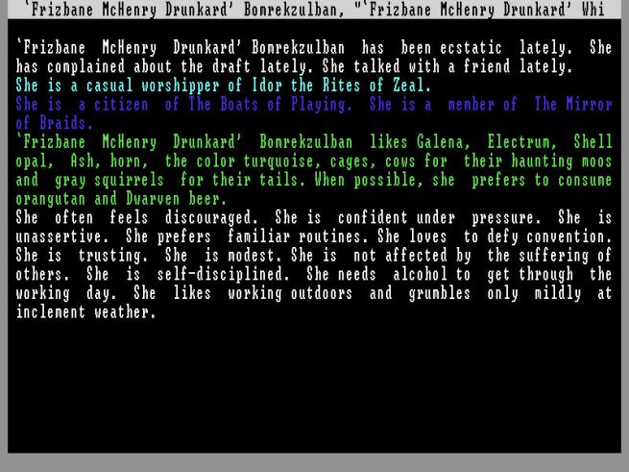
Dwarf Fortress
© 2006-2014 Bay 12 Games
Notes:
Dwarf Fortress is a game about constructing, managing and defending a sprawling underground stronghold.
The player can’t directly affect the world, but must assign tasks and mark designations which are obeyed by a band of dwarves. When the dwarves feel like complying.
This game goes to ridiculous lengths when simulating its agent behaviour. Each dwarf has hobbies, friends, enemies, likes and dislikes, moods, skills, all of which affect whether they will work towards the tasks you assign them or choose to start drunkenly breaking furniture. This complex agent design is the source of much of the game’s value, and leads to interesting and often hilarious incidental behaviour.
In terms of the key expectations from a couple of slides ago:
When the dwarves are satisfied they achieve their tasks efficiency; effectively planning paths to navigate the environment, locating resources when required, and distributing sub-tasks between several agents.
They act with self-preservation in mind by defending themselves from threats and by eating, sleeping and taking time off work when they need to.
Their simulated behaviour convincingly gives the impression of individuals with character and personality, adding immense value to the game.
However, performance sometimes suffers with large numbers of dwarves active, although with such a complex simulation this is to be expected.
So what about my project?

Slide 6
Project scenario - Zombles
Management game built on top of a simulated zombie epidemic.
Procedurally generated city environment
Resources distributed around the city that can be used to construct barricades
Survivors act autonomously, but can be assigned tasks by the player:
  Collect designated resources
  Build a barricade in a specific location
  Navigate to a position
  Purposefully attack a target instead of fleeing
Implementing the survivor AI is the challenge this project will explore.
Notes:
So what’s the exact problem this project aims to tackle?
Around two years ago I started work on a simple strategy game centered around a simulated zombie epidemic, but had to leave it in a state where the zombies were effectively smarter than the human survivors.
The environment is a procedurally generated city, filled with scattered resources that can be used by the agents to construct barricades.
These agents should both be able to act autonomously to increase their chances of survival (by running away from danger, barricading themselves into buildings, and so on), while also obeying tasks assigned by a player.
This project aims to find a suitable implementation for the survivor AI by comparing two conceptually distinct approaches.

Slide 7
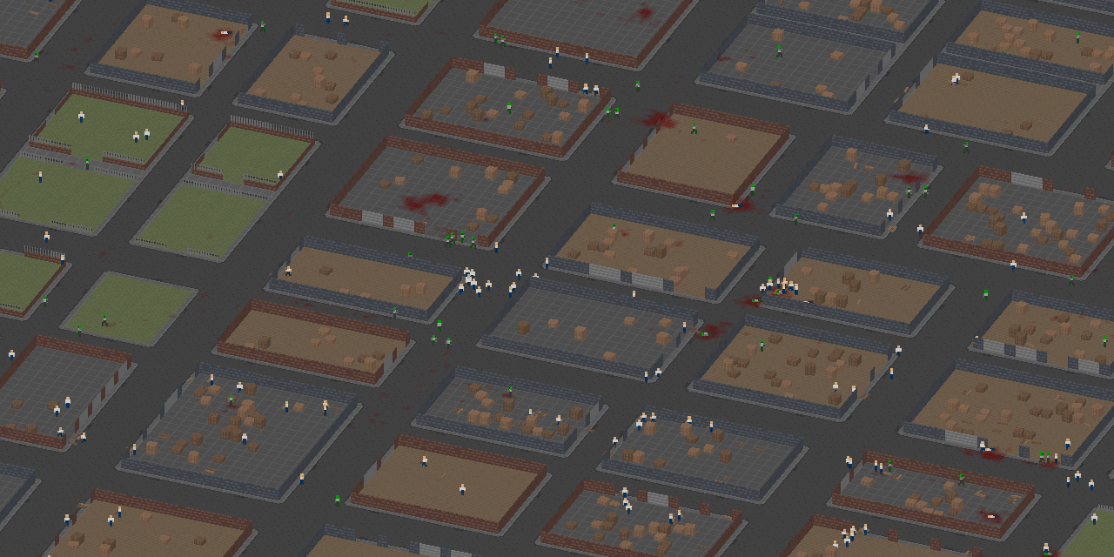
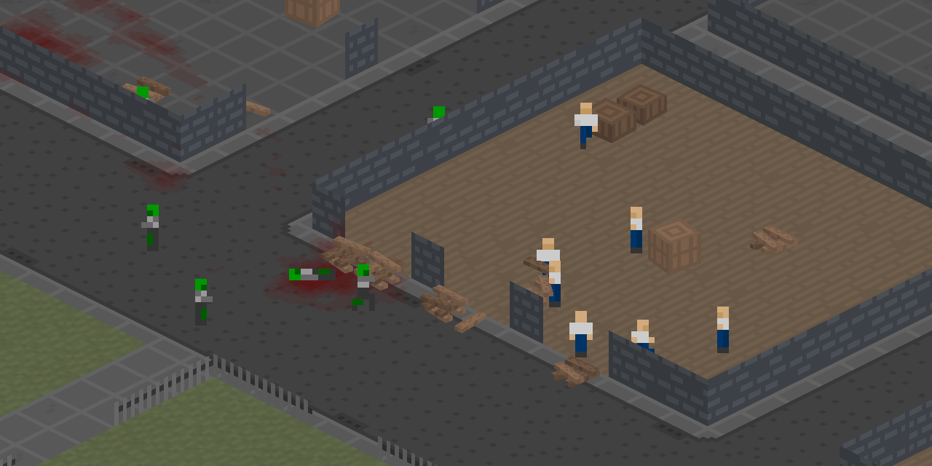
Notes:
Here’s a couple of pictures of the game in action.
Up top we can see what a typical procedurally generated city looks like, featuring blocks of buildings separated by streets.
Down there we have a group of survivors constructing a barricade from planks salvaged from crates, with a few zombies outside.

Slide 8
Proposed approaches
Two main deliverables will be implemented and compared:
Subsumption architecture – build a set of simple behaviours that are ordered into a stack, where higher behaviours subsume lower ones. Complex behaviours emerge from interplay between these “layers”.
Initially proposed by Rodney Brooks.
Beliefs Desires Intentions – each agent maintains an abstracted knowledge base of their environment, from which desires are derived and committed to as intentions.
Based on a model of human reasoning developed by Michael Bratman.
Notes:
As I mentioned earlier, I’ll be implementing and comparing two core designs for the agent AI, which will serve as the main deliverables for the project.
First is a Subsumption architecture, which uses an ordered stack of behavior “layers”. The behavior at the top of the stack may choose to act first, otherwise control will be given to the next layer, and so on.
This is pretty simple to implement, but for more complex behavior to emerge you’ll need groups of layers interacting with each other in a constructive manner.
The second approach will be a Beliefs Desires Intentions model, where each agent records an abstracted representation of their environment from which they attempt to identify desires that work towards a set of goals. These desires are filtered and committed to as intentions.
This can be more difficult to design and implement, but can be a more powerful architecture allowing for more intelligent behavior.
Back to the Subsumption architecture, and how I’ve applied it to this project…

Slide 9
Subsumption architecture
Proposed behavioural layers are listed on the right, in order of descending precedence.
Implementation of this approach is essentially complete, with only some minor instances of occasional unnatural behaviour to eliminate.
Complex behaviours such as barricade construction emerge from interactions between simple layers.
Drop Resource
Self Defence
Mob
Vacate Block
Flee
Follow Route
Pickup Resource
Find Resource
Harvest Resource
Seek Refuge
Wander
Notes:
On the right are the behavioural layers I’ve designed and built for the human agents, each one being relatively simple to write.
- List them all -
They’re ordered in terms of which are queried first when an agent needs to act, with Drop Resource taking precedence and Wander acting only if nothing else does.
They’re mostly self explanatory, although a few warrant an explanation. Self Defence compels an agent to attack an enemy that is too close, Mob makes agents intentionally head towards a zombie if that zombie is outnumbered by survivors, and vacate block will lead an agent out of a building if they perceive danger or are holding a barricade resource.
From these simple layers, complex behaviours are designed to emerge. For example, if a survivor is outside a building that appears safe it will travel inside because of Seek Refuge, then will find and pickup a barricade resource if one exists by following the Harvest, Find and Pickup behaviours. Because the agent is holding a resource, the Vacate Block behaviour will trigger and it will navigate outside, upon which Drop Resource will force it to leave the barricade material just outside the building. This cycle repeats, and piles of barricade material build up over time to form barricades.
Let’s see it all in action…

Slide 10

Notes:
Initially the survivors and zombies are distributed fairly randomly, but soon the survivors form groups.
Here a group of survivors collectively decide to “mob” a vulnerable zombie, although not without losing one of their own.
This group is working on a barricade, and this one is in trouble…
Fighting back looked like a good idea when there were only two zombies visible, but perhaps wasn’t wise in the long run.
Couple of cowards there.
Humans can’t see through walls, so zombies can sneak up on them.
Another barricade building group… and another that have finished theirs, and are pretty safe.

Slide 11
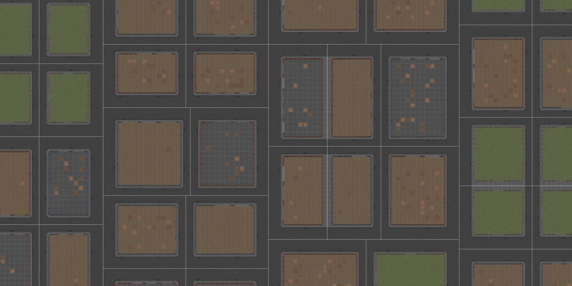
BDI - Beliefs
Notes:
The BDI architecture is the next thing to implement, although my plan for doing so is mostly complete.
The first part is the beliefs model, which will be oriented around a two-level abstraction of the environment.
The higher level abstracts the world into blocks, the areas separated by white lines in the image. Each agent will remember things like the number of humans, zombies and resources last seen in each block, and how long ago their last observation was.
The low level abstraction records the exact positions of nearby entities, forgetting where things are after a certain amount of time of not seeing them.
The high level abstraction allows agents to efficiently judge when they should move to a different block, while the low level abstraction lets them be aware of their immediate surroundings.

Slide 12
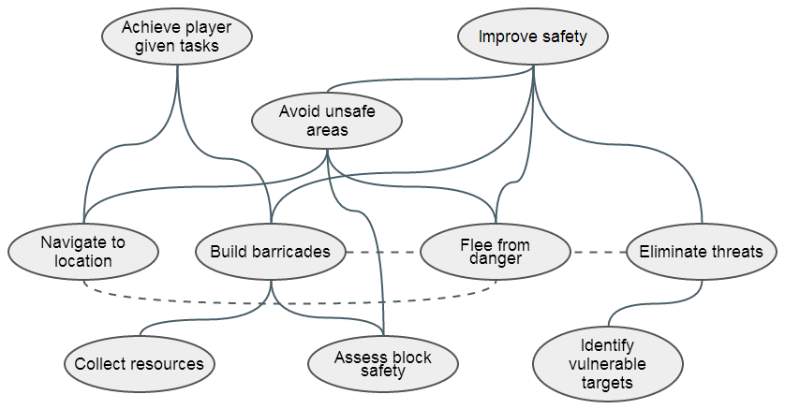
BDI - Desires
Notes:
The next part of the acronym is the process by which desires are found by processing the beliefs model.
A useful technique for discovering atomic desires is to break down the overall goals for your agents into sub-goals, as I’ve done here.
The goals are successively deconstructed as you go from the top of the image to the bottom, with solid arcs showing ancestry.
Dashed lines show possible conflicts between goals, where one may interfere with another.
Each of these desires will have a system for detecting if they are valid for a given context, such as Fleeing from danger being desirable if a threat is present.

Slide 13
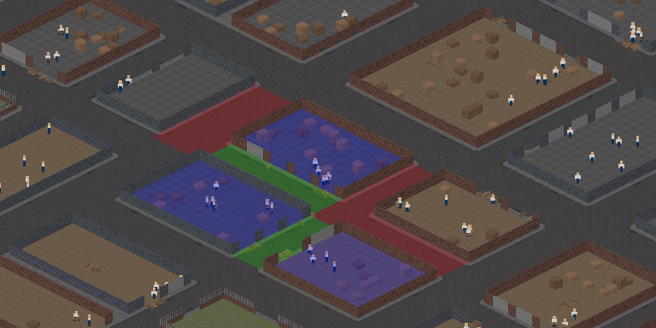
BDI - Intentions
Notes:
Finally we have intentions, which are a subset of the desires we previously found that are committed to for an extended period of time.
It would be pretty inefficient to do the whole desire discovery process every simulation step, so instead agents periodically review their situation and decide whether it would be worth checking to see if a better intention is possible.
Here’s an example for where intentions can make sophisticated behaviour easier to implement than with a Subsumption-based approach. Rather than only barricading the entrances of buildings, a BDI agent can efficiently commit to repeatedly extending barricades to cover a larger area of the world.
The general method I’ll use will be to start with barricading single buildings, then progressively consuming adjacent streets and buildings.
So there are the two approaches, but how do we compare them?

Slide 14
Final analysis
How should the two architectures be compared?
Survival rate
  Test a range of initial states
  No player input
Task completion
  Timed completion of a set of pre-defined goals
Simulation step time
  With several world sizes
  With a range of agent counts
Subjective qualities
  Prevalence of “weird” behaviour
Notes:
These four criteria stem from the four points I listed way back at the start of this presentation.
Survival rate will test the agent’s aptitude for autonomous self-preservation, task completion time evaluates their ability to efficiently achieve player-given goals, I’ll be testing the average computation time of a simulation step for each approach to test performance, and I’ll be on the lookout for weird and irrational behaviour (although that’s obviously pretty subjective).
For each of the tests both architectures will execute on the same set of initial states to ensure fairness. For the performance test I’ll also be observing the effects of using smaller or larger worlds, and a range of agent counts.

Slide 15
Recap
This project is about comparing two agent designs for a simulation game.
Agents must achieve tasks autonomously, defend themselves, act naturally, and not be computationally expensive.
Two approaches, a Subsumption architecture and Beliefs Desires Intentions model, will be implemented and compared.
Subsumption is essentially finished, and the BDI design has been planned in some detail and will be implemented soon.
Any questions are welcome!
Notes:
So that’s the project.
To reiterate, the goal is to compare two AI architectures to identify which is more suitable for this particular game environment.
Four main qualities will be used to evaluate and compare them, which are autonomous task completion, self defense, lack of unnatural behavior, and computational cost.
These two approaches are a Subsumption architecture, which is essentially complete, and a BDI model.
I hope you all found this somewhat interesting, and I’m eager to answer any questions you may have.

