Slide 1
Loading Balance Problem
Zhiyuan Wang 12032878
Supervisor: Ke Tang
Solve by Linear Program

Slide 2
Content
Generate tree Structures and discuss how to choice tree and child machine node
Generate a graph with no cycle from a graph with cycles
LP-based Algorithm has best result

Slide 3








Generate tree Structures and discuss how to choice tree and child machine node
$$M_{4}$$
$$M_{5}$$
$$M_{6}$$
$$J_{7}$$
$$J_{8}$$
$$J_{9}$$
$$J_{10}$$
$$J_{11}$$
The source graph

Slide 4













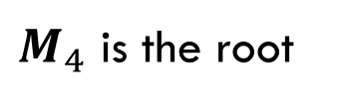



Generate tree Structures and discuss how to choice tree and child machine node
$$M_{4}$$
$$M_{4}$$
$M_{4}$ is the root
$$J_{7}$$
$$J_{10}$$
$$J_{7}$$
$$J_{10}$$
$$M_{5}$$
$$M_{5}$$
$$M_{6}$$
$$M_{6}$$
$$J_{8}$$
$$J_{9}$$
$$J_{11}$$
$$J_{8}$$
$$J_{9}$$
$$J_{11}$$

Slide 5


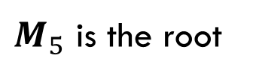














Generate tree Structures and discuss how to choice tree and child machine node
$$M_{5}$$
$$M_{5}$$
$M_{5}$ is the root
$$J_{8}$$
$$J_{9}$$
$$J_{10}$$
$$J_{8}$$
$$J_{9}$$
$$J_{10}$$
$$M_{4}$$
$$M_{6}$$
$$M_{4}$$
$$M_{6}$$
$$J_{7}$$
$$J_{11}$$
$$J_{7}$$
$$J_{11}$$

Slide 6













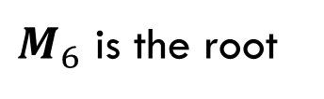



Generate tree Structures and discuss how to choice tree and child machine node
$$M_{6}$$
$$M_{6}$$
$M_{6}$ is the root
$$J_{10}$$
$$J_{11}$$
$$J_{10}$$
$$J_{11}$$
$$M_{4}$$
$$M_{5}$$
$$M_{4}$$
$$M_{5}$$
$$J_{7}$$
$$J_{8}$$
$$J_{9}$$
$$J_{7}$$
$$J_{8}$$
$$J_{9}$$

Slide 7
































Generate tree Structures and discuss how to choice tree and child machine node
$$M_{4}$$
$$M_{5}$$
$$M_{5}$$
$$M_{6}$$
$$J_{7}$$
$$J_{10}$$
$$J_{8}$$
$$J_{9}$$
$$J_{10}$$
$$J_{8}$$
$$J_{9}$$
$$J_{10}$$
$$J_{10}$$
$$J_{11}$$
$$M_{5}$$
$$M_{6}$$
$$M_{4}$$
$$M_{6}$$
$$M_{4}$$
$$M_{6}$$
$$M_{4}$$
$$M_{5}$$
$$J_{8}$$
$$J_{9}$$
$$J_{11}$$
$$J_{7}$$
$$J_{11}$$
$$J_{7}$$
$$J_{11}$$
$$J_{7}$$
$$J_{8}$$
$$J_{9}$$
These are better case, the max number of jobs need to process in one machine is 2.

Slide 8
Generate a graph with no cycle from a graph with cycles
Job
Job
Job
3
3
3
3
Machine
3
Machine
3
Machine
6
2
6
2
6
0
4
7
4
7
6
7
6
2
7
6
2
7
6
4
7
2
2
2
2
2
0
4
4
7
4
4
7
4
4
7
1
1
7
1
1
7
1
1
7
3
1
3
1
3
1
6
6
6
6
6
6
Origin Graph
Find the Cycle
Remove the Cycle

Slide 9
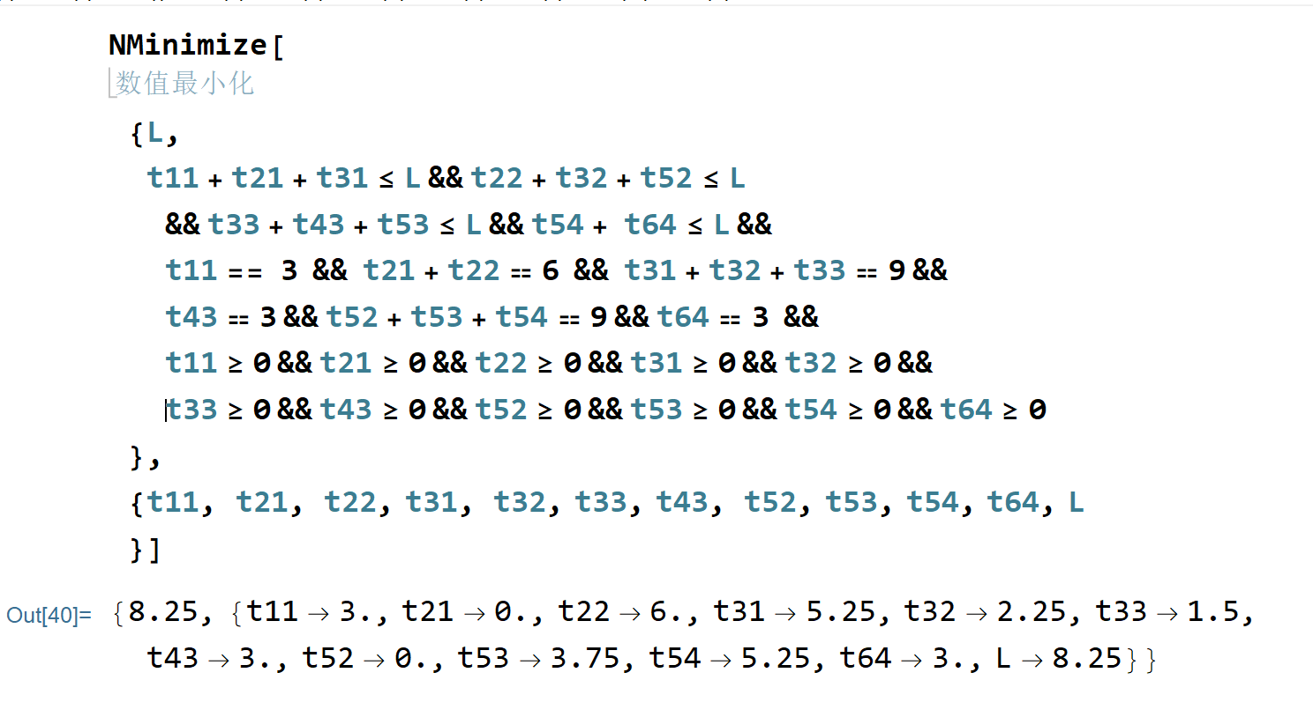
Generate a graph with no cycle from a graph with cycles
Job
3
Machine
6
9
3
9
3
Origin Graph
Calculate Process

Slide 10
Generate a graph with no cycle from a graph with cycles
Job
3
3
Machine
6
0
No
Cycle
6
8.25
9
5.25
2.25
8.25
1.5
3
3
8.25
0
3.75
8.25
9
5.25
3
3
Generate Result
Calculate Process

Slide 11
Generate a graph with no cycle from a graph with cycles
Job
3
3
Machine
6
0
No
Cycle
6
8.25
9
5.25
2.25
8.25
1.5
3
3
8.25
0
3.75
8.25
9
5.25
3
3
Generate Result
Calculate Process

Slide 12
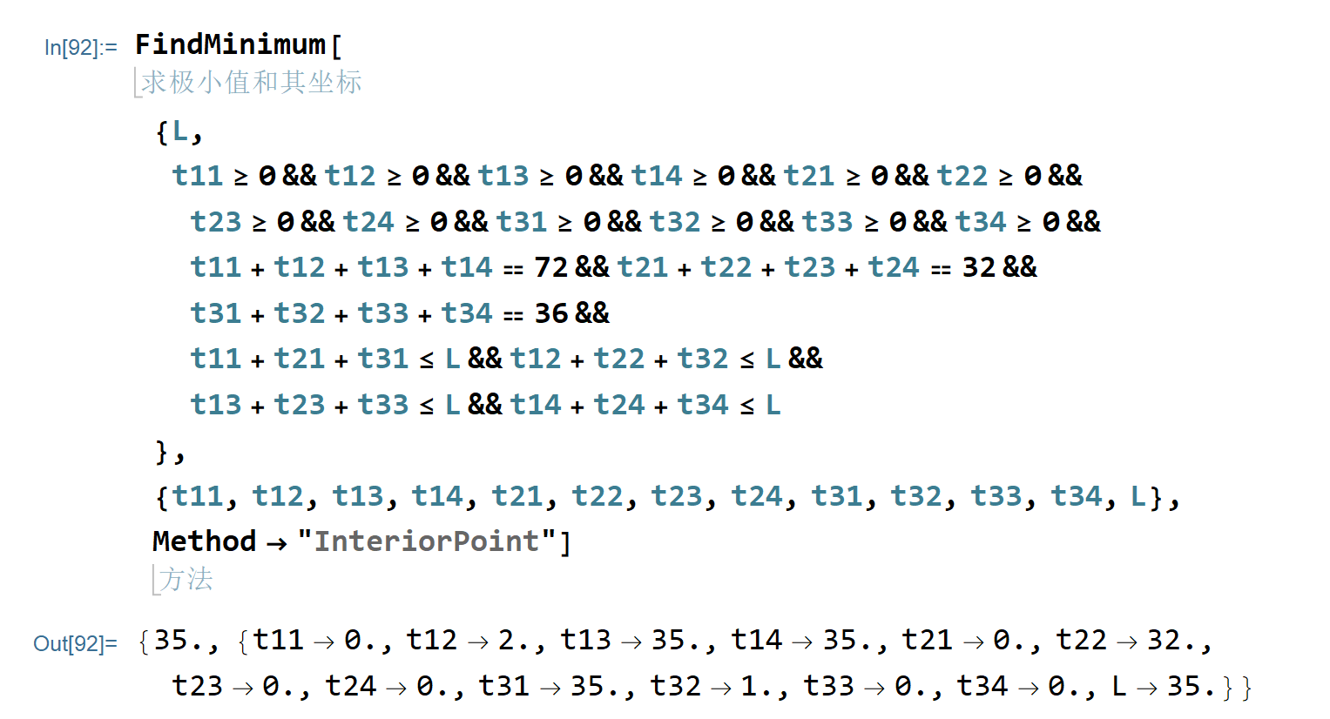
Generate a graph with no cycle from a graph with cycles
I can’t find an example that the graph drawn by my LP software has a cycle.
I try to construct many examples that can get the optimal value with a cycle, but my LP program prefers to set one edge of the cycle to 0.

Slide 13
Thank You !
Q&A

