Slide 1
Disjoint Paths Problem
Zhiyuan Wang 12032878
Supervisor: Ke Tang
Greedy Algorithm

Slide 2
Content
Introduction to the Disjoint Paths Problem.
Introduction to the Greedy Disjoint Path Algorithm
The example about Disjoint Path Problem

Slide 3
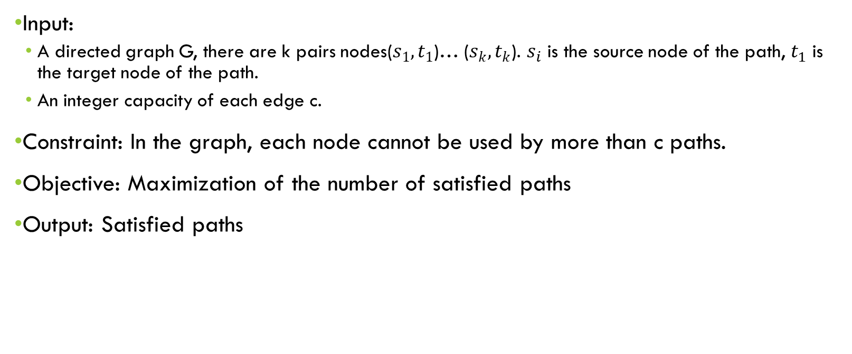
Disjoint Paths Problem
Input:
A directed graph G, there are k pairs nodes($s_{1},t_{1}$)… ($s_{k},t_{k}$). $s_{i}$ is the source node of the path, $t_{1}$ is the target node of the path.
An integer capacity of each edge c.
Constraint: In the graph, each node cannot be used by more than c paths.
Objective: Maximization of the number of satisfied paths
Output: Satisfied paths

Slide 4
Greedy Disjoint Path Algorithm
Choose the shortest path from the paths that satisfy the constraint and add into the result set, until there is no path can satisfies the constraint.

Slide 5


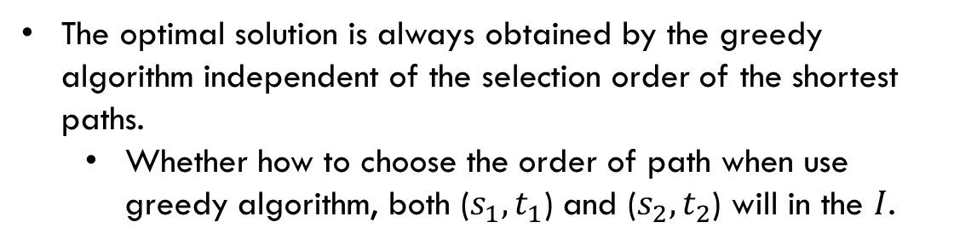


Example 1
c=1
$$t_{2}$$
The optimal solution is always obtained by the greedy algorithm independent of the selection order of the shortest paths.
Whether how to choose the order of path when use greedy algorithm, both ($s_{1},t_{1}$) and ($s_{2},t_{2}$) will in the $I$.
$$s_{1}$$
$$t_{1}$$
$$s_{2}$$

Slide 6




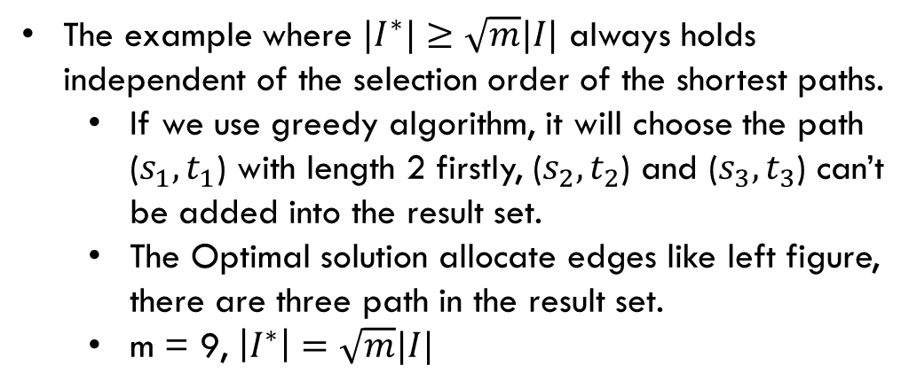


Example 2
$$s_{2}$$
$$s_{3}$$
$$t_{2}$$
$$t_{3}$$
The example where $|I^{∗}|≥\sqrt{m}|I|$ always holds independent of the selection order of the shortest paths.
If we use greedy algorithm, it will choose the path ($s_{1},t_{1}$) with length 2 firstly, ($s_{2},t_{2}$) and ($s_{3},t_{3}$) can’t be added into the result set.
The Optimal solution allocate edges like left figure, there are three path in the result set.
m = 9, $\left|I^{∗}\right|=\sqrt{m}|I|$
$$s_{1}$$
$$t_{1}$$
c=1

Slide 7


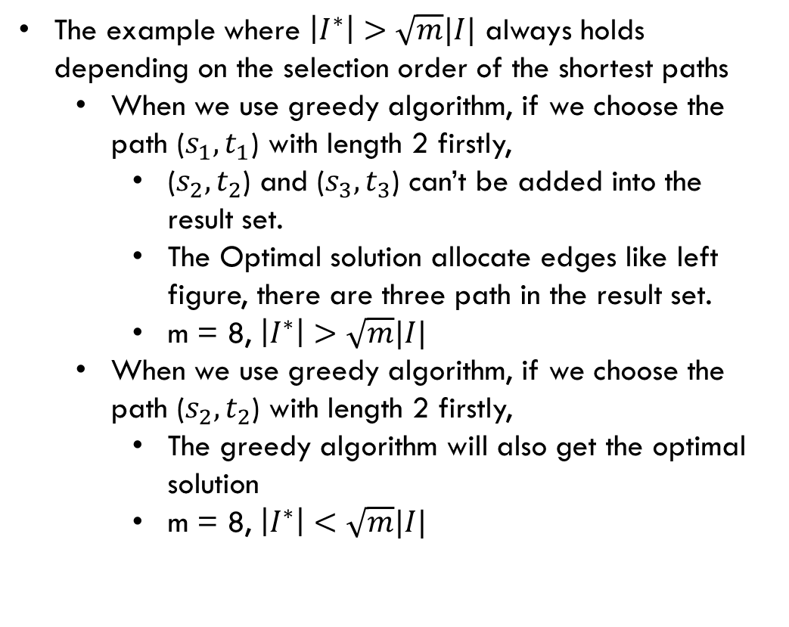
Example 3
The example where $\left|I^{∗}\right|>\sqrt{m}|I|$ always holds depending on the selection order of the shortest paths
When we use greedy algorithm, if we choose the path ($s_{1},t_{1}$) with length 2 firstly,
($s_{2},t_{2}$) and ($s_{3},t_{3}$) can’t be added into the result set.
The Optimal solution allocate edges like left figure, there are three path in the result set.
m = 8, $\left|I^{∗}\right|>\sqrt{m}|I|$
When we use greedy algorithm, if we choose the path ($s_{2},t_{2}$) with length 2 firstly,
The greedy algorithm will also get the optimal solution
m = 8, $\left|I^{∗}\right|<\sqrt{m}|I|$
$$s_{2}$$
$$s_{3}$$
$$t_{3}$$
$$s_{1}$$
$$t_{2}$$
$$t_{1}$$
c=1

Slide 8
Thank You !
Q&A

